Slide 1
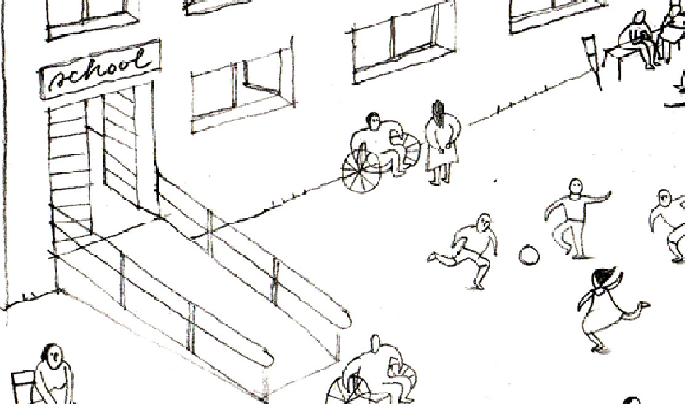

Inclusion of Persons with Disabilities in Shelter and Settlements Programming
Global Shelter Cluster
ShelterCluster.org
Coordinating Humanitarian Shelter
April 2021 - Working Group Call
Notes:
Introductions of group

Slide 2

Agenda
Introduction to USAID-BHA grant project and call for feedback/ input into review of AUOR guidelines
Sharing from IOM Nigeria on the Improved Shelter and Settlements Design for PWSN case study
Update on Accessible and Inclusive IECs (as part of the Shelter IEC Compendium project)
Sharing and call for feedback on proposed Shelter and Mental Health learning event
AOB and Q&A
Notes:
Brief overview of agenda
Ask for any other business to put at end

Slide 3
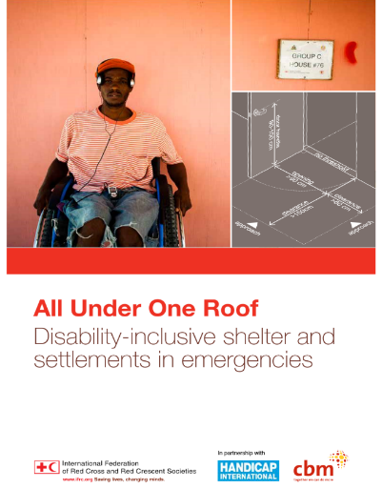
USAID-BHA Grant
Working group submitted a proposal to review and update the All Under One Roof guidelines (and the training materials)
Technical partner WBU. Working with working group partners and OPDs to understand how the guidelines can be more relevant and user friendly
Work will be supported by IFRC Americas to provide translation of updated training materials and creation of an online tutored training course (including pilot)
We need feedback from anyone who has experience of using the guidelines.
Contact: disability.inclusion@sheltercluster.org or lemarshall@redcross.org.au
Notes:
Brief overview of agenda
Ask for any other business to put at end

Slide 4
Update – IOM Nigeria Shelter & Settlements Improvements for Persons With Disabilities

Slide 5
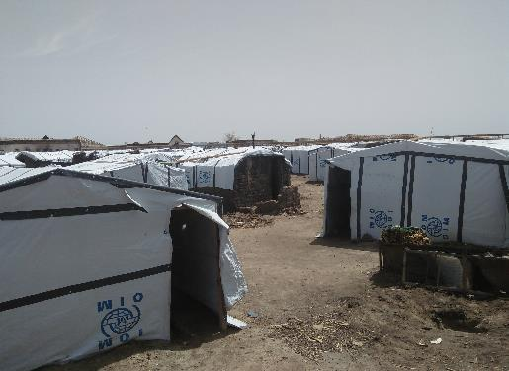

Slide 6
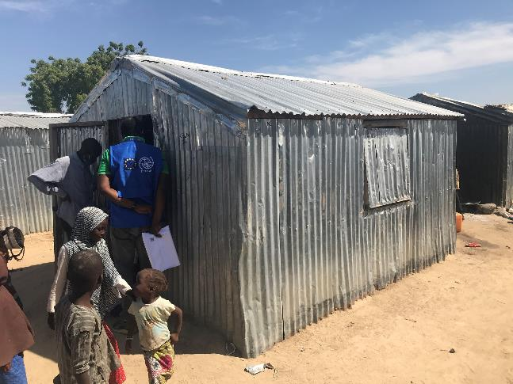

Slide 7
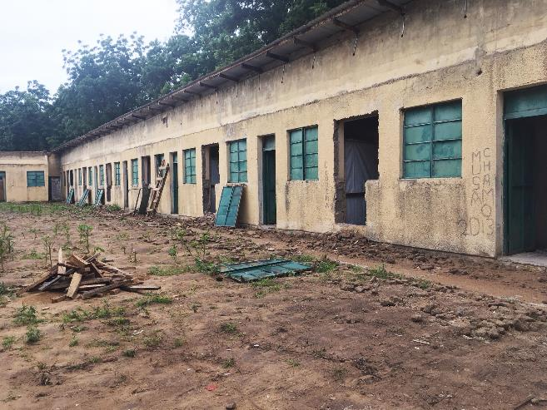

Slide 8
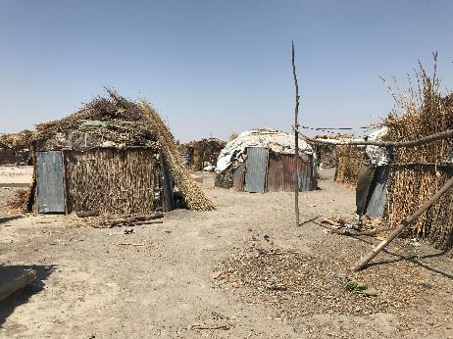

Slide 9
Assessment Phase
Above all, Qualitative rather than Quantitative
Looking at the interrelations between the individuals and the shelter, and the shelter surroundings
Inclusive of caregivers and of entire households
Focussing on how the individuals might have already adapted their surroundings, or mitigated barriers themselves
Aiming to eventual solutions which are low-cost, simple, localised, adaptable

Slide 10
Assessment Phase
Both FGDs and 230+ individual shelter visits in 14 sites
Teams mixed by gender and by sector (Shelter + CCCM)
Working with other actors in each site
Working with local organisations for persons with disabilities

Slide 11
Main challenges
Challenges shared with all field programmes in Nigeria
Insecurity, distance and remote-support limitations
Limited resources and funding

Slide 12
Main challenges
Challenges shared with other Shelter-PWD projects around the World
How to attach shelter improvements to structurally or materially weak shelters
How to adapt shelter improvements to the local context – e.g. sitting on the ground, not at a table
Needing to think about the whole family and caregivers – including caregivers under the age of 18
Gaps in holistic/multi-sectoral support for PWDs and their families, with the Shelter department acting alone

Slide 13
Main challenges
Challenges specific to the shelter situation in Nigeria
Mapping and designing solutions for a wide range of disabilities – and a wide range of shelter models

Slide 14
Main challenges
Most Common challenges observed so far, for the PWDs
No matter what sort of shelter model, the most common observed challenges for the PWDs are smaller, often-repeated daily activities – getting up and down, or moving in and out of the shelter
Some daily activities have been completely taken out of the hands of the PWDs – e.g. cooking. How likely is it, that some measures to improve the cooking area in the shelter will really reverse this situation?

Slide 15
Main challenges
Cross-cutting issues
Women and girls who are caregivers list many more daily tasks and activities than male caregivers
Women and girls have more often mentioned social stigmatization as a reason for staying more often inside the shelter or the shelter plot

Slide 16
Next steps
Piloting of Shelter Improvements (10-15 beneficiaries in one site)
Expansion/Scale-up
Drafting of an ‘Interventions Catalogue’

Slide 17
How To Get Started?
Field Work! – And, MUST be individualised
Have mixed teams – Team members can come from lots of different sectoral backgrounds
Work with local partners with local expertise
Explore the individual stories – ‘how’, ‘why’ ‘who’
Start early thinking about appropriate solutions

Slide 18
How To Budget?
Work towards equitability of outcomes
Have a per-unit cost relative to the overall costs of the complete shelters
Be a little bit flexible
Use S,M,L categories within the general cost envelope
Consider moving the ‘settlements’ improvements to a separate budget line

Slide 19
Localisation of categories and priorities
Take into consideration the global categories – Washington Questions
But be aware that there are already regional variants
The local assessment process will – and should – go much further, and to a large extent supersede than the Washington Questions
Adapt using the categories where necessary, to fit the specifics of a localised shelter programme
Be aware of what the project teams can and cannot assess – but look for partners and referral pathways, as well

Slide 20
Technical Issues – Weak shelters – strong supports
Search for what has already been done, and what has been somewhat strong – and then make that stronger, more durable and more comfortable
How can supports stand on their own?
How to strengthen the whole of the shelter, if necessary?
Remember local cultures and context
What needs to be stable, what needs to be moveable?
Explore modular options
Don’t forget ‘quality of life’ improvements
Be clear on what you can and can’t do
Worst-case scenario – replace the shelter?

Slide 21
Any Questions?

Slide 22
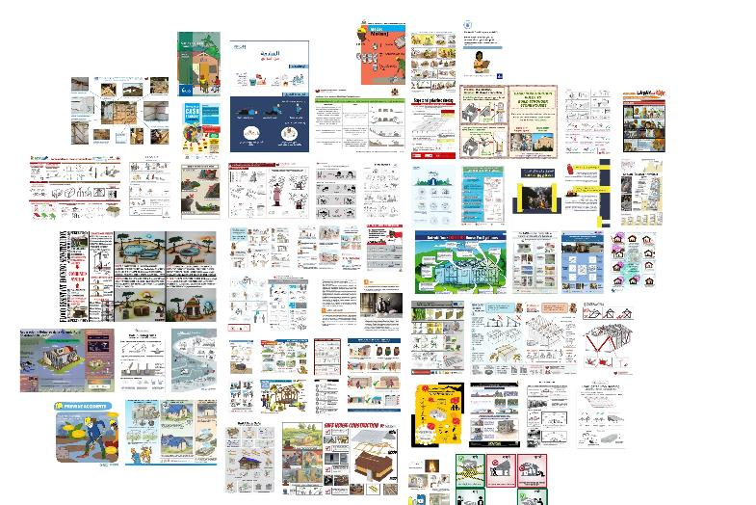
Accessible and Inclusive IEC Materials
15 May - 2020

Slide 23

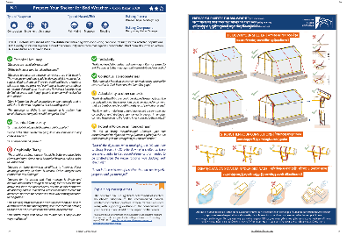
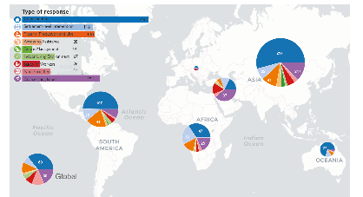

IEC Material Compendium
IEC@sheltercluster.org

Slide 24
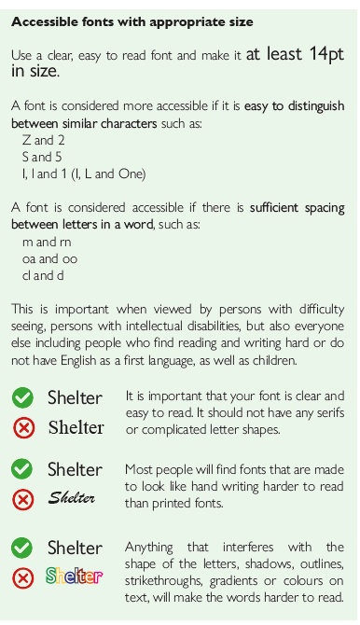
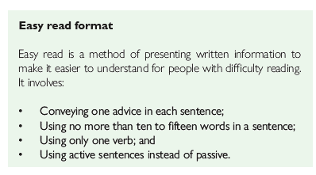

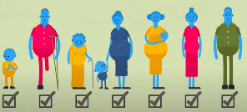
Accessible and Inclusive IEC Materials.......
Aim to make IEC materials accessible for everybody- Use a range of communication channels and address specific needs with tailored materials.
Consult with different groups
Promote inclusion through messaging
Allocate additional budget and resourcing
IEC Material Compendium
IEC@sheltercluster.org

Slide 25
Shelter and Mental Health Learning Event
How to do more and do better regarding mental health in shelter programming
Two half day sessions
  Thursday 20th May (afternoon UK)
  Friday 28th May (morning UK)
Practical focus.
Case studies
  MH impacts of shelter programming
  Opportunities for MH of innovative shelter programming
Develop shared understanding of language and scope of the intersections between Shelter and Settlements assistance, mental health and well-being
Mental Health, Protection, Gender and Disability Inclusion
Living conditions: physical and mental health
Programming entry-points

