Slide 1
Sub-national Shelter & NFI Cluster Coordinator
KR-I and Kirkuk
Activity-based Costing for Shelter
Achievements 2019
HRP 2020 – targets and priority interventions
Winter 2019/2020
Activity Info and WDS Database reporting
Questions?
Wednesday, 27th November 2019
https://www.sheltercluster.org/response/iraq

Slide 2
Activity-Based Costing
Average costs for activities including direct and support costs—SAG partners were consulted on and provided feedback on the results and then the costs were presented to OCHA.
List of Indicative Activities Per Cluster and Cost for 2020 HRP - Shelter and NFI
No. | Activity | "Unit Cost (per family of 6)" | "Total Cost (per family of 6)" | Remarks
1 | Non-Food Item (NFI) Kit Distribution | $250 | $340 | The total cost includes the cost of the kit as well as the staff required to assess needs and distribute the kits, plus the relevant support costs. This can include both in-kind and cash-based modalities.
2 | Sealing-Off Kit (SOK) Distribution | $210 | $285 | The total cost includes the cost of the kit as well as the staff required to assess needs and distribute the kits, plus the relevant support costs. This can include both in-kind and cash-based modalities.
3 | Critical Shelter Upgrades | $1,000 | $1,350 | This cost is variable, with a Cluster-set average of $1,000. However, the exact cost is dependent on the status of the structure to be upgraded/repaired, the size of the HH, proximity to specialized markets, availability of skilled labour and what is necessary to reach minimum standards. The total cost includes the staffing necessary to conduct detailed technical assessments and Bills of Quantity preparation, as well as the relevant support costs for the program.
4 | Cash for Rent | $1,200 | $1,620 | This cost is based on a Cluster-set average of $200 per month for 6 months, however, this should be understood to be an average, as exact prices will depend on the area, the HH size, the quality of the structure, and the length of the program. Total costs include the staff necessary to conduct detailed vulnerability assessments and provide support to HHs and landowners, as well as the necessary support costs.

Slide 3
5 | War Damage Shelter Repairs (Category 2) | $1,800-$3,000 | $2,430-$4,050 | This cost is a range based on partner-reported averages. However, this cost should be understood to be variable based on the individual structure, location in the country including proximity to specialized markets and availability of skilled labour, HH size, and nature and type of damage. Total costs include engineering staff to conduct detailed technical assessments and prepare Bills of Quantity, staff to conduct vulnerability assessments for targeting, and the necessary support costs.
6 | War Damage Shelter Repairs (Category 3) | $3,000-$5,000 | $3,900-$6,500 | This cost range is based on a Cluster-determined average based on past partner achievements. However, this cost should be understood to be variable based on the individual structure, location in the country including proximity to specialized markets and availability of skilled labour, HH size, and nature and type of damage. Total costs include engineering staff to conduct detailed technical assessments and prepare Bills of Quantity, staff to conduct vulnerability assessments for targeting, and the necessary support costs.
7 | Low-Cost Transitional Shelter (Including RHUs, traditionally-constructed, etc) | $2,500 | $3,325 | This cost is variable, based upon an average from past partner interventions including RHUs and constructed interventions. However, these costs should be understood to be variable based on the construction typology selected, the location of the intervention including proximity to specialized markets and availability of skilled labour, and the HH size. The total costs include skilled staff to conduct detailed technical and vulnerability assessments, and transportation of materials as necessary, as well as the relevant support costs.
8 | Winter Assistance Distribution | $63-$200 | $82-290 | Winter assistance is provided as a range, consisting of the minimum assistance package up to a more robust package, which should be provided on the basis of a vulnerability assessment and specfic HH needs. The total cost includes the skilled staffing necessary to conduct vulnerability assessments and transportation of materials as neccessary, as well as the relevant support costs.
9 | Children's Winter Clothing | $67 | $84 | This cost is based on a Cluster-set guideline, and the total cost includes the skilled staff necessary to conduct vulnerability assessments and the logistics costs necessary to provide assistance, as well as the relevant support costs.
10 | Tent Replacement | $400 | $540 | This cost is based on a Cluster-set guideline and the total cost includes the costs for transport, installation and necessary support costs. It does NOT include the cost of a replacement slab which would require additional costs.
11 | In Camp Site Upgrades | $120 | $140 | This cost is based on a Cluster-set average guideline and the total cost includes the costs for transport, installation, and necessary support costs. These activities can include electrical wiring, replacement slabs, and other related activities.

Slide 4
2. Achievements 2019 – Shelter and NFI
District | Beneficiary type | Shelter Target (ind.) | Reached (ind.) | NFI Target (ind.) | Reached (ind.) | Partners
Al-Hawiga | IDP OoC | 8,061 | 619 | 3,992 | 3,140 | HRF
Al-Hawiga | Returnees |  | 6,683 |  | 1092 | Mission East
Daquq | Returnees | 4,648 | 715 | 4,408 |  | IOM
Dibis | IDP OoC | - |  | - | 966 | IOM, HRF
Kirkuk | IDP Camp | 18,065 | 3,968 | 17,422 | 8,821 | HRF
Kirkuk | IDP OoC |  | 3,366 |  | 3,372 | HRF, IOM, CRS
Total |  | 30,774 | 15,351 | 25,822 | 17,391
HRF: 1393 IDP HHs out of camps will be assisted with critical shelter upgrades – IHF Second Allocation: Kirkuk and Daquq Nov 2019 - 2020
https://www.sheltercluster.org/response/iraq

Slide 5
2. Achievements 2019 – War-damaged Shelter
2. Achievements 2019 – War-damaged Shelter
District | Sub-district | Partner(s) | # of houses rehabilitated | Status
Kirkuk | Al-Hawiga | IOM | 121 | Completed
Kirkuk | Al-Hawiga | NRC | 461 | Completed
Kirkuk | Al-Hawiga | CRS | 39 | Completed
Kirkuk | Al-Hawiga | Mission East | 220 | Completed
Kirkuk | Al-Hawiga | Medair | 20 | Ongoing
Kirkuk | Dabes | IOM | 101 | Completed
Kirkuk | Daquq | IOM | 138 | Completed
Kirkuk | Kirkuk | NRC | 417 | Ongoing
Kirkuk | Kirkuk | IOM | 112 | Completed
Kirkuk | Kirkuk | IOM | 25 | Ongoing
Total |  |  | 1,654
Partners have clear capacity to implement WDS Cat 2&3
This is a mix of reporting from WDS Portal and Activity Info.
All Partners are reminded to report in both the same numbers.
WDS reporting – to avoid duplication, geospatial information on locations and coverage.
AI reporting – track achievements against targets (Clusters and OCHA)
WDS Dashboard can be found here:
https://www.sheltercluster.org/response/iraq

Slide 6
3. HRP 2020 – targets and priority interventions
HRP Target 2020 | IDPs in camp |  | IDPs out of camp |  | Returnees
 | Shelter | NFI | Shelter | NFI | Shelter | NFI
Al-Hawiga | - |  | - |  | 10,883 | 2,673
Kirkuk | 4,453 | 1,677 | 16,080 | 13,470 | 3,828 | 932
Daquq | - |  | 669 |  | 225 | 55
Total | 6,130 |  | 30,780 |  | 18,510
Shelter interventions are prioritized for 2020:
substandard or war-damaged shelter remains the main obstacle to return – cat. 2&3
critical shelter affects well-being, health and protection of IDPs in and out of camps – SOKs, shelter upgrades, rental subsidies
NFI support for new comers and replenishment, very vulnerable – NO winter support
ALL interventions to be based on socio-economic vulnerability (SEVAT)!
https://www.sheltercluster.org/response/iraq

Slide 7
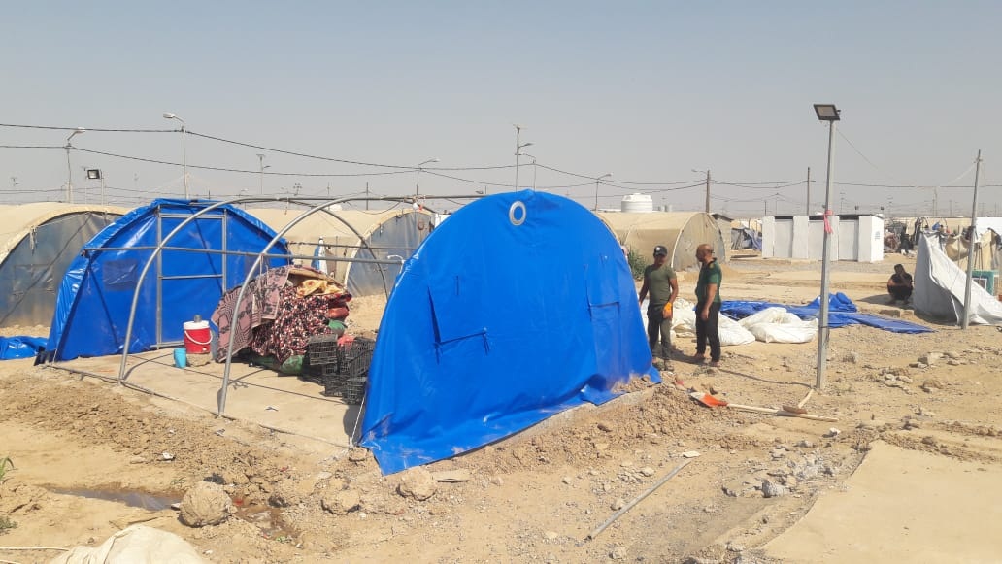
4. Winter items and Interventions
Humanitarian Partners (UN agencies, NGOs)
Essential Winter kit (kerosene heater, kerosene jerry can) and Full winter kit (thermal blanket, carpets, mats, etc.), or Cash for winter (esp. in out of camp settings)
Children winter clothing
Sealing Off Kits for people living in critical shelter
Tent replacement
Government
Heating fuel (200 l per family for 4 months)
Clothing
MOMD tent replacement
Tent replacement in Jad’ah camps, IOM 2019
https://www.sheltercluster.org/response/iraq

Slide 8
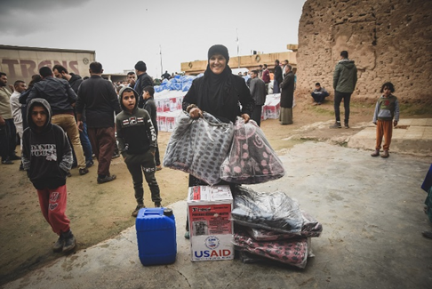
4. Winter Response Plan
IDPs in Camps
UNHCR – provision of cash for winter
Tearfund - cash for clothes for children
IDPs Out of Camp:
CRS, IOM and UNHCR have confirmed winter plans for Kirkuk – coordinate to avoid duplication
ACTED – replacement of 165 tents in Yahyawa – Jan 2020
IOM winter distribution, 2018
https://www.sheltercluster.org/response/iraq

Slide 9
4. Winter Response Plan – key advocacy messages
Advocacy with MOMD and COMSEC to provide IDP in camps with
kerosene for heating and cooking
NO kerosene distributions by humanitarian agencies
Shelter Cluster partners are urged to finalize winter distributions in December 2019 and report in Activity Info
https://www.sheltercluster.org/response/iraq

Slide 10
5. Activity Info and WDS Database reporting
Shelter Cluster has created the following databases for reporting:
Contingency stock of agencies
Assessments – partners should report in Assessment Registry AND AI
4W – planned and ongoing activities
Completed activities
Completed WDS is also reported to the WDS portal of Shelter Cluster and UN-Habitat
Partners can monitor their areas of work through the Shelter Cluster Interactive Dashboard
Shelter Cluster also provides trainings on AI Reporting, WDS and the use of BoQ, SEVAT
https://www.sheltercluster.org/response/iraq

