Slide 1
Ninewa Shelter & NFI Cluster Coordination Meeting
Agenda
Review of Pending Action Points from 07.29.19 Meeting
Key Issues – Updates from Partners by District
  Hamdaniya
  Mosul
  Sinjar
  Tel Afar
  Tilkaif
Update on Mid-Year Review of Achievements
IHF Second Allocation
HLP-Shelter Tenure Security Workshop
Winter Planning & Contingency Planning
Government-Initiated Returns of IDPs from Ninewa
AOB Wednesday, 28 August 2019
http://sheltercluster.org/response/iraq

Slide 2
Review of 29 July Meeting
Review of Pending Action Points from 07.29 Meeting
  Partners to continue to update Activity Info databases, liaise with Shelter Cluster for any issues in reporting
  SNFI Cluster to Share PMR Results – Pending OCHA Release
  Shelter to invite partners to HLP-Shelter Workshop – Tomorrow!

Slide 3
Ninewa Updates by District
Hamdaniya
Partners | Sub-District | What | Targets | September Plans

Slide 4
Ninewa Updates by District
Mosul
Partners | Sub-District | What | Targets | September Plans
NRC | Al Rifai, Al Shuhada, Al Smud, Al Uraibi, Danadan, Mamoon, Mansour, Misherfa, Mosul Jadida | WDS Cat 2 Rehabs | 29 HHs | Completion of works.
UN-Habitat | Al Shifaa 5 Neighborhood (coordination with IOM?) | Category 2 & 3 Rehabilitation | 200 HHs | Technical Assessment and BoQ creation ongoing.
UN-Habitat | Bab Sinjar, West Mosul | Construction of low-cost housing units | 144 HHs ongoing | Continuing construction
UN-Habitat | Zanjilli, West Mosul | Category 1, 2 & 3 Rehabilitation | 84 HHs (ongoing) | Rehabilitation of additional 333 damaged houses. Selection of an additional 100 damaged HHs in Zanjili.
UN-Habitat | Al Sikak, Maghrebi and Matahin, Mosul | Category 2, & 3 Rehabilitation | 150 HHs | Technical assessment of Al Sikak and Matahin is completed. Technical assessment of Maghrebi is ongoing.

Slide 5
Ninewa Updates by District
Sinjar
Partners | Sub-District | What | Targets | August Activities
UN-Habitat | Sinjar City, Krtk; Weran Shar; Al-Shuhadaa; and Rozh halat | WDS Category 2 & 3 Rehabilitions | 200 HHs | Ongoing technical assessment and BoQ creation

Slide 6
Ninewa Updates by District
Tal Afar
Partners | Sub-District or Town | What | Targets | August Activities
Mission East | Ayadiyah | War Damage Rehabs, Cat 1 & 2 | 150 HHs | Vulnerability Assessments
Peace Winds Japan | Gir Kafir village, Zummer sub-district, Tel afar District, Ninewa Governorate | WDS, SEVAT assessment and technical assessment | 120 HHs | Continue SEVAT assessment and technical assessment

Slide 7
Ninewa Updates by District
Til kaif
Partners | Sub-District | What | Targets | August Activities

Slide 8
Mid-Year Update on Achievements
SNFI Achievements Reported Jan-July 31
District | Shelter Target | NFI Target | Shelter Achievement | NFI Achievement
Hamdaniya | 13,326 people | 40,459 people | 16,831 (126%) | 34,911 (86%)
Mosul* | 156,605 people | 165,199 people | 14,565 (9%) | 47,654 (29%)
Sinjar | 6,710 people | 4,986 people | 600 (1%) | 12,852 (257%)
Tel Afar | 17,237 people | 16,476 people | 0 (0%) | 5,116 (31%)
Til Kaif | 4,209 people | 7,173 people | 2,564 (61%) | 900 (13%)

Slide 9
IHF Second Allocation
Although there remain high levels of need in Ninewa, Ninewa will not be a priority for the IHF 2nd Allocation, as there are many partners operating in Ninewa with their own funding.
  Prioritized districts for shelter will likely be: Anbar, Dohuk, Kirkuk, and Salah-al-Din

Slide 10
HLP-Shelter Workshop
Housing, Land, and Property & Shelter Partners Joint Workshop
  The 2nd HLP-Shelter Workshop will be held tomorrow—registration has closed, but if you still want to attend, please speak to me immediately after the workshop
  Dalia Aranki, from the Global HLP Area of Responsibility is visiting and available to meet with partners independently as well.
  Outputs expected—better referral pathways, templates, enhanced linkages between shelter & HLP partners.

Slide 11
Winter & Contingency Planning
Do partners have plans for winter? We are starting to collate winter plans into a database to maximize coverage. Please don’t forget to use the Activity Info planning tab to report any planned winter plans, and please coordinate with the relevant Sub-Nationals.
Contingency Planning—at the moment there is nothing reported in the contingency planning tab. We would like to start filling this out, so if partners have tentative contingency planning in place, please reach out to me so we can discuss it.

Slide 12
Government-Initiated Returns from Ninewa
Partners may be aware that there has been a major push by Ninewa authorities to have IDPs from areas outside Ninewa return to their areas of origin.
This is happening at several levels with varying levels of coordination, and the Shelter, CCCM, and Protection Clusters are working through OCHA to ensure that any returns that occur are voluntary and include appropriate provisions for returnees in Areas of Origin.
Please let us know if you receive any information or pressure from authorities related to this event.

Slide 13
Any Other Business?
  Any points partners need assistance with or would like to raise for future meetings?

Slide 14
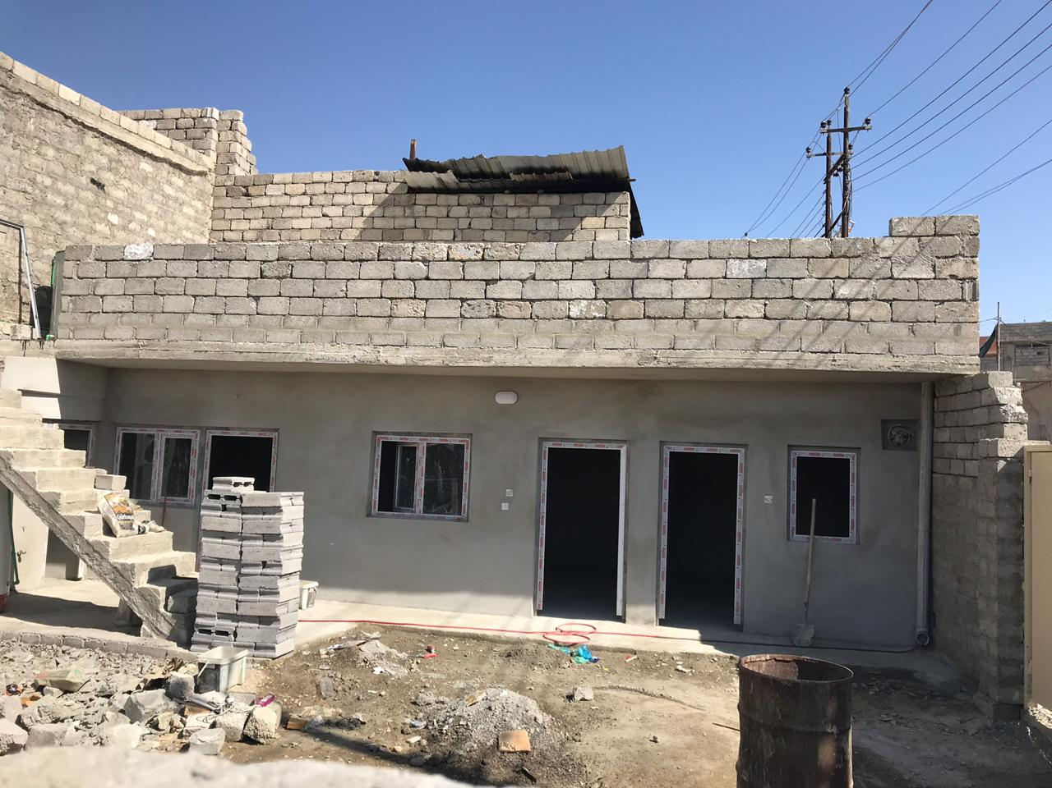
THANK YOU
IOM credit: Core Housing Pilot in West Mosul, 2019

