Slide 1
Ninewa Shelter & NFI Cluster Coordination Meeting
Agenda
Review of Pending Action Points from 08.28.19 Meeting
Briefing from CCCM Cluster and Partners on the Ongoing Forced Relocations and Coerced Departures in Ninewa
DTM Update on Receiving Locations for Forced Relocations and Coerced Departures
Update on August Achievements & Gaps
Key Issues – Updates from Partners by District
  Hamdaniya , Mosul, Sinjar, Tel Afar, Tilkaif
IHF Second Allocation Results
IIC Complaints Focal Points
Movement of Ninewa SNFI Coordination Meeting to Mosul
AOB Wednesday, 25 September 2019
http://sheltercluster.org/response/iraq

Slide 2
Review of 28 August Meeting
Review of Pending Action Points from 08.28 Meeting
  Partners to continue to update Activity Info databases, liaise with Shelter Cluster for any issues in reporting
  Shelter Cluster to circulate the outcomes of the HLP-Shelter Workshop

Slide 3
CCCM Update on Ninewa Forced Returns & Coerced Departures
Briefing from CCCM Cluster Sub-National Coordinator, Annika Gerlach
Updates from relevant partners

Slide 4
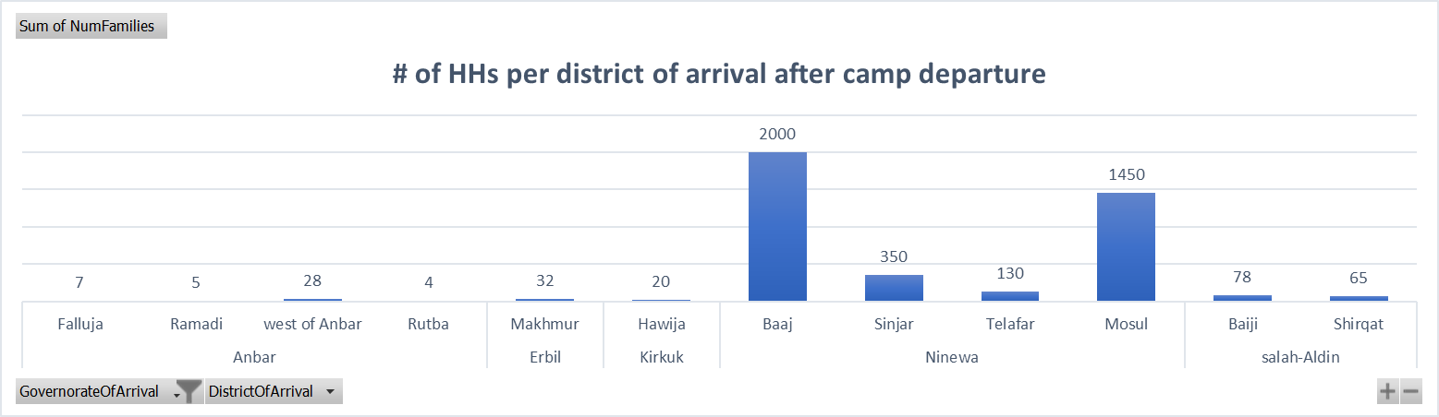
DTM Tracking of Forced Returns and Coerced Departures
DTM has recorded 6,615 HHs that have left camps between August 17 and September 22.
Of those who left camp settings for non-camp settings, the majority remain in Ninewa, primarily in Ba’aj (2000 HHs) and Mosul (1450 HHs) districts.

Slide 5
DTM Tracking of Forced Returns and Coerced Departures
IOM DTM conducted follow up phone interviews with a representative sample of the 600 HHs that were forced to depart Haji Ali between September 4-10.
64% of those surveyed said they left the camp involuntarily, and 6% did not want to answer.
56% of HHs returned to their location of origin while 44% were secondarily displaced.
95% of those who returned to their location of origin returned to their habitual residence, however, 74% of those people returned to a destroyed house.
Half of those returned reported a fear of eviction.
41% of those who did not return reported staying in either a camp or a tent as a shelter, and 24% reported sheltering in UABs. 69% of these HHs reported a fear of eviction.
Unavailability of basic services was reported as the primary reason--by 81% of HHs—not to return, followed by damage and destruction or occupation by someone else of their residence.

Slide 6
Update on Achievements
SNFI Achievements Reported in Activity Info Jan-August 31
District | Shelter Target | NFI Target | Shelter Achievement | NFI Achievement
Hamdaniya | 13,326 people | 40,459 people | 17,130 (128%) | 32,602 (81%)
Mosul* | 156,605 people | 165,199 people | 15,242 (10%) | 48,654 (29%)
Sinjar | 6,710 people | 4,986 people | 2,465 (37%) | 12,852 (258%)
Tel Afar | 17,237 people | 16,476 people | 0 (0%) | 5,116 (31%)
Til Kaif | 4,209 people | 7,173 people | 3,461 (82%) | 2,100 (29%)

Slide 7
Ninewa Updates by District
Hamdaniya
Partners | Sub-District | What | Targets | October Plans
CNSF | Kakae villages – Majidia, Wardak, and Kazakan | Reconstruction of Cat 4 Houses | 100 HHs | Construction underway, except for Kazakan, which is completed
CNSF | Kakae village - Majidia | Rehabilitation of Cat 3 Houses | 30 HHs | Construction will continue
Partners reporting in Activity Info: BCF, CNSF, Caritas Czech, Caritas Iraq, CRS, IOM, IRW, Malteser International, Mission East, MoMD, Samaritan’s Purse

Slide 8
Ninewa Updates by District
Mosul
Partners | Sub-District | What | Targets | October Activities
Medair | West Mosul (Zinjili, 17 Tamouz, and Mushirfa) | War Damage Rehabs | 17 HHs | Rapid Security Assessment finalized for Mushirfa, Zinjili, and 17 Tamouz Conduct the WDS scoping Conduct SEVAT (TBC) Develop BoQs for WDS Cat-2
Partners reporting in Activity Info: BCF, CRS, HA, IOM, IRW, Malteser Int’l, NRC, RIRP, Samaritan’s Purse, UN-Habitat
UNDP (does not report in Activity Info, does report in the WDS Portal)

Slide 9
Ninewa Updates by District
Sinjar
Partners | Sub-District | What | Targets | October Plans
Medair | Sinuni, Golat Village | NFI Distribution | 342 HHs | Completed September 16th: -UNHCR kits distributed to the remaining families -218 blankets, 42 cooking stoves, 51 Jerrycans, 345 Hygiene kits, 19 Female sanitary kits
IOM | Sinjar, Al Shamal, Markaz Sinjar | War Damage Rehabs Cat 2 & 3 | 300 HHs
Partners reporting in Activity Info: IOM, Mission East

Slide 10
Ninewa Updates by District
Tal Afar
Partners | Sub-District or Town | What | Targets | October Plans
ACTED | Tal Afar | War Damage Rehabs, Cat 2 & 3 | 850 HHs | Finalize the rehabilitation of the first 500 HHs of the caseload
CRS | Tal Afar | War Damage Rehabs, Cat 2 & 3
Mission East | Ayadiyah | War Damage Rehabs, Cat 1 & 2 | 150 HHs | Technical Assessments
Peace Winds Japan | Gir Kafir village, Zummer sub-district, | War Damage Rehabs, | 120 HHs | SEVAT Assessment of 195 HHs, Technical Assessment of 120 HHs
Partners reporting in Activity Info: CRS, IOM, TDH-Lausanne

Slide 11
Ninewa Updates by District
Til kaif
Partners | Sub-District | What | Targets | October Plans
CNSF | Wana-Amar Kbr, Wana-Amar Bet, Wana-Shihia, Wana-Mhwer Shimaly, Wana-Mhwer Al Jwnby, and Wana Simahla villages | Reconstruction of Category 4 Damaged Houses | 285 HHs | Construction to continue
Medair | Wana, Qara Kharab & Ghuzayli | War Damage Rehabs Cat ?? | 63 Structures, 106 Families | Finalize BoQs, start the tendering process
Partners reporting in Activity Info: Caritas Iraq, Medair, Mission East

Slide 12
IHF Second Allocation
Five proposals were submitted for the IHF 2nd Allocation, with 10 partners represented, including 5 national NGO partners
The total allocation of $3.3 million was split amongst four proposals, funding 8 partners.
Partner (Lead Agency) | Budget | Beneficiary HHs | Locations | Activities
CCR | $1,465,000 | 2,934 HHs | Dohuk, SAD | SOK & NFI Distribution, Critical Shelter Upgrades, Cash for Rent
HRF | $773,000 | 1,393 HHs | Kirkuk | SOK Distribution, Critical Shelter Upgrades
SZOA | $642,000 | 1,337 HHs | Anbar | SOK & NFI Distribution, Critical Shelter Upgrades, Cash for Rent
UN-Habitat | $433,000 | 1,000 HHs | Anbar | SOK Distribution
TOTAL | $3.3 million | 6,664 HHs

Slide 13
IIC Call Center Focal Points
The Iraq Information Center (formerly the IDP Call Center) has been forwarding complaints and requests for services to the Shelter Cluster
  We will refer these complaints to your organization, however, we want to clearly identify focal points for each organization to receive complaints. Focal points should ideally be someone in a supervisory capacity of programming, backed by an M&E staff or PSEA focal point
  For organizations that have hotlines, we would still like a clear focal point for complaints as hotlines are not always active and may cost complainants money
  Partners are requested to share their complaint focal point by 30 September with Teri (coord2.Iraq@sheltercluster.org)

Slide 14
Shall We Move the Ninewa SNFI Meeting to Mosul?
A proposal has been made to move the Ninewa SNFI meeting to Mosul, with DRC initially offering to host.

Slide 15
Any Other Business?
  Any points partners need assistance with or would like to raise for future meetings?

Slide 16
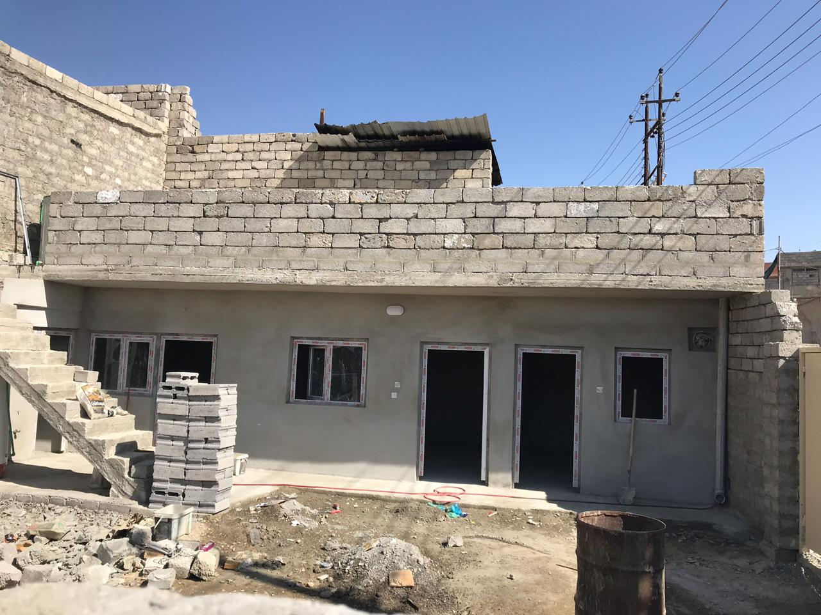
THANK YOU
IOM credit: Core Housing Pilot in West Mosul, 2019

