Slide 1

JOINT INITIATIVE FOR SUSTAINABLE HUMANITARIAN PACKAGING WASTE MANAGEMENT
GSC NFI WORKING GROUP MEETING, APRIL 2021

Slide 2
COLLABORATIVE EFFORT: 16 partners
A Joint Initiative - to achieve sustainable changes, leverage strengths and experiences and “share the burden to reduce the burden”
Many ongoing efforts to improve packaging and reduce packaging waste
Lack of coordination - opportunity to increase impact and find collective solutions
Steering Committee: USAID, ECHO, WFP, UNEP/OCHA Joint Environment Unit, IOM, Global Logistics Cluster, ICRC, Danish Refugee Council, Save the Children, CRS
Technical Coordination Working Group: all of the above plus the Global Shelter Cluster, UNHCR, IFRC, FCDO, RISE, UNHRD Lab, MIT Lincoln Labs
Notes:
GSC hoping to join more formally when additional capacity in place (Steering Committee). Engagement to date mostly through the ECOP.

Slide 3
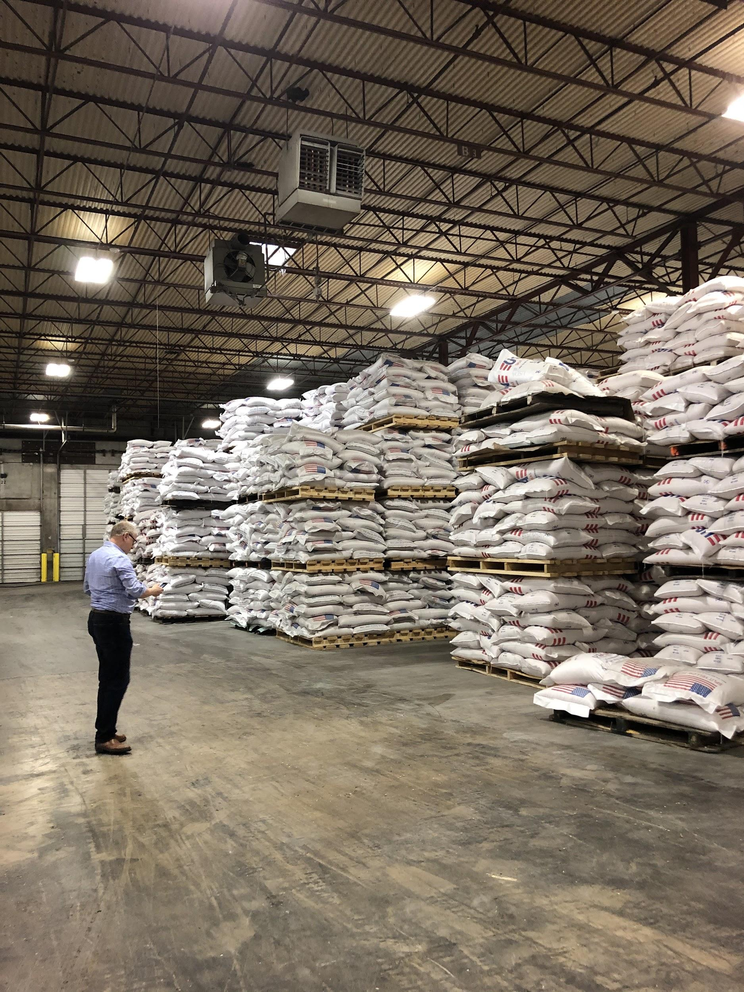
JOINT INITIATIVE KEY STEPS TO DATE
2019 - Co-conceived with USAID & WFP/GLC
July 2020 - Scoping Published: informed planning of the JI
Nov 2020 - Collaborative Roadmapping (joint planning process)
January 2021 - 4 year Logframe & Activity Plan published (scoping + partner priorities + joint planning)
Feb 2021 - meeting to approve activity plan
March 2021 - Activity kick off, with different orgs leading & multiple orgs participating in each activity
April 2021 - USAID/ECOS funding for implementation phase (coordination; communications, policy & learning; support services; lead on some technical activities)
April 2021 - first Technical Coordination Working Group meeting
Notes:
Funding: 735k for ECOS support, 795k for MIT LL, est. 199k for PSLA, 250k for AAAS fellow
= totals 1.7M, almost 2M with AAAS fellow funding

Slide 4
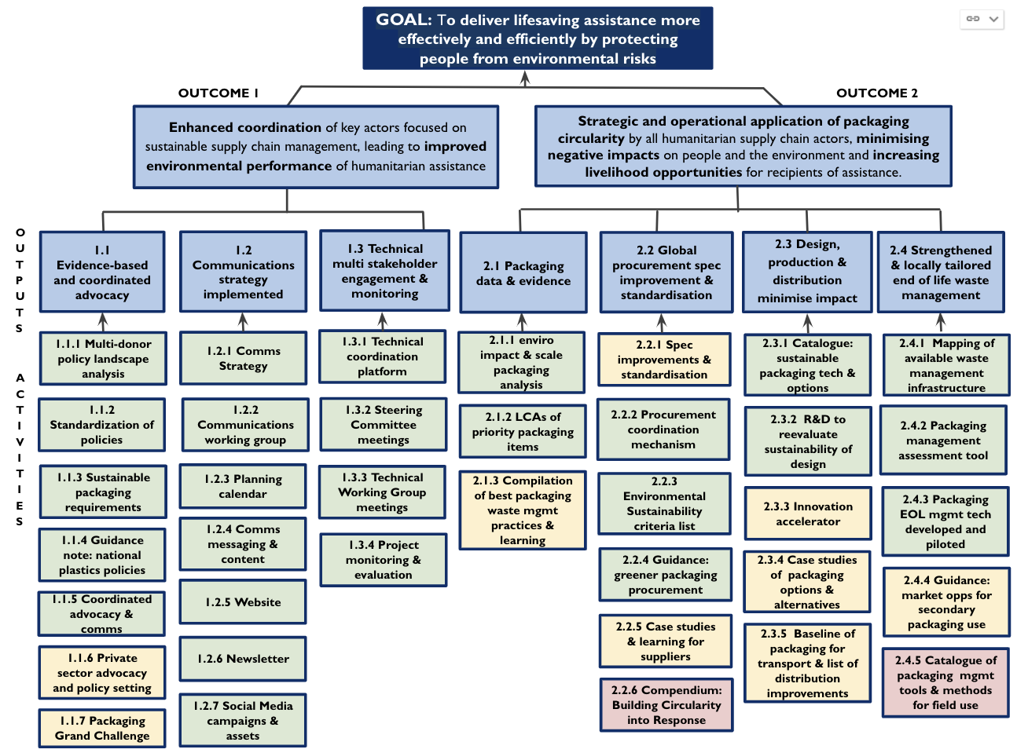

Slide 5
OPPORTUNITIES FOR COLLABORATION
POLICY and ADVOCACY
1.1.4
Short guidance note “cheat sheet” for main HA contexts, including plastic bans, relevant Basel convention regulations, transboundary movements etc.
Led by the UNEP/OCHA Joint Environment Unit with consultant support from USAID inputs from BRS and operational partners with experience of working with new regulations.
Starting May 2021- when consultant on board sub-working group will be set up
Guidance note on international & national policies governing plastic use
TECHNICAL STAKEHOLDER ENGAGEMENT
1.3.1
Need to coordinate across organisations and sectors to share information and coordinate on technical activities
Similar initiatives spanning shelter, logs and all sectors
Set up in Q2 2021; use throughout and beyond the Joint Initiative. GLC can provide this platform, pending funding to update it
Technical coordination and information dissemination platform set up and used to share technical information
PACKAGING DATA & EVIDENCE
2.1.2
Started by WFP with existing LCA initiative for one food packaging item
Opportunities for funding further LCAs being explored by USAID
ECHO funding for LCAs may be available via ERC HIP 2021 (interest in joint application?)
Link to BRE/GSC ECOP shelter materials LCA tool which incorporates some packaging and in discussion on inclusion of additional types of packaging
LCAs of highest volume packaging items / most commonly delivered items per country/region

Slide 6
OPPORTUNITIES FOR COLLABORATION
PROCUREMENT
2.2.1
Many partners have or are introducing specification improvements that can be shared across the sector. This would be followed by the discussion on standard specifications and how to take this forward.
GSC work on specification improvements (packaging & commodities)
Specification improvements for packaging of main relief items and standard specifications are proposed.
2.2.3
Various partners are already working on this and can share sustainability criteria and experience.
GSC trying to incorporate sustainable procurement in tendering for manufacturers
Starting April 2021 post TCWG, led by DRC
6 months for development of criteria list, followed by a piloting phase
Packaging sustainability criteria list for tender contracts
DESIGN, PRODUCTION & DISTRIBUTION
2.3.2
GSC NFI working group looking at environmental impact of NFIs
Number and type of products will dependent on stakeholder priority & interest, ideally covering food, non-food and kits.
Existing initiatives: PP bags via Innovation Norway funding (ICRC, WFP, UNHCR); UNHRD re-designed items (e.g. hygiene kit).
Late 2021/early 2022: could leverage EU's R&D funding, and could focus on specific priorities of partners
R&D to reevaluate the design of most common packaging products to increase sustainability

Slide 7
OPPORTUNITIES FOR COLLABORATION
END OF LIFE MANAGEMENT
2.4.1
GSC interest in recycling/repurposing of specific items
In discussions with WFP re leading with support from USAID
Partners can influence locations / methodology
A first step could be sharing tools, processes and data already being used to map this type of info
Results can be integrated into the GLC Logs Capacity Assessments.
Mapping of available waste management infrastructure in operating countries
2.4.4
Leads tbc based on locations & partners' priorities
Work with private sector and local actors
Design a methodology that can then be applied in other locations. Pilot solutions.
Could include a fact sheet on waste types and market based solutions for types waste (global solutions)
Guidance on market-based opportunities for secondary use of packaging (Reuse, recycling and repurposing in key crisis locations)
2.4.5
To engage the field and match field needs to technological options and allow field practitioners to more easily incorporate into response.
Raised as a priority by the ECOP
Catalogue of packaging management tools and methods for field use

Slide 8
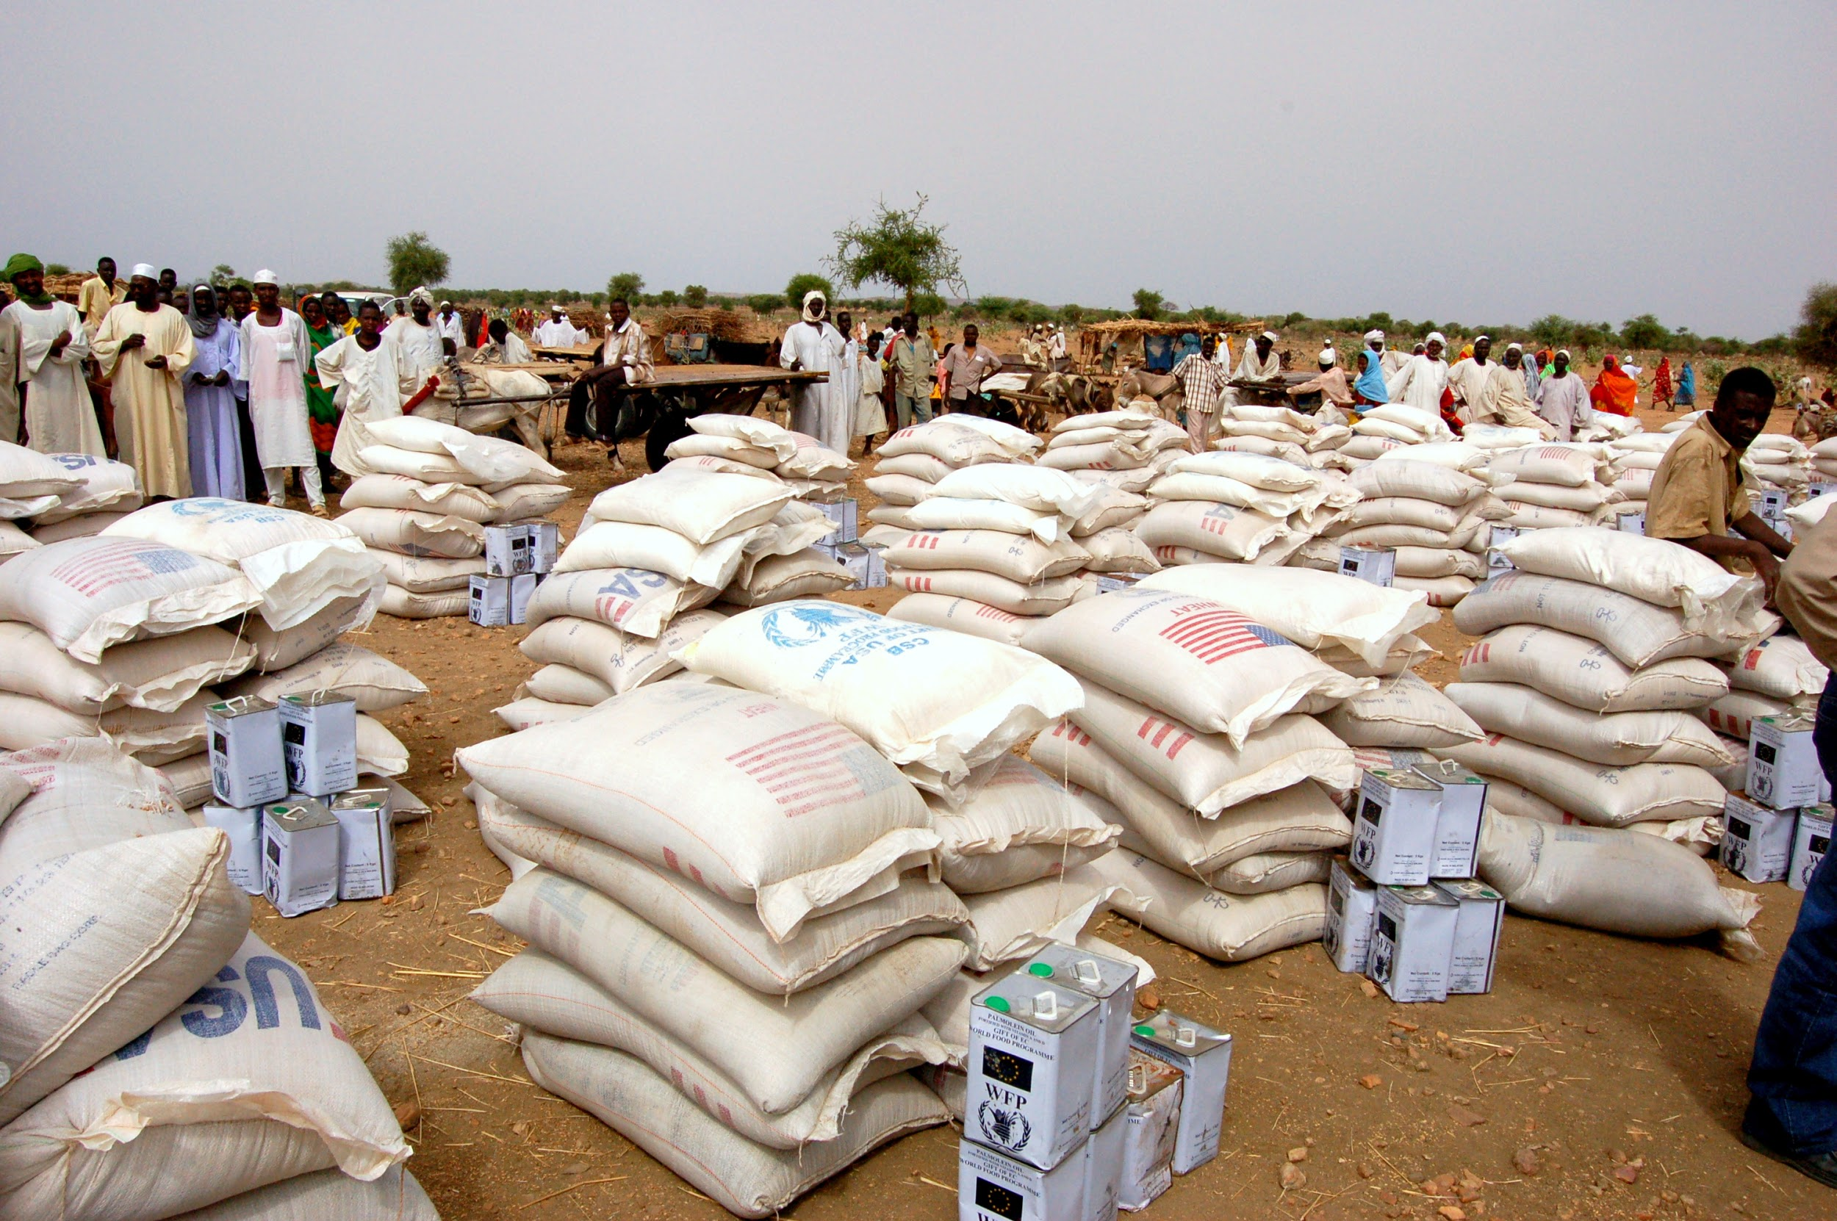
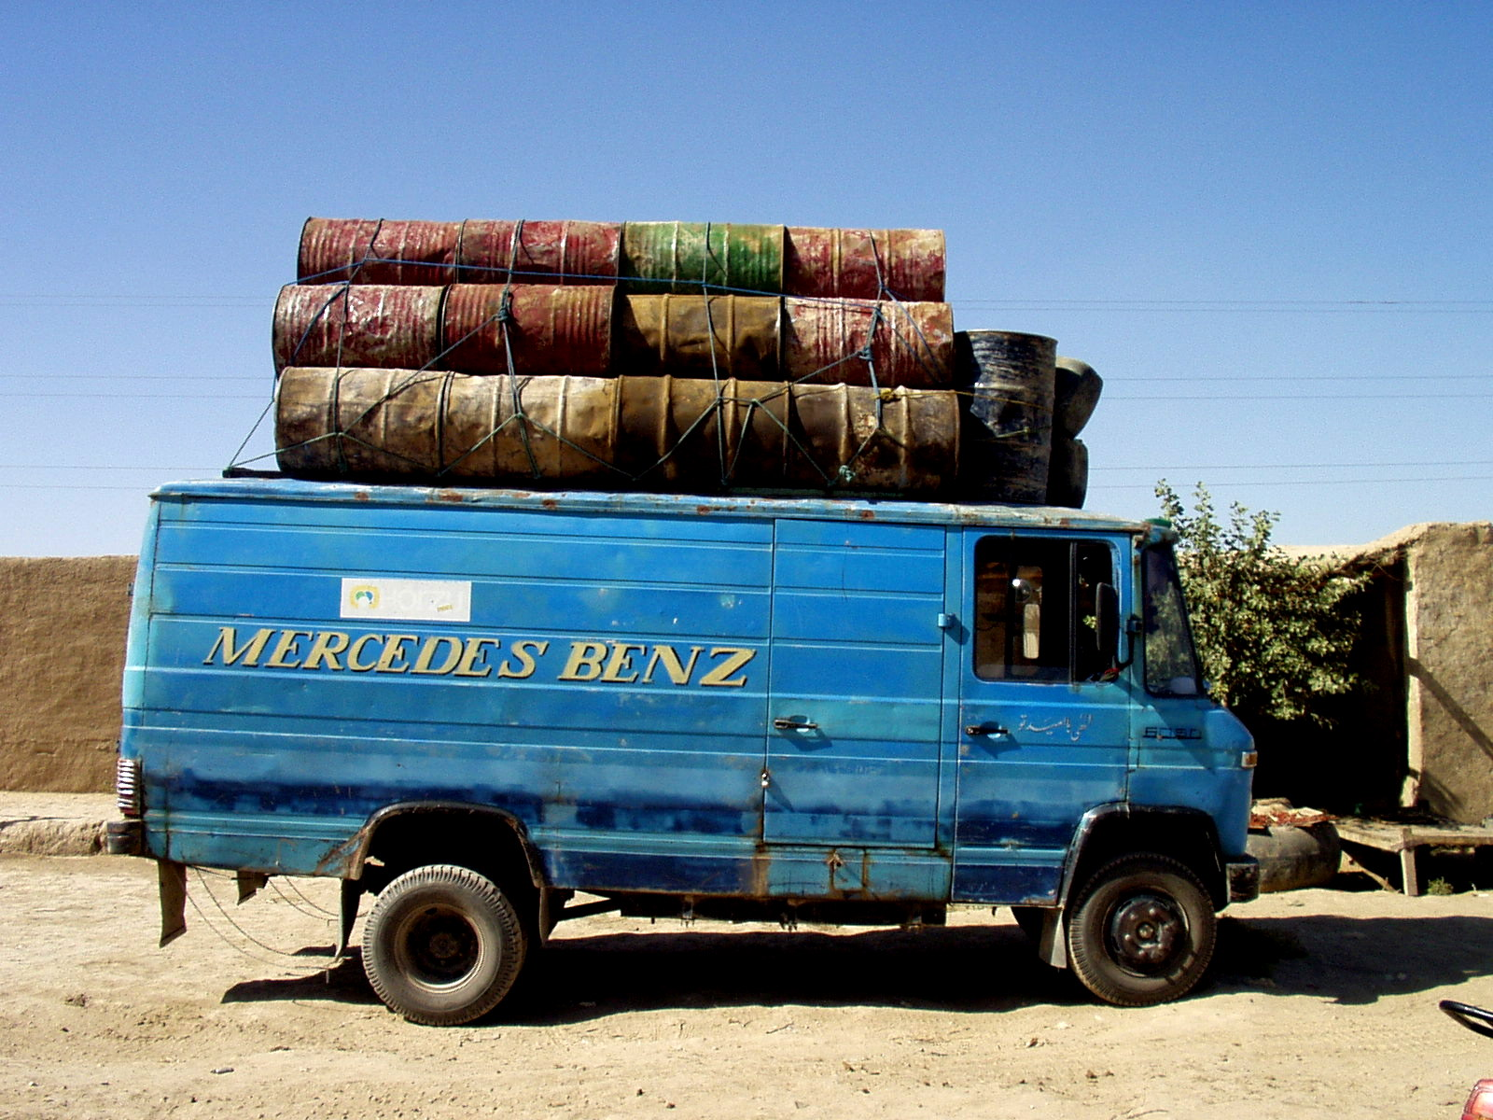
DISCUSSION
Questions/comments?
Discussion on opportunities for collaboration
Related activities of the NFI WG?
Join sub-working groups for certain activities?

Slide 9
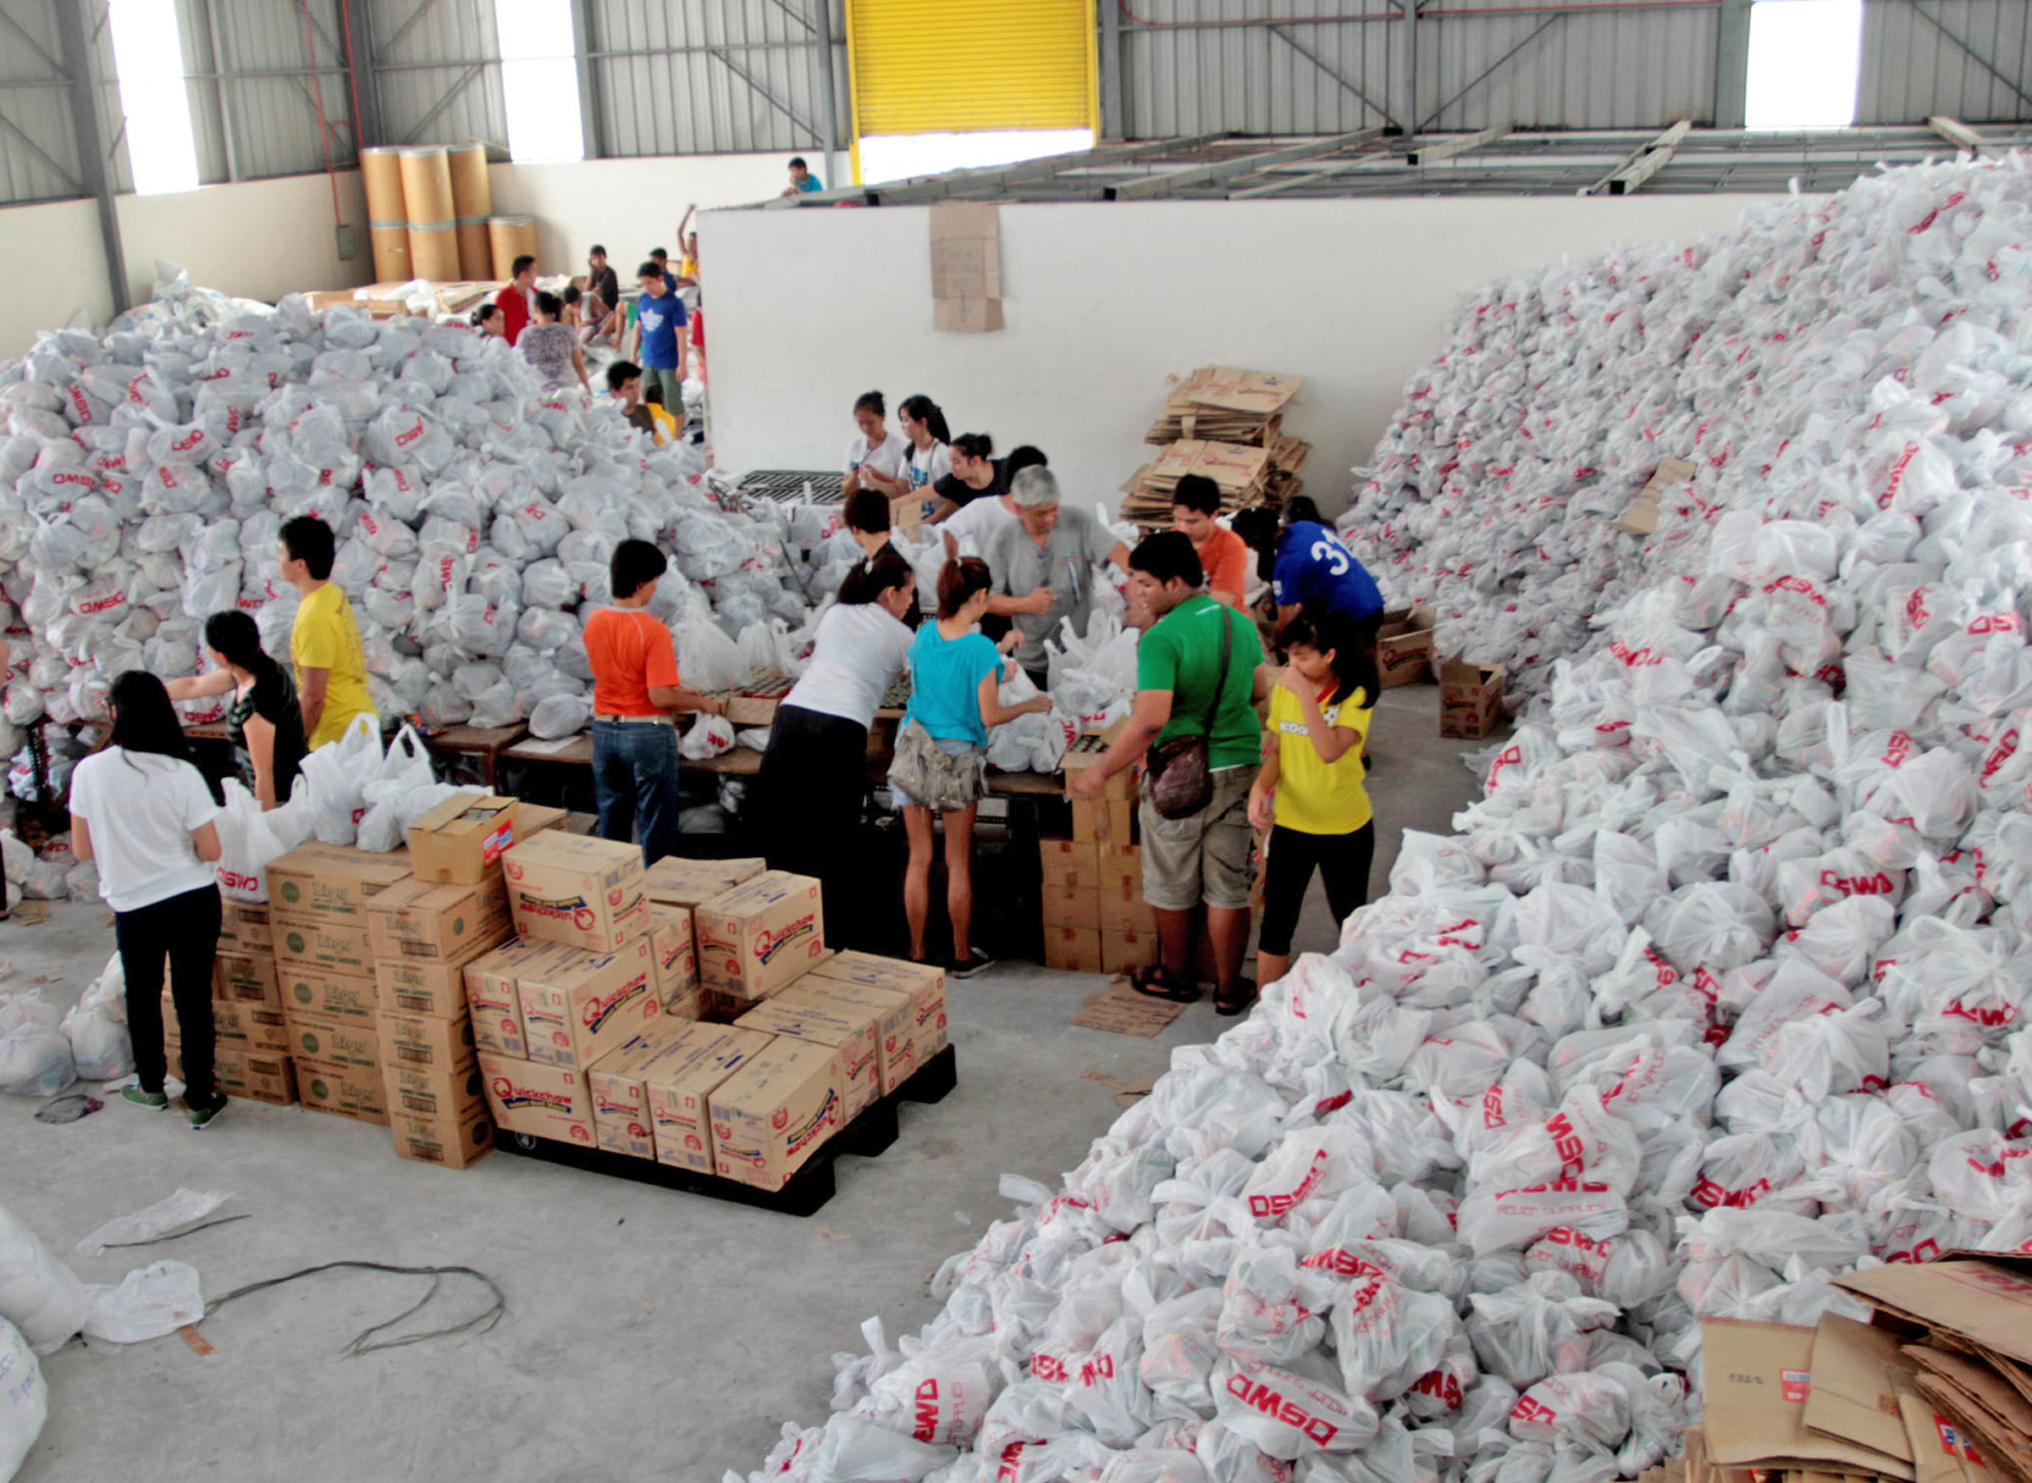
NEXT STEPS
Activity planning and implementation
Partners contacted by activity leads to set to sub-working groups and define scope of work for specific activities - a good time to join!
Funding
ECHO/EU funding exploration/applications
Coordination
Next TCWG meeting in June.
Steering Committee 17 May
Events & Comms
HNPW: April 26 - briefing session on the Initiative & April 30 Technical Session
Newsletter: Joint.Initiative@icf.com

Slide 10
THANK YOU!
USAID CONTACTS:
Dr. Erika Clesceri (eclesceri@usaid.gov)
Greg Olson (golson@usaid.gov)
Greg Rulifson (grulifson@usaid.gov)
Chris Pettit (Chris.Pettit@icf.com)
Mandy George (mandy.george@cadmusgroup.com)
Carmen Saab (Carmen.Saab@cadmusgroup.com)
bha,scm.sustainability@usaid.gov
Mike Mikkoff: michael.minkoff@cadmusgroup.com
CREDIT: UNEP/OCHA JEU

Slide 11

MOST PACKAGING BECOMES WASTE (EVENTUALLY)
Unintended consequence of vitally important services
Few systems to manage solid waste in most humanitarian contexts
Packaging can also = opportunities
PHOTO CREDIT: UN JEU

Slide 12
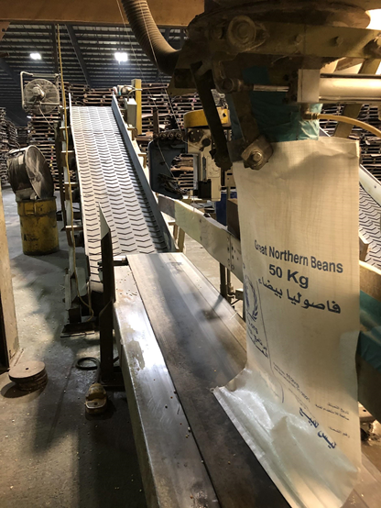
SCOPING: PRIORITIES IDENTIFIED
Enhance Humanitarian Coordination
Private Sector Engagement in Policy and Standard Setting
Detailed Assessments and Case Studies
Production, Procurement, Distribution, Usage
End of Life Management
Notes:
Reference the landscape mapping document that was in the preworkshop materials
These are the priorities that we laid out in the scoping document. We’ll get to #1 later.
All the circular economy framing is familiar to the private sector, and we don’t have any assistance without them.
Assessments of particular products or events are needed to add to the growing library started by our colleagues and their efforts
Across the supply chain, we found that the materials themselves and how they are distributed needed addressing
Of course, we will still have some waste to manage in these humanitarian contexts, and helping our humanitarian community know what to do, when to do it and in which context should be a target across all of our programs.

