Slide 1



Shelter & NFI monthly meeting
13 July 2021
12:00 – 13.00 (LBY time)
Shelter NFI Sector Libya
ShelterCluster.org
Coordinating Humanitarian Shelter
Please introduce yourself in the chat

Slide 2
AGENDA
Introduction
Updates from the Partners
Inter-agency Referral System consultation with SNFI sector
Focus on ‘Informal Settlements’
Updates from the Sector, incl. Information Management
AOB

Slide 3
2. PARTNER UPDATE
In alphabetical order – well almost!
DRC
NRC
UN-Habitat
UNHCR
CESVI
CEFA (no update)

Slide 4

2. PARTNER UPDATE
Donor: SDC
Duration: 01.02.2021 – 30.04.2022
Area: Tripoli ( AbuSalim, Ain Zara, Sidi Alsayah, and Soug Algouma)
Targeted population: IDPs, Returnees, Host community, and mix migrants.
Type of assistance: Rehabilitation and S/NFI kits.
Ongoing activities:
Assessing Identified location for intervention: Sidi Alsayah- IDPs site (37HH).
Conducting introductory meetings with targeted municipalities.

Slide 5
2. PARTNER UPDATE
NRC- Shelter updates
Projects charged to UNHCR:
1. Tender evaluation is ongoing for the first package of work; rehabilitation and upgrade of 24 houses at Alsabrie, 2 camp infrastructure, and 30 shelter unit at Al Hilies, Benghazi.
2. Rehabilitation of 41 houses at Al Sabrie; technical assessment is completed, BoQs and scope of work are completed. All documents shared with UNHCR for review.
3. For infrastructure works in Tripoli, technical assessment is completed, BoQs and scope of work are completed. All documents shared with UNHCR, and tender will be launched this week.
Projects charged to other donors:
1. Rehabilitation and upgrade of two health centers in Al Hadba and Mashroe Zerae- Tripoli; technical assessment is completed, all technical documents and final package completed, tender will be launched this week.
2. Rehabilitation of housing units - Benghazi: Registration and vulnerability assessment for 102 HHs in Gamminess is completed, technical assessment is ongoing.
3. Rehabilitation of housing units – Tripoli: working on registering potential beneficiaries through community focal points and local councils, vulnerability assessments started for HHs identified in Abu Salim (AL Khalatat area).

Slide 6
4. PARTNER UPDATE
UN-Habitat Update
UN-Habitat has engaged two consultants working on an assessment on Libya’s Land Administration and Land Management. A wide variety of actors are asked to complete a questionnaire, along with key informant interviews.
UN-Habitat Libya hosted a Roundtable on ‘Addressing Land Administration and Land Rights Challenges to Pave the Ground for Peace and Stability in Libya’ on the 29th and 30th June in Tunis. The roundtable brought together land and HLP experts and practitioners from different institutions and disciplines to exchange their experiences and discuss the priorities for action in the Libyan land / HLP sector.

Slide 7
2. PARTNER UPDATE
UNHCR:
During June, UNHCR managed to reach 4,444 individuals mainly refugees, asylum seekers, migrants and IDP’s.
40 individuals (32 males / 7 females) out of the 4,444 have been reached at a detention center in the East (Alkufra), 892 reached at CDC, and 524 individuals at the TNB(Tripoli Naval Base). Whereas 2,985 were internally displaced persons targeted at Abugrain & Weshka, Murzuq IDP families in Benghazi.
During the month a total of 9,738 NFIs, 3,098 HKs and 10,265 hand soap have been distributed at the CDC, TNB, DCs and IDP camps/urban settings.

Slide 8
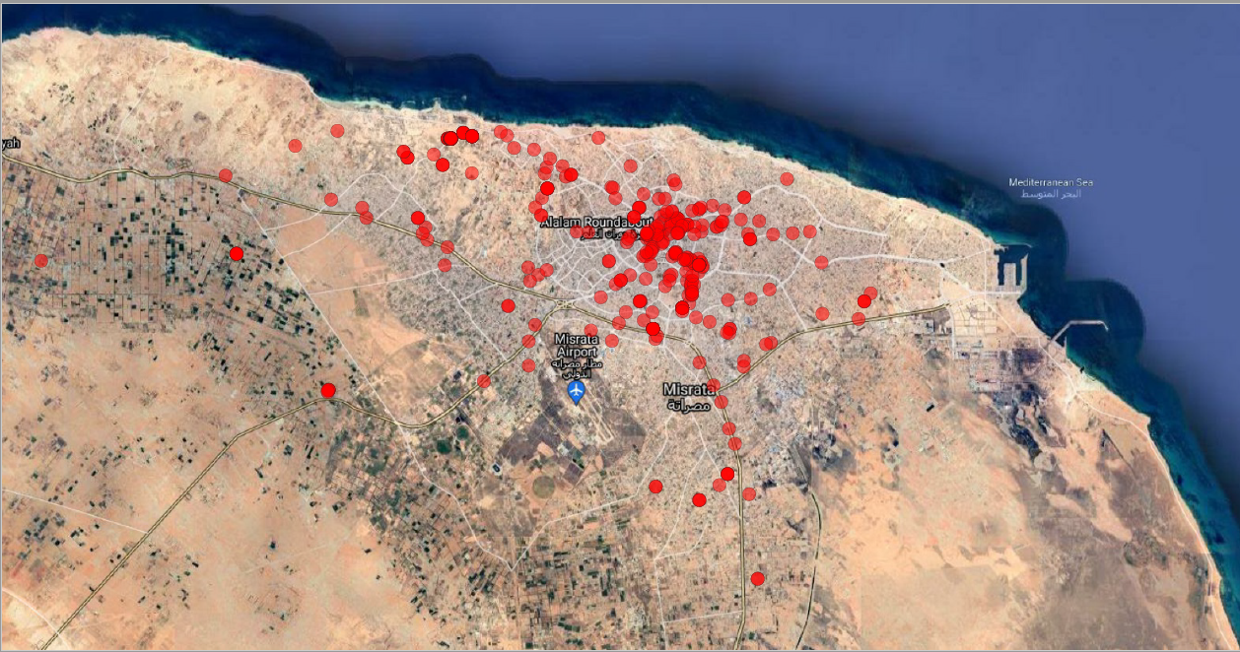
2. PARTNER UPDATE
Cesvi – Activities in June 2021
NFI distirbutions in the Misrata Urban Areas – see map
NFI distributions with the Ministry of Social Affairs
MoSA has requested assistance for back-to-school kits distribution, which Cesvi cannot address with the current projects.
Cash for Rent activities ongoing
Distribution of Non Food Items in the Month at MoSA
توزيع المواد غير الغذائية في الشهر
Distribution dates (DD/MM/YY) مواعيد التوزيع (اليوم / الشهر / السنة) | Type of kits distributed نوع المجموعات الموزعة | total individuals assisted | Male / ذكر | Female / أنثى | children / الأطفال
06/06/21 - 07/06/21 | Hygiene kits and clothing kits أطقم النظافة ومجموعات الملابس | 213 | 44 | 37 | 132
MAP: Cesvi NFI distributions April – June 2021 in Misrata

Slide 9
2. PARTNER UPDATE
Verbal Updates:
IOM (Derna)
PUI
Any other updates from participants?

Slide 10


Interagency Referral System consultation with SNFI sector
3. INTERAGENCY REFERRAL

Slide 11
Why a referral system?
During registration of NFI beneficiaries the team comes across a HH at risk such as child-headed household
During an assessment the team identifies needs for provision of food
SNFI staff is alerted about a household at immediate risk of eviction
During a post-distribution monitoring visit the team learns that an elderly household members needs urgent medical assistance
What does your team do?

Slide 12

INTERAGENCY REFERRAL SYSTEM
WHY?: coherent, coordinated, accountable, principled and comprehensive response
WHAT?: direct an individual to a secondary service because beyond expertise; scope of work and to avoid duplications
WHO?: frontliners, personnel working in specialized agencies

Slide 13
Interagency Referral System
HOW?
Referral SOP and forms
WHAT?
Service mapping
TO WHOM?
Referral pathway
Referral platform for an automated process

Slide 14
Groups of concern
Refugees, Asylum Seekers
Internally Displaced Persons
Migrants
Returnees
Any other person at heightened risk

Slide 15
Current status and proposed changes
Currently
Proposed enhancement
Limited to Protection Sector
  Referral SOP
  Service mapping at baladiya level
Accessible only to focal points within PS
‘Manual’ referral via email
Multisectoral
Information about services available publicly
  Some sensitive services might have restricted access
Clear referral pathways
Standardized approaches
Strengthened accountability

Slide 16
What we need your feedback on
What information does the service mapping need to include to be useful?
  What geographical level?
  What details on services should be included?
  Are there any concerns related to listing contact details on a public dashboard?
  How frequently should it be updated? By whom?
What might be the key barriers and challenges in using the referral system?

Slide 17
Proposed next steps
Step | Focal point | Mar | Apr | May | June | July | Aug | Sept | Oct. | Nov. | Dec.
Presentation to different sectors | PS IMO
Revision of the guidance note and referral form templates | PS and Sectors’ coordinators
Revision of the on-line service mapping tool (data inputs) | PS IMO and Sector’s coordinators
Information submitted in the on-liner service mapping | Organization focal points
Development of area specific referral pathways | ACGs and Sector Coordinators
Training on IA SOPs and referral to sectors | PS Coordinators

Slide 18
Why should the SNFI Sector take an interest in Housing, Land and Property (HLP) issues, including forced evictions?
- Long lessons learnt that if we do not – we can do harm
- Sustainability of our work
- its in the SPHERE – Security of Tenure in Shelter and Settlements sector
4. FOCUS ON INFORMAL SETTLEMENTS
i. Evictions in Libya – update on Eviction Task Force work
ii. Settlement Mapping

Slide 19
What the ETF is to deliver on
4. FOCUS ON INFORMAL SETTLEMENTS
Advocacy document
Key messages – version 1 endorsed by ISCG
Operational guidance
List of recommended actions for eviction aversion and impact mitigation
Eviction tracking & risk monitoring
Eviction tracker
Version 2
Guidance on cash response (IDPs)
Eviction monitoring checklist
Site – level eviction risk mapping

Slide 20




Operational guidance
4. FOCUS ON INFORMAL SETTLEMENTS
Gathering information
Advocacy and negotiation
Monitoring and follow up
Response
Notes:
Validation of the entry
Referral to relevant Protection or S/NFI partner to verify the eviction threat if needed or bilateral follow up with the reporting entity. The Interagency Referral SOP will be applied to conduct individual referrals.
Agreement on appropriate actions to be taken as per table below
Acknowledgement of the receipt to the reporting entity with feedback on the action taken

Slide 21
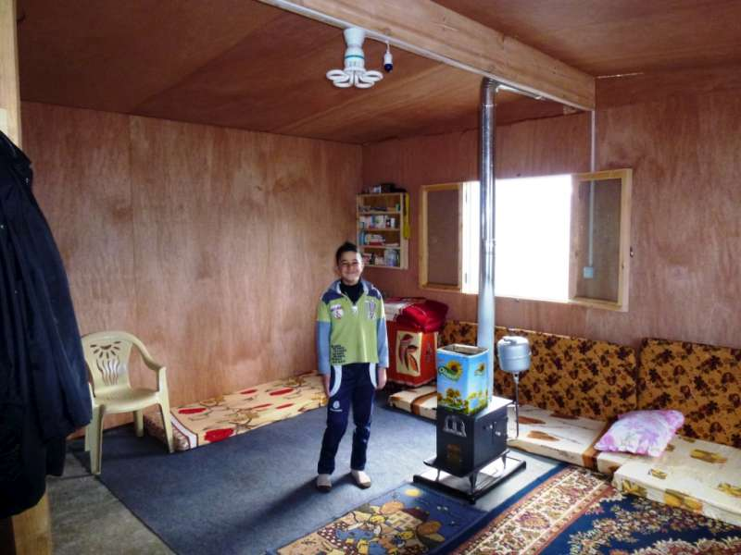
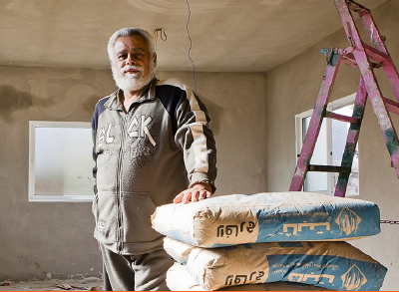
Multi-purpose cash assistance (MPCA)
Cash for rent (CfR)
Labelled cash
Occupancy free of charge
Response
Notes:
These are the main alternatives we got under Rental market interventions. Programs that use a market-based approach to support displaced people ability to access or retain rental housing or land for settlement.
MPCA refers to unrestricted cash transfers to cover basic needs. Displacement or the loss of people’s homes can be an trigger to provide MPC. This modality offers people a maximum degree of choice, flexibility and dignity. Post distributing monitoring often indicates that a significant amount of beneficiaries have used MPC to cover housing costs therefore, we can consider MPC can have a direct shelter outcome.
Cash for rent (CfR): is literally money (or a cash transfer) given directly to a lessor, landlord or landlady, a propriety owner or manager to cover the accommodation costs for a specific amount of time. It is usually based on a pre-existing relationship between a landlord and tenant, although NRC may also assist in some cases.
Single-purpose cash is similar to CfR as both intent to cover rent and in some instances also the cost of utilities. However, in this case, cash if given directly to the beneficiary. This is the reason it cannot be restricted and it is called Labelled cash. The key to have a shelter outcome is on the beneficiary identification process and the timing of the assistance. Just as we provide cash at the start of the school year to support parents of school-age children sending them to school, the teams might select beneficiaries based on their shelter needs.
OFC, also known as rehabilitation-for-rent, works directly with propriety owners to increase or improve the stock of adequate housing (utilities can also be upgraded). In exchange for this assistance, the landowners must agree to allow a vulnerable household to live in the rehabilitated space free of charge (or at a reduced rent) for a defined period of time.

Slide 22
Why do we need an eviction tracker?
4. FOCUS ON INFORMAL SETTLEMENTS
Rationale
Objective
Currently scattered information about eviction threats
Need for a systematized approach to recording and analyzing information
Part of a comprehensive system
Support to a more coordinated response
Record, track and trigger response, including through interagency referrals, to cases of evictions and threats thereof affecting individuals and collective sites and strengthen understanding of factors which put persons at heightened risk.

Slide 23
How does it work?
4. FOCUS ON INFORMAL SETTLEMENTS
  Reporting form available to all humanitarian actors
    Reporting
    Reporting and referral
  Entries assessed and validates by PS and SNFI sector co/coordinators
    If needed response initiated
  Quantitative analysis of trends by sector’s IMO with different levels of access
Notes:
Validation of the entry
Referral to relevant Protection or S/NFI partner to verify the eviction threat if needed or bilateral follow up with the reporting entity. The Interagency Referral SOP will be applied to conduct individual referrals.
Agreement on appropriate actions to be taken as per table below
Acknowledgement of the receipt to the reporting entity with feedback on the action taken

Slide 24



Site – level eviction risk mapping
4. FOCUS ON INFORMAL SETTLEMENTS
Eviction risk index
  Land ownership?
  Previous eviction threats?
  Location/land value/land development plans?
  Type of agreement?
  Critical protection concerns?
Settlement mapping
  Defining information needs
  Review of existing data of partners
  Bridging information gaps – data collection
  Validation with affected communities

Slide 25
Next steps
4. FOCUS ON INFORMAL SETTLEMENTS
Outreach to SNFI and Protection partners to obtain secondary data for site profiles
Finalization of eviction risk index
Finalization of operational guidance on evictions
Training on Eviction response and tracking for humanitarian actors (early August)

Slide 26
5. SECTOR UPDATE
HRP or non-HRP in Activity Info
Tawergha Response – NFI and Cash for Shelter
  Meeting between sector, LibAid and MoIDPs on damage assessment support
Discussions with BHA, ECHO and Sector partners about long-term strategy of the sector
In depth meeting with OCHA South on increased engagement and how to better articulate needs
UNHCR plastic sheeting, still looking for a home!

Slide 27
6. AOB
Next meeting Wednesday 11th August @ 11:00 Libya (2nd Wednesday of the month)

Slide 28
Thank you
Shelter NFI Sector Libya
ShelterCluster.org
Coordinating Humanitarian Shelter & NFI
SNFI Sector Coordinator
Richard Evans
evans@unhcr.org
SNFI Sector Co-Coordinator
Zaid Al Jabari
zaid.aljabari@nrc.no
SNFI Sector IMO
Awat Salih
salihaw@unhcr.org
SNFI Translator
Ali Abdullatif
abdullat@unhcr.org

