Slide 1
Training on online data collection (Kobo)
Kyiv, 17 February 2016
Delivered by Shelter Cluster team:
Igor Chantefort
Andrii Mazurenko

Slide 2






Session 1. INTRODUCTION
Notes:
5 min – objectives, goals, outcomes
5 min – self evaluation
5 min – information flow cycle
5 min – what is Kobo and why kobo within all these stages
1 min – agenda of the day
9:30 – 9:40 ICE BREAKER – circle – stepping in – confident in excel, pivot table, who did data collection, who did online/mobile data collection, who did data cleaning, who heard about data cleaning, who did participate in data collection campaign, what is GIS, who did GIS, who is very confident with GIS (grading questions by thematic)
9:40 – 10:00 general presentation – Objectives, Goals, Outcomes – part of community of practice, Kobo, data collection tools. Better understand kobo tool and be capable to adapt kobo form / change thematic, access to CODs by Shelter Cluster and instructions. Only few might be interested to interact with CODs (graph by type of users), what is Kobo (5 min)
Information flow cycle

Slide 3

Session 1 Objectives, Goals & Aims
Goal, to create a community of practice with an understanding of data collection & able to develop and relay a data collection campaign
Aim, to be able to independently develop simple form, to modify existing one, to extract and analyze the data collected.
Objective, to get you as Super User of Kobo Data collection tool
Notes:
Community of practice
Data collection campaign in 2016

Slide 4













Session 1 Evolution Tree of Users
IM Data Collection Specialist
IM generalist
Pivot table on Excel
Did design a survey
Super User
Advanced User
Automatic sum & filters on Excel
Did participate on a survey…
Basic User
Not using …
Basic excel,
Using on line forms
No excel,
No computer…
The Boss
Notes:
Presentation of the different level

Slide 5

Session 1 Evaluate yourself
Notes:
Fil up the form – 5 minutes

Slide 6












Information Management is a cycle of six stages
Design
Combining
Notes:
Different approaches at every stage.
Question: can you tell different ways to collect data? (interview, internet, paper etc).

Slide 7







Why Online/mobile data collection tool?
?
??
??
?
??
??
??
?
??
Interview
Field Agent
Data Entry
Quality Control
Raw Data Analysis
Report
??
??
?
?
Notes:
Each step is potential a misunderstanding and a lose of information
Shortening the process is a gain in time and quality

Slide 8






Why Kobo ?
Acquee
COMMANDmobile®
CommCare
CommTrack
CSPro
CyberTracker
DevInfo
do Forms
droidSURVEY
Enketo Smart Paper
EpiCollect
FrontlineSMS Fulcrum
GeoChat
GeoPoll
Humanitarian Data Toolkit
Imogene
iSURVEY
KoBo
Last Mile Mobile Solution
Magpi
Majella Insight Mobenzi Researcher
Nokia Data Gathering system
Oasis Mobile
Open Data Kit
openXdata
Pendragon
Poimapper
PSI Mobile – Fusion
RapidSMS
RDMS
Smap
SoukTel
Telerivet
ViewWorld
Voxiva
Wepi
Notes:
Kobo is an integrated solution: when you need different software to program then to analyze kobo offer an all in one solution
Kobo is free of charge and was developed for humanitarian workers
Kobo server is now also running on shelter cluster server as final try before to be fully accessible.

Slide 9
What is the language? Sprechen Sie Kobo ?
?
.XLS
+ .HTML
= .XML
Xml is the language how all data collection forms are coded
You don’t need to know .XML, kobo will ‘translate’ for you.
Notes:
Each step is potential a misunderstanding and a lose of information
Shortening the process is a gain in time and quality

Slide 10

Agenda
Morning
09h00 09h30 Session 1 Introduction
09h30 10h30 Session 2 Design
10h30 11h00 Session 3 Collection
11h00 11h15 Coffee
11h15 11h45 Session 4 Combining/
Processing
11h45 12h30 Session 5 Analysis/ Dissemination
Afternoon
13h30 14h00 Session 6 Programing
My 5 first question on Kobo
14h00 14h45 Session 7 Programing Adding 5 more: date, pictures…
14h45 15h00 Coffee
15h00 16h00 Session 8 Programing
16h00 16h30 Presentation of Participants
16h30 16h45 Short break
16h45 17h15 Session 9 Data analysis
17h15 17h45 Session 10 WRAP UP

Slide 11
Information Management is a cycle of six stages
Design
Combining
Notes:
Beginning with the first step: design.
But before we start, Question: which types of data collection you know? How did you collect data in your work?
Kobo is integrated online and offline solution:
Online – it allows real time data collection and view on server; while at the same time functionality allows for entering data in the form without internet connection and upload later when it is available (ex: fill out in the field, come back to office and already there upload to the server).
At the same time, Kobo is extensively used at stages of Collection, Combining and Processing, while for Design/Analysis and Dissemination there are other tools.
As majority of us come in the end with Excel for analysis and visualization, excel is also used offenly at design stage. That is why some times we will be speaking about other tools than kobo

Slide 12


Session 2. Making a plan is first step to any data collection!
Plan before you start data collection;
Define roles and assign responsibilities for each step;
Budget!
Recognize stakeholders;
Define expected outcomes;
Define data model;
Create, manage and document data management system
Document strategy;
Revisit the plan throughout project life cycle.
Notes:
Planning is rarely a party as well as managing huge projects. That is why here are several tips:
Plan BEFORE. As I hope we all will learn today, the better data collection is planned, the easier it is then to work with results. We cannot foresee all turns of destiny, but have a strategy is something achievable.
What are roles and responsibilities? There is a person, who designs questionnaire; Several others have a look at it and comment – provide feedback. There is a data collector – someone who goes to the field to register all the information… This should be defined, with key responsibilities, so that from the very beginning it is understandable WHO is responsible at this particular stage.
Note: Often data collection (like needs assessments) is only part time involvement for all participants. Therefore, to clearly identify human resources needs is key to success.
Data collection costs money: vehicles, fuel, work time of people

Slide 13

Session 2. Assess data needs
Strategic
WHAT you want to measure
WHY you need to measure
HOW you will measure
Operational
What is level of data collection?
Design your data model
Explain your data
Notes:
Wrap up after each session
Ask what they learned yesterday
00

Slide 14

Session 2. WHAT you want to measure
Population data
# IDPs
# affected communities
Damage data
# destroyed houses
# damaged houses (cat 1,2,3)
Other thematic data
# communities without water
# cases of flu per week
Format
 | Text
 | Number
 | Date
 | GPS Coordinates
 | Picture
Type

Slide 15



Session 2. WHY you need to measure it?
We do not have these data! We need it NOW!
Bring me beneficiary lists NOW!
I want to have an overall picture! What is going on outside this office???
Quantify needs;
Register beneficiaries;
Monitor and evaluate program
Etc…

Slide 16




Session 2. HOW you will measure it?
Check for available data
Secondary data review
Government data;
Assessments;
Available researches;
Info from partners…
Going to the field to collect data directly from people
Primarily data collection

Slide 17


Session 2. LEVELs of data collection
  Individual
  Household
  Community (village, city, district, region)
  Institution (school, Collective Center)
  etc…
Note: More detailed data collected requires more time, people and resources!
Levels of data collection are interlinked:
Individual → Household → Community
SAMPLING

Slide 18
Session 2. Sampling and confidence level - 1
Having enough representative number of assessed units, it is possible to make judgments about the entire group.
Sampling – scientifically defined number of enough interviews to be able to assess entire group.
Confidence level – degree to which indicators on the bigger group are statistically relevant.

Slide 19
Session 2. Sampling and confidence level - 2
To calculate sample size, confidence level and confidence interval, see: http://www.surveysystem.com/sscalc.htm
Let’s try calculate sample size for population group 30,000 individuals and with confidence interval 5%, confidence level is 95%...
  379…

Slide 20

Session 2. Exercise
5 Min.
SCRAMBLE EXERCISE
In groups, list examples for different levels of data collection:
Individual;
Household;
Community
Institution.

Slide 21

Session 2. Design a data model
Design you questions;
Decide on types of answers;
Explain your data.

Slide 22
Session 2. Designing your questions
  Open questions: Closed questions:
What is your most urgent need ? (Pick one) |  | Food
 | X | Shelter
 |  | Water
 |  | Livelihoods
 |  | Health
 |  | Education
What is your most urgent need ? | Father is ill and cannot work
What is your most urgent need ? (Pick three) |  | Food
 | X | Shelter
 |  | Water
 | X | Livelihoods
 |  | Health
 | X | Education
What is your most urgent need ? (Pick one) |  | Food
 |  | Shelter
 |  | Water
 |  | Livelihoods
 |  | Health
 |  | Education
 | X | Other (specify)
!
  Requires human reading in order to analyse
!
  What about answers you had not thought of?
Notes:
Also worth talking about how the questions are used. An example that came up was that the participants were asking about type of job to see if the beneficiary needed financial assistance. It may be better to ask income level if that is the criteria for the assistance. Another example was seeing if the beneficiary would qualify for fishery assistance. The participants again asked for jobs, but could be a yes/no question.

Slide 23
Session 2. 1,2,3-choice questions
Single choice questions;
Multiple choice questions…
…
WHAT IS THE DIFFERENCE and WHEN we use them?
Notes:
R is also Realistic

Slide 24
Session 2. SMART Indicators
Specific – target a specific area; should be clear what is to be measured/improved
Measurable – quantifiable or clear qualitative measurement; something that can be expressed in numbers or in terms of a meaningful scale of values
Achievable – has to be possible to measure from an operational standpoint
Relevant – relevant and useful in measuring the need/activity/objective it’s linked to
Timebound – must be measurable in a specific period of time (more relevant to monitoring)
Notes:
R is also Realistic

Slide 25
Session 2. Design a data model
A data model describes how you store your data
Regions
Region | Number of houses | Number of people | GCA/NGCA
TEXT | NUMBER | NUMBER | GCA/NGCA
Agencies
Agency Name | Email address | Phone number | Active
TEXT | TEXT | TEXT | YES/NO
!
Too much data in one field makes it difficult to analyze data

Slide 26
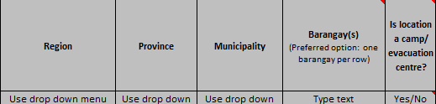
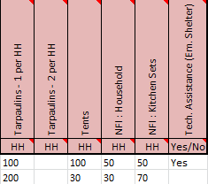
Session 2. How to build the model in Excel
First row headers
One data type per column
One piece of data per cell
A sheet with the definition of your data on
Example
Example
Example
Guidance notes

Slide 27
Session 2. Explain your data
Give explanation of each data
A house is partially damaged if it is still repairable.
Example
Partially damaged house
Let’s have a look at a simple example…

Slide 28
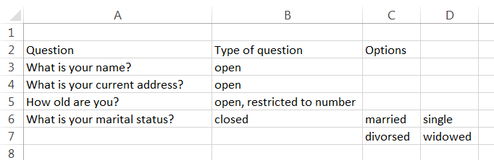

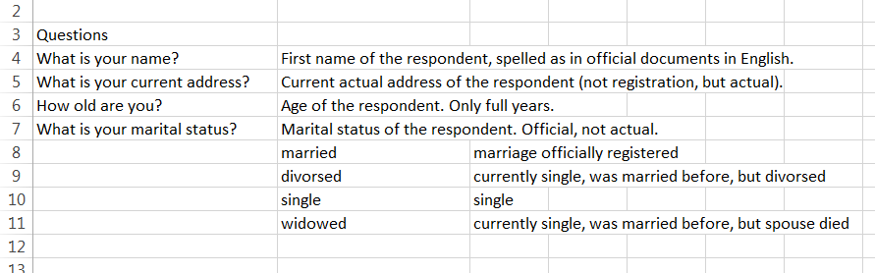
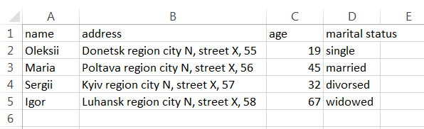
Session 2. Data model example
QUESTIONNAIRE
RAW DATA

Slide 29
Session 2. P Coding - 1
      There are 120 Ivanivka, 107 Oleksandrivka, 73 Andriivka in Ukraine
Each oblast, raion, municipality and village has its own pre-defined unique number: the P-code (KOATUU)
This is useful, because many municipalities have the same names for villages/cities.
Sometimes if you have your location question “open”, it is impossible to find the right “Ivanivka”…
4424084003
Pcode for Ivanivka, Mistkivska silrada, Svativskyi district, Luhanska oblast
Example
4421483003
Pcode for Ivanivka, Davydo-mykilska silrada, Krasnodonskyi district, Luhanska oblast
Notes:
Philippines specific example. Good principle which can be adapted to the appropriate country if available

Slide 30
Session 2. P Coding - 2
Administrative level | Name | Example | P-code
Admin 1 | Region | Luhanska oblast | 4400000000
Admin 2 | District / city of regional subordination | Krasnodonskyi district | 4421400000
Admin 3 | Municipalities | Davydo-mykilska silrada | 4421483000
Admin 4 | Villages | Ivanivka | 4421483003

Slide 31
Session 2. Common Operational Datasets
The Common Operational Datasets (CODs) are critical datasets that are used to support the work of humanitarian actors across multiple sectors. They are considered a de facto standard for the humanitarian community and should represent the best-available datasets for each theme.
They may include:
  Administrative boundaries;
  Populated places (settlements);
  Transportation network (roads, airports, checkpoints);
  Hydrology (rivers etc)
  Population statistics (IDPs, resident population etc);

Slide 32

Session 2. Where to get CODs?
List of locations with P-codes and pre-conflict population (shared with email now);
State Statistics Service of Ukraine / Ministries;
https://www.humanitarianresponse.info/en/operations/ukraine

Slide 33
Session 2. Structure and priorities
There are always several key questions and many additional.
Use cascading to prioritize and set a structure:
Do you have your house damaged?
What is the level of damage?
Light
No
Yes
Medium
Heavy
Destroyed

Slide 34

Session 2. EXERCISE 2
In groups prepare draft 5-7 questions on a specific thematic (10 min):
    Village assessment;
    Monitoring and evaluation;
    Beneficiary registration;
    Damage assessment.
Take into account the following:
    Level of data collection;
    Types of questions;
    Are they SMART?
    Structure.

Slide 35
Session 3. COLLECTION
Notes:
Intensive and highly important for super user = team manager
Type of data collection 5 min
Online vs. offline: Kobo is both
Printing offline version, browsers, Android and iOS (mobile)
Walking through Kobo interface (20 min):
Log in + registration
General dash board (print screenshots with comments)
Draft forms and projects (print screenshots with comments)
Project management (print screenshots with comments)
Question library(print screenshots with comments)
Settings (print screenshots with comments)
Plan data collection! Geographical way, Sampling, Timeframe, Logistical arrangements 5 min
Never underestimate time consuming interview: phone or face-to-face (double the time from the pilot for planning est.)
Briefing and training of the team: team should not be stuck with the first problem encountered
Priorities must be communicated to the team!

Slide 36
Information Management is a cycle of six stages
Design
Combining
Notes:
Different approaches at every stage.
Question: can you tell different ways to collect data? (interview, internet, paper etc).

Slide 37
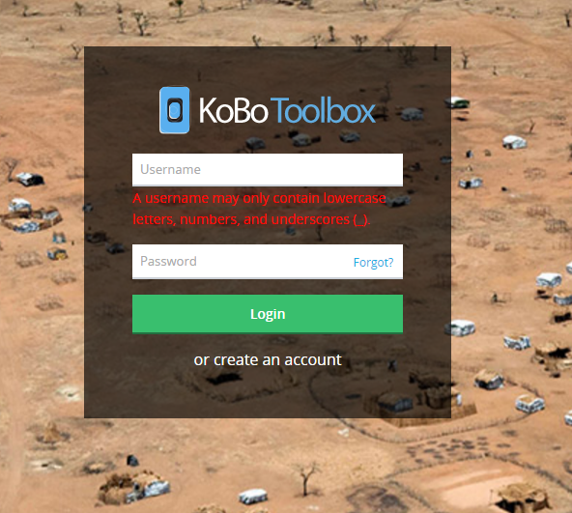
Session 3. Kobo main page
Page address is: https://kobo.humanitarianresponse.info
https://kobo.unhcr.org/accounts/login/?next=/#/ (if UNHCR cluster)
Account for humanitarian agencies is free of charge;
As many surveys as possible;
5 min to register.

Slide 38
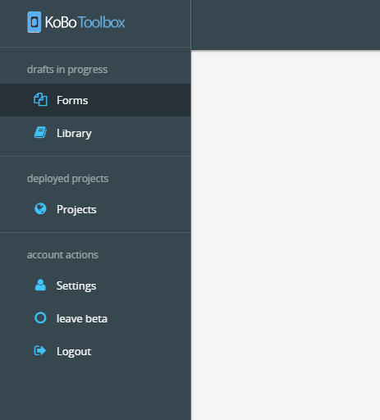
Session 3. KOBO MAIN MENU
Forms – all draft forms that user is working on.
Library – library of questions, if created.
Projects – all forms that are deployed and work online
Settings
Log out

Slide 39
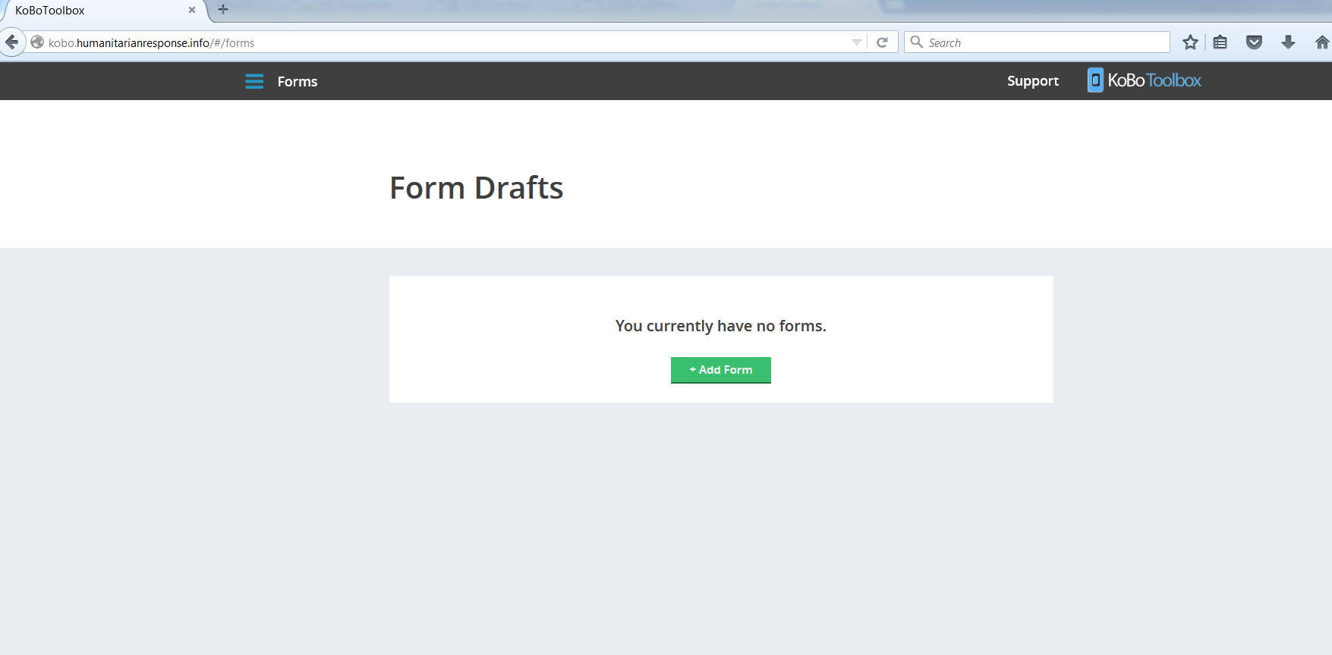
Session 3. Draft Forms
MENU → FORMS
Main menu is accessible by clicking here
To create new draft form.

Slide 40
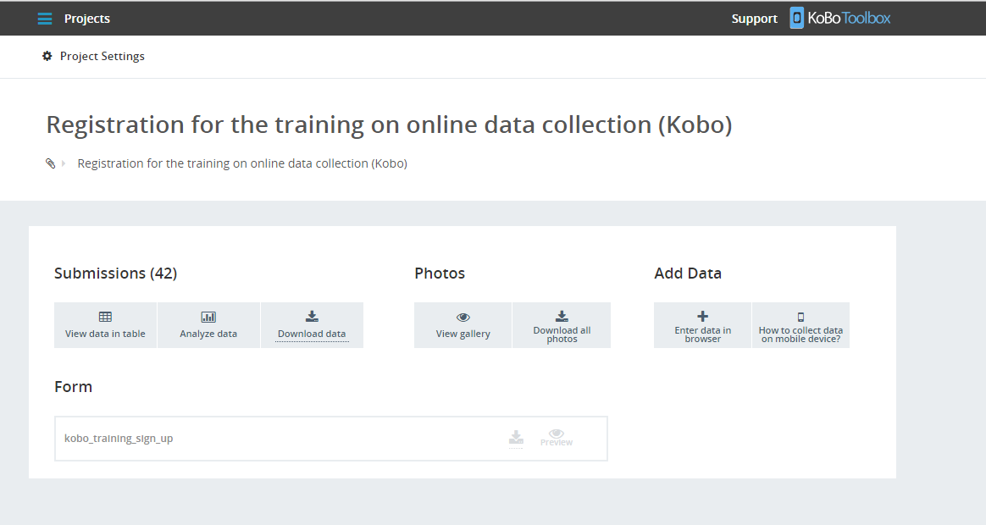
MENU → PROJECTS
Project settings
Main menu
Instructions on how to use form in browser and mobile device
Link to the online form available in browser
Preview the online form
Preview submitted data in the browser. Allows to edit submissions online
Export data submitted to date in XLS, CSV, ZIP, KML or Excel Analyzer
Download skeleton of the form (in XLS, XML, SPSS Labels)
Gallery of pictures

Slide 41
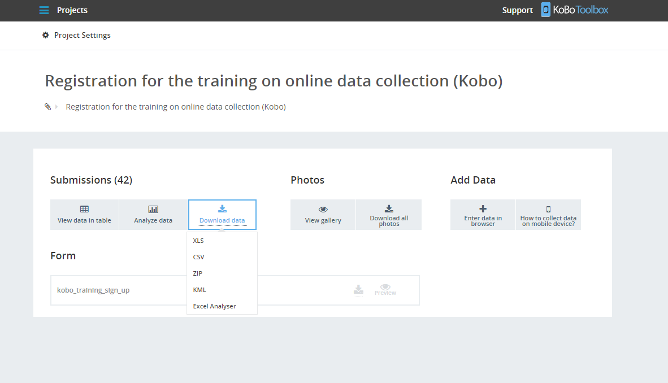
MENU → PROJECTS

Slide 42
MENU → PROJECTS
Project settings
Main menu
Instructions on how to use form in browser and mobile device
Link to the online form available in browser
Preview the online form
Preview submitted data in the browser. Allows to edit submissions online
Export data submitted to date in XLS, CSV, ZIP, KML or Excel Analyzer
Download skeleton of the form (in XLS, XML, SPSS Labels)
Gallery of pictures

Slide 43
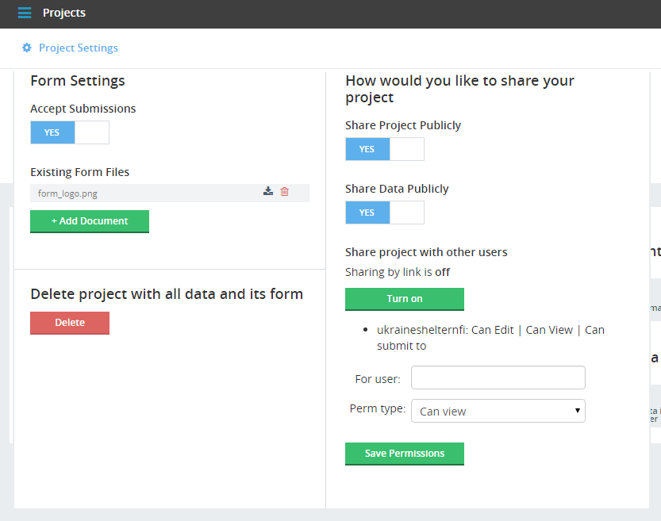
MENU → PROJECTS → PROJECT SETTINGS
Link to the form can enable users without login and password access and view project.
Form can be deployed, but disabled for submissions
Link to the form can enable users without login and password access and view all the data.
Additional documents may be uploaded, in case form uses media embedded in questions and/or notes media (pictures, sounds)
Projects within Kobo can be shared with other Kobo users. Three level of rights: to edit, to view and to submit data.
DO NOT DELETE WITHOUT THINKING TWICE!!!

Slide 44
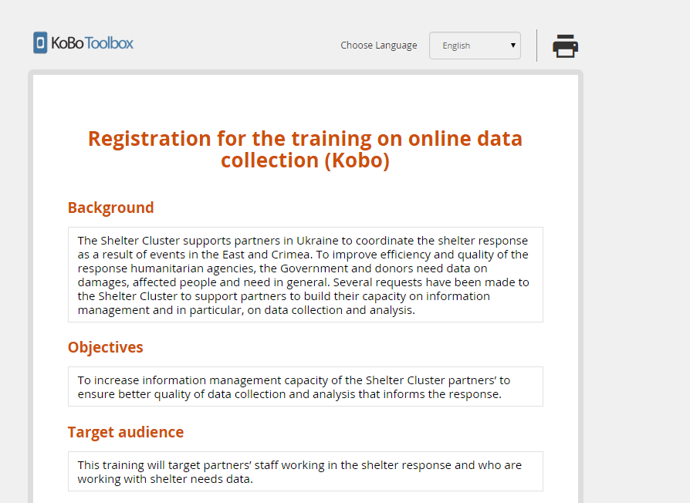
ONLINE FORM
Print entire form for offline use
Language selection (for Multilanguage forms only)

Slide 45

Session 3. Creating and editing forms
Manual
Visual editor
Coding in Excel, transforming in XML;
Needs advanced skills and knowledge;
Allows to use more functionality (ex.: cascading is not yet available in visual editor);
Allows design form better.
Easy for beginners;
Reduced functionality;
Quick to start;
Allows immediate preview.

Slide 46
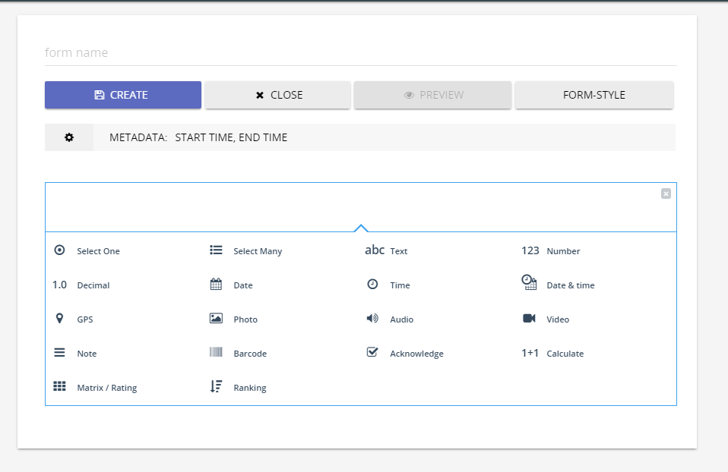
Session 3. Adding questions to the form
One choice question
Multiple choice questions
Open questions
Only numbers are accepted as an answer
Additional explanation and text. May be introduction message.

Slide 47
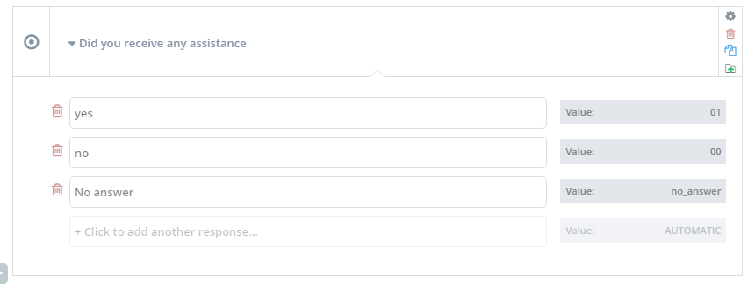
Session 3. Labels and values - 1
Label: what is seen in user mode: question text and options as answers etc.
Value: the way data recorded in the online database. The same format would be seen when export data for analysis.
!!! Proper values at the design stage are critical to simplify analysis process later. !!!
Answers’ values: what YOU will see when exporting submissions
Question text
Answers’ labels: what user will see when using form

Slide 48
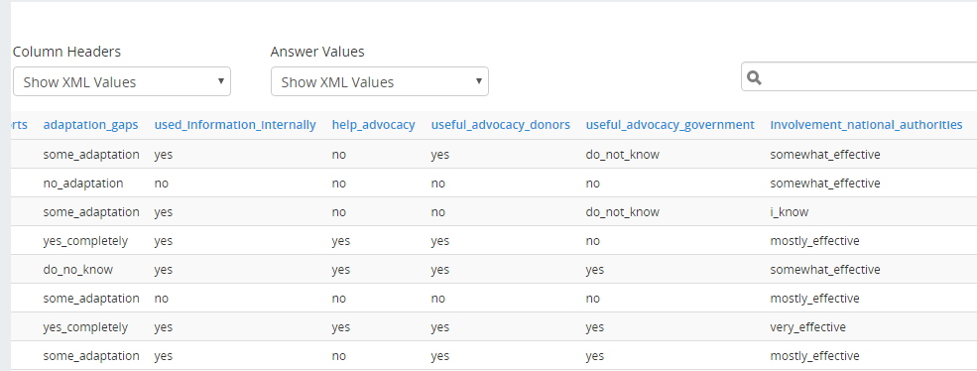
Session 3. Labels and values - 2
Labels and values are critical for analysis:
  All data is exported in the format of values, not labels.
Column header: is made out of value, not label (available only in manual coding)
All answers are values, not labels. Easiness of their understanding is upon form designer!

Slide 49

Session 3. Additional features of Kobo
Hints;
Restrictions and restrictions messages;
Validation of data;
Adding picture;
Adding geodata;
Introduction to designing form manually;
Multilanguage support
Using mobile devices for data collection…

Slide 50


Session 3. Before going for data collection
Have a plan! Who goes where and when, how often, logistics planned etc.
Have idea what you will do with data after it is collected!
Brief and train your team! Communicate priorities!

Slide 51
Session 4. Combining and processing data

Slide 52
Information Management is a cycle of six stages
Design
Combining
Notes:
Different approaches at every stage.
Question: can you tell different ways to collect data? (interview, internet, paper etc).

Slide 53

Session 4. Combining data
Always all the data is pulled together into one document for further processing and analysis.
Depending on the way data was collected combining data may happen in different ways and steps…

Slide 54

Session 4. Paper based form
Digitalizing data – entering data from paper form into Excel or any online form;
Merging all data from different localities into master one;
Cleaning data, validating data and beginning of analysis.

Slide 55
Session 4. Excel based form
Digitalizing data – entering data from paper form into Excel or any online form;
Merging all data from different localities into master one;
Cleaning data, validating data and beginning of analysis.

Slide 56
Session 4. Kobo form
Digitalizing data – entering data from paper form into Excel or any online form;
Merging all data from different localities into master one;
Cleaning data, validating data and beginning of analysis.

Slide 57
Session 4. Well-designed Kobo form
Digitalizing data – entering data from paper form into Excel or any online form;
Merging all data from different localities into master one;
Cleaning data, validating data and beginning of analysis.

Slide 58
Session 4. Extracting data from Kobo
Simply click “Download data” at the project management form and select format: XLS, CSV, ZIP, KML…
MENU → PROJECTS

Slide 59

Session 4. Data cleaning
Data cleaning is the process of detecting and correcting corrupt or inaccurate records from a database.

Slide 60
Session 4. Data cleaning
Be creative!
  Lookup functions
    Easy to find non-existing codes (typos)
  Formulas
    Check for mathematical and logic consistency
  Compare with other sources (Triangulation)
    Validation of values/expected ranges (do we have approximately the same)
  Compare with previous years
    Validation of values/expected ranges (do we have approximately the same)

Slide 61
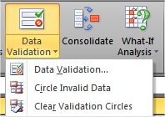

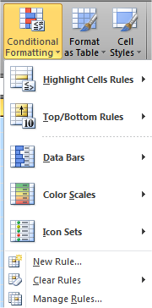
Session 4. Useful Excel Tools
Data -> Validation (allows only certain values)
Data -> Sort & Filter
Home-> Conditional Formatting
Pivot Tables
Formulas

Slide 62
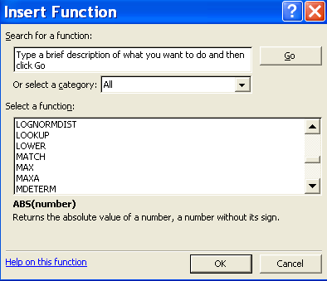
Session 4. Some useful Excel functions
Logic
  And
  Or
  If (then)
  Not
Mathematical/Statistical
  Average
  Count
  CountA
  CountBlank
  CountIf
  Dsum
  SumIf
  Rank
Information
  Trim
  Clean
  Vlookup
  Concatenate
  Left
  Right
  Mid
  Len
  Find
  Proper
  Lower
  Upper
  IsBlank
  IsText
  Yearfrac
  Today
Use the help in Excel which gives guidance on the use of each formula

Slide 63
Session 4. Let’s try
Demonstration exercise!

Slide 64
Session 4. EXERCISE
5 Min.
SCRAMBLE EXERCISE
You have received now dataset extracted from Kobo sign up for training form.
In groups, work on cleaning the data and present final results.

Slide 65
Session 5: ANALYSIS/DISSEMINATION
Notes:
A must for a super user: Contributing to the analysis of the data collection
Filters – subtotal – 5 min
Pivot tables – 20 min – step by step
What it is and hot to start
Fields to manipulate
Return of the value
Graphs
10 min Mapping on kobo and google earth
5 min Graphs – showing good and bad! Grandma principle!

Slide 66
Information Management is a cycle of six stages
Design
Combining
Notes:
Different approaches at every stage.
Question: can you tell different ways to collect data? (interview, internet, paper etc).

Slide 67



Session 5: ANALYSIS/DISSEMINATION
If for Information Manager Officer these 2 separated activities are very detailed & involve 3 different functions.
For super-users it will be merged in 1 condensed task summarizing the 3 different functions .
Notes:
A must for a super user: Contributing to the analysis of the data collection
Filters – subtotal – 5 min
Pivot tables – 20 min – step by step
What it is and hot to start
Fields to manipulate
Return of the value
Graphs
10 min Mapping on kobo and google earth
5 min Graphs – showing good and bad! Grandma principle!

Slide 68


Session 5: ANALYSIS/DISSEMINATION
a postulate –what element(s), rule(s) is fixed-
an hypothesis – what you assume-
a methods –how to work data to make indicators and proxy indicators-
a results –a percentage, a breakdown, a figures etc.-
Visualization of the data is the medium between analysis & dissemination and it could revert forms as: graph(s), indicator(s), map(s)
Notes:
Example for:
Postulate: With relative ceasefire, new movements population are considered as negligible. No obvious reasons for secondary movement despite a) return home; b) integration locally c) to be resettled somewhere else in Ukraine
Hypothesis: Observation on 6 months showing a natural decrease of resident of Collective Center is related to returns and secondary to integration.
Methods: comparing # of departure during the 6 last months with the place where they left and their intention and with the total population of Collective Centre sampled in the region.
Results: % variation for CC occupancy ratio; # individuals who did left for return, # individuals who did left for integration
Visualization is even one cumulated bar showing remaining, left and integration. Or even one % for occupancy ration and a pie chart for left & integration.

Slide 69
Session 5: ANALYSIS
Analysis aim to proceed clean raw data into indicators to prove or revoke an hypothesis.
Analysis involve a level of expertise for the interpretation of the data.
Decide the final confidence level (usually the same as sampling)
Keep in mind what you are looking for or want to demonstrate.
Even better plan a list of what you expect and don’t worry we will always find interesting other pieces of information along road.
Decide to use , or not, proxy indicator.
Notes:
Ask to the audience what is a Proxy indicator

Slide 70

Session 5: Proxy Indicator
Indicator Expected
Example: Direct analysis
# of Individual per Household
Example: Indirect analysis
Adequate Shelter
Raw Data A
Raw
A1
Indicator Expected
Raw B
PROXY
Raw
A3
Raw Data B
Raw
A2
What is a proxy indicator? (intermediate calculation)
Be careful to not use too early and too many proxy indicators, it will jeopardize the confidence level.
Notes:
Metaphor:
Direct analysis is like: apple + knife = apple slice
Indirect is like: apple & pineapple & peer + knife = fruit slice. Lemon + juicer = lemon juice. Everything together = mix fruit salad

Slide 71
Session 5 Tool for the ANALYSIS
Processing an indicator could be an average (cost for rent in a city), a range (minimum/ maximum), a sum (number of IDP’s per oblast).
To get them, we mainly use excel with filters and subtotal formula (useful for monitoring master lists on regular manner) or create a pivot table.
Notes:
A must for a super user: Contributing to the analysis of the data collection
Filters – subtotal – 5 min
Pivot tables – 20 min – step by step
What it is and hot to start
Fields to manipulate
Return of the value
Graphs
10 min Mapping on kobo and google earth
5 min Graphs – showing good and bad! Grandma principle!

Slide 72
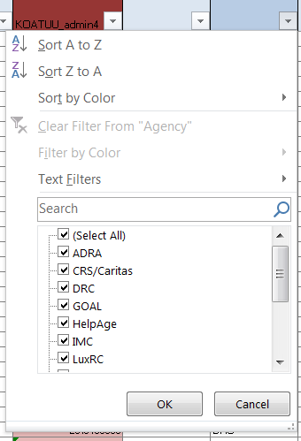
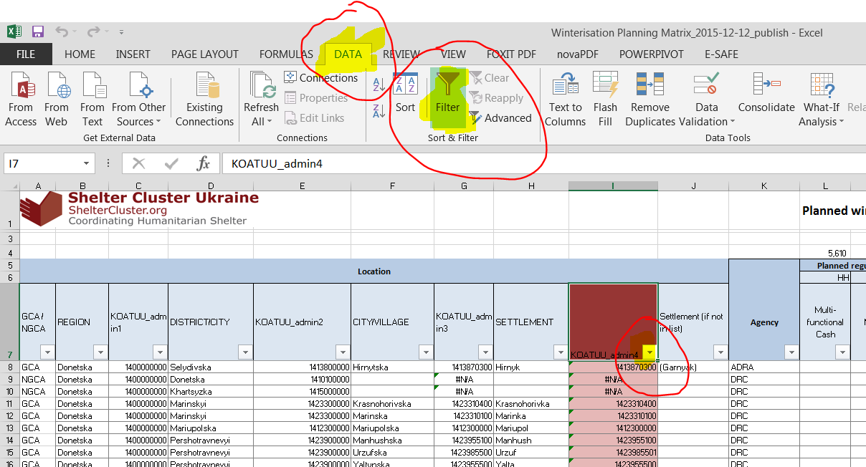

Session 5 Working on master list 1
REMINDER Be sure that data is organized on sequential and consecutive manner, one data per cell, avoiding cell merging
Set some automatic filters
Notes:
A must for a super user: Contributing to the analysis of the data collection
Filters – subtotal – 5 min
Pivot tables – 20 min – step by step
What it is and hot to start
Fields to manipulate
Return of the value
Graphs
10 min Mapping on kobo and google earth
5 min Graphs – showing good and bad! Grandma principle!

Slide 73
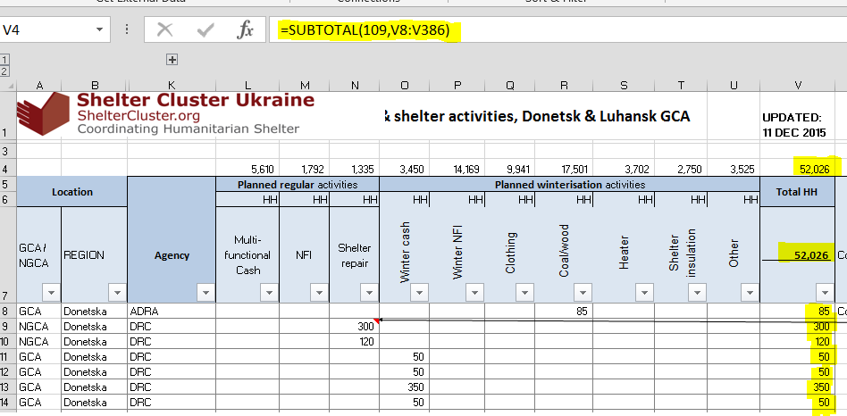
Session 5 Working on master list 2
Insert on title the formula =subtotal(109,$A$1:$A$100) for summing visible cell
Use formula =subtotal(9,$A$1:$A$100) for summing complete column range
Please note that $ argument is used to fix a variable in excel facilitating the copy paste of a determined fixed range.
Notes:
A must for a super user: Contributing to the analysis of the data collection
Filters – subtotal – 5 min
Pivot tables – 20 min – step by step
What it is and hot to start
Fields to manipulate
Return of the value
Graphs
10 min Mapping on kobo and google earth
5 min Graphs – showing good and bad! Grandma principle!

Slide 74
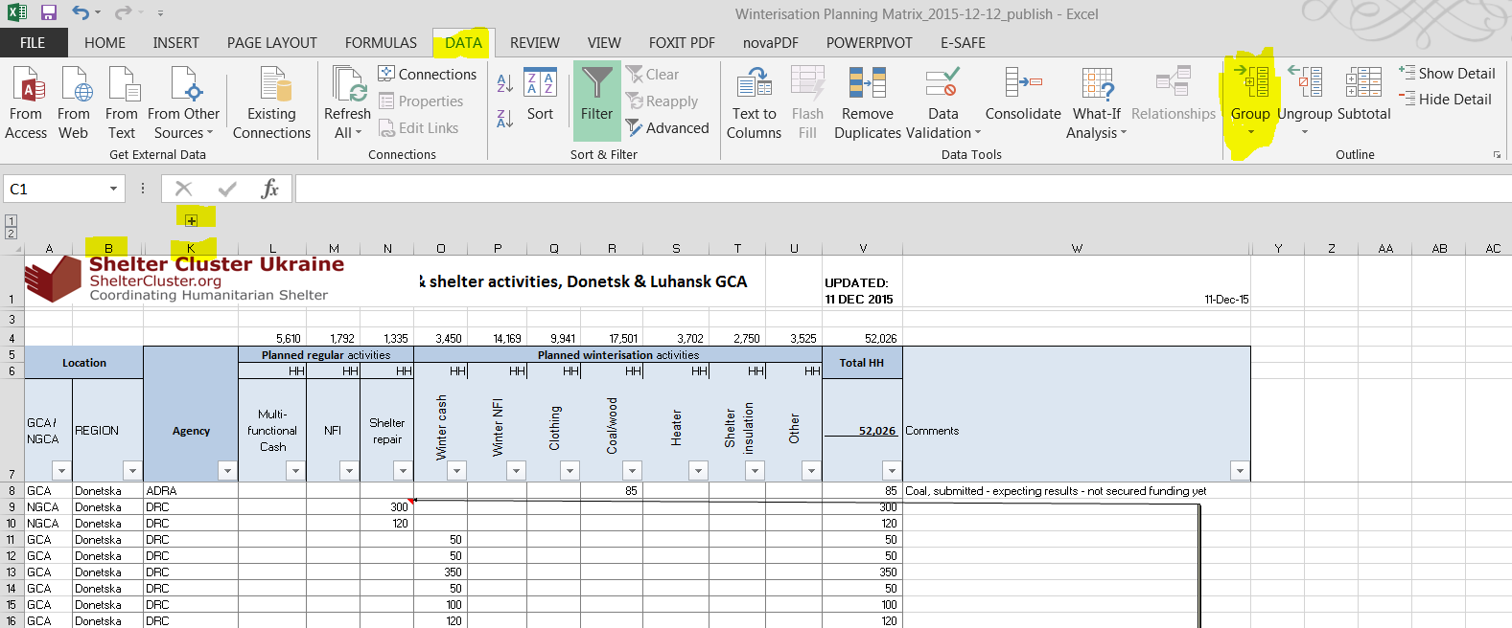
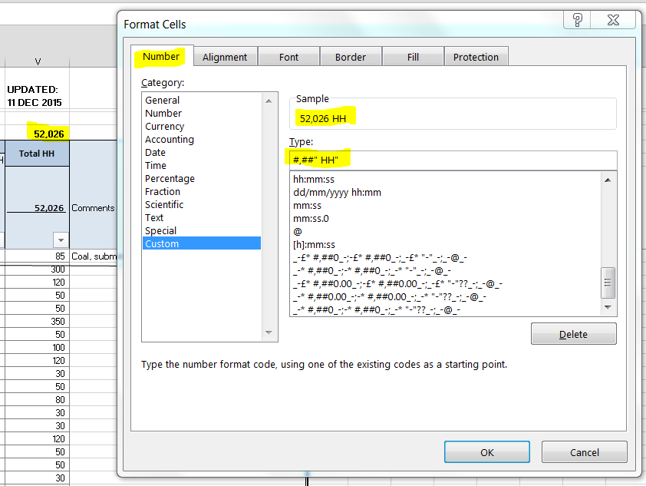

Session 5 Working on master list 3
For better presentation use group function …
… & cell formatting
#,## meaning a figures formatted with separator like 1,000
“ ” is to included a text label (visible but not counted as cell with text)
Notes:
A must for a super user: Contributing to the analysis of the data collection
Filters – subtotal – 5 min
Pivot tables – 20 min – step by step
What it is and hot to start
Fields to manipulate
Return of the value
Graphs
10 min Mapping on kobo and google earth
5 min Graphs – showing good and bad! Grandma principle!

Slide 75
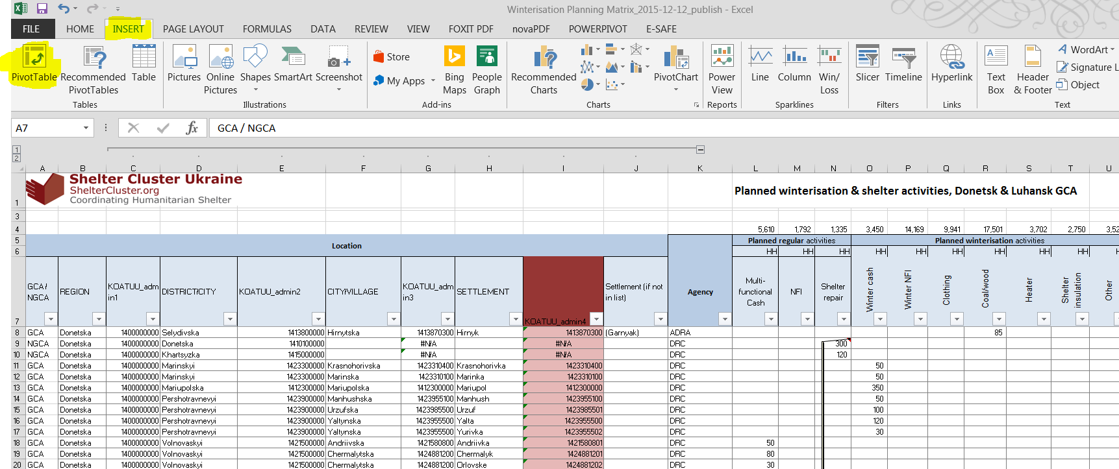
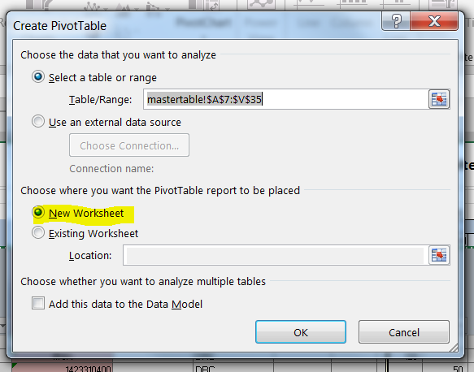
Session 5 Working with Pivot Table 1
REMINDER Be sure that data is organized on sequential and consecutive manner, one data per cell, avoiding cell merging, each column of the future pivot table shall get an unique title.
Pivot table is a two steps creation
2) Click on pivot table
1) SELECT ONLY the part with column header
Notes:
A must for a super user: Contributing to the analysis of the data collection
Filters – subtotal – 5 min
Pivot tables – 20 min – step by step
What it is and hot to start
Fields to manipulate
Return of the value
Graphs
10 min Mapping on kobo and google earth
5 min Graphs – showing good and bad! Grandma principle!

Slide 76
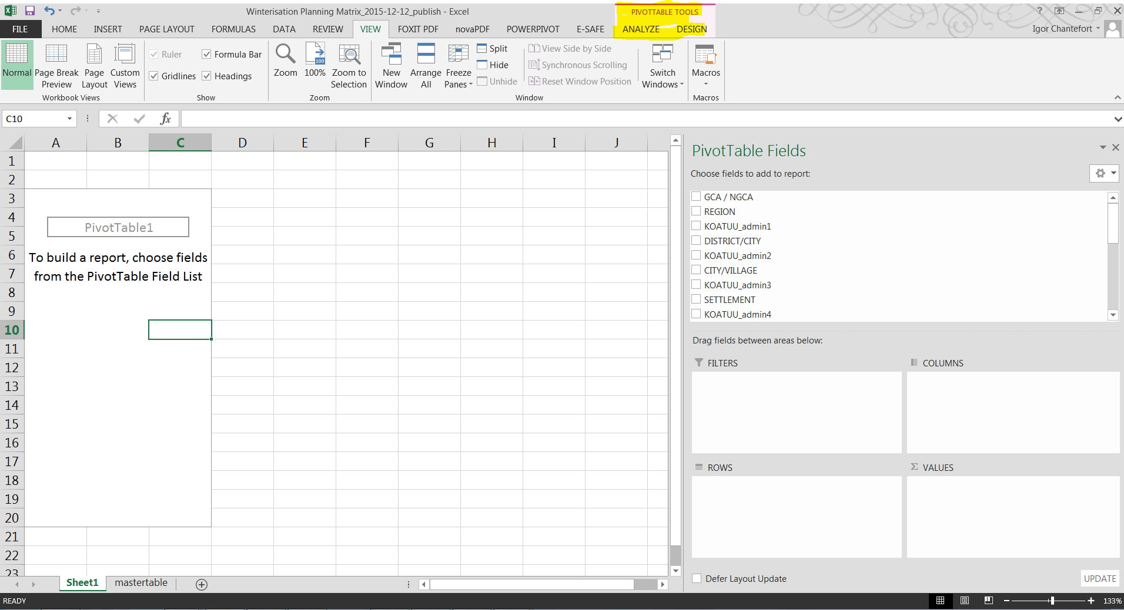
Session 5 Working with Pivot Table 2
Pivot table is a way to organized data
Name of selected column to be ‘drag & drop’
Place for main filters ex: working only on certain oblast
Row &/or Column to organized categories
Clicking inside pivot table range will activate it
Value of what will be represented example counting in #of HH or summing # of beneficiaries
Notes:
A must for a super user: Contributing to the analysis of the data collection
Filters – subtotal – 5 min
Pivot tables – 20 min – step by step
What it is and hot to start
Fields to manipulate
Return of the value
Graphs
10 min Mapping on kobo and google earth
5 min Graphs – showing good and bad! Grandma principle!

Slide 77
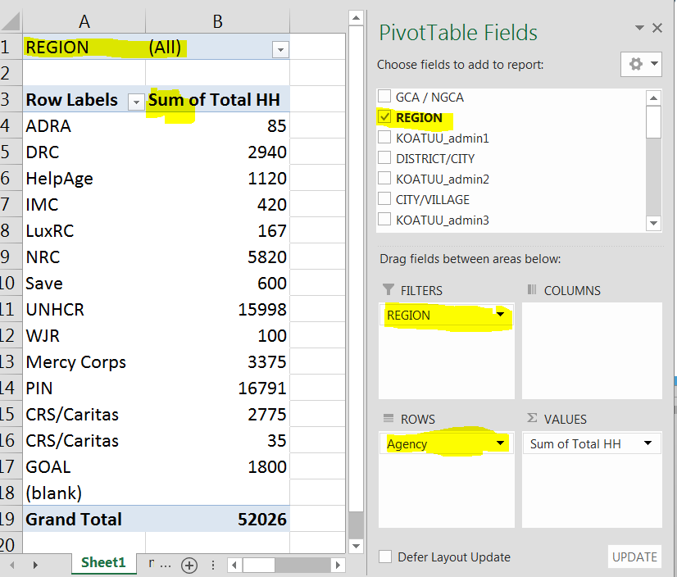
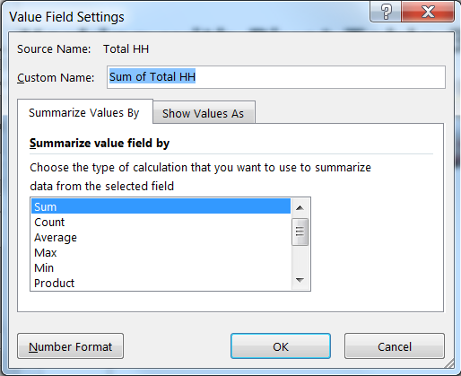
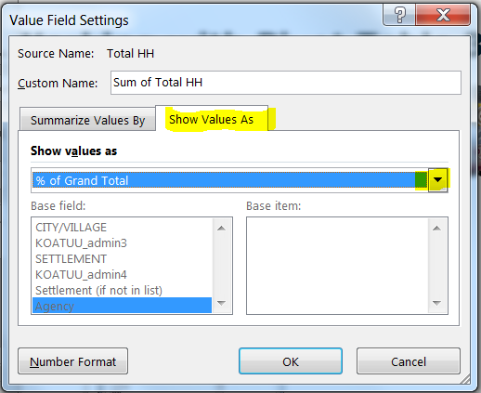
Session 5 Working with Pivot Table 3
Note:
Small arrows allow specific selection
Sum precise the function of the value
By clicking on the Value, we can change the function, sum, average or the format (figures, %, % per column)
Notes:
A must for a super user: Contributing to the analysis of the data collection
Filters – subtotal – 5 min
Pivot tables – 20 min – step by step
What it is and hot to start
Fields to manipulate
Return of the value
Graphs
10 min Mapping on kobo and google earth
5 min Graphs – showing good and bad! Grandma principle!

Slide 78
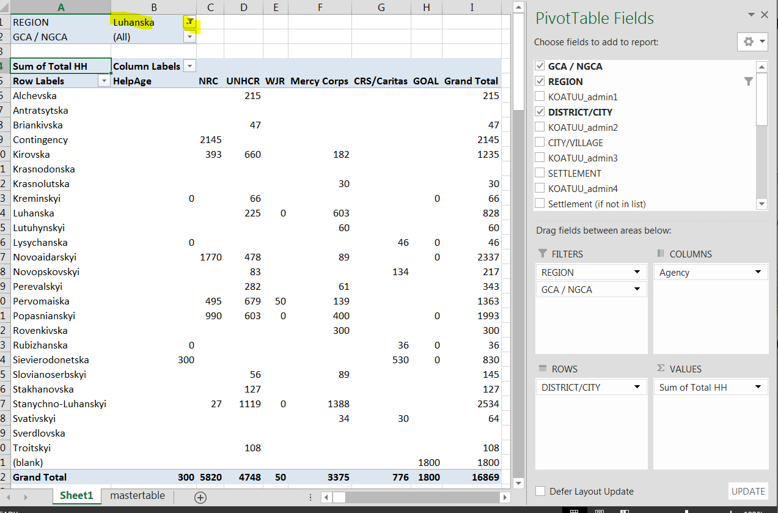
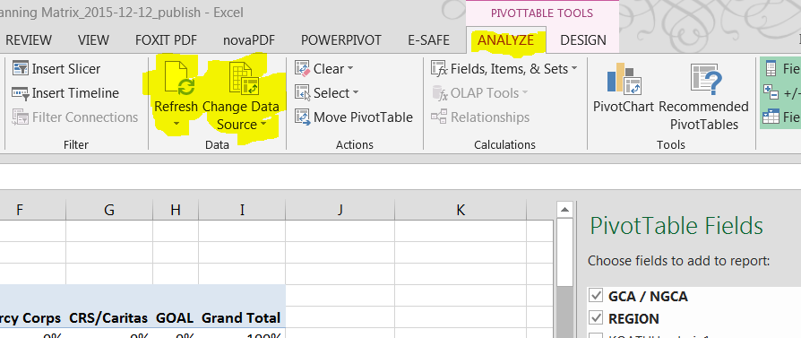
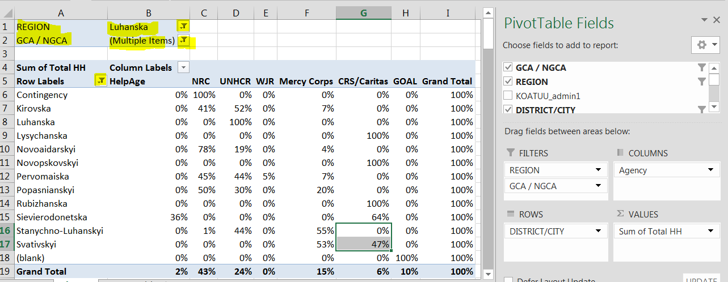
Session 5 Working with Pivot Table 4
You can change until you reach the output expected
Tip If you need to refresh your data set (source)
Notes:
A must for a super user: Contributing to the analysis of the data collection
Filters – subtotal – 5 min
Pivot tables – 20 min – step by step
What it is and hot to start
Fields to manipulate
Return of the value
Graphs
10 min Mapping on kobo and google earth
5 min Graphs – showing good and bad! Grandma principle!

Slide 79
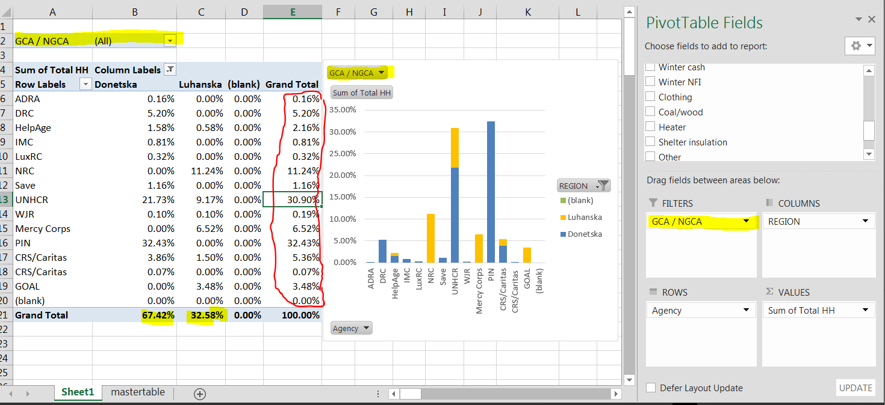
Session 5 Working with Pivot Table 5
You can link a graph to visualize your main findings
Notes:
% of the grand total
Main % Donetsk / Luhansk as bottom of column
In row the agency achievements (red line)
You can play with filters things will be updated automatically

Slide 80

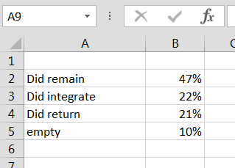
Session 5 Tool for Dissemination
How to visualize and represent your indicators might significantly emphasize one aspect or the others
47%
Occupancy Ratio
Notes:
A must for a super user: Contributing to the analysis of the data collection
Filters – subtotal – 5 min
Pivot tables – 20 min – step by step
What it is and hot to start
Fields to manipulate
Return of the value
Graphs
10 min Mapping on kobo and google earth
5 min Graphs – showing good and bad! Grandma principle!

Slide 82
session 6- PROGRAMMING
My 5 first question on Kobo
In 30 minutes set up the 5 first question from the exercise of the morning.
The exercise is on individual computer but you can still keep your group in order to help each other.
Take the first and most simple one
Your objective is to get a first run
Notes:
A must for a super user: Contributing to the analysis of the data collection
Visual editor – 10 min
30 min Session on programming – My five first questions into Kobo.
no cascading
geolocalization
30 min Second session. Modify and adding more questions
Adding 5 more questions – dates, pictures, first cascading – simple, first restrictions
WRAP UP and 5 min of walk through how to import dataset
COFFEE BREAK
3-30 pm – 4:30 pm Third session. Import common set of data.
Minimum 15 questions, with geolocation, cascading, dates, pictures with hints, restrictions and restriction messages
20 min presentation per group (5 min per group)
Describe difficulties
10 min break SHORT
30 min Work on the data analysis – Sign up for training form
extract (remind how to do it)
data clean
minimal analysis (agency, location, office, experience etc)
30 min – WRAP UP and KOBO advanced features
FEEDBACK FORM

Slide 83
session 7 - PROGRAMMING
Another 5 please….
On the 5 first questions, please select 5 others but covering field as date, photo, restrictions.
This step will last for 45 minutes…
Notes:
A must for a super user: Contributing to the analysis of the data collection
Visual editor – 10 min
30 min Session on programming – My five first questions into Kobo.
no cascading
geolocalization
30 min Second session. Modify and adding more questions
Adding 5 more questions – dates, pictures, first cascading – simple, first restrictions
WRAP UP and 5 min of walk through how to import dataset
COFFEE BREAK
3-30 pm – 4:30 pm Third session. Import common set of data.
Minimum 15 questions, with geolocation, cascading, dates, pictures with hints, restrictions and restriction messages
20 min presentation per group (5 min per group)
Describe difficulties
10 min break SHORT
30 min Work on the data analysis – Sign up for training form
extract (remind how to do it)
data clean
minimal analysis (agency, location, office, experience etc)
30 min – WRAP UP and KOBO advanced features
FEEDBACK FORM

Slide 84
session 8 - PROGRAMMING
Serious things started
Now after 2 short try, the objective is to encode a maximum of field using cascading and the maximum of features
This step will last for 60 minutes…
Notes:
A must for a super user: Contributing to the analysis of the data collection
Visual editor – 10 min
30 min Session on programming – My five first questions into Kobo.
no cascading
geolocalization
30 min Second session. Modify and adding more questions
Adding 5 more questions – dates, pictures, first cascading – simple, first restrictions
WRAP UP and 5 min of walk through how to import dataset
COFFEE BREAK
3-30 pm – 4:30 pm Third session. Import common set of data.
Minimum 15 questions, with geolocation, cascading, dates, pictures with hints, restrictions and restriction messages
20 min presentation per group (5 min per group)
Describe difficulties
10 min break SHORT
30 min Work on the data analysis – Sign up for training form
extract (remind how to do it)
data clean
minimal analysis (agency, location, office, experience etc)
30 min – WRAP UP and KOBO advanced features
FEEDBACK FORM

Slide 85
session 8 - PROGRAMMING
Importing a data set with geolocation
Notes:
A must for a super user: Contributing to the analysis of the data collection
Visual editor – 10 min
30 min Session on programming – My five first questions into Kobo.
no cascading
geolocalization
30 min Second session. Modify and adding more questions
Adding 5 more questions – dates, pictures, first cascading – simple, first restrictions
WRAP UP and 5 min of walk through how to import dataset
COFFEE BREAK
3-30 pm – 4:30 pm Third session. Import common set of data.
Minimum 15 questions, with geolocation, cascading, dates, pictures with hints, restrictions and restriction messages
20 min presentation per group (5 min per group)
Describe difficulties
10 min break SHORT
30 min Work on the data analysis – Sign up for training form
extract (remind how to do it)
data clean
minimal analysis (agency, location, office, experience etc)
30 min – WRAP UP and KOBO advanced features
FEEDBACK FORM

Slide 86
Presentation from participants
1 example will be shown per group
State which difficulty you met
Give your feed back and specific questions
Notes:
A must for a super user: Contributing to the analysis of the data collection
Visual editor – 10 min
30 min Session on programming – My five first questions into Kobo.
no cascading
geolocalization
30 min Second session. Modify and adding more questions
Adding 5 more questions – dates, pictures, first cascading – simple, first restrictions
WRAP UP and 5 min of walk through how to import dataset
COFFEE BREAK
3-30 pm – 4:30 pm Third session. Import common set of data.
Minimum 15 questions, with geolocation, cascading, dates, pictures with hints, restrictions and restriction messages
20 min presentation per group (5 min per group)
Describe difficulties
10 min break SHORT
30 min Work on the data analysis – Sign up for training form
extract (remind how to do it)
data clean
minimal analysis (agency, location, office, experience etc)
30 min – WRAP UP and KOBO advanced features
FEEDBACK FORM

Slide 87
session 9 – Data analysis
Objective: run and practice a short analyze using filter, master list etc.
Upload the winterization excel file
Analyze the file, create a pivot table
According the message that you want to convene, prepare a table and related graph.
Notes:
A must for a super user: Contributing to the analysis of the data collection
Visual editor – 10 min
30 min Session on programming – My five first questions into Kobo.
no cascading
geolocalization
30 min Second session. Modify and adding more questions
Adding 5 more questions – dates, pictures, first cascading – simple, first restrictions
WRAP UP and 5 min of walk through how to import dataset
COFFEE BREAK
3-30 pm – 4:30 pm Third session. Import common set of data.
Minimum 15 questions, with geolocation, cascading, dates, pictures with hints, restrictions and restriction messages
20 min presentation per group (5 min per group)
Describe difficulties
10 min break SHORT
30 min Work on the data analysis – Sign up for training form
extract (remind how to do it)
data clean
minimal analysis (agency, location, office, experience etc)
30 min – WRAP UP and KOBO advanced features
FEEDBACK FORM

Slide 88
session 10 – Wrap up
Identify what did you learn today (referring to the self evaluation form and use another color for ticking boxes)
Fill up the feed back form
Have a good rest
Notes:
A must for a super user: Contributing to the analysis of the data collection
Visual editor – 10 min
30 min Session on programming – My five first questions into Kobo.
no cascading
geolocalization
30 min Second session. Modify and adding more questions
Adding 5 more questions – dates, pictures, first cascading – simple, first restrictions
WRAP UP and 5 min of walk through how to import dataset
COFFEE BREAK
3-30 pm – 4:30 pm Third session. Import common set of data.
Minimum 15 questions, with geolocation, cascading, dates, pictures with hints, restrictions and restriction messages
20 min presentation per group (5 min per group)
Describe difficulties
10 min break SHORT
30 min Work on the data analysis – Sign up for training form
extract (remind how to do it)
data clean
minimal analysis (agency, location, office, experience etc)
30 min – WRAP UP and KOBO advanced features
FEEDBACK FORM

