Slide 1
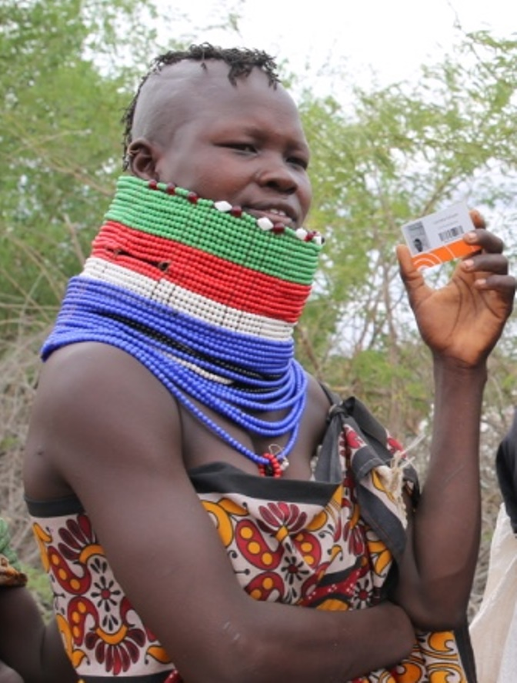
LMMS

Slide 2
What is LMMS
Last Mile Mobile Solution(LMMS) is a stand-alone system that uses web-based mobile applications to better manage responses to disasters.
LMMS digitizes registration of beneficiaries and automates distribution of services such as Food, NFI and Cash, resulting in more effective, efficient and fully accountable practices.

Slide 3
motivation
Make everyone count – not to leave anyone behind
Use tech to achieve SDGs
Not only to create reports but make informed decisions – health, education, agriculture..
“Any report made out of inaccurate data is simply guess work”. William Ruto - Deputy President, Kenya.
Use tech to empower the vulnerable persons in the community

Slide 4




LMMS global footprint
East Africa | West Africa | South Africa | Asia /ME/LA | Agencies
Kenya Uganda Tanzania Ethiopia South Sudan Sudan Somalia Burundi Rwanda | Mali Niger Chad Sierra Leone Mauritania CAR Senegal | Malawi Lesotho Zimbabwe DR Congo Swaziland Mozambique | Myanmar Philippines Pakistan Haiti Iraq Lebanon | Oxfam ICRC Medair NRC Save Mercy Corps Samaritan’s Purse’ ACF COOPI DRC German Red Cross Tearfund IFRC Food for the Hungry WVI

Slide 5



Partnering and Collaboration

Slide 6
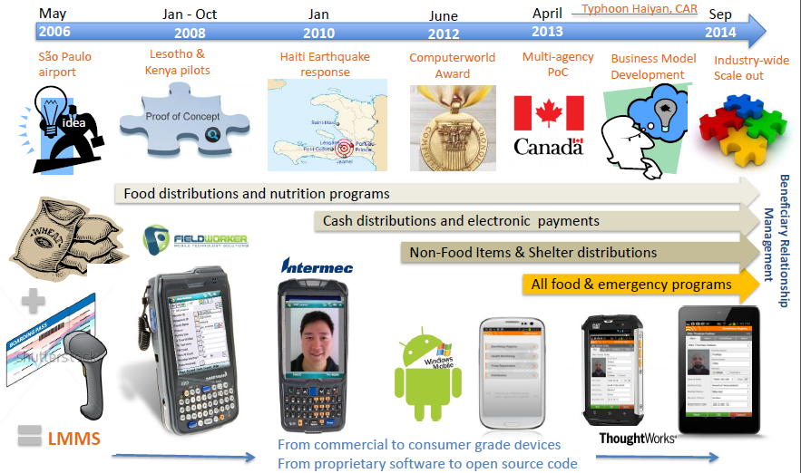
Timeline and Key Milestones

Slide 7

Challenge to the sector
1. LMMS for multiple agencies
2. Joint training and field operations
OXFAM
WFP
IOM
UNHCR
IFRC
ACF
Save
3. LMMS for Rapid
Emergency
Deployment
Beneficiary
WVI - Food
Islamic Relief
IFRC
5. Single registration – Multiple interventions
WVI NFI
WVI Shelter
4. Data sharing and use of existing platform

Slide 8
LMMS Operations
Product Development
Internal Technical support
External service delivery
Software development
Field support
Training
Online forums

Slide 9
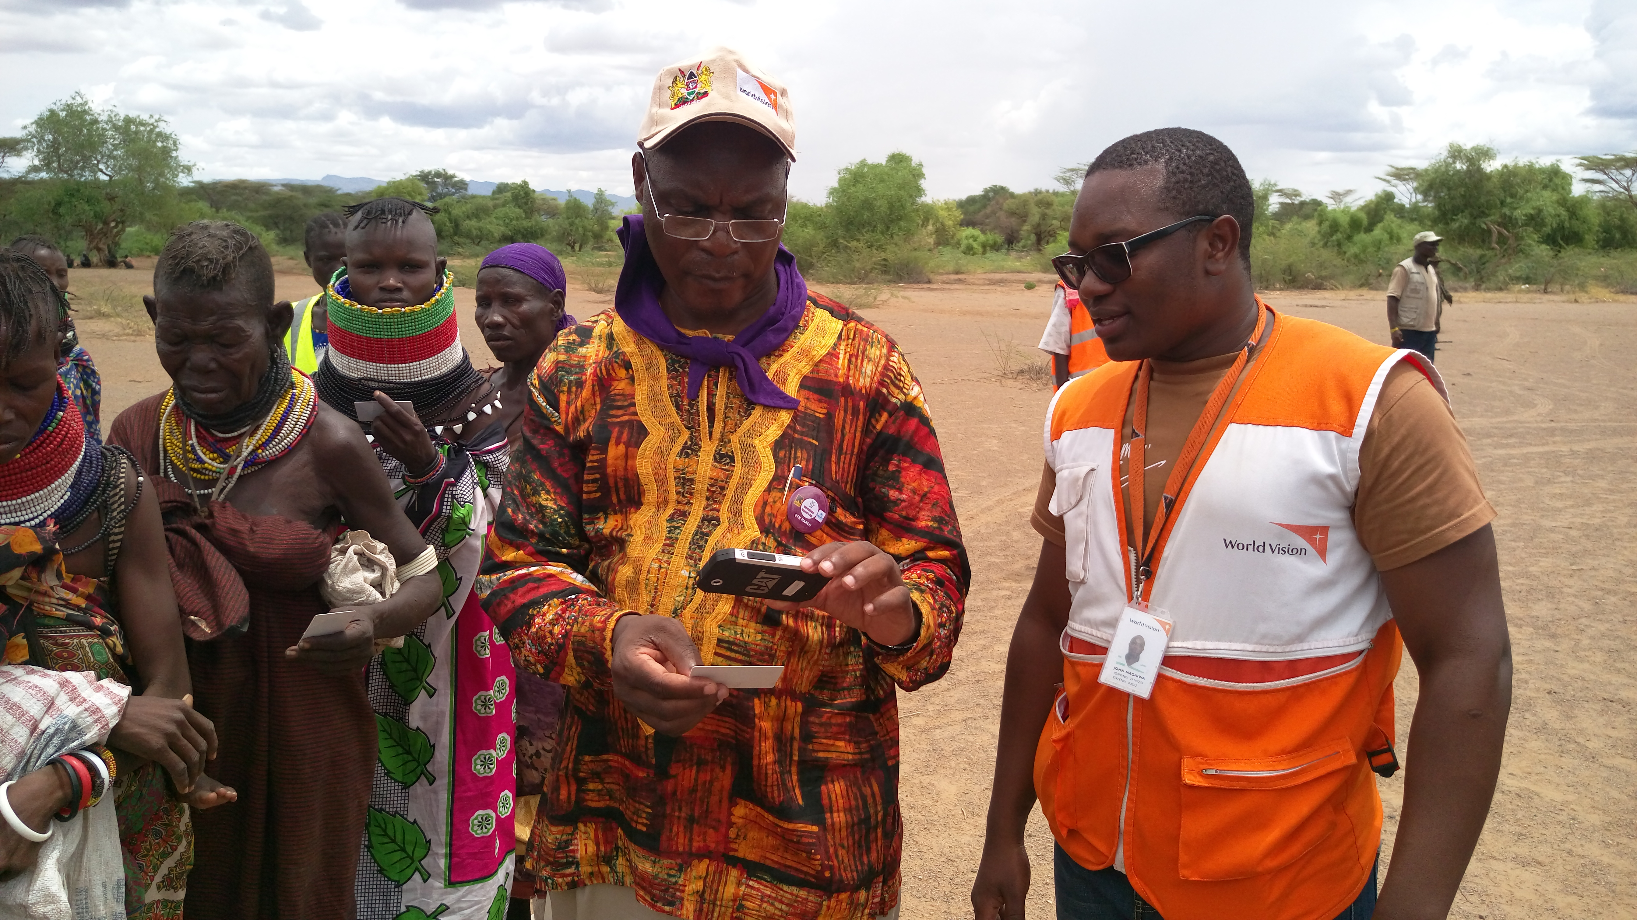

Slide 10
References
http://www.lastmilemobilesolutions.com/
http://www.cashlearning.org/resources/video-library/an-introduction-to-last-mile-mobile-solutions-lmms-
www.alnap.org/pool/files/innovationcasestudyno3-lmms.pdf
http://www.wvi.org/international/publication/world-vision-international-annual-review-2014
http://www.wvi.org/
http://www.worldvision.ca/give-a-gift/Donating%20Resources/Documents/LMMS-Case-Study-FINAL-COPY.pdf

