Slide 1
AFGHANISTAN Best practices: reporting made simple
02 October 2017
Global Shelter Cluster retreat, Geneva

Slide 2
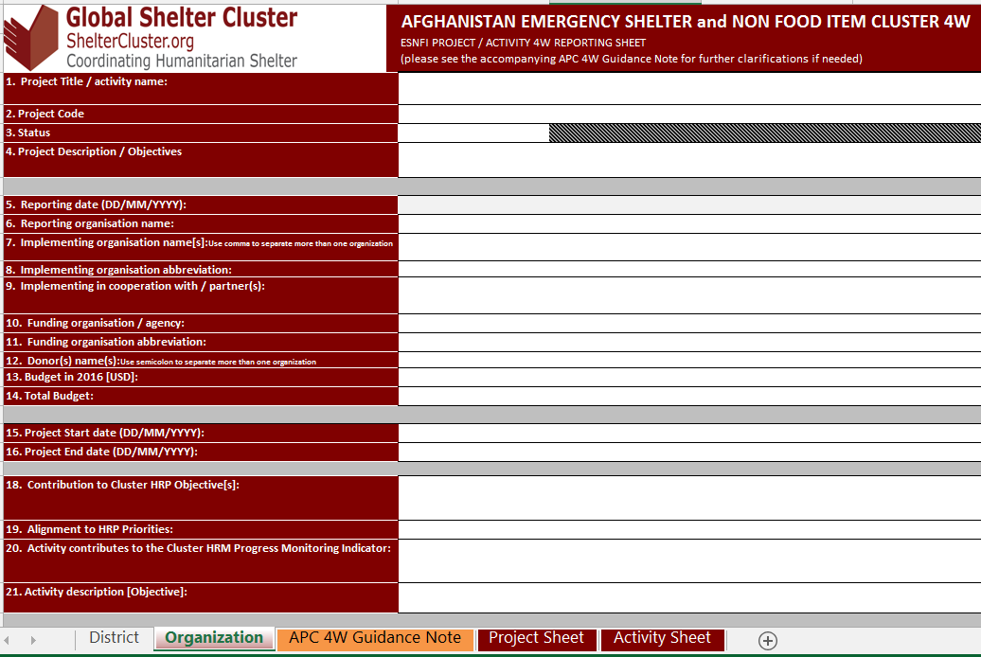
Before…
Excel spreadsheets for 3W and HRP reporting;
Project based reporting → 1 file per project;
Quarterly updates from partners;
Labour intensive collation of data → delays and errors;
Stockpile updates via emails…

Slide 3
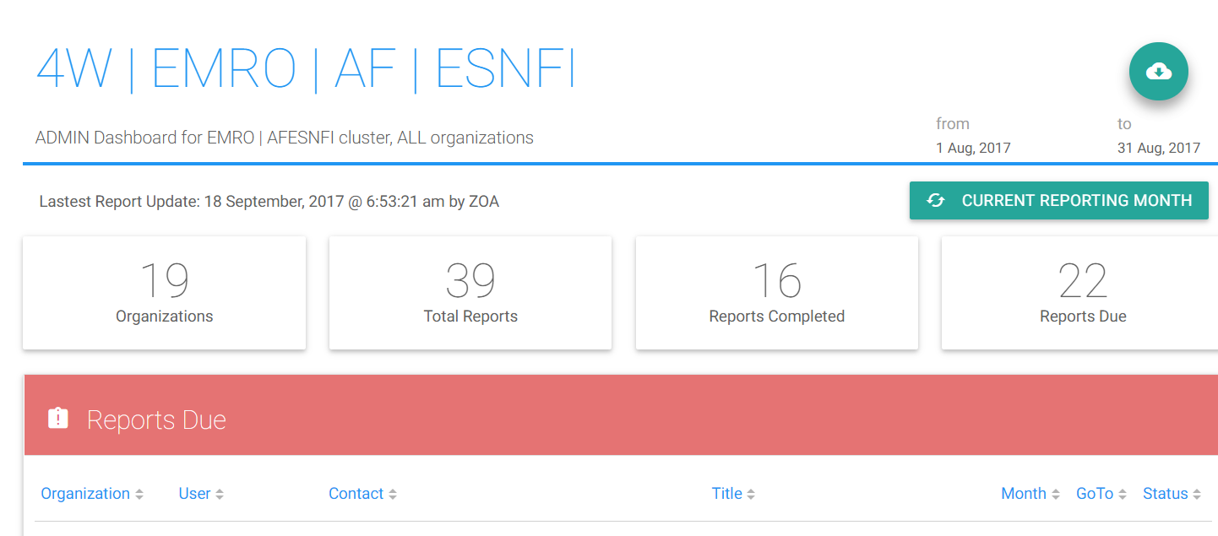
…after
Inter-Cluster agreed reporting tool: ReportHub;
Light, the same data requirements as before, supported by the technical team (Skype group, by iMMAP, 24/7);
Easy to report for partners and easy to extract data for Clusters
Live monitoring of the reporting status
Report extract function (raw data)
Automatic reminders

Slide 4
ReportHub serves multiple purposes
ReportHub
HRP reporting
Activities
Locations
Stockpiles
Locations
Funding
Available stocks
Stocks in pipeline
Timelines

Slide 5
Challenges
Cannot be used for emergency updates (fixed on monthly periodic reporting);
Centralized vs. decentralized reporting by organizations (field vs national level);
Partners require more training – the system is new;
Translation into local language (Dari and Pashto) – access for non-English speakers (incl. government);
Reporting habits and engagement with partners – labour intensive;
User management (verification of authentic users per organization);
Alignment with FTS, and other new online tools for the HPC

Slide 6
Next steps
Alignment of the ReportHub with in-country reporting requirements;
Integration with Humanitarian Programme Cycle planning tools (online platform), incl. FTS;
Translation into local language;
…

Slide 7
Thank you
Any questions?
Cluster IMO a.i.: mazurenk@unhcr.org
For more details on the system, please contact iMMAP (aporro@immap.org)

