Slide 1


Somalia Shelter Cluster Monitoring & Evaluation Framework
WORKSHOP OBJECTIVES AND DAY-PLAN
Present draft framework and indicators
To review these and in particular, to use your technical and contextual knowledge to ground these to the Somalia context.
Focus on structure of framework and indicators (not semantics at this point)
FUTURE WORKPLAN
To circulate draft framework for comments (August), host 2-day workshop (september) and to take framework to field (Oct-Nov); finished framework delivered (Dec).
Shelter Cluster Workshop
UNHCR, Nairobi, Kenya
18 December 2014

Slide 2
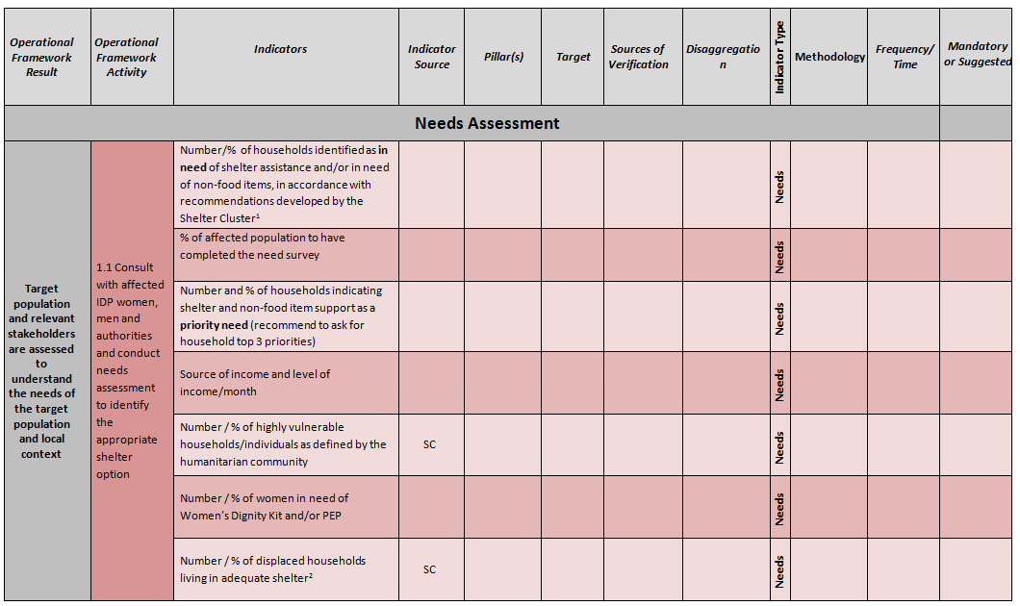
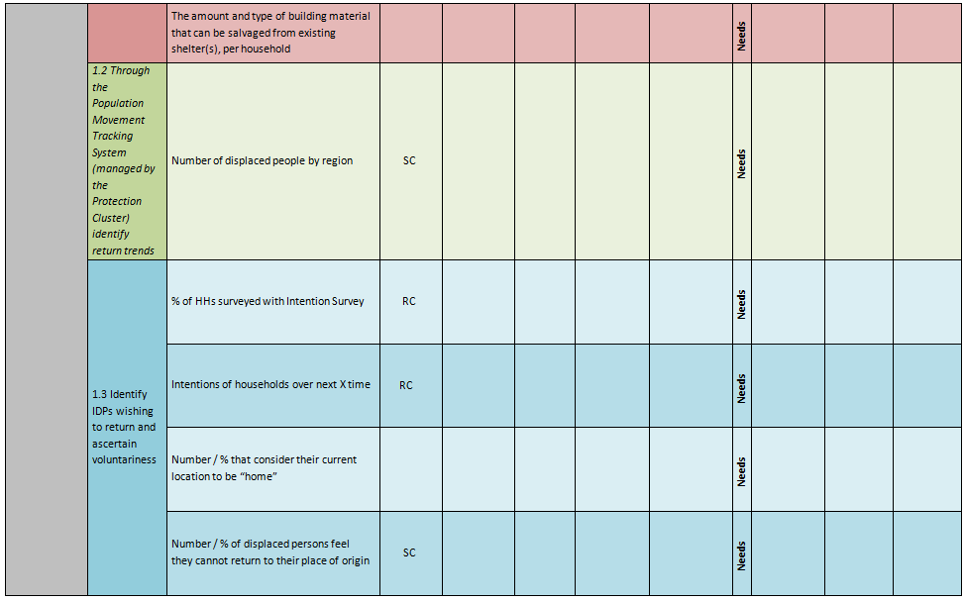

TITLE 1 TITLE 1 TITLE 1
M&E Framework Matrix
Objectives of presentation:
Timeline for completion and handover; Necessary WG feedback
Project cycles ; NFI, Emergency, Transitional and Permanent
Indicator Matrix; Baseline, Needs, Registration, Monitoring, Post Evaluation Distribution, Construction Monitoring, Post Construction Monitoring
Tool Matrix; Use of tool, indicators, analysis, etc
2

Slide 3
TITLE 1 TITLE 1 TITLE 1
Programme Cycle
Timeline for completion:
    Feedback from TWG members (by 5 January)
    Framework, guidance document, tool refinement (by 23 January)
    Presentation and handover (end of January)
    Training support (early February)
2

Slide 4
Somalia Shelter Cluster Monitoring & Evaluation Framework
WORKSHOP OBJECTIVES AND DAY-PLAN
Present draft framework and indicators
To review these and in particular, to use your technical and contextual knowledge to ground these to the Somalia context.
Focus on structure of framework and indicators (not semantics at this point)
FUTURE WORKPLAN
To circulate draft framework for comments (August), host 2-day workshop (september) and to take framework to field (Oct-Nov); finished framework delivered (Dec).
M&E and the Project Cycle

Slide 5
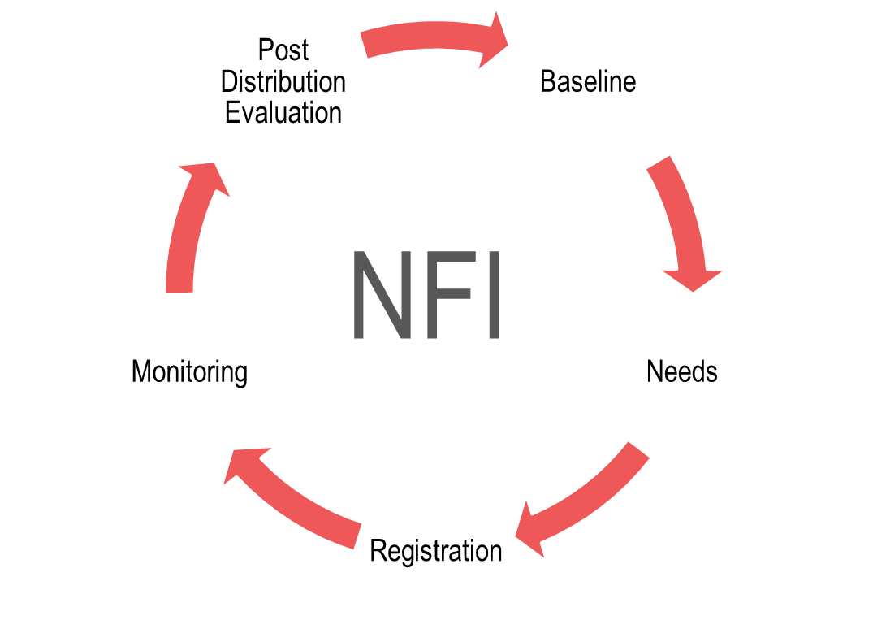
TITLE 1 TITLE 1 TITLE 1
Programme Cycle
How will the proposed M&E framework fit your existing programmes?
The NFI programme cycle is comprised of 4 phases :
Baseline
Needs
Registration
Monitoring
Post Distribution Evaluation
NB. The M&E framework will focus on external processes and internal processes (staffing, funding, communications etc).
2

Slide 6
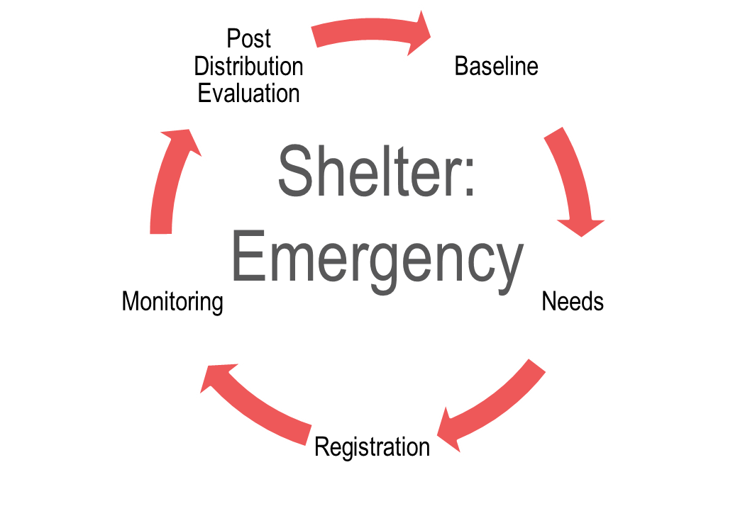
TITLE 1 TITLE 1 TITLE 1
Programme Cycle
The Emergency programme cycle is comprised of 4 phases :
Baseline
Needs
Registration
Monitoring
Post Distribution Evaluation
2

Slide 7
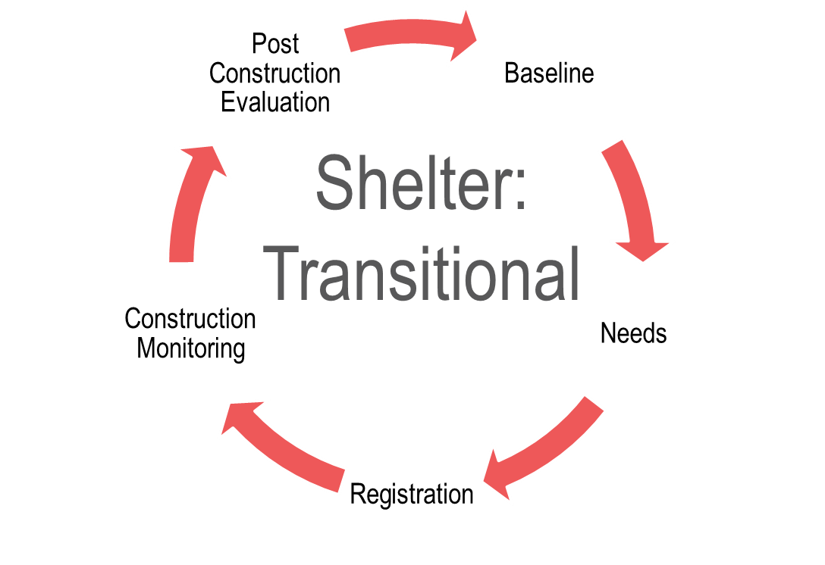
TITLE 1 TITLE 1 TITLE 1
Programme Cycle
The Transitional programme cycle is comprised of 4 phases :
Baseline
Needs
Registration
Construction Monitoring
Post Construction Evaluation
Delivery; construction completed, land deeds handed over, etc
Construction process
Voucher distribution / “ground” breaking
2

Slide 8
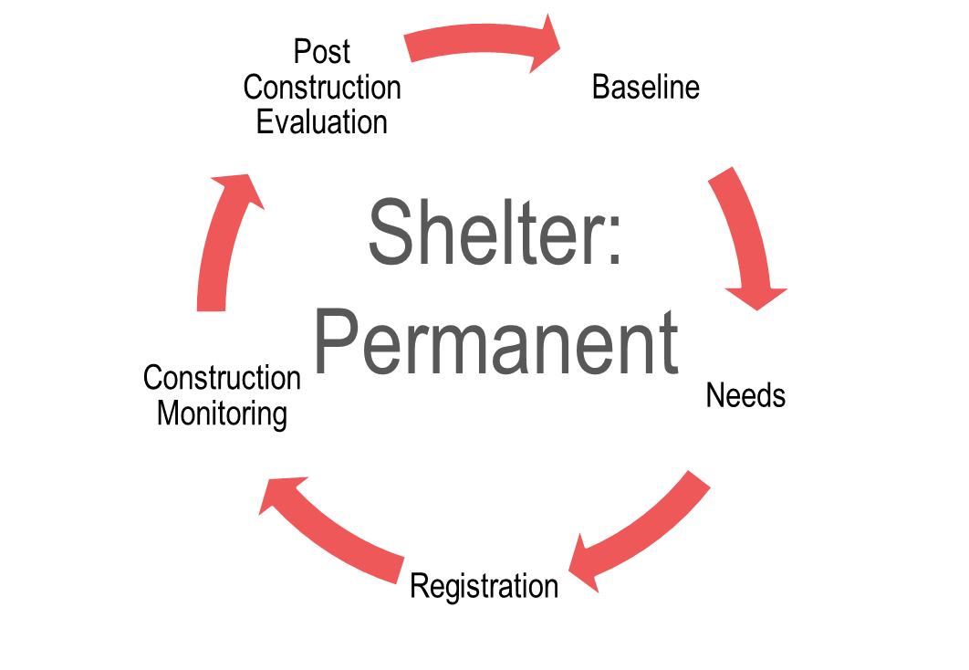
TITLE 1 TITLE 1 TITLE 1
Programme Cycle
The Permanent programme cycle is comprised of 4 phases :
Baseline
Needs
Registration
Construction Monitoring
Post Construction Evaluation
2

Slide 9
Somalia Shelter Cluster Monitoring & Evaluation Framework
WORKSHOP OBJECTIVES AND DAY-PLAN
Present draft framework and indicators
To review these and in particular, to use your technical and contextual knowledge to ground these to the Somalia context.
Focus on structure of framework and indicators (not semantics at this point)
FUTURE WORKPLAN
To circulate draft framework for comments (August), host 2-day workshop (september) and to take framework to field (Oct-Nov); finished framework delivered (Dec).
Framework development and M&E Matrix

Slide 10

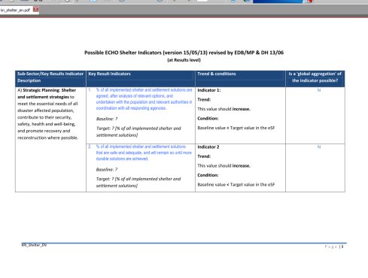
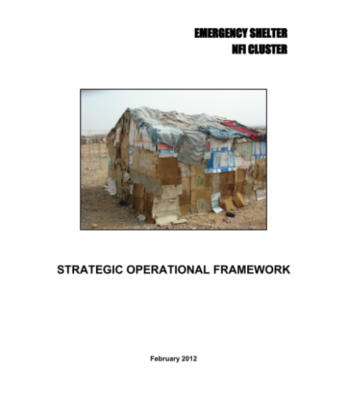
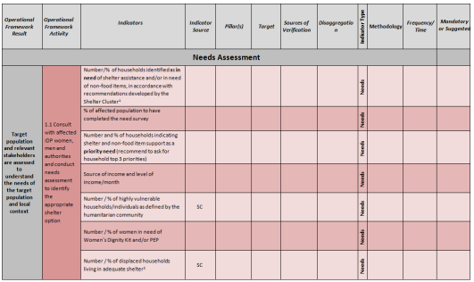
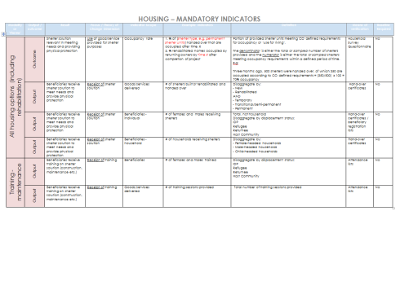
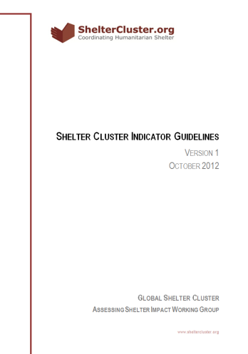
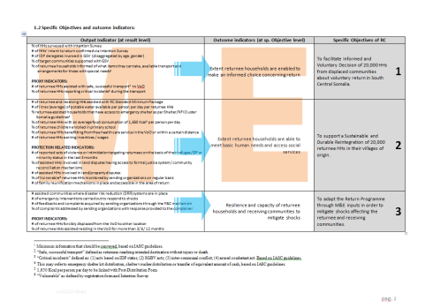
TITLE 1 TITLE 1 TITLE 1
Development of the M&E Matrix
The Indicator Matrix currently represents a consolidation of existing frameworks and indicators
ECHO
ECHO
Sphere
NRC
Current M&E Framework
Shelter Cluster Strategic Operational Framework
Shelter Cluster
Global Indicators
Return Consortium
2

Slide 11
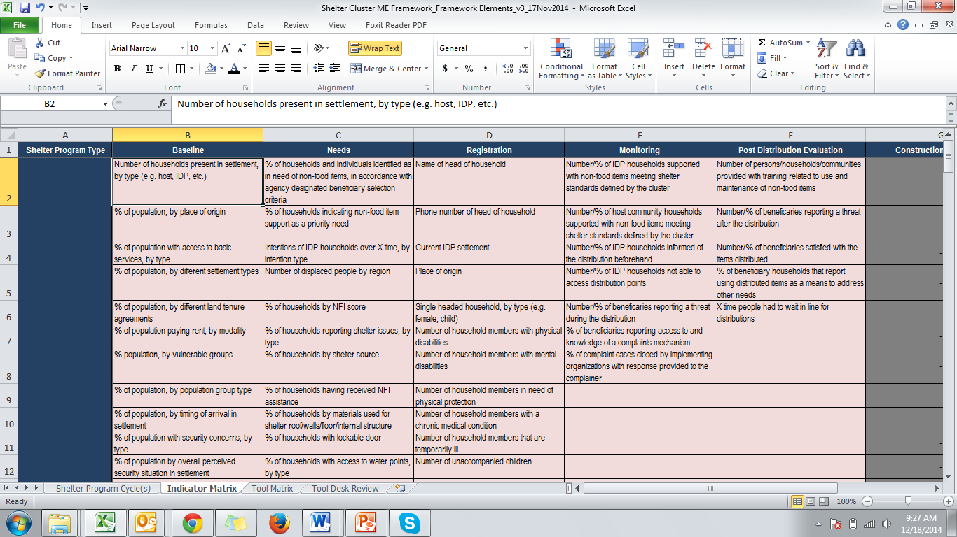
TITLE 1 TITLE 1 TITLE 1
Indicator Matrix
Linking Operational Framework to the M&E Framework
2

Slide 12
TITLE 1 TITLE 1 TITLE 1
Indicator Matrix
Linking Operational Framework to the M&E Framework
2

Slide 13
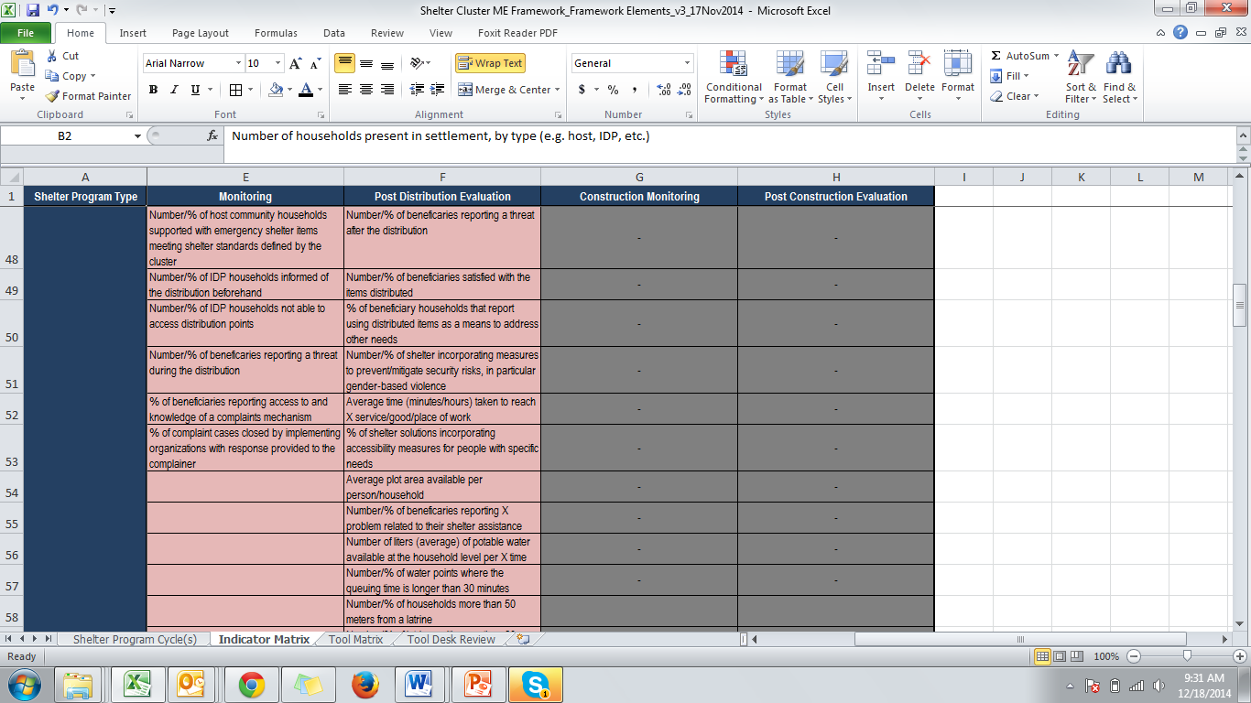
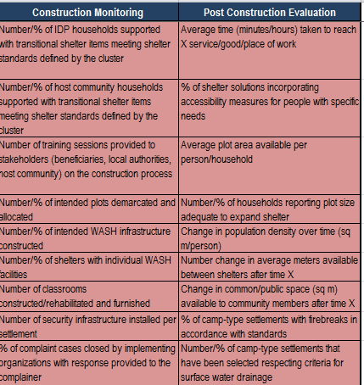
TITLE 1 TITLE 1 TITLE 1
Indicator Matrix
2

Slide 14
Somalia Shelter Cluster Monitoring & Evaluation Framework
WORKSHOP OBJECTIVES AND DAY-PLAN
Present draft framework and indicators
To review these and in particular, to use your technical and contextual knowledge to ground these to the Somalia context.
Focus on structure of framework and indicators (not semantics at this point)
FUTURE WORKPLAN
To circulate draft framework for comments (August), host 2-day workshop (september) and to take framework to field (Oct-Nov); finished framework delivered (Dec).
Tools

Slide 15
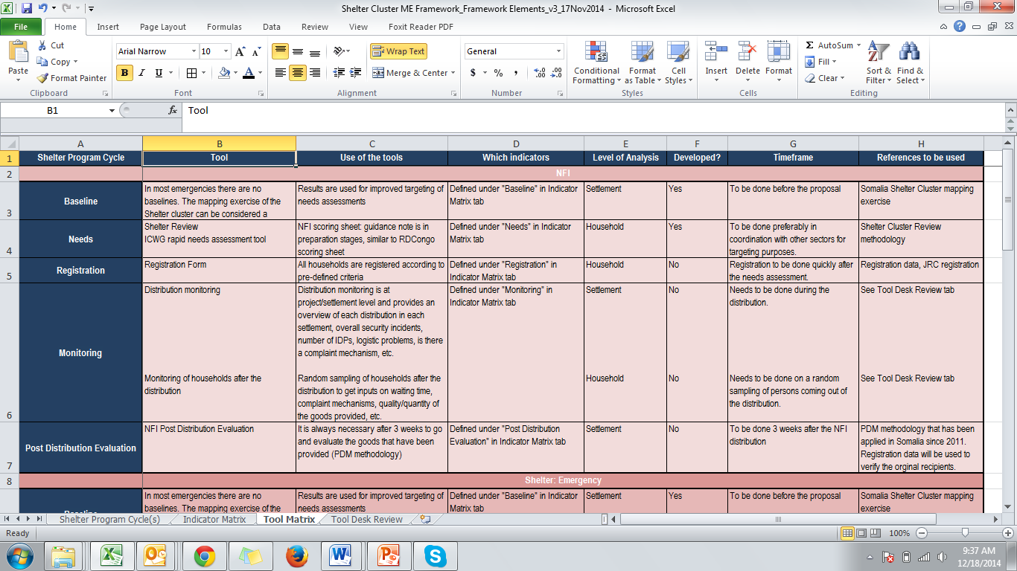

TITLE 1 TITLE 1 TITLE 1
M&E Tools
How do the three pillars translate to the Shelter Cluster M&E framework and possible tools?
First, let’s consider the distribution of Emergency Assistance Packages to a displaced population:
Discussion points:
Timing of tools, especially PDM – how many weeks after distribution? (see timing column)
Tool
Indictors
# of items distributed
(Un)intended item use
Households’ Satisfaction
Repeat CORE population and intention questions
Mainly output focussed
Project Cycle
Baseline
Needs
Registration
Monitoring
Evaulation
Use of Tool
2

Slide 16

TITLE 1 TITLE 1 TITLE 1
M&E Tools
How does this translate to Projects framework and possible tools?
The monitoring and evaluation of shelter project involves at least two more steps:
Project Cycle
- Context Analysis
- Population Assessment
- Intentions Survey
Tools
- Strategic Planning
- Settlement Planning
Use of tools
When & How
Indicators and Level of Analysis
# of items distributed
(Un)intended item use
Households’ Satisfaction
References
2

Slide 17
Somalia Shelter Cluster Monitoring & Evaluation Framework
WORKSHOP OBJECTIVES AND DAY-PLAN
Present draft framework and indicators
To review these and in particular, to use your technical and contextual knowledge to ground these to the Somalia context.
Focus on structure of framework and indicators (not semantics at this point)
FUTURE WORKPLAN
To circulate draft framework for comments (August), host 2-day workshop (september) and to take framework to field (Oct-Nov); finished framework delivered (Dec).
Tool Desk Review

Slide 18
TITLE 1 TITLE 1 TITLE 1
Tool Desk Review
Full Tool Review; Tool Name, Type of Tool, Agency, Shelter Type, ETC
ECHO
ECHO
Sphere
NRC
Desk Review
Shelter Cluster
Global Indicators
Return Consortium
2

Slide 19
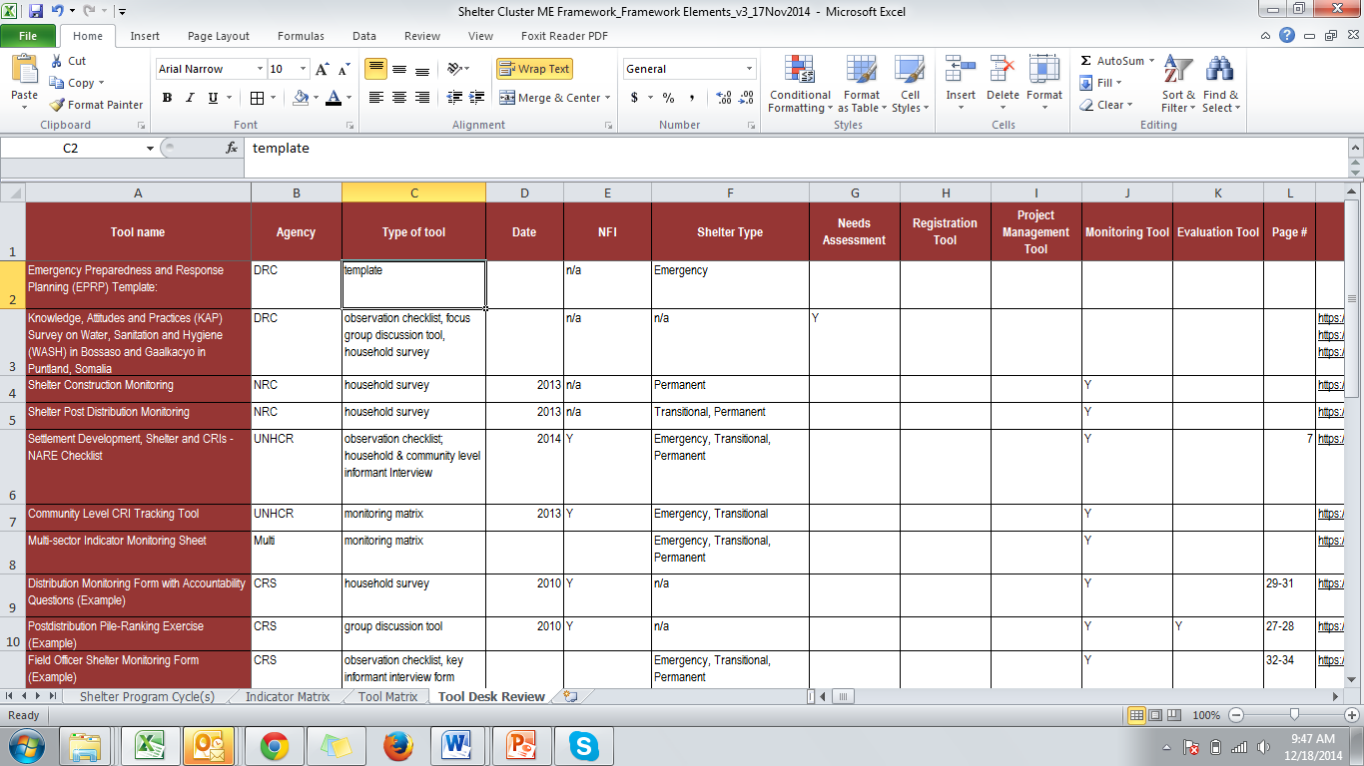
TITLE 1 TITLE 1 TITLE 1
Shelter Cluster Strategic Operational Framework
Linking Operational Framework to the M&E Framework
2

Slide 20
Somalia Shelter Cluster Monitoring & Evaluation Framework
WORKSHOP OBJECTIVES AND DAY-PLAN
Present draft framework and indicators
To review these and in particular, to use your technical and contextual knowledge to ground these to the Somalia context.
Focus on structure of framework and indicators (not semantics at this point)
FUTURE WORKPLAN
To circulate draft framework for comments (August), host 2-day workshop (september) and to take framework to field (Oct-Nov); finished framework delivered (Dec).
Thank you
Any questions?

