Slide 1

Monitoring NFI distributions in hard to reach areas within SYRIA
From Relief to Self-Reliance
Nairobi, Kenia. December 7th, 2016
All content in this document is the property of International Medical Corps and should not be reproduced without prior written consent. This material is protected by copyright. ©2015 International Medical Corps. Materials may not be reproduced without International Medical Corps’ prior written consent.

Slide 2
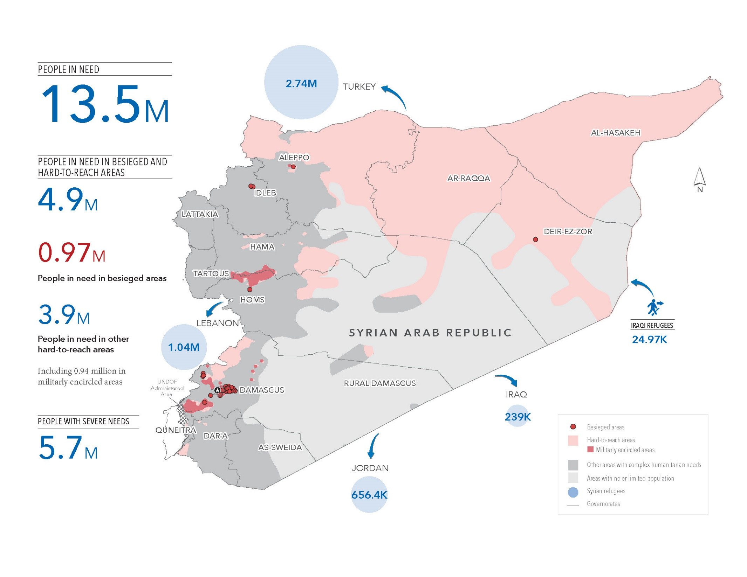
Notes:
Syria is one of the most complex and dynamic humanitarian crises in the world today. Since March 2011, over a quarter of a million Syrians have been killed and over one million have been injured. 4.8 million Syrians have been forced to leave the country, and 6.5 million are internally displaced, making Syria the largest displacement crisis globally.
In 2016, an estimated 13.5 million people, including 6 million children, are in need of humanitarian assistance. Of these 5.47 million people are in hard-to-reach areas, including close to 600,000 people in 18 besieged areas.
The Syrian government and its allies remain responsible for the majority of existing sieges.
Four communities – eastern Aleppo city, Madaya and Douma in Rural Damascus and alWaer in Homs – require immediate international assistance to prevent looming humanitarian catastrophes. These four critically imperiled areas combined contain more than half a million people.

Slide 3
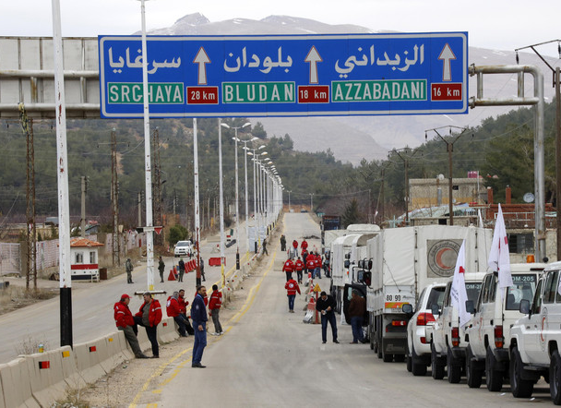
Needs of people living in besieged areas within Syria
974,080 people in need in 16 besieged areas
Denial of basic rights - freedom of movement and access to adequate food, water, and health care
Frequent denial of entry of humanitarian assistance and blockage of urgent medical evacuations
People are shot by snipers, killed, or injured while fleeing in search of food and safety
Notes:
Besieged area: The U.N. says it considers an area besieged if three criteria are met: The area is surrounded by "armed actors," humanitarian aid cannot regularly enter, and civilians, including the sick and wounded, cannot enter and exit.
There are 18 besieged areas in Syria (Damascus, Rural Damascus, Homs, Deir Ezzor, and Idlib governorates), 15 by the Government of Syria or its allies, and three by armed opposition groups or the so called ISIL .
In areas besieged by the Government of Syria or its allies, humanitarian agencies cannot deliver assistance without its approval, a procedure subject to rejections and delays. Armed groups also deny convoys’ access to areas they put under siege.
Civilians in many besieged communities will face serious food insecurity and vulnerability to cold this winter as a result of the capture and destruction of agricultural land, deforestation, and severe access restrictions.
The medical situation in besieged areas is alarming, as life-saving medical supplies continue to be excluded from most aid convoys and hospitals are being targeted at an increasing rate.
Indiscriminate attacks and attacks against civilians, including with internationally banned landmines, cluster munitions, and chemical weapons, as well as with incendiary munitions, bunker busters, and explosive weapons with wide-area effects, are being conducted on besieged communities at an alarming rate.
Approximately 974,080 people in need of humanitarian assistance, including 411,000 children and 6,250 Palestine refugees, live in 16 besieged areas within Syria. Civilians living in besieged locations are denied their basic rights, including freedom of movement and access to adequate food, water, and health care. Frequent denial of entry of humanitarian assistance into these areas and blockage of urgent medical evacuations result in civilian deaths and suffering. Others have been shot by snipers, killed, or injured while fleeing in search of food and safety.

Slide 4
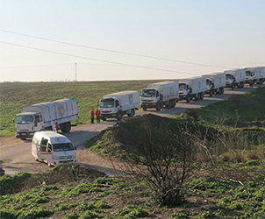
Needs of people living in hard-to-reach areas within Syria
3.9 million people in need
Unable to reach in a sustained manner
935,500 in militarily encircled locations: further constraints of freedom of movement and access to basic assistance
Further 1.4 million people in need live in areas controlled by ISIL
Notes:
Hard to reach area: The United Nations places an estimated 4.5 million Syrians into a separate category called "hard to reach," a step below besieged. It defines that as "an area that is not regularly accessible to humanitarian actors for the purpose of sustained humanitarian programming as a result of denial of access."
Continual need to secure access, or restrictions such as active conflict, multiple security checkpoints or failure of the authorities to provide timely approval.
Some areas are physically surrounded by single or multiple armed actors.
Constraining access for both supplies and people to and from the area.
Doctors Without Borders said it doesn't use that distinction, "as the medical consequences for both types of region are similar." Medical supplies are almost never allowed in, it said, and medical evacuations are rarely allowed out.
3.9 million people in need live in hard-to-reach areas that humanitarian actors are unable to reach in a sustained manner through available modalities. Of people living in hard-to-reach areas, 935,500 are in militarily encircled locations, subject to further constraints of freedom of movement and access to basic assistance. A further 1.4 million people in need, including 700,000 children,live in areas controlled by ISIL, where access remains highly restricted due to insecurity and restrictive policies vis-à-vis humanitarian actors.

Slide 5
Access issues
Factors that obstruct the humanitarian response
Parties to the conflict denying life-saving medical evacuations on political grounds.
Removing critical medical supplies from cross-line convoys.
Delaying issuance of the approval and facilitation letters required for convoys entering areas.
Placing restrictions on the activities of humanitarian actors.
Sometimes directly targeting humanitarian workers.
Lack of safe, unimpeded, and sustained access for humanitarians.
In 2015, 25 inter-agency convoys reached 620,565 people in need.
In 2016 (until mid-October 2016) more than 87 inter-agency cross-line convoys, reached almost 3.2 million people.
Seldom delivery of life-saving assistance and protection services in a timely, effective and strictly needs-based manner on a sustained basis.
Notes:
The lack of safe, unimpeded, and sustained access for humanitarians operating in Syria remains the greatest obstacle to reaching people in need. A variety of administrative and political factors further impede humanitarian access.
Notable improvements in access to besieged, military encircled and hard-to-reach areas were achieved in 2016 compared to the previous year. In 2015, 25 inter-agency convoys reached 620,565 people in need in besieged and hard-to-reach locations. Since the beginning of the year to mid-October 2016, the UN and partners have conducted more than 87 inter-agency cross-line convoys, reaching almost 3.2 million people in need.
A range of factors continues to obstruct the humanitarian response, with parties to the conflict denying life-saving medical evacuations on political grounds, removing critical medical supplies from cross-line convoys, delaying issuance of the approval and facilitation letters required for convoys entering besieged and hard-to-reach areas, placing restrictions on the activities of humanitarian actors within respective areas of control and sometimes directly targeting humanitarian workers.

Slide 6
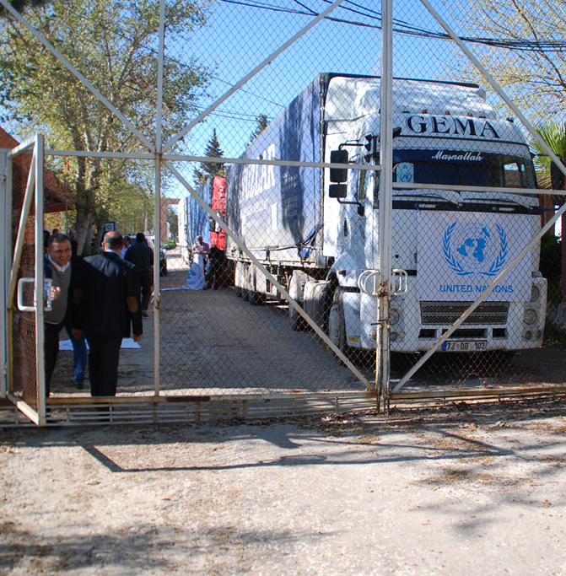
Accessing besieged and hard to reach areas
High-altitude airdrops: Deir-ez-Zor City and airlifts from Damascus to Qamishli
Humanitarian convoys:
  Cross-line, and cross-border modalities from neighbouring countries
  In country through an implementing local partner (SARC or local NGO’s)
Parties to the conflict have both the ability and the legal obligation to facilitate humanitarian access without condition or delay.
Notes:
To adapt to these challenges, humanitarian partners, working together from multiple countries - Syria, Turkey, Jordan, Lebanon, and Iraq - continue to employ a combination of regular, cross-line, and cross-border modalities to deliver humanitarian aid to people in need. As a measure of last resort, in the first half of 2016, the UN also commenced a series of high-altitude airdrops to Deir-ez-Zor City and later airlifts from Damascus to Qamishli.
Despite these measures, access to many areas with severe needs remains extremely constrained. And the blame for the continued obstruction of humanitarian access falls on the parties to the conflict, who have both the ability and the legal obligation to facilitate humanitarian access to people in need without condition or delay.
While hard to reach areas are more regularly accessed than besieged areas, particularly through NGO programming, access is still insufficient to meet needs. Locations that are not regularly accessible for sustained programming due to unlawful obstruction of humanitarian assistance by parties to the conflict.

Slide 7
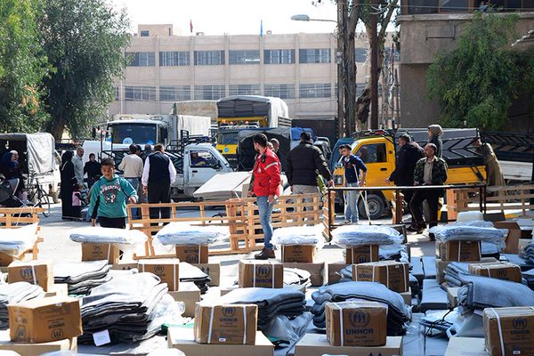
Non-food items in Syria
Lack of access for in-depth needs assessments and systematized post-distribution monitoring.
Where markets are available and physically accessible, basic and essential NFI needs can be met by those with sufficient economic resources.
Availability of NFIs in the markets is unpredictable, but a majority of sub-districts have at least 70 per cent of basic NFIs available in markets.
Notes:
Overall, roughly a quarter of the Syrian population is in need of shelter or NFI assistance, across nearly all governorates. In some areas there remain continued and heightened lack of access for in-depth needs assessments and systematized post-distribution monitoring.
In those locations where markets are available and physically accessible, basic and essential NFI needs can be met by those with sufficient economic resources. Availability of NFIs in the markets is unpredictable, varies across locations, and is severely limited in some areas, but a majority of sub-districts have at least 70 per cent of basic NFIs available in markets.
Access to NFIs is restricted both physically (e.g. by distance and insecurity) and economically (by lack of financial means and/or the prohibitive cost of some items), with an estimated 10.7 million people experiencing restricted access to NFIs. There is a continuing high level of need for in-kind NFI assistance, but needs are not uniform and change according to circumstances, requiring more flexible and specialized responses. In many locations, alternative modalities (e.g. cash and vouchers) can provide appropriate forms of assistance, where they can support existing local markets.

Slide 8
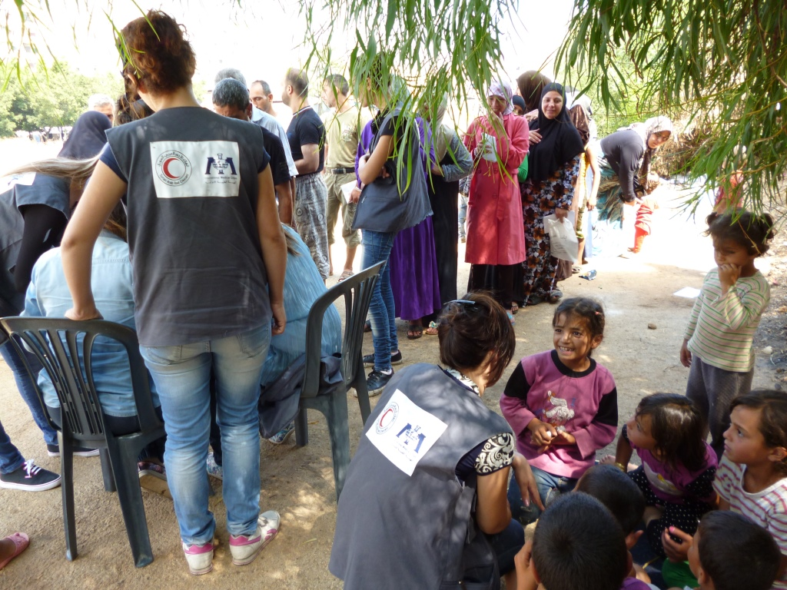
Monitoring modalities of distributions by implementing partner in hard-to-reach areas
On-site distribution monitoring
Implementing partner
self-monitoring
Third party monitoring partner
Peer to peer
Notes:
In areas with access constraints, assessment and monitoring is difficult to undertake via traditional methods, so innovative approaches to response monitoring have to be used.
IMC requests facilitation letters from SARC for staff to attend distributions with at least one staff. If we get the approval our staff observe the distributions but without receiving lists of beneficiaries. However, demographical data is normally provided. Sometimes IMC staff is able to talk to beneficiaries to get their feedback, but with limited informal interaction. Photos are taken when agreed with the implementing partner. Hotline number on kits packages is mandatory internal policy to be able to receive feedback from the beneficiaries.
If the implementing partner does not allow IMC presence in the distribution, they do self-monitoring and IMC receives post distribution reports from the local partners including number, and gender of beneficiaries but not names. IMC request the partner to provide pictures with embedded GPD coordinates and dates. Strengthening engagement with and capacity building of national humanitarian actors as they have the most opportunities for accessing people in need.
Important to include a code of conduct based on Humanitarian Accountability Partnership (HAP) for the implementing partner to follow its clauses.
Third party and peer-to-peer monitoring has been progressively incorporated into monitoring systems by other agencies to enhance available information and analysis.
Whereas third party monitoring is still considered a controversial idea which not all agencies agree with, peer to peer systems seem to be more accepted by the different stakeholders.
Peer to peer monitoring means that interconnected actors ("peers"), during and after the distribution, share resources and information amongst each other without the use of a centralized administrative entity. However, IMC has not been able to put in place any of this two mechanisms.

Slide 9
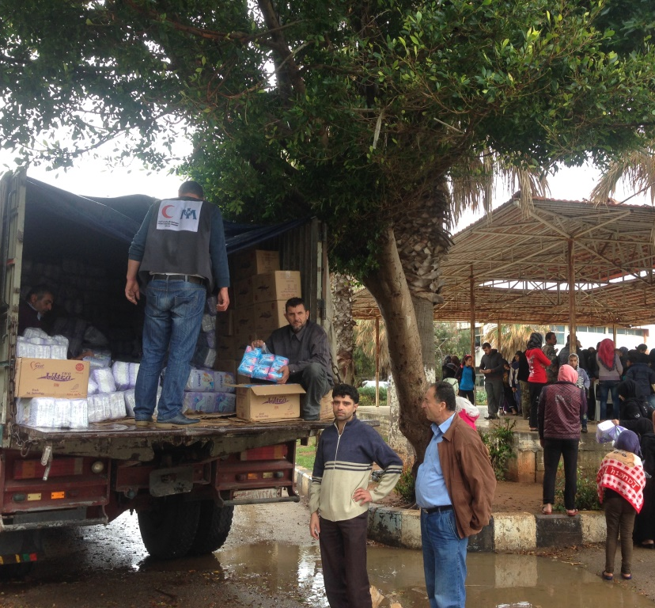
Constraints and challenges
  Security restrictions and concerns
  Governmental approvals
  Approvals to attend distributions
  Local partners’ capacity
  Geographically spread of IDP
  Limited resources to allocate one monitor for each distribution
  Delays in delivery and poor planning
  Timeliness and quality of distribution reports
  Lack of feedback mechanisms
Notes:
These are some of the constraints and challenges most of the NGOs operating in hard to reach areas face on a daily basis.

Slide 10
Feedback mechanisms
Beneficiary help desk
Letter boxes
Emails and SMS
Websites
Focus group discussions
Individual interviews during the field visit or collecting stories for the reports/newsletters
Open meetings with communities or partner agencies
Visiting beneficiaries especially female (individually)
Project staff phone numbers
Community level connections
Inter‐agency coordination meetings
Surveys/questionnaires (or additional questions on standard ones)
Consultations with community
institutions/local structures
  Community feedback to be included into response monitoring processes.
During the distribution
Post-distribution
Notes:
As beneficiaries have different capacities and preferences, so one BFC mechanism will not suit all. Some beneficiaries have a mobile phone, others do not. Some are shy, others do not come to a distribution point. Similarly, some complaints need to be addressed immediately while others can be investigated and procedures improved over time. Accordingly, it is best to have a combination of BFC mechanisms – such as having staff open to receiving informal comments, having a hotline, and holding periodic community consultations. Having more complaints may not be a sign of a bad project – it may be a sign of positive community relationships, because people who are willing and comfortable to complain are also people who have a belief their complaint will be heard and acted upon.

Slide 11
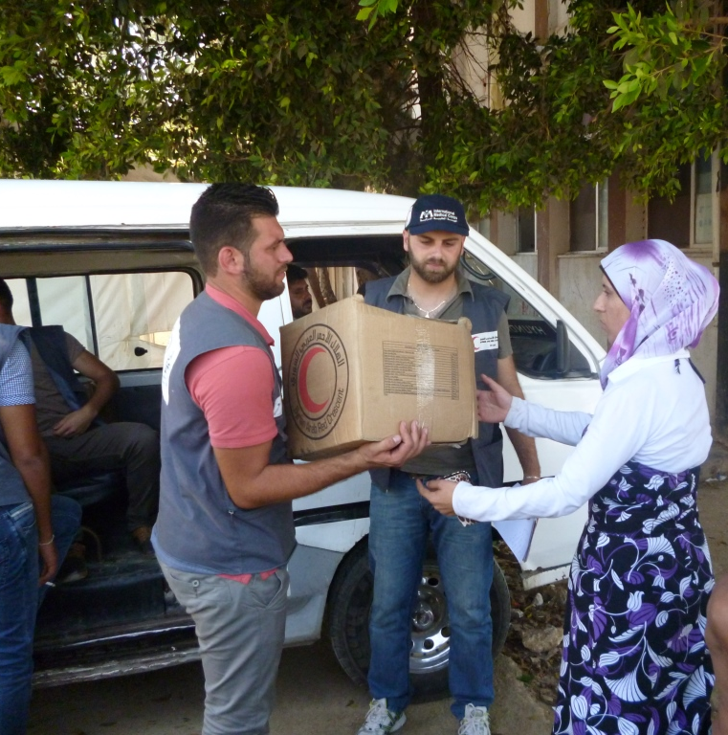
Alternatives to Exit beneficiary interview
(during distribution)
  Informal interaction between project staff and beneficiaries
  Direct observation without interaction with beneficiaries
Notes:
Exit interviews are conducted immediately following a distribution, as beneficiaries leave the site. They should focus on the process of the distribution. They provide an opportunity for the distributing agency to gather feedback on how smoothly the distribution proceeded whether the information provided before a distribution matched; what beneficiaries experienced during the process; whether beneficiaries received what was expected; and whether there were any protection concerns raised during the distribution process, costs they incurred to attend the distribution, etc.
Informal interaction between project staff and beneficiaries: All the participating agencies reported that beneficiaries approach their project staff during their field visits and share their problems. This is the easiest and most comfortable way for beneficiaries to raise an issue. Usually these type of complaints are not being recorded, but a serious issue is being recorded into their daily notebooks/dairies for further discussions. The beneficiaries do not hesitate at all and speak openly. The project staff members try to find out the best way to respond to their complaints on the spot. In fact beneficiaries usually women prefer to an immediate solution than have a matter treated as an ongoing complaint.
Direct observation without interaction with beneficiaries:
Is the distribution point near to the camp/ community?
How many recipients have received the items in this location?
How long did the distribution take?
Did the distribution start on schedule?
Perception on beneficiaries needs and quality of items
Was the quality of items appropriate?

Slide 12
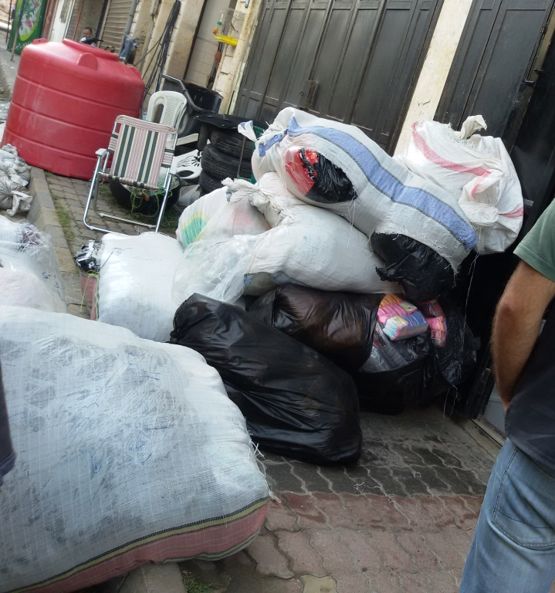
Alternatives to Post-distribution monitoring survey (after distribution)
  Consultations with community institutions/local structures/key informant interviews
  Hotline number on kits packages
  Letter boxes
Notes:
Post-distribution monitoring occurs approximately 1 or 2 months following a distribution. This form of monitoring allows for more detailed feedback on the usage of items, and whether items distributed where: appropriate; of suitable quality; of sufficient quantity.
Hotlines: Provide contact details of the relevant program head where beneficiaries can ring and share the problems they have. The relevant program head takes actions accordingly.
Letter boxes: letter boxes are established in public places which are accessible for all. Since majority of the targeted population are illiterate, but still agencies receive written complaints. These letters are either written by the religious leader or beneficiary approached an educated person to put on the paper what he/she feels about the aid and project activities.

Slide 13
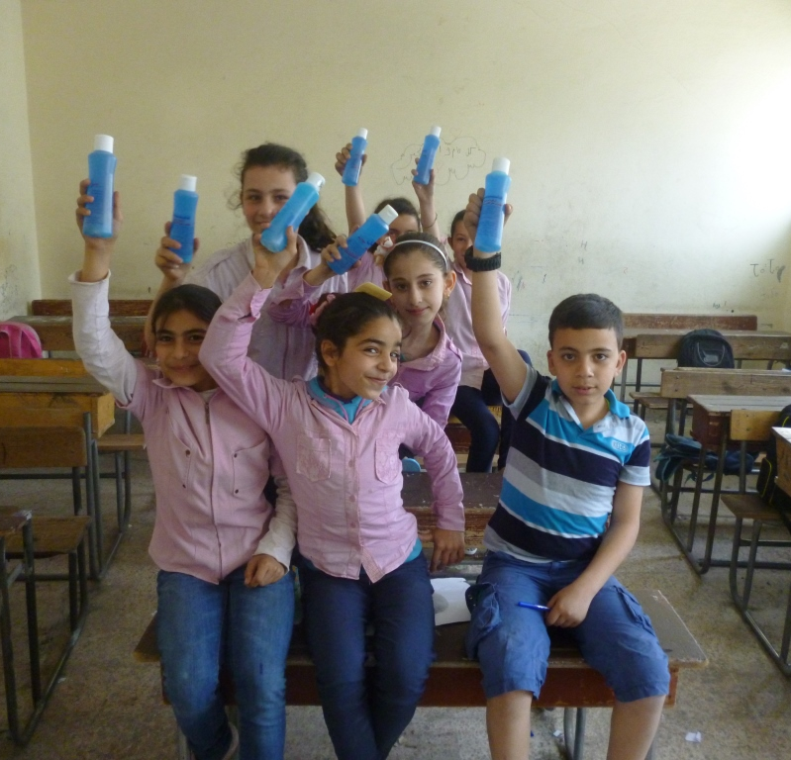
Recommendations
Harmonized tools.
Engagement and capacity building
Beneficiary satisfaction survey
Best practices
Improve timeliness and content of monitoring reports
Notes:
Compile all monitoring reports, templates, etc. from sector members and – based on the information provided - develop a set of harmonized tools.
Strengthening engagement with and capacity building of national humanitarian actors as they have the most opportunities for accessing people in need.
Include a “client/beneficiary satisfaction survey” during distributions. Agencies already completing such surveys will share their practices.
Identify best practices and common manners in which to report and facilitate compiling and sharing the information amongst members for incorporation into programmes across the sector.
SARC and the agencies working with and monitoring through SARC, commit to working on the existing monitoring practices to improve timeliness and content of monitoring reports so they can have an increased impact on programmes in real time.

