Slide 1
IEC Material – Build Back Safer ‘Repairs’

Slide 2

IEC Material – Build Back Safer ‘Repairs’

Slide 3
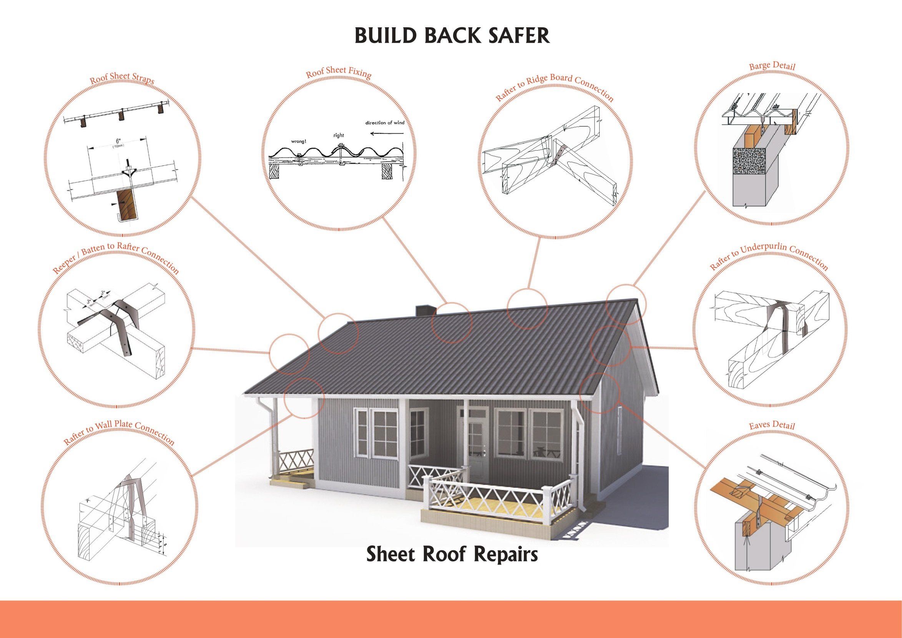
IEC Material – Build Back Safer ‘Repairs’

Slide 4
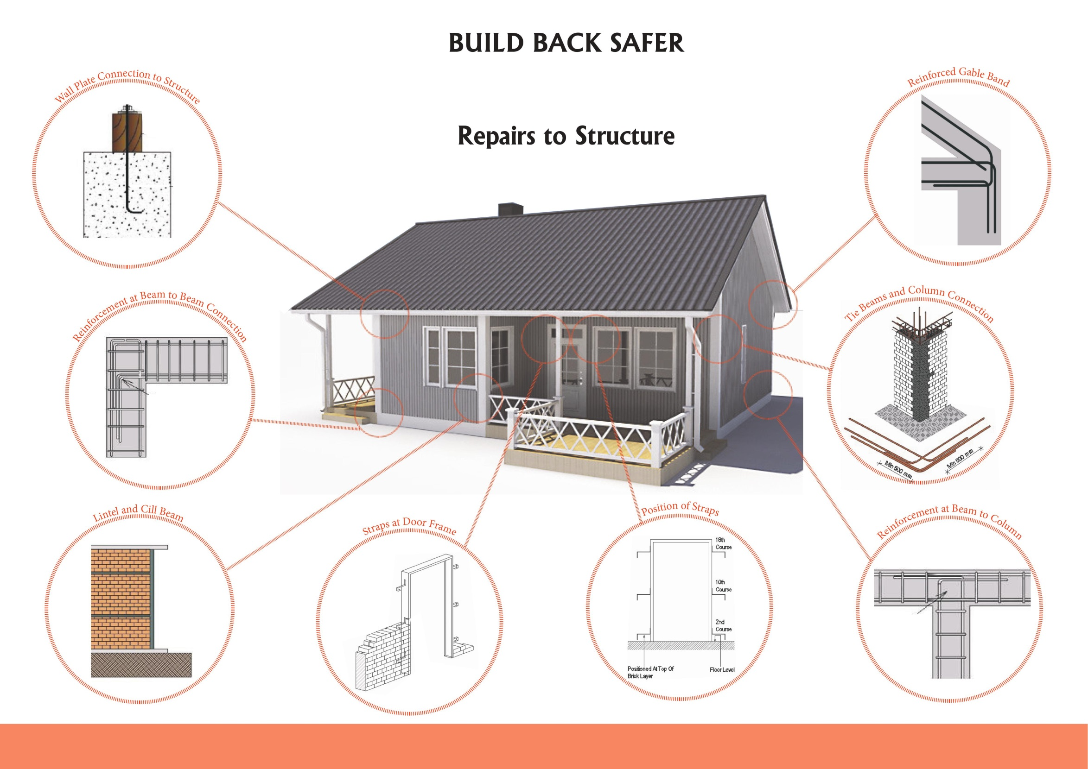
IEC Material – Build Back Safer ‘Repairs’

