Slide 1
RRMP – Rapid Response to Movements of Population
Global Shelter Cluster – NFI Workshop
Nairobi, 7-9 December 2016

Slide 2
Why developed?
Extensive often recurring needs and limited resources
Difficulties in prioritizing affected areas for assistance
Inadequacies of using social vulnerability or beneficiary profile (all IDPs, all returnees, etc.) as a proxy for NFI vulnerability
Interest in better determining NFI need specifically

Slide 3
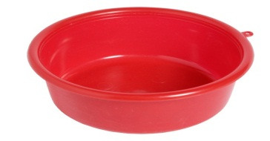
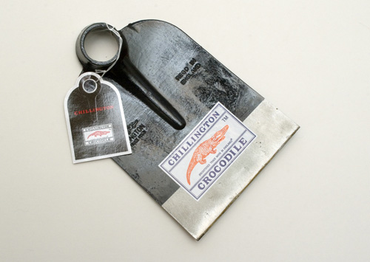
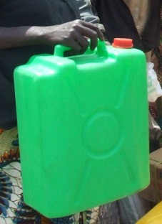

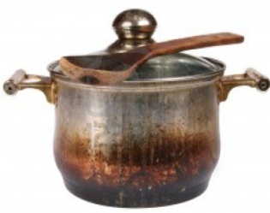
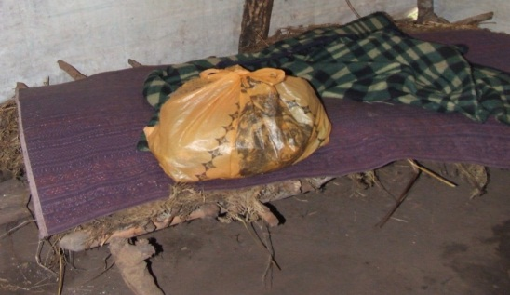
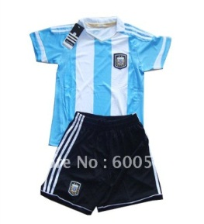
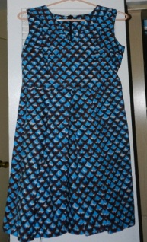
The NFI Score-Card in DRC
→ Quantity and Quality of :
3. Bassine
3. Basin, Bucket,
other containers
2. Casserole
4. Tools
1. Jerry-cans
2. Cooking pots
4. Outils aratoires
5. Bed / mattress / mat
6. Blanket / sheets
8. Children’s clothing
7. Women’s clothing

Slide 4
What it is and how it has evolved
Guidance Notes on
sample size and methodology for 35 / 70 / 100 households
how to score different items
Gives a score per household and across selected area on NFI vulnerability 0 - 5
3 – 3.9 : moderate acute vulnerability
4 – 5 : severe acute vulnerability
Changes over time – removing mosquito nets, adding in basins / buckets
Training of NFI actors

Slide 5
2016 – Humanitarian Needs Overview (HNO)

Slide 6
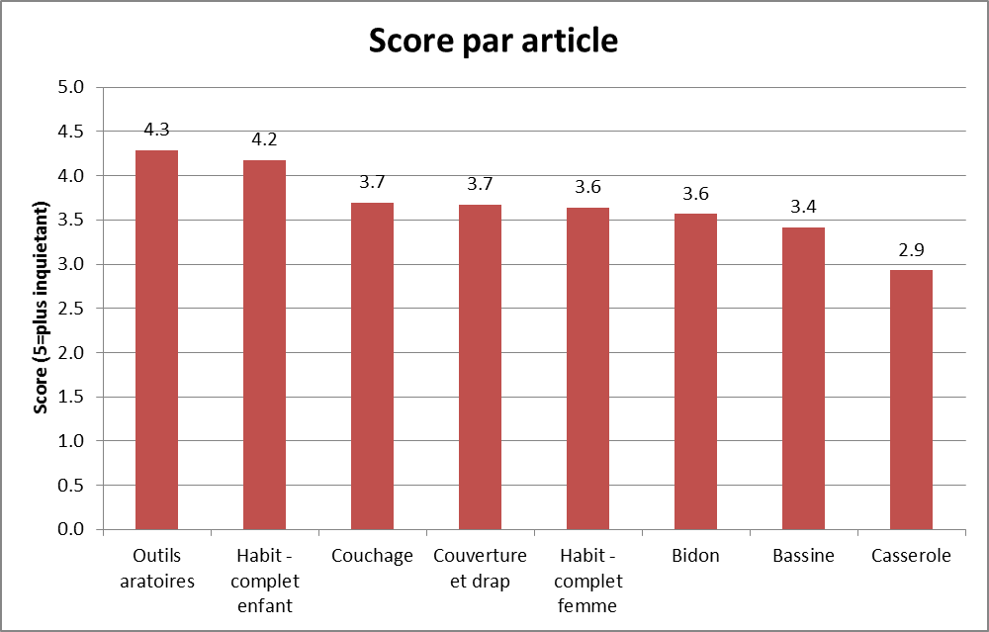
What it tells you

Slide 7
What it tells you
Article | Score = 0 | Score = 1 | Score = 2 | Score 3 | Score = 4 | Score = 5
Score Total | 0% | 0% | 3% | 33% | 48% | 16%
Bidon |  | 1% | 13% | 13% | 41% | 32%
Casserole | 1% | 12% | 13% | 35% | 10% | 29%
Bassine | 12% | 1% | 7% | 28% |  | 52%
Outil aratoire |  |  |  | 28% | 10% | 62%
Couchage |  | 1% | 4% | 26% | 42% | 26%
Couverture et drap |  | 1% | 4% | 25% | 46% | 23%
Habit - complet enfant |  |  |  | 13% | 54% | 33%
Habit - complet femme |  |  |  | 39% | 48% | 9%
Table 3 - Score NFI par groupe de richesse
Groupe de population | Score NFI
Le tier le plus pauvre | 4.4
La moyenne | 3.7
Le tier le plus riche | 2.9
Coefficient de Gini | .3

Slide 8
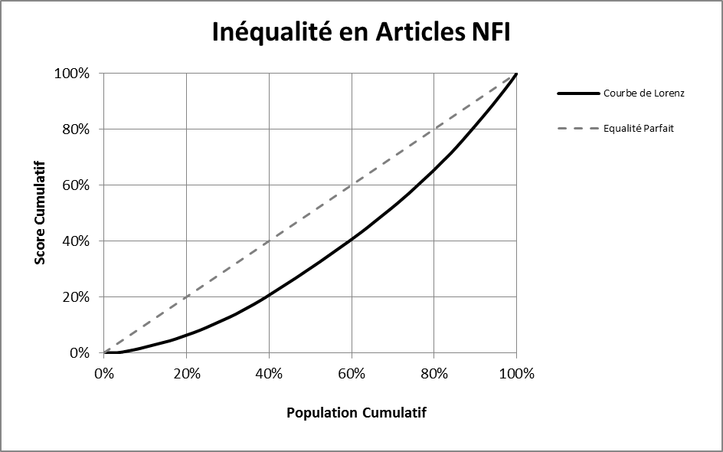
What it tells you

Slide 9
Measuring Outcomes / Improvements – RRMP 2015

Slide 10
Changes in Score-Card by family size (NRC/RRMP – 2015)

Slide 11
REACH Evaluation
Support from Global Shelter Cluster
Evaluating the Tool / Data Collection / Use
November 2016 – Lea Macias in DRC
Interviews
Observation of Teams
Focus Groups
Reliability Testing

Slide 12
REACH Evaluation - Conclusions
Tool and approach is sound– right items / no need for different weighting
Data collection – highly subjective, too much room for interpretation
Issue of ownership vs. access (IDPs in host families)
Directions in guidance note not followed / guidance note doesn’t address certain issues
No Statistical correlation in results between the 2 teams
How to better include contextual factors in analysis

Slide 13
REACH Evaluation
Next Steps . . .
Workshop with field teams – harmonize approaches
Clarify scoring - Ownership – Access – Nothing
Qualitiative analysis – How to incorporate
Other experiences? - Somalia, CAR, …
Training and Roll out

