Slide 1
Global Shelter Cluster
NFI WG
NFI WG Survey
NFI Capacity Training Prep and Needs

Slide 2
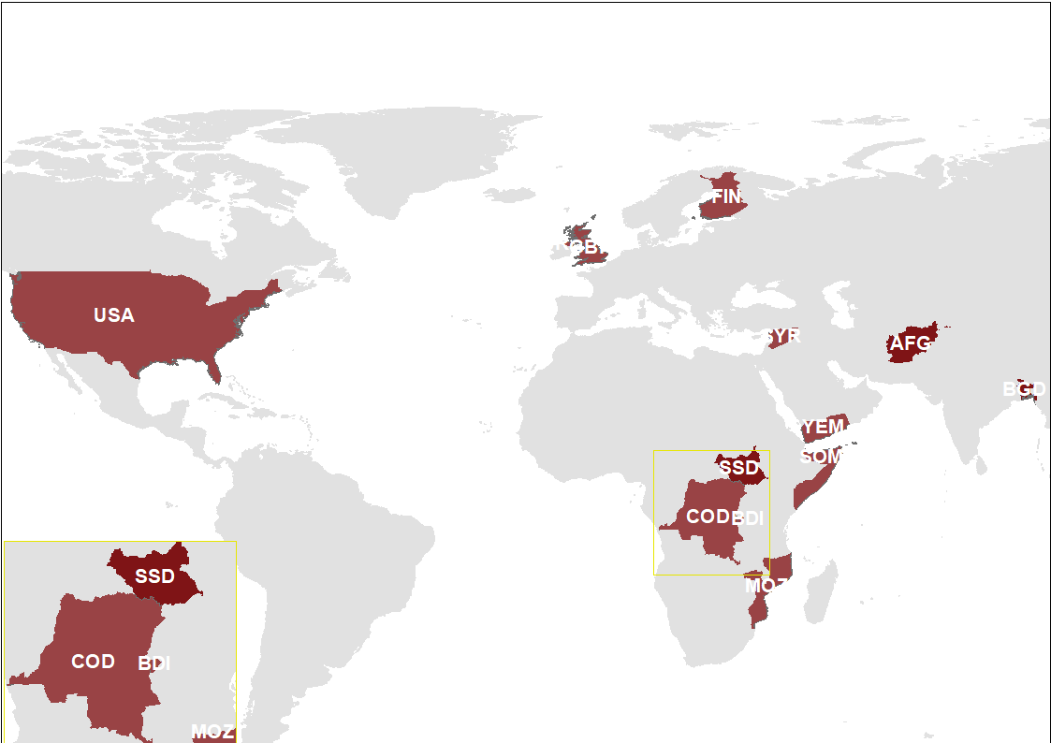
15 respondents from 12 countries
NB: other = 2 consultants

Slide 4
Other ideas for trainings
Winterization
Safeguarding
Really want to emphasize aid diversion, as well as contextualization of kits
NFI kit management explanation to the beneficiaries

Slide 5
What will be required to compile the curriculum?
Easy = Various resources already exist (handbooks, guidelines, agency internal trainings etc.) but need to be consolidated and reworked into an global online training module; an organisation could champion the module in consultation with the NFI WG members,
Medium = Some resources already exist, but need to be adapted for NFI, and some complementary content needs to be developed in consultation and agreement with the Shelter Cluster, NFI WG members and possibly other stakeholders outside of the cluster
Hard/difficult = No resources currently exists on this specific topic (or we aren’t yet aware of it) so content needs to be newly developed (most likely through hiring of a consultant) in consultation with the Shelter Cluster and NFI WG members possibly other stakeholders outside of the cluster

Slide 6
Organisations’ Contributions
What can you organization contribute?
NFI modalities, fuel
Materials and case studies
Experiences with common pipelines
Course planning and implementation, also online. Research and reporting
editing/review
We have developed the need assessment tool, PDM toolkit, AAP toolkit for S/NFI distribution, Methodology for response guidance, etc.
Can offer some time to write or edit narrative.

