Slide 1
Global Shelter Cluster Annual Meeting 2019
Overview of Global Shelter Cluster Survey Findings
October 2019 - Geneva

Slide 2
Summary
Participant profile
GSC service usage and feedback
Feedback from national shelter coordination teams
Feedback on GSC meeting outcomes and impediments to shelter response

Slide 3
Participant profile
Who participated in the survey?

Slide 4
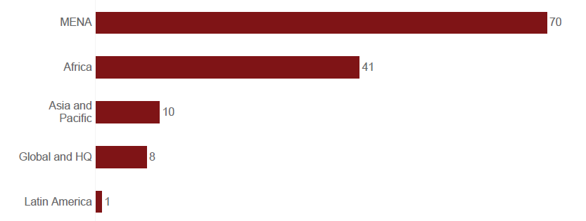
Number of respondents by region
130 responses
(as of 03 October 2019)
Notes:
Largest proportion of the respondents from the MENA region (54%), followed by Africa (32%).

Slide 5
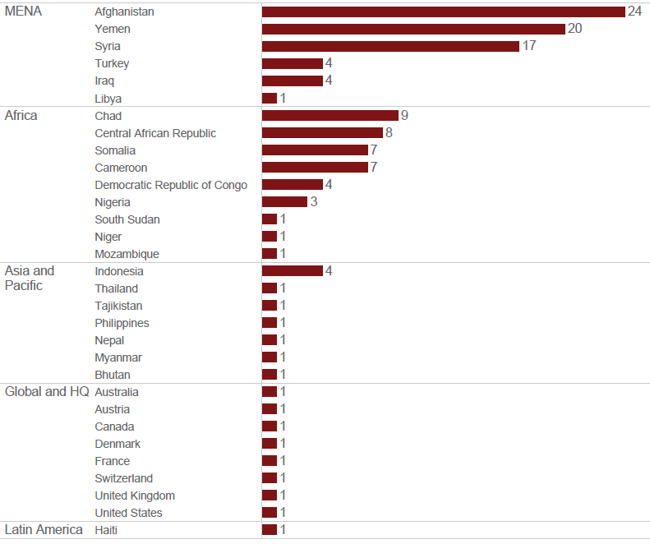
Number of respondents by country
Notes:
Afghanistan, Yemen and Syria provided the most respondents.
Within Africa, Chad, CAR, Somalia and Cameroon had the most respondents.

Slide 6
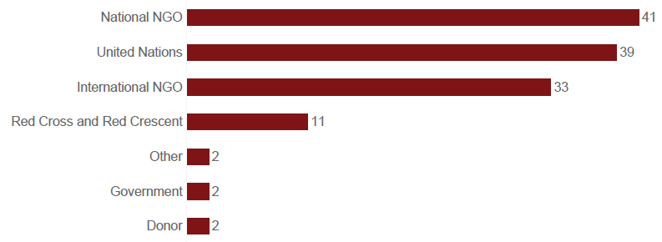
Number of respondents by organization type
Notes:
Large number of national NGOs (32%); significant increase in national NGO respondents compared to the previous year (when just a few responded).
Also large proportion of UN Agencies (30% of respondents) and international NGOs (25%)

Slide 7
GSC service usage and feedback
What GSC services have respondents used/hosted and were they satisfied with these?

Slide 8
GSC services: number of respondents reporting using/hosting each
Notes:
Respondents to the survey were asked to identify which GSC services they had used or hosted – they were able to select more than one.
Note that 38% (49 respondents) had not used or hosted any GSC services.
Of these, just over half (55% of those reporting not using / hosting services) reported that they were aware of services available.
The most commonly used service was the Humanitarian Shelter Coordination course (28%), followed by the GSC website (28%), REACH assessment and evaluation support (23%) and GFP for coordination missing and/or remote support (23%).

Slide 9
GSC services: level of satisfaction
Coordination Indicator 1.1: % of stakeholders who are satisfied with the performance of the Shelter Cluster disaggregated by country-level and global.
Target 2020: 90%
Survey result: 86%
Notes:
Note that there was no response from 34 respondents (who hadn’t used services)
The majority of respondents (86%) reported being satisfied or very satisfied with services.
Of those that reported not being satisfied, feedback was not very comprehensive or detailed, limited to the following comments:
they are ineffective and rarely do anything substantial on ground
Parce-que fait des efforts pour assister les personnes sur les sites ainsi que les lieux de regroupement
because all the requirement is not covered
Faible coordination sur le terrain

Slide 10
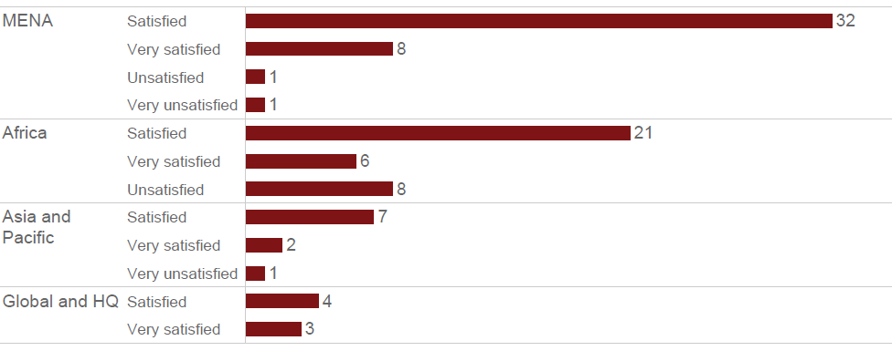
Satisfaction with GSC services by region
Notes:
The 90% target was met in the MENA region (95% satisfied or very satisfied)
Country-level disaggregation isn’t possible due to limited number of surveys.
The majority and highest proportion of unsatisfied people were located in Africa (23% unsatisfied)
The specific countries where people were unsatisfied were Central African Republic (3), Chad (2), Somalia (2) and Cameroon (1).

Slide 11
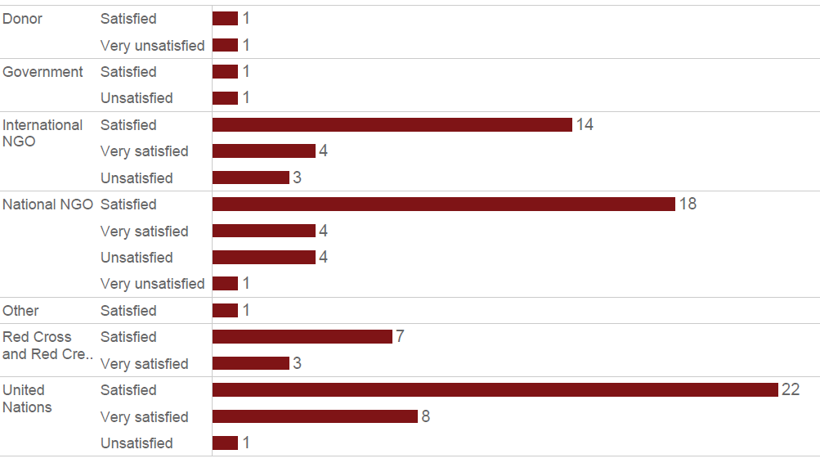
Satisfaction with GSC services by organisation type
Notes:
The largest number of unsatisfied respondents were national NGOs (5) followed by international NGOs (3).
Red Cross + Red Crescent movement and UN agency respondents were generally satisfied with services.
There were only 2 donor and government respondents.

Slide 12
Qualitative feedback on preferences to improve GSC services
More research, literature and guidance on the implementation of cash for shelter during emergency phase.
More workshops and exposure visits facilitated by the cluster.
Help enhance capacity building of national staff.
Private sector engagement support services.
Additional support to help apply the strategies that have been developed.
Sharing the results of workshops and reports.
Comments related to in-country support and capacity building
Comments related to specific or thematic programme needs
Comments related to sharing materials and increased interactions
Regional forums for more regular interactions [with other cluster members].
There are good resources on the GSC website but mostly in English- would be useful to translate the most useful ones into French.
Enhance the role of the technical coordinator in direct rather than remote support to the country clusters i.e. more missions to review, recommend or document lesson learnt and improvements on programming.
Global services are exhaustive but would be good to have more field-level capacity building.
Improve toolkits for different shelter assessments relevant to multiple contexts.
A quick introduction to the available GSC services for the Turkey SNFI Cluster
Notes:
This is not a full list of all feedback provided, rather a selection of the most constructive.
Comments centred around 3 main themes: increased levels of in-country support and capacity building (particularly of national staff), comments related to specific programme needs (cash for shelter, assessments, private sector engagements), and sharing materials / increased interactions.

Slide 13
Feedback from national shelter coordination teams
What tools do partners/members of in-country coordination team most commonly use, and do they feel prepared to address challenges?

Slide 14
Tools used by shelter coordination teams
Notes:
The 68 respondents reporting being a permanent member of the shelter coordination team (sector/cluster coordinator or other team member, and partner organizations) were asked to report on the tools that they used to address challenges.
The Shelter and NFIs indicator guide was the most popular resource used, followed by guidance on selecting NFIs for shelter.

Slide 15
Coordination team preparedness to address challenges
Evidence-Based Response Indicator 4.1: % of shelter cluster coordination team members who feel prepared / have access to tools to address ongoing and emerging challenges
Target 2020: 70%
Survey result: 56% feel fully prepared; 42% feel somewhat prepared but need more tools, 2% do not feel prepared
Coordination team members were asked if they felt sufficiently prepared to address challenges, and whether they needed more tools.
Notes:
The respondents reporting to be a permanent member of the shelter coordination team (sector/cluster coordinator or other team member, and partner organizations) were asked to report whether they felt prepared to address ongoing and emerging challenges.
Although more than half felt prepared (33 respondents), half of respondents in MENA and 38% in Africa felt that more tools are needed.

Slide 16
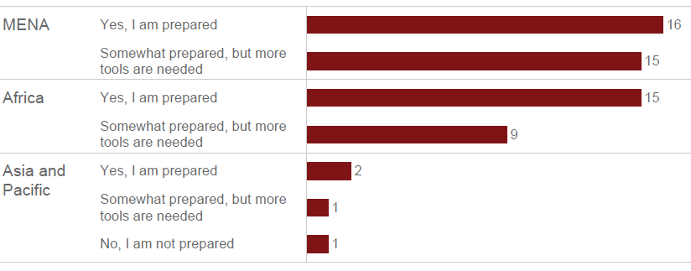
Coordination team preparedness to address challenges by region
Notes:
The respondents reporting to be a permanent member of the shelter coordination team (sector/cluster coordinator or other team member, and partner organizations) were asked to report whether they felt prepared to address ongoing and emerging challenges.
Although more than half felt prepared (33 respondents), half of respondents in MENA and 38% in Africa felt that more tools are needed.

Slide 17

Coordination team qualitative feedback on how GSC can support capacity building
More training on operational issues like team management, admin procedures, finance/budget management
More training both via online systems and in-person missions
Training IM staff on Information Management
As a member of the coordination team, we are too isolated in the country context. When new people join the Inter Cluster coordination team and HCT from different operations, the level and view of discussion change at the coordination and relevant meetings. We should be more familiarised with other contexts. This can be short missions for the national coordination team in other operations- for capacity building as well as supporting other emergencies.
Share online training sites, or better still prepare context-related training to meet immediate needs

Slide 18
Coordination team access to evidence and learning
Evidence-Based Response Indicator 3.3: % of shelter cluster coordinators and partners reporting that they have accesss and use evidence, learning and best practices
Target 2020: 90%
Survey result: 93%
Coordination team members were asked if they agree with the statement ‘I have sufficient access and consistently use evidence, learning and best practice in my daily work’
Notes:
The respondents reporting to be a permanent member of the shelter coordination team (sector/cluster coordinator or other team member, and partner organizations) were asked this question.
Most agreed that they have sufficient access and can use evidence, learning and best practice, with the exception of 2 respondents in MENA and 2 in Africa.
Those that disagreed said ‘I use my experience and learning, not sure that qualifies as best practices’

Slide 19
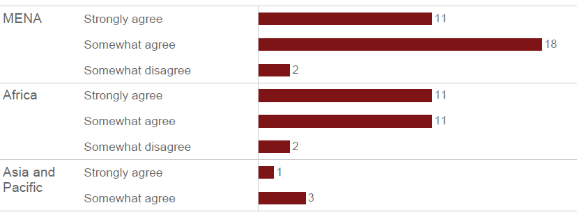
Coordination team access to evidence and learning by region
Notes:
The respondents reporting to be a permanent member of the shelter coordination team (sector/cluster coordinator or other team member, and partner organizations) were asked this question.
Most agreed that they have sufficient access and can use evidence, learning and best practice, with the exception of 2 respondents in MENA and 2 in Africa.
Those that disagreed said ‘I use my experience and learning, not sure that qualifies as best practices’

Slide 20
Coordination team feedback on country-level shelter cluster strategy
Evidence-Based Response Indicator 3.1: % of shelter cluster partners reporting that response strategies are ‘appropriate’ based upon the existing evidence
Target 2020: 68%
Survey result: 93%
Coordination team members were asked if they agree with the statement ‘The current shelter strategy of the country-level cluster is appropriate AND based upon existing evidence?’
Notes:
Most of the coordination team respondents in all regions thought that the country shelter strategy is appropriate and based on existing evidence.
However in MENA, around a third (11 / 31) thought that the strategy was not based on existing evidence, and 3 thought that the strategy is not appropriate at all.
Some country-specific feedback:
Chad: It is appropriate but there needs to be an agreed model of shelter to use by partners. This aspect have been discussed, elaborated by technical group and will be with ICC and HCT to be supported.
Syria: It is somewhat appropriate and based on existing evidence, yet it is hard to implement.
Afghanistan: The current strategy is appropriate and based on existing evidence, nonetheless its not well implemented. The strategy advocates for both emergency & transitional shelter solutions to support resilience for populations affected by natural disasters and conflict, however the response provided is largely emergency-oriented with limited options for transition.

Slide 21
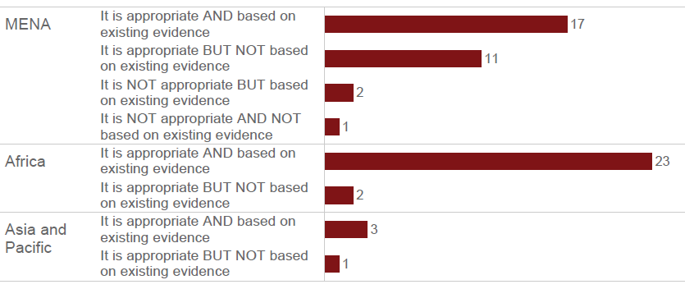
Coordination team feedback on country-level shelter cluster strategy by region
Notes:
Most of the coordination team respondents in all regions thought that the country shelter strategy is appropriate and based on existing evidence.
However in MENA, around a third (11 / 31) thought that the strategy was not based on existing evidence, and 3 thought that the strategy is not appropriate at all.
Some country-specific feedback:
Chad: It is appropriate but there needs to be an agreed model of shelter to use by partners. This aspect have been discussed, elaborated by technical group and will be with ICC and HCT to be supported.
Syria: It is somewhat appropriate and based on existing evidence, yet it is hard to implement.
Afghanistan: The current strategy is appropriate and based on existing evidence, nonetheless its not well implemented. The strategy advocates for both emergency & transitional shelter solutions to support resilience for populations affected by natural disasters and conflict, however the response provided is largely emergency-oriented with limited options for transition.

Slide 22
Feedback on GSC meeting outcomes and impediments to shelter response
What do GSC 2019 Meeting Attendees want as an outcome, and what do they believe are impediments and solutions to current shelter response?

Slide 23
Number of attendees reporting each impediment to shelter response
Notes:
161 meeting attendees answered the question:
What are 3 of the most influential impediments facing the shelter sector in your experience in the last 12 months?
Participants selecting ‘other’ wrote:
More analysis on shelter and protection including impacts where there are gaps;
Rigid standardised data collection acting as a barrier for reporting
Inadequate housing policy in terms of durable solutions
1) Unhealthy competition between responding agencies 2) Lack of prioritisation and organisation cultural change towards 'nexus' approach.' approach
low engagement of local actors; low understanding of the broader potential impacts of shelter programming
Competing agenda with multi sector approach
Lack of Logistics Cluster
Sector co-leading issues
weak engagement on environmental issues.
Poor understanding and recognition of the shelter sector
Access
Poor diaspora engagement
Government cluster leads not adequately resourced or empowered to lead coordination

Slide 24
Number of attendees reporting each impediment to shelter response
Notes:
161 meeting attendees answered the question:
What areas of cluster coordination have the greatest potential to reduce those impediments? (3 choices)
Fundraising from a shelter for protection perspective.
mainstreaming capacity building into management roles, more investment in technical and management staff
Better integrated response and coordination
Improved environmental capacity
Greater understanding of local needs and community interaction
organisational leaders need to lead cultural change within their orgs to ensure that a 'One UN/OneHumanitarian' (including 'nexus') approach is actively supported. Cluster Coordinators need to be empowered to deliver the approach.
Greater investment in country level coordination systems and planning
Communications/advocacy on behalf of S&S sector
empowered staff who are engaged to stay in their field positions
Ensuring cluster coordinators are technically qualified
Advocacy to ensure the donors deliver of fund appropriately to support the recovery of shelter and settlements.
IASC to clarify the lead agency responsabilities and ensure that rules are globaly respected
Reactivate LOG cluster
Further guidance, leadership, negotiation to secure access to most vulnerable individuals.
Support revision of Disaster Law legislative frameworks to empower Government leads
this list is missing contextualised guidance and support to operatiobnal partners

Slide 25
Feedback on what would be a great GSC 2019 meeting outcome
Connect with other practitioners, discover new practices
Involvement of Diaspora in shelter cluster
Guidance on Family-level Shelter Resilience against Category 4-5 Cyclones and engagement of Diaspora for "Safer Shelters"
Joint funding proposals on thematic priorities
Clearly spelt out or realigned strategy for the coming years that is developed with that full engagement of all key stakeholders and well communicated to participants.
Clarify a set of specific guidelines for the support of the inter-cluster coordination for the year to come.
Increase knowledge related to urban shelter response.
Exchange of practices around the world
Improve coordination knowledge, experience sharing and learning from other shelter coordination contexts.
An overall strategy, SOPs and guidance for Cash Programming
Networking, partnerships and exchange
Strategy understanding and development
Specific thematic topics
As always an opportunity to network and connect with colleagues globally, and to garner further discussion and input into urban programming and the application of the settlements / area based approach.
The chance to share knowledge and practice, and connect to shelter practitioners/Coordinators in various countries
Consensus on sector issues we commit to addressing in FY2020 and actionable next steps.
Clearer understanding of the direction of GSC research and evidence pillar.
Being more informed about what GSC members believe is important to ensure fire safety in shelter provision and how to best engage with them to ensure progress towards fire safety.
Information exchange, and lessons learnt
Becoming aware of the key trends - challenges and opportunities - faced by the sector, and, as much as possible, discuss and agree on the way forward - at both strategic and operational levels
Explore partnership opportunities with the private sector; Secure and finalize partnership agreements / shared leadership agreements
Get clear guidance on how to better localize shelter assistance (including cash) and shelter (cluster) coordination
Increased inter-agency collaboration and representation
Partnerships with other organisations
Notes:
This is a collection of most, but not all, of the responses to the question:
What would be a great meeting outcome for you?

Slide 26
Thank you

