Slide 1
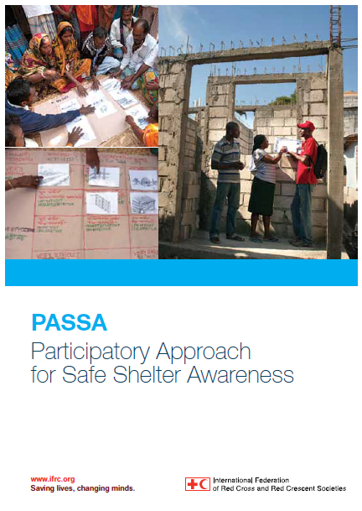
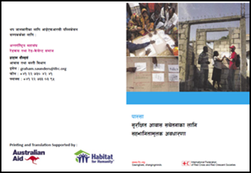
PRESENTATION TO RRWG
Participatory Approach for Safe Shelter Awareness

Slide 2
Status
What it is?
PASSA ToT Training – Nepal – November 2015
How it fits into Reconstruction and Recovery Work Plan of Collective Approach?
Who else is using it in Nepal EQ response?

Slide 3
What is PASSA: Background
Developed by IFRC in 2009 to 2011
Based on PHAST (Participatory Hygiene and Social Transformation)
Used in over 50 countries mainly Habitat for Humanity and the Red Cross Movement.

Slide 4
PASSA
Participatory Approach to Safe Shelter Awareness
The aim of PASSA is to develop local capacity to reduce shelter and settlement related risk by raising awareness and developing skills in joint analysis, learning and decision-making at community level

Slide 5
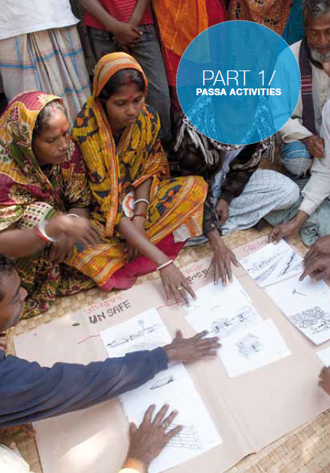
8 PASSA Steps
Historical profile
Community mapping and visit
Frequency and impact of hazards
Safe and unsafe shelter and settlement
Options for solutions
Planning for change
Problem box
Monitoring plan

Slide 6
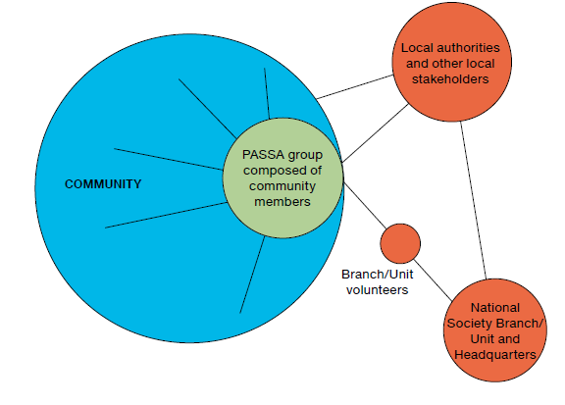
PASSA GROUP
The PASSA group has between 20-40 persons that are part of the community, formed with a mix of people from different backgrounds, age, gender, education, income level, occupation, owners and renters, etc that widely represents the community
Notes:
2

Slide 7
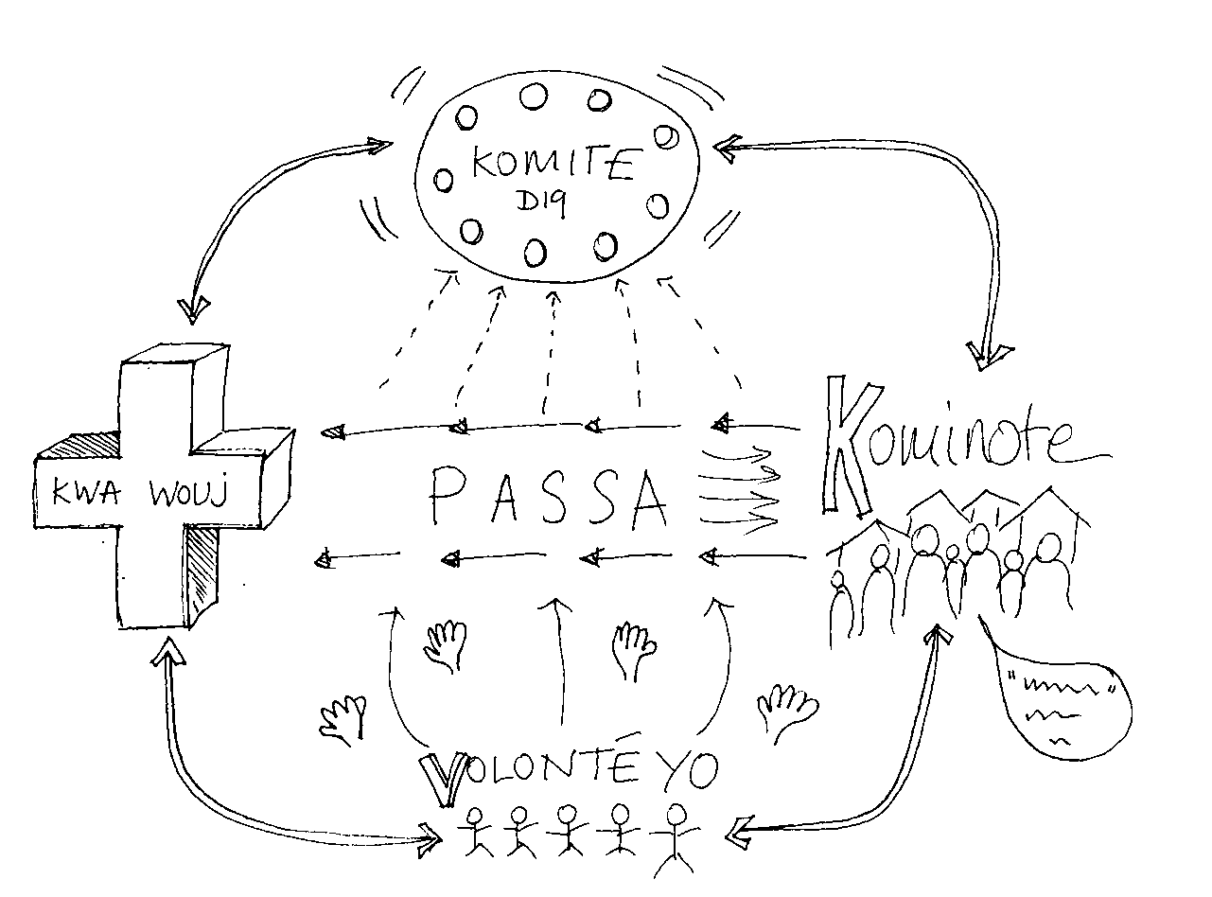
Time frame
Can be carried out over 2 months or 5 day
Passa Light – 2.5 days
Time is often allowed so that:
PASSA groups can communicate with other members of the community what has been discussed
Reflection time needed for some activities

Slide 8
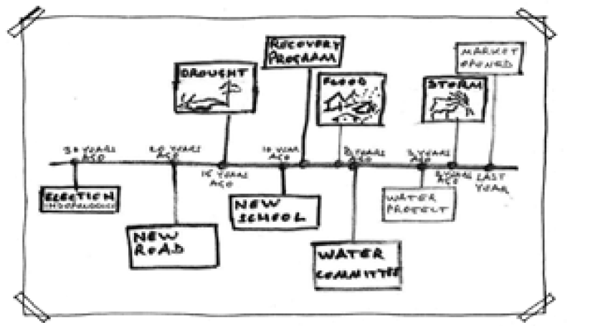
Activity 1A – Historical Profile (Major Events)
Historical profile
The historical profile helps to understand the different events that have caused any impact on the community and highlights its vulnerabilities.
Notes:
Traditionally this focuses on the major events in the communities history, ranging from political events, a fire, building of s significiant building, an outbreak in disease etc. To identify the reasons for it’s vulnerability ie. – there was a big flood/ hurricane/ earthquake etc. identify the larger risks. Sometimes the risks can be smaller… so we added a secondary activity – Everyday Problems. – not historical.

Slide 9
Activity 1B – Historical profile (EVERYDAY problems)
Problems faced | Vulnerabilities
Shortage of fire wood | Take time to access materials, more difficult for the poorest
Lack of drainage/sewage staignant water | Diseases malaria/typhoids/cholera/diarrhoea
Lack of health center nor medical support | No first Aid, Limited access to medical care
Blackout/power cuts and insecurity- no reliable electricity , light | Use of insecure electrical connections that can cause fires /
Lack of Toilets | Health risk
Drinking water supply | Unreliable water supply
Restricted access during monsoons and winter | Reduced access to markets, reduced access to help in emergencies.

Slide 10
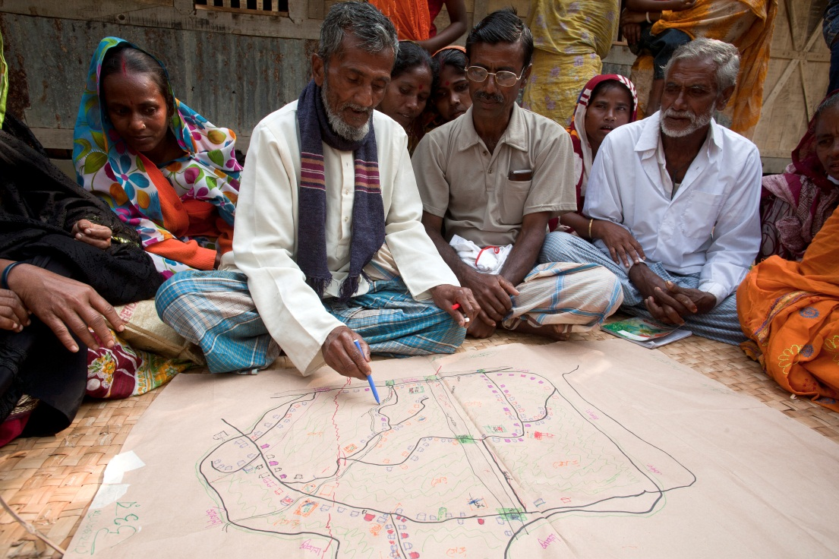
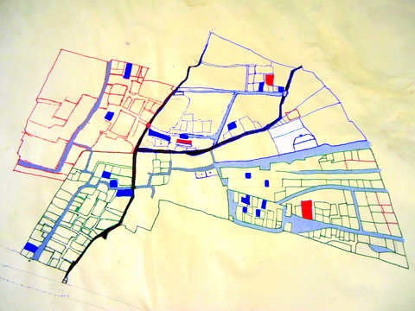
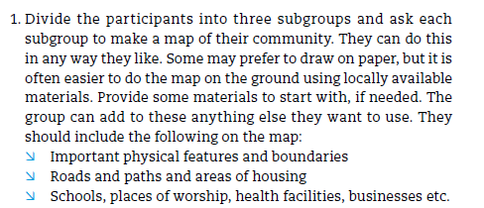
Activity 2 - Community Mapping and Community Visits
Notes:
Mind map. Shows the areas that people think are important. Chance for the community to understand their neighbourhood. Map illiteracy – sense of place. Important when it comes to making contact with the local authorities. Power.

Slide 11
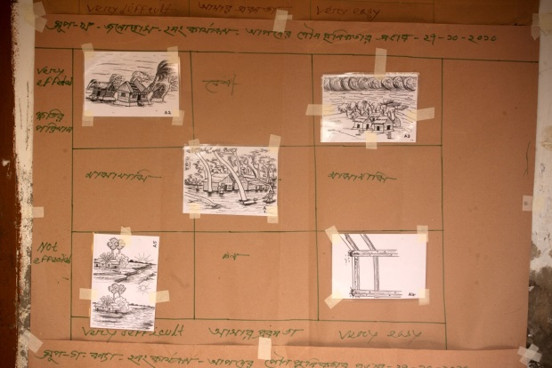
Activity 3 Impact and Frequency
of Hazards
Frequency Impact | Very Unlikely | Sometimes | Very Likely
Big Impact | Earthquake | Severe flooding | Localised flooding
Medium Impact | Fire Cholera | Political Outbreaks (Coup d’État) Cyclones (Hurricane) | Debris (lack/bad management) Restricted access Damaged water pipes Misuse of the canal Latrines (lack, poor maintenance)
Very Limited Impact | Car Accidents | Collapse of damaged building | Swampy soil Unhealthy and congested market Lack of gutters Lack of public lighting/electricity

Slide 12
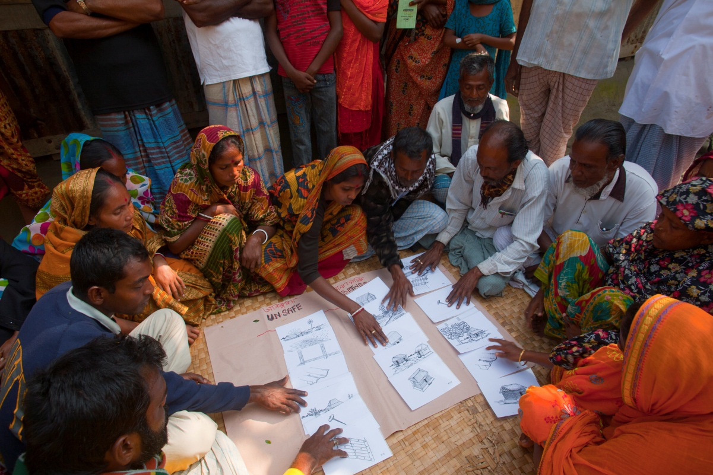
Activity 4A - Safe and Unsafe Habitat
Notes:
The ‘Safe and Unsafe’ Extended to all aspects in the habitat. Infrastructure/ drainage and wastemanagement.

Slide 13
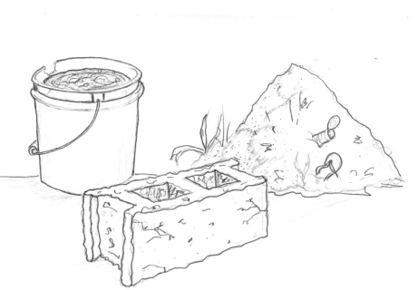
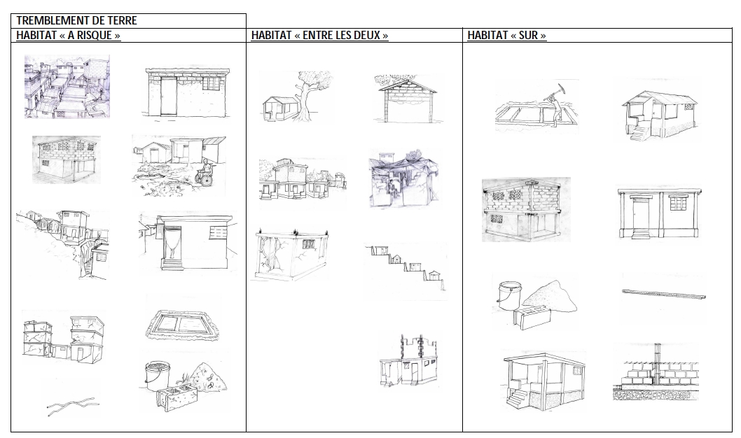
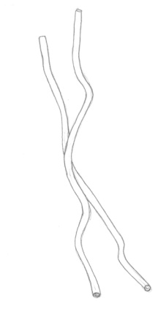
Activity 4B: Safe and unsafe shelter
Poor materials
Poor materials
Notes:
Aspects of good and bad in each one
Poor materials low level of construction knowledge, short cuts in manufacturing blocks etc.

Slide 14
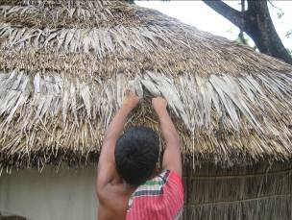
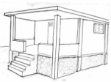
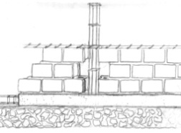
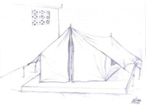
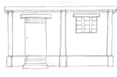
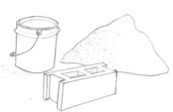
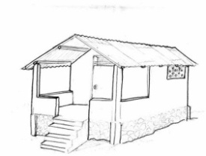
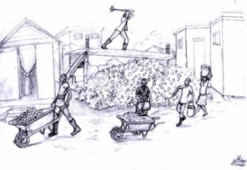
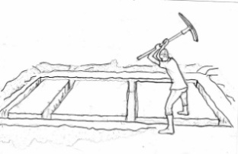
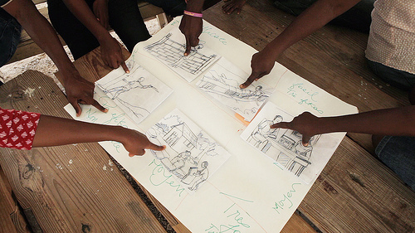
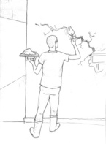
Activity 5 Options for Solutions
Difficulty
Feasiblility Effectiveness | Very Difficult | Moderately difficult | Very Easy
Very Effective
Moderately Effective
Not effective
Gain knowledge of materials and safer construction techniques
Effectiveness
Notes:
Soft and hard solutions. Training, sensitisation and technical solutions.

Slide 15


Activity 6 – Planning for change
Community Action plan - example
Problem | STEP 1 | STEP 2 | STEP 3 | STEP 4 | STEP 5 | Solution
DEBRIS Management | Sensitisation of the problem | Improve infrastructure around debris management and related capacity | Creation of a new system for debris management s | Maintenance and follow up and of new system | Engagement with local authorities and request for support | Good debris management, and the area is clean
 | Activities 1. Hygiene Promotion 2. 3. | Activities 1. Training and Capacity building 2. 3. | Activities Collection and debris dumping . | Activities 1. Punctual verification of collection and debris dumping 2. 3. | Activities 1. 2. 3.
 | Resources needed Existing Capacity Responsibilities | Resources needed Existing Capacity Responsibilities | Resources needed Existing Capacity Responsibilities | Resources needed Existing Capacity Responsibilities | Resources needed Existing Capacity Responsibilities

Slide 16
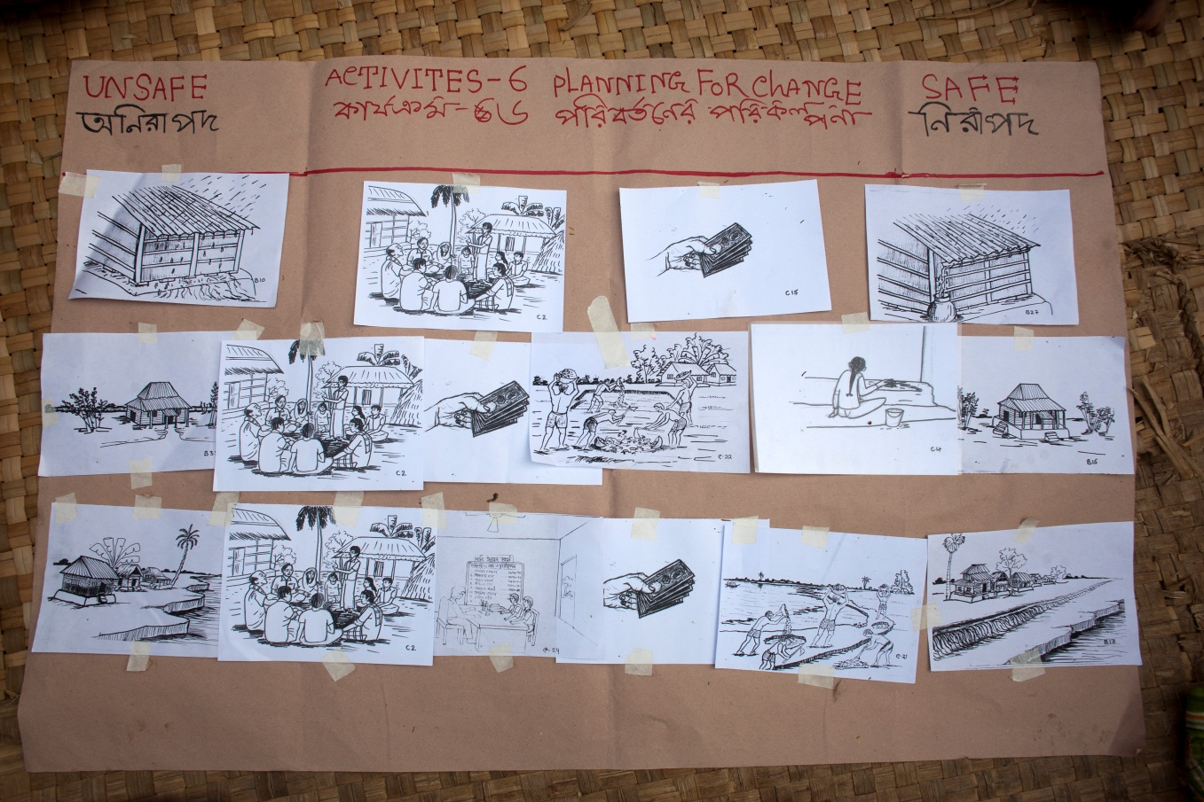
Activity 6 – Planning for change

Slide 17
Activity 7: Problem Box
Identify possible problems in implementing the plan to make improvements in shelter safety
Seek solutions to these problems
Identify possible changes needed in the plan
Problems the group can deal by itself without changing the plan | Problems the group can deal by itself with changes in the plan
Problems that cannot be solved by the group but can be solved with outside help | Problems for which the group cannot think of a solution, even with outside help

Slide 18
Activity 8: Monitoring and Evaluation
Monitoring against the action plan
Roles and responsibilities:
Community
Committees / Community based organisations
Red Cross Society
Local authorities
Using:
Indicators, mapping, progress meetings to monitor the changes…and highlight blockages and solutions

Slide 19
Summary of Steps
The 8 traditional PASSA sessions
Historical profile (and every-day problems) – mapping risks and challenges on time line/seasonal
Community Mapping and Community visits – transect walks and mapping the settlement
Impact and frequency of Hazards – Which hazards happen most often and cause the most damage
Safe and Unsafe Shelter and Settlement – identifying safe and unsafe shelter practices in the community/district
Options for Solutions– selecting appropriate measure of improvement which are achievable
Planning for Change–creating a plan with all the steps needed to reach improved shelter and Settlement
Problem Box– identifying problems which may need to be overcome (iterative with the plan)
Monitoring Plan– assign tasks/steps to members of the community , design monitoring methodology

Slide 20
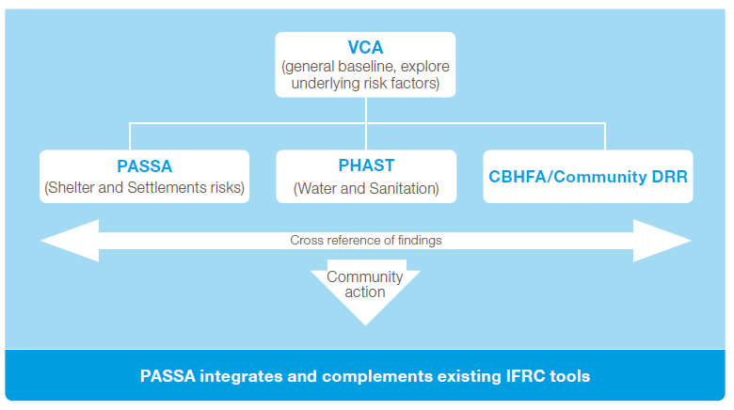
How did authors envisage PASSA would fit in?

Slide 21

PASSA Trainers of Trainers (ToT) Nepal – November 2015
PASSA ToT undertaken in Nepal in November 2015
2 Facilitators from IFRC
34 Participants from xxx Organisations including xxxxxx
PASSA Manual already translated in Nepali through Habitat for Humanity

Slide 22
PASSA in Nepal for Earthquake Recovery
Now PASSA Working Group established through Shelter Cluster
PASSA Technical Share Folder set up through Dropbox for Nepal Community of Practice.
Now developing context specific training cards – CARE taking lead.
Partners now developing projects and programmes to integrate PASSA.
Plan to have second ToT Training in December 2015

Slide 23
PASSA Task Group
CARE considering calling it PASHA – Participatory Approach to Safe Habitat Awareness – and based on context in Nepal
PASSA is listed on Workplan, but recognise it is not the only Participatory Tool.

Slide 24
PASSA Summary
Something you can start right now. Don’t need to wait on central Gov. approval.
Helps communities design their own recovery programme. Bottom up approach. Agency activities are more likely to be relevant to community.
A Participatory Assessment Tool, Mobilisation Tool, An Awareness and Sensitisation Tool
Can do PASSA light
Can pick just some activities

