Slide 1
Population Data Management

Slide 2
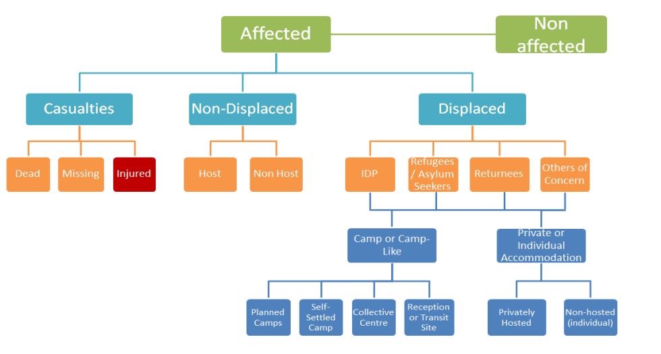
Population Data Management (PDM)
Is the recording of the number and characteristic, disaggregated as appropriate, of a population in a specific place and time period, for the purpose of programming effective response and decision-making

Slide 3
Importance of PDM
Scale and scope of emergency
Consistency in figures
Strategic and Programme planning
Delivery of protection and assistance
Funding

Slide 4
Types of Population
Total population
Population affected
Population in need
Population targeted
Population reached

Slide 5
Factors affecting PDM
Disaster
Conflict
Influx
Movements

Slide 6
Available Population figures
Census 2005
Assessments
Total Population of Country: 9 m
Total IDP families in camp: 17633 HHs/ 92000 indivs
Total IDP families in village: 40 HHs
Total Refugee + other of concern in camp: 33022
Other estimates/ assessment additional figures refugees: 22000 HHs/ 120000 indivs
Other estimates/ assessment additional figures IDPs: 15000 HHs/80000 indivs

Slide 7
Shelter Cluster Stock
Emergency Tents: 4550 pieces
NFI set:
Mattress: 5164
Blanket:197
Fuel Barrel: 385
Stoves: 435
Sleeping mats: 136
Sleeping bags: 500
Current Response Capacity and Gaps
*Number of Kits/Durable Upgrades
Unknown Gap
Country needs
3,756
Storm Emergency
Gap
Baseline Target

Slide 8
Population Figures Challenges
Location
Accessibility
Duplication/Overlapping
Frequent movements/ Influx
Outdated data

Slide 9
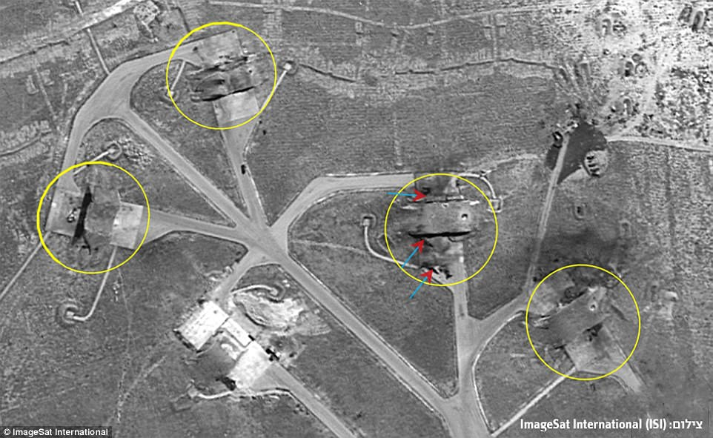
Possible Methodology
Head count
Registration/Census
Shelter count
Household Survey
Assessment
Screening
Satellite images
SDR
Profiling

Slide 10
THANK YOU

