Slide 1
Protection Mainstreaming
ICCG – IHF 1st Standard Allocation
Erbil, Iraq – 26 February, 2018

Slide 2
Protection Mainstreaming
What is “Protection Mainstreaming”?
The process of incorporating protection principles and promoting meaningful access, safety and dignity in humanitarian aid.
Although not all agencies implement protection programming, every agency has a responsibility to include protection principles into programmes.
Protection Mainstreaming focuses not on WHAT we do (the product/service) but rather on HOW we do it (the process)

Slide 3
4 Key Elements
1. Prioritize safety and dignity and avoid causing harm: Identifying the physical and psychological threats affected populations can face in accessing our services, and act to prevent, minimize or mitigate the negative effects of our intervention.
Examples:
Provide assistance in safe and secure locations (away from threats such as violence, GBV, attacks).
Ensure access to services respects culture and religious norms/practice.
Ensure the design of facilities preserve the safety and dignity of individuals.
Do not share identifiable information unless informed consent has been given.
Ensure confidentiality and privacy in any form of consultation.
Consider potential tensions between affected population and host communities.

Slide 4
4 Key Elements
2. Meaningful access: Ensure access to assistance in proportion to need and without barriers (e.g. physical, financial, discrimination, information). Pay attention to those who are particularly vulnerable or have difficulty accessing services.
Examples:
Consult with all population groups (AGD approach) to identify specific needs and challenges they may face.
Develop vulnerability criteria.
Make adaptation to infrastructures to ensure services can be accessed by persons with reduced mobility.
Monitor access to services, potential discrimination and services being diverted.

Slide 5
4 Key Elements
3. Accountability: Set up appropriate mechanisms through which affected populations can measure the adequacy of interventions and address concerns or complaints.
Examples:
Be transparent (provide information about how to access assistance).
Monitor how assistance is delivered – is it reaching the identified population?
Is it meeting the needs identified? Set-up comprehensive complaints mechanism.

Slide 6
AAP includes:
Feedback and complaints:
Actively seek the views of affected communities to improve policy and practice in programming
Trans-parency:
Provide timely and adequate information
Partici-pation:
Enable affected communities to play an active role in the decision-making processes
(commitments endorsed by the Interagency Standing Committee, 2011)
Notes:
In December 2011, the IASC adopted five commitments on AAP:

Slide 7
Accountability to affected populations
Beneficiaries are key partners in their own future. Three key areas:
Information provision (CwC): Provide to affected people accurate, timely and accessible information about assistance. Information provided has to be clearly understandable by everyone, irrespective of their age, gender, or other characteristics.
Consultation (CwC): Seek the views of all segments of the affected population and invite feedback throughout each stage of the project cycle.
Complaints and feedback mechanisms (CFMs): Provide a means for affected people to voice complaints and provide feedback on areas relevant to operations in a safe and dignified manner. A CFM system must include established procedures for recording, referring, taking action and providing feedback to the complainant. Valid complaints and useful feedback must be taken into account to ensure improved programming.

Slide 8
4 Key Elements
4. Participation and Empowerment: Support the development of capacities. Assist people to claim their rights, including (not limited to) the rights to shelter, food, water, sanitation, health, education.
Examples:
Consult regularly with all layers of the society and include the affected population in project design and evaluation.
Work with local authorities and civil society.
Identify the coping mechanisms and design intervention to avoid resorting to negative coping mechanisms.
Hand-over facility management to community or local authorities. Support representative community groups.

Slide 9
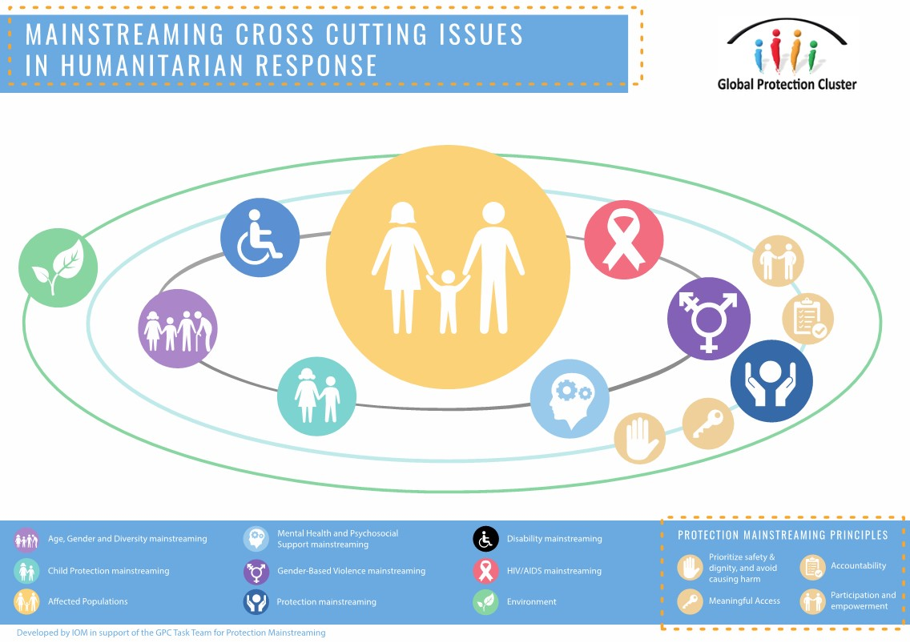
Notes:
Affected populations are at the center of humanitarian action
The application of PM principles allow for all the above described issues to be reflected during the response.
Finally humanitarian practitioners must consider and respect the environment where the humanitarian response takes place to ensure contextually appropriate action which avoids environmental degradation putting a strain on affected populations’ exposure to risks.

Slide 10
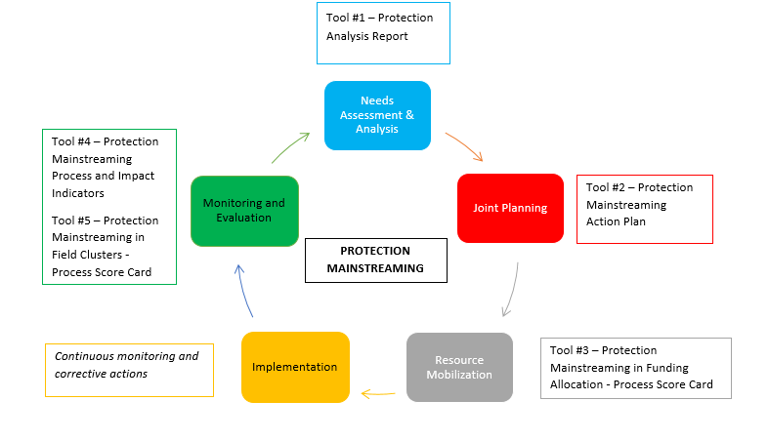
Protection Mainstreaming in the HPC

Slide 11
Tools - Collective Level
Protection Risk Analysis Methodology and Report Template: Template to gather information about threats, vulnerable groups and capacities.
Protection Mainstreaming Action Plan: Template for planning and reporting on protection mainstreaming related activities.
Protection Mainstreaming in Funding Allocation – Process Score Card: Template to assess the quality of proposal submitted to the review board.
Protection Mainstreaming Process and Impact Indicators: List of suggested indicators to monitor protection mainstreaming.
Protection Mainstreaming in Field Clusters – Process Score Card: Template to evaluate the mainstreaming of protection in the cluster level system.

Slide 12
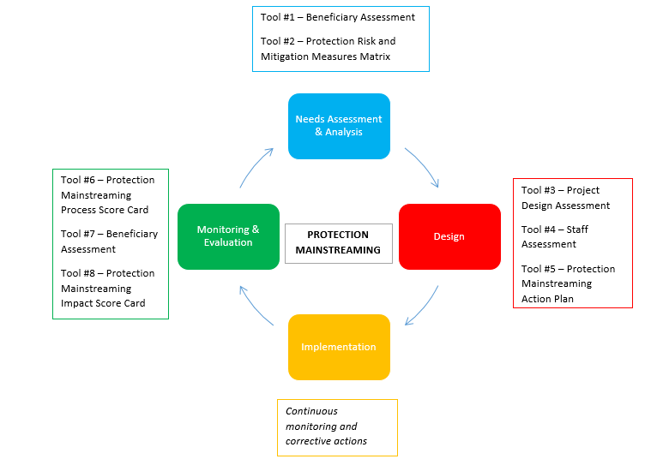
Protection Mainstreaming in the Project Cycle

Slide 13
Tools – Individual Level
Beneficiary Assessment (Baseline/Endline): Template to gather beneficiary’s perception of safety/dignity, access to services, accountability and participation.
Project Design Assessment: Template to assess the project proposal alignment with PM principles.
Staff Assessment : Template to assess the staff knowledge and skillset on PM.
Protection Mainstreaming Action Plan: Template for planning and reporting on PM activities.
Protection Mainstreaming – Process Score Card: Template to assess the level to which the organization has followed the steps to effectively mainstream protection.
Protection Mainstreaming – Impact Score Card: Template to assess the impact of having mainstreamed protection on affected populations.

Slide 14
Global Resources and Support
Material Available:
Protection Mainstreaming Training Package
Protection Mainstreaming Sector-Specific Checklists (Guidance App)
Protection Mainstreaming Videos
Tip Sheets / Guidance Notes - Protection Cluster, Cluster, ICCG, HCT
Coming soon:
Protection Mainstreaming E-Learning Course
Protection Mainstreaming Toolkit

Slide 15
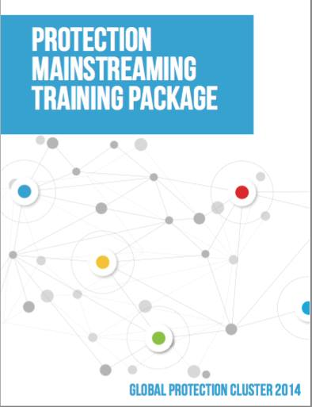
Global Resources and Support
GPC Protection Mainstreaming Training Package: Available in English, French, Arabic and Spanish
Notes:
The GPC Protection Mainstreaming Training Package has been developed to support field-based capacity-building of humanitarian workers from all sectors in humanitarian (including protracted) emergencies – in both conflict and natural disaster contexts. It can also be used to train government actors that are involved in the design and delivery of humanitarian programs. The Training Package is available in English, French, Arabic and Spanish. Follow this link: http://www.globalprotectioncluster.org/en/areas-of-responsibility/protection-mainstreaming.html

Slide 16
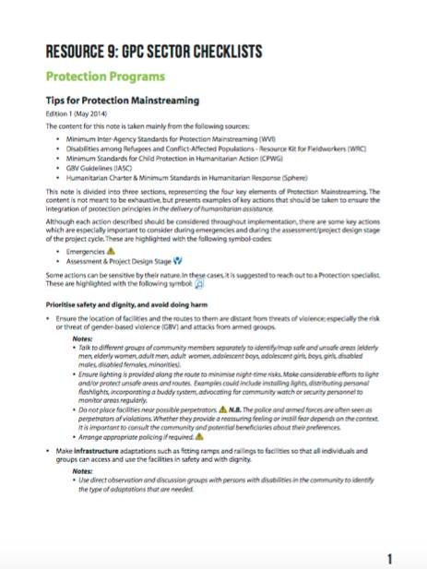
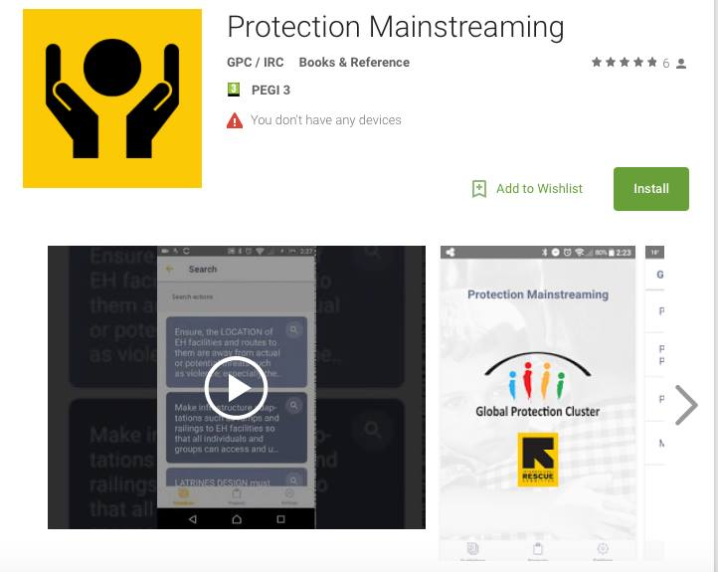
Global Resources and Support
GPC Protection Mainstreaming Sector-Specific Checklists and Guidance App
Notes:
The GPC Sector Checklists provide specific actions to mainstream protection principles in other humanitarian sectors/clusters (Shelter, WASH, CCCM, Education, Health, Food Security and Livelihoods, Protection). Follow this link: http://www.globalprotectioncluster.org/en/areas-of-responsibility/protection-mainstreaming.html
The Protection Mainstreaming Guidance App is based on the GPC Sector Checklists. It provides a solution to streamline Protection Mainstreaming guidance to your specific needs. It is available for download through the Google Play and iTunes App Stores.

Slide 17
Global Resources and Support
GPC Protection Mainstreaming Video is a short on the four principles of protection mainstreaming
The video is available in English with Spanish and Arabic subtitles.
http://www.globalprotectioncluster.org/en/areas-of-responsibility/protection-mainstreaming.html

Slide 18

Gender Marker in IHF Proposals
ICCG
26 February 2018

Slide 19
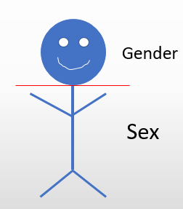
What is Gender?
Gender is a socially constructed definition of women and men. It is not the same as sex (biological characteristics of women and men) and it is not the same as women. Gender is determined by the conception of tasks, functions, roles and responsibilities attributed to women and men in society and in public and private life.

Slide 20
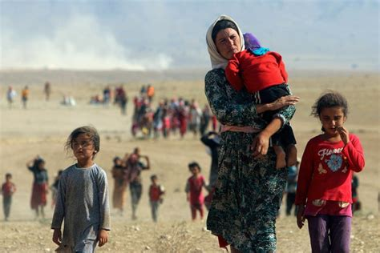
Why should gender be considered in proposals?
Different Roles
Different Needs
Better Response

Slide 21
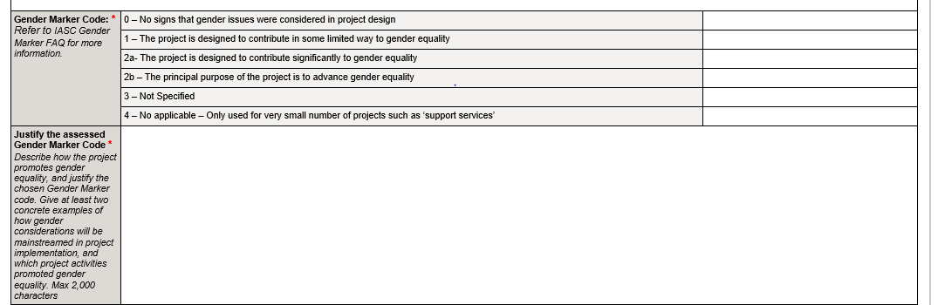
Gender Marker in IHF Proposals
To Achieve a 2a code, gender concerns must be addressed in:
Needs Analysis
Activities
Outcomes

Slide 22
Gender marker in IHF proposals
Needs Analysis
- Who is affected? How are they affected? Who has access and what are the barriers to accessing services? Do women and men participate equally in decision making?
Activities/Outcomes
- All activities should relate to and be justified by the needs and context described.
- Need to provide target proportions (men, women, boys and girls) to enable monitoring of equitable participation and fair distribution of resources.
- Set targets, and explain why you set them, for the participation levels of women, girls, boys and men in the various activities. Ratios do NOT have to be 50-50 --- they rarely are.

Slide 23
Criteria that Should be Addressed in Proposal Development
Design services that meet the needs of the target population
Show how women, girls, boys and men use the services or benefit from them
Example: Separate latrines for men and women in service delivery areas
Access to service for women, girls, boys and men
Examine barriers that might exist to access for certain groups
Example: Examine the composition of women and men in service delivery teams. Examine if registration for services is not excluding some highly vulnerable groups such as female headed households, widows, etc.
Participation of women and men
Ensure women, men, boys and girls participate in design, implementation, monitoring and evaluation.
Example: How many women are in decision making positions for the project design and implementation?

Slide 24
Criteria that Should be Addressed in Proposal Development
Training should benefit men and women equally
Example: In cash for work activities, avoid male only work. Tailor trainings to accommodate women. (ex. can women bring their children or is child care provided?)
Address Gender-Based Violence
Services delivered should not put individuals at risk of GBV
Example: Examine the presence of lighting and lamps around service delivery areas (in camps, settlements, etc.) with a specific emphasis paid to sanitation facilities. Examine distance between toilets, water points and dwelling places to reduce risk of GBV. Examine the timing of distribution of food and non food items for safety and security.
Collect, Analyze, and Report on Sex/Age Disaggregated Data (SADD)
Assists with determining needs and gaps among different groups that have not been met
Collect SADD using quantitative methods such as surveys, registration lists, distribution lists, clinic records etc. Qualitative methods such as key informant interviews, focus group discussions and one-on-one in-depth interviews should be used also.

Slide 25
Gender disaggregated indicators
Indicators should be disaggregated by sex and age to show the proportions of male and female who will benefit.
# of farmers benefitting from agricultural inputs and livestock.
# of men and women farmers benefitting from agricultural inputs and livestock.
# of children attending school
# of girls and boys attending school
# of health workers receiving training
# of men and women health workers receiving training
Gender Marker Tip Sheets – by sector: https://www.humanitarianresponse.info/topics/gender/document/gender-marker-tip-sheets-english

Slide 26
Protection from Sexual Exploitation and Abuse (PSEA) in IHF Proposals
ICCG
26 February 2018

Slide 27
Protection from Sexual Exploitation and Abuse (PSEA)
Sexual exploitation = any actual or attempted abuse of a position of power, vulnerability or trust for sexual purposes
1) Often an exchange
2) Always an improper use of position
3) With purpose to benefit from it
ex. Paying for sex; engaging in a sexual relationship in exchange for a job or for more rations/goods/shelter, etc.
Sexual abuse = the actual or threatened physical intrusion of a sexual nature by force or under unequal /coercive conditions
ex. Sex with a minor (under 18), rape, inappropriate touching, etc.

Slide 28
The PSEA Code of Conduct
The Secretary General Bulletin (ST/SGB/2003/13) outlines the UN’s zero tolerance approach to SEA. It prohibits the exchange of money, employment, goods or services for sexual favours or other forms of humiliating, degrading or exploitative behaviour
It is the UN’s Code of Conduct on PSEA.
It applies to:
All UN staff and humanitarian/aid workers
All persons that have entered into a cooperative arrangement (or contract) with the UN (employment/partnership)
Example: drivers, cleaners, daily laborers, distribution staff, etc.
Standards apply at all times even when on leave or off duty.
Notes:
Note that some individuals do not consider themselves “aid workers” so do not feel that the SG Bulletin applies to them. This is incorrect as it applies to all staff, regardless of their job title or position.

Slide 29
Grant Agreement- Article IV clause 4 and 5
The Implementing Partner acknowledges and agrees that United Nations and OCHA have zero tolerance for abuse and misconduct, including sexual exploitation and abuse. It shall communicate accordingly to its Personnel and shall take all reasonable measures to prevent abuse and misconduct.
In particular, but not limited, the Implementing Partner represents and certifies to undertake all reasonable actions to prevent: sexual exploitation and abuse, sexual and work place harassment, discrimination, assault, threat, jeopardizing life of staff or others, abuse of authority, mismanagement, misuse and misappropriation of assets and funds, theft, fraud, corruption, misrepresentation, collusion and other violation of procurement principles, gross negligence, conflict of interest, violation of the relevant law, and/or of International Humanitarian, Human Rights and Refugee Law and of humanitarian principles, abuse of UN status, privileges and immunities, violation of confidentiality, violation of terms and contractual clauses under this Agreement. The Implementing Partner must comply with all requirements of the UN Standards of Conduct

Slide 30
Six Core Principles
Sexual exploitation and abuse is serious misconduct and ground for disciplinary measures, including summary dismissal.
Sexual activity with children (persons under the age of 18) is prohibited - regardless of the age of majority or age of consent locally. Mistaken belief in the age of the child is not a defence.
3. Exchange of money, employment, goods or services for sex, including any humiliating, degrading, or exploitive behaviour is prohibited. This includes beneficiaries but also job seekers.

Slide 31
Six Core Principles
Sexual relationships between staff and beneficiaries of assistance (since they are based on unequal power dynamics) are strongly discouraged.
Where a staff member has concerns or suspicions regarding sexual exploitation or abuse by a fellow worker, whether in the same agency or not, he/she must report such concerns via established reporting mechanisms.
In Iraq, this includes the PSEA Network (emond@unfpa.org) or the UN IDP Call Centre (80069999)
Staff and related personnel are obliged to create and maintain an environment that prevents sexual exploitation and abuse. Managers at all levels have an additional responsibility to do so.
Notes:
The UN is not concerned with preventing sexual relationships but with preventing abuse, particularly of vulnerable populations. The focus is not on the individual or whether there is consent, but on the nature of the relationship.
Where there is an unequal power dynamic, there is a strong potential for abuse. The SGB requires all - whether they are international or from the local population - to show good judgment, and to think about their actions and the consequences of their actions. All exploitative and abusive acts are prohibited, whether they are committed against a person of concern to the UN or someone living in the local community.
Mandatory reporting applies to all personnel and partners.

Slide 32
PSEA in your Projects
Project proposal:
Have you analyzed risk of SEA?
Will your staff have one-on-one interactions with the beneficiaries?
Will your project include distribution of goods such as food, water, NFI, shelter, or cash?
Will your staff control or influence access to services such as livelihood opportunities, health care, education, etc.?
Does your proposal include activities/strategy (and budget) to reduce SEA risks?
Awareness raising materials or sessions
Training for beneficiaries and/or for staff on PSEA.
PSEA policy in place, including Code of Conduct

Slide 33
PSEA in your Projects
Monitoring and Evaluation: identify, collect, and analyze key indicators.
% of staff with signed Code of Conduct
% of staff who received briefings or trainings on PSEA
% of activities where Code of Conduct and/or PSEA communication materials are displayed.
# of post-distribution or post-activity assessments, surveys, or feedback forms completed. These should include questions such as:
Did you feel safe?
Were you ever asked to pay or give anything in exchange for your assistance?
Do you know how to report abuse or exploitation?
Future activities should be modified based on this feedback!

Slide 34
PSEA in your Projects
Staff Training: Assess the need for staff training on PSEA, and plan/budget for trainings as required.
Outreach and awareness raising: Key Messages should include:
This humanitarian assistance is free.
You should not be asked to give money or anything else in return for your assistance.
If you feel unsafe or wish to file a confidential complaint, please call the free UN IDP Information Centre Hot Line (80069999).

Slide 35
PSEA Resources
Iraq PSEA Network: Jennifer Emond, emond@unfpa.org; 07510157328; - Douglas Jennings, douglas.jennings@wfp.org, 07827806774
Global PSEA Task Force – Tools: http://pseataskforce.org/
PSEA Implementation Quick Reference Handbook: http://www.chsalliance.org/files/files/PSEA%Handbook.pdf
Frequently Asked Questions: http://www.pseataskforce.org/uploads/tools/faqsseabyunpersonnelandpartners_echaecpsunandngotaskforceonpsea_english.pdf

Slide 36
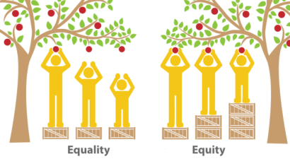
Thank You

