Slide 1
Shelter Working Group Meeting
Monday 29 June, 02pm
APAD Office

Slide 2
Agenda
Welcome & introductions
Information update
Cash working group update
District Focal points
AOB
Next meeting

Slide 3
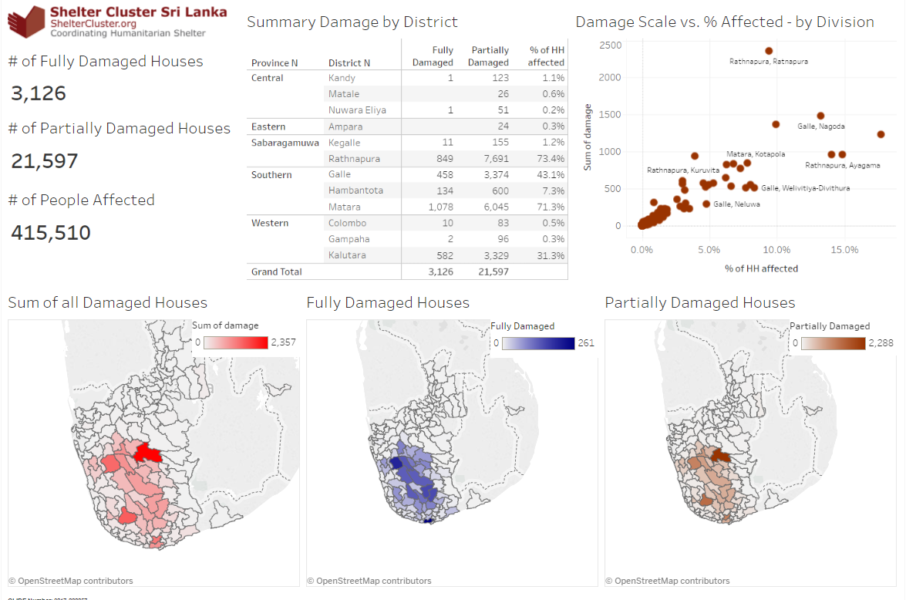
Update as at 28.06.2017
Click Here for Latest DMC Update

Slide 4
4 District
Transitional Shelter | 90
Permanent House | 250
Unmarked District for the Response Plan
Partially Damaged Houses | 20439
Fully Damaged Houses | 2967
Item | Total # of HH
Household NFIs Kits/ Cash | 26635
Shelter Repair kits/Cash | 5700
Repairing | 58
Community Based Shelter Progrrame | 400
Permanent House | 290
Transitional Shelter | 540
Items | Total Response Needed | Response Plan | Gap
Cash/ Shelter Repair Kits | 20439 | 6158 | 14281
Cash/ Household NFI Kits | 23406 | 26635 | (3229)
Permanent House/Transitional Shelter | 2967 | 830 | 2137

Slide 5
Ratnapura
Partially Damaged Houses | 7691
Fully Damaged Houses | 849
Item | Total # of HH
Household NFIs Kits/ Cash | 6928
Shelter Repair kits/Cash | 2460
Repairing | 0
Permanent House | 0
Transitional Shelter | 150
Items | Total Response Needed | Response Plan | Gap
Cash/ Shelter Repair Kits | 7691 | 2460 | 5231
Cash/ Household NFI Kits | 8540 | 6928 | 1612
Permanent House/Transitional Shelter | 849 | 150 | 699

Slide 6
Kalutara
Partially Damaged Houses | 3329
Fully Damaged Houses | 582
Item | Total # of HH
Household NFIs Kits/ Cash | 8267
Shelter Repair kits/Cash | 0
Repairing | 0
Community Based Shelter Programme | 400
Permanent House | 0
Transitional Shelter | 280
Items | Total Response Needed | Response Plan | Gap
Cash/ Shelter Repair Kits | 3329 | 400 | 2929
Cash/ Household NFI Kits | 3911 | 8267 | (4356)
Permanent House/Transitional Shelter | 582 | 280 | 302

Slide 7
Matara
Partially Damaged Houses | 6045
Fully Damaged Houses | 1078
Item | Total # of HH
Household NFIs Kits/ Cash | 7782
Shelter Repair kits/Cash | 3240
Repairing | 58
Permanent House | 40
Transitional Shelter | 0
Items | Total Response Needed | Response Plan | Gap
Cash/Repair Kits | 6045 | 3298 | 2747
Cash/NFI Kits | 7123 | 7782 | (659)
Permanent House/Transitional Shelter | 1078 | 40 | 1038

Slide 8
Galle
Partially Damaged Houses | 3374
Fully Damaged Houses | 458
Item | Total # of HH
Household NFIs Kits/ Cash | 3658
Shelter Repair kits/Cash | 0
Repairing | 0
Community Based Shelter Programme | 200
Permanent House | 0
Transitional Shelter | 20
Items | Total Response Needed | Response Plan | Gap
Cash/ Shelter Repair Kits | 3374 | 200 | 3174
Cash/ Household NFI Kits | 3832 | 3658 | 174
Permanent House/Transitional Shelter | 458 | 20 | 438

Slide 9
WASH sector coverage
 | Type of Activity
1 | Distribution of Water bottles
2 | Provision of 1000L water tank to camp
3 | Repairing community rural water supply
4 | Jerry cans (20 liters)
5 | Disinfection kits
6 | Hygiene kit
7 | Water Trucking
8 | Well cleaning
9 | Field water quality testing equipment and consumable support to MoH for day to day support kit
10 | Capacity building to Government officers on well cleaning
11 | Dengue awareness program
12 | Public Health Awarnes Program
13 | Construction of SP Latrines
14 | Hand-Washing Facilities (Water-Tank with Washing Consumables)
15 | Provision of Washing and Bathing Facility including Water Connection
16 | Rehabilitation of school WASH facilities, provision of school cleaning kits
17 | Water purification Tablets
18 | Diesel driver Submersible water pumps
19 | Water Pump(3HP)
Target beneficiaries: 550,000
Total number of people reached – 71,384
Planned to reach – 227,420
1 | Alliance Development Trust (ADT)
2 | A-PAD
3 | Habitat for Humanity Sri Lanka
4 | LEADS
5 | Oxfam
6 | Plan International Sri Lanka
7 | Save the Children
8 | Sri Lanka Red Cross
9 | Team Rubicon UK
10 | UNICEF
11 | World Vision Lanka
12 | ADRA

Slide 10
Assessment from Team Rubicon UK
Name of well Owner | No of People or Family using | Purpose | Water Quality Result
T G Benadik T G Benadik | 2 families (10 people) | Washing and drinking | Residual chlorine -0ppm E coli-detected PH-6.2Turbidity -<5
T G Jayantha | 6 families (16 people) | Washing and drinking | Residual chlorine -0ppm E coli-0 PH-6.2 Turbidity -<5
Jokin | 9 people | Washing and drinking | Residual chlorine -0ppm E coli- detected PH-6.2 Turbidity -<5
W.K Kusuma | 15 people | Washing and drinking | Residual chlorine -.5ppm E coli- 0 PH-6.2Turbidity -<5
NK Shriya HieymanthiNK Shriya Hieymanthi | 5 people | Washing and drinking | Residual chlorine -.5ppm E coli- 0 PH-6.2Turbidity -<5
H V AriyarathneH V Ariyarathne | 20 people | Washing and drinking | Residual chlorine -1ppm E coli- 0 PH-6.2 Turbidity -<5
A M WilsonA M Wilson | 14 people | Washing and drinking | Residual chlorine -.5ppm E coli- 0 PH-6.2 Turbidity -<5
N K Ranjith | 8 people | Washing and drinking | Residual chlorine -.5ppm E coli- 0 PH-6.8 Turbidity -<5
P Liyanage | 6 people | Washing and drinking | Residual chlorine -.5ppm E coli- 0 PH-6.2 Turbidity -<5
E A Situruwan | 4 people | Washing and drinking | Residual chlorine -0ppm E coli- detected PH-6.2 Turbidity -<5
Chaminda Kumara | 6 people | Washing and drinking | Residual chlorine -0ppm E coli- detected PH-6.2 Turbidity -<5
P.G Layanal | 4 people | Washing and drinking | Residual chlorine -0ppm E coli- detected PH-6.2 Turbidity -<5
Mahesh Maburanga | 4 people | Washing and drinking | Residual chlorine -.5ppm E coli- 0 PH-6.2 Turbidity -<5
P G Waruna | 6 people | Washing and drinking | Residual chlorine -.5ppm E coli- 0 PH-6.2 Turbidity -<5

Slide 11
Key highlights from the cash working group.
Several organizations use / intend to use cash
Need of better coordination and harmonization of cash based interventions.
Save the children prepared an SOP for cash based programming.
Bring to gather lesson leant from previous cash based programming
Conduct an Emergency Market Mapping Analysis (EMMA) and explore the possibility of cost sharing
Need of working with Ministries to include CBP into their response.
Provide a brief update of the working group in the sector meeting

Slide 12
Web Details
www.sheltercluster.org
https://www.sheltercluster.org/response/sri-lanka-floods-2017
https://www.sheltercluster.org/sri-lanka-floods-2017/documents/21062017-nbro-presentation
https://www.sheltercluster.org/response/sri-lanka-floods-2017/documents?sort=date&sort_direction=DESC

