Slide 1
Shelter Working Group Meeting
Monday 12 June, 10AM
Save the Children Office
Information Management

Slide 2
Agenda
1. Assessments
2. Information management update
3. Beneficiary selection guidance
4. IEC materials and DRR
5. AOB

Slide 3
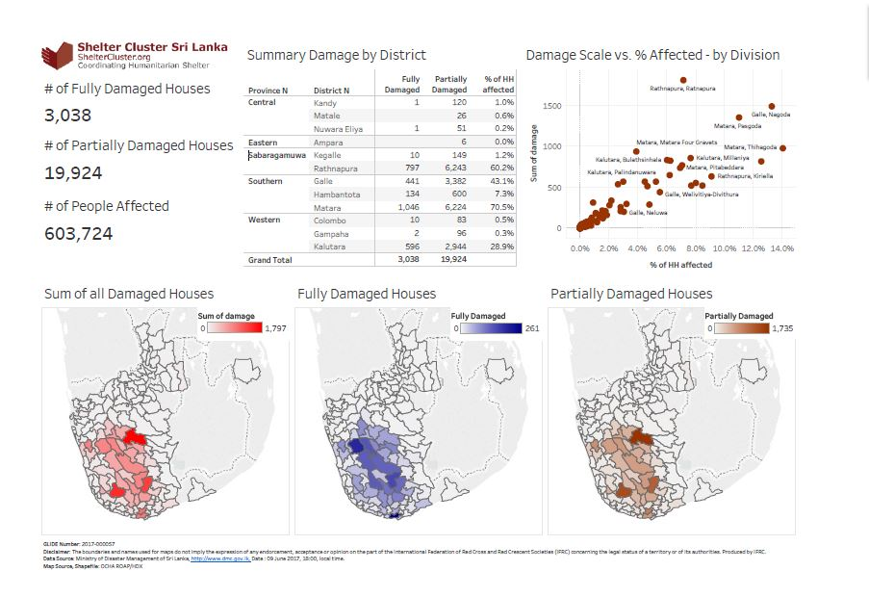
Update as at 11.06.2017 (Click Here for Web Update)
Click Here for Latest DMC Update

Slide 4
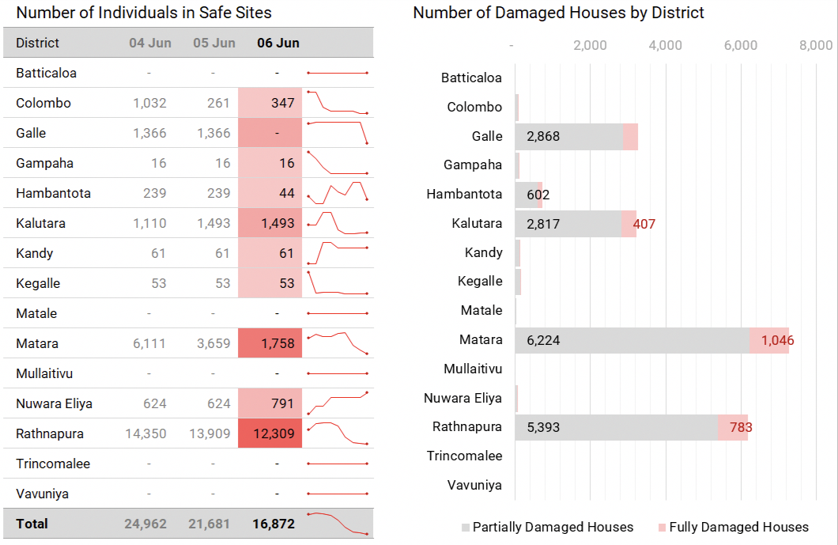

Slide 5
Few More Details
https://public.tableau.com/profile/neil.bauman#!/vizhome/SriLanka170609-DamageCausesHazardsRisksbyDivision/Dashboard2?publish=yes
https://public.tableau.com/profile/neil.bauman#!/vizhome/SriLanka170609-DamageScalevAffected/Print-Damagescalevaffected?publish=yes

Slide 6
Working Agencies
IOM
WORLD VISION LANKA
SAVE THE CHILDREN
SRI LANKA RED CROSS SOCIETY
MUSLIM AID SL
OXFAM
SHELTER BOX
ADRA SRI LANKA
HABITAT FOR HUMANITY
HANDICAP INTERNATIONAL
HABITAT FOR HUMANITY
UNHABITAT
Detail Activities of the Agencies – (Click Here for Excel Sheet)
4W Template

Slide 7
Agency | Relief Items | Area of intervention
IOM/WVI | NFI pack: 3900 Shelter Repair: 3900 | Ratnapura
IOM/Save the Children | NFI pack: 3900 Shelter Repair: 3900 | Matara
UNHabitat | 1500 transitional shelters/Community-based programming | Kaluthara, Galle
Habitat for Humanity | 250 transitional shelters 250 permanent houses | Kaluthara
Red Cross | 1100 family tents
TOTALS | NFI Kits: 7800 Shelter Repair: 7800 Transitional: 1750

