Slide 1
Shelter Working Group Meeting
Monday 16 June, 10AM
Save the Children Office

Slide 2
Agenda
Introductions
IM & District Update
Cargills
WASH and Shelter
IOM Transitional Shelter evaluation
IEC materials and DRR
AOB and Next Meeting

Slide 3
Goal
The goal of the Shelter Sector is to provide people affected by the floods with the means to live in a safe, dignified and appropriate shelter. The Sector will support owner-driven recovery, prioritise the most vulnerable people, families and communities, and invest in DRR.
Objectives
Objective 1: Emergency shelter
Provision of emergency shelter items contributing to self-recovery such as shelter kits (including tools and CGI) or their cash equivalent, supported by appropriate training, community mobilisation and IEC material.
Objective 2: Support to return
Support the most vulnerable households to return through the provision of NFI kits (including kitchen sets, solar lights), or their cash equivalent along with appropriate IEC material.
Objective 3: Support to relocation and resettlement
Provision of transitional shelters for vulnerable households in hazardous landslide areas where a longer term permanent housing solution will need to be found.
Objective 4: Technical support
Provide education information and communication on safer construction principles, and community-based hazard awareness, preparedness and DRR, during all phases of the response.

Slide 4
Objective | Displaced/non-displaced | Intervention type
Emergency shelter | Non-displaced | Shelter Kits/cash
Support to return | Non-displaced | Household NFI Kits/cash
Support to relocation & resettlement | Displaced | Transitional Shelters
Technical support | Displaced/non-displaced | IEC materials, DRR

Slide 5
Agreed Kit Contents
Shelter Repair Kits (USD 95)
Priority | Items
high | CGI (Galvanized Corrugated Iron) Sheets
high | Mammoty with handle
high | Hand saw
high | Crow bar
high | Claw hammer
high | Mana' knife
high | Roofing Nails
high | Nails
high | Shears

Slide 6
Household NFI Kits (USD 60)
Priority | Items
 | Kitchen Utensils
high | Cooking pot
high | Sauce Pans
high | Deep Plates
high | Mugs with handles
high | Curry Spoon
high | Rice Spoon
high | Kitchen knife
high | Kerosene Oil Cooker / Stove
high | Coconut Scraper
 | Lighting
high | Solar Lamp
high | Torch with batteries
 | Bedding
medium | Bed sheets
medium | Bed sheets
low | Pillow cases
low | Curtain

Slide 7
District Focal Points:
Save the Children: Matara
World Vision: Ratnapura
UNHabitat: Galle & Kaluthara
Cluster | Lead-Agency | Comments
Coordination | RCO/OCHA | Sitreps, shelter advocacy, FA, SRP, intercluster coordination, advocacy with Government.
WASH | Oxfam | Ensure shelter sites have WASH facilities, support on identifying informal settlements
Early Recovery /Livelihoods | FAO | Link between shelter and livelihoods, hazardous and no-build zones.
Education | Save the Children | Use of schools as collective centres, relocations from schools.
Protection | UNICEF | Loss of documentation, Housing, Land and Property issues, GBV, female and child headed households, elderly and disabled, vulnerability data, security.

Slide 8
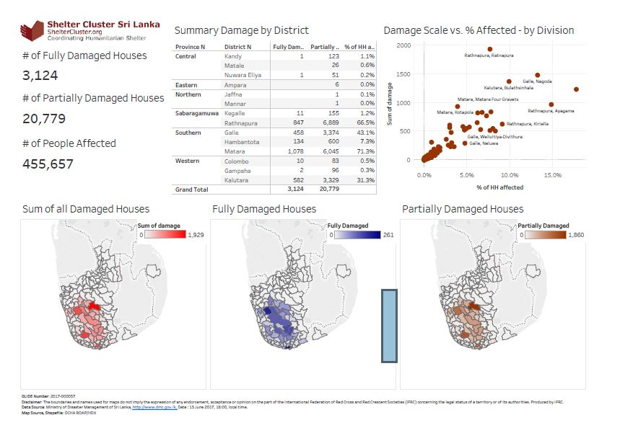
Update as at 15.06.2017
Click Here for Latest DMC Update

Slide 9
Web Updates
https://public.tableau.com/profile/neil.bauman#!/vizhome/SriLanka170615-Summary/SummaryDamage-District?publish=yes
https://public.tableau.com/profile/neil.bauman#!/vizhome/SriLanka170615-DamageCause/DamageCause?publish=yes
https://public.tableau.com/profile/neil.bauman#!/vizhome/SriLanka170615-DamageScalevaffected/Print-Damagescalevaffected?publish=yes

Slide 10
4W Update as at 15.06.2017
Completed Distribution
1788 NFi Kits
Ongoing Distribution
1880 NFi Kits
Planned (funded)
4500 Cash
600 Community Based Shelter Programme
8725 NFi Kits
3650 Shelter Repair Kits
50 Transitional Shelters
Planned (subject to funding)
1000 NFi Kits
340 Transitional Shelters
250 Tents
Reporting Template – Compiled Version

Slide 11
Web Details
www.sheltercluster.org
http://www.sheltercluster.org/response/sri-lanka-floods-2017
http://www.sheltercluster.org/response/sri-lanka-floods-2017/documents?sort=date&sort_direction=DESC
http://www.sheltercluster.org/sri-lanka-floods-2017/library/meeting-minutes

