Slide 1
Shelter Working Group Meeting
Monday 21 June, 10AM
APAD Office

Slide 2
Agenda
Introductions
IM & District Update
NBRO Presentation
Key messages for donors
AOB and Next Meeting
Technical Working Group: IEC materials

Slide 3
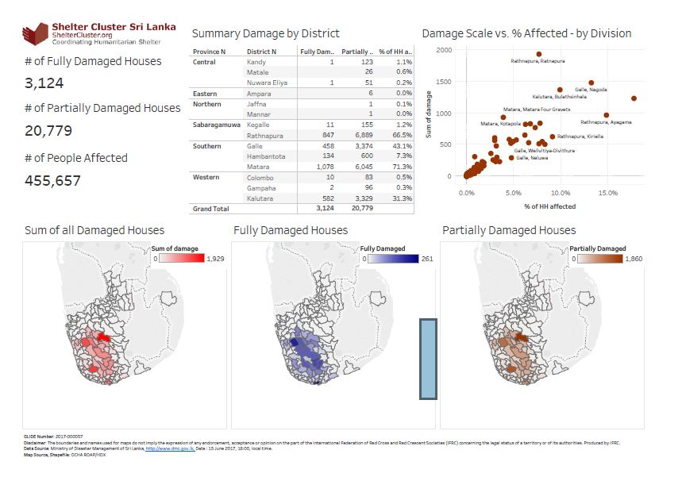
Update as at 15.06.2017
Click Here for Latest DMC Update

Slide 4
Galle - 01 camp Kalutara - 11 camps Ratnapura - 44 camps Flood affected people are almost resettled in their own place. Directly and indirectly affected people by the landslide are still in the above 56 camps.

Slide 5
Ratnapura
Agency | NFI Kit/cash | R.K/cash | Tr.S | CB | Tents
IOM
SLRCS | 288
ADRA
UN HABITAT
WORLD VISION | 2510 | 1650
SAVE THE CHILDREN
HABITAT FOR HUMANITY
PLAN INTERNATIONAL | 2500
PARCIC
District Total | 5298 | 1650 | 0 | 0 | 0

Slide 6
Kalutara
Agency | NFI Kit/cash | R.K/cash | Tr.S | CB | Tents
IOM
SLRCS
ADRA
UN HABITAT | 3000 |  | 30 | 400
WORLD VISION
SAVE THE CHILDREN
HABITAT FOR HUMANITY | 1000 |  | 250
PLAN INTERNATIONAL
PARCIC
District Total | 4000 | 0 | 280 | 400 | 0

Slide 7
Ratnapura
Agency | NFI Kit/cash | R.K/cash | Tr.S | CB | Tents
IOM
SLRCS | 427
ADRA | 1060
UN HABITAT
WORLD VISION
SAVE THE CHILDREN | 3500 | 3240
SAVE THE CHILDREN | 700
HABITAT FOR HUMANITY
PLAN INTERNATIONAL
PARCIC | 250
District Total | 5937 | 3240 | 0 | 0 | 0

Slide 8
Galle
Agency | NFI Kit/cash | R.K/cash | Tr.S | CB | Tents
IOM
SLRCS | 373
ADRA | 820
UN HABITAT | 1975 |  | 20 | 200
WORLD VISION
SAVE THE CHILDREN
HABITAT FOR HUMANITY
PLAN INTERNATIONAL
PARCIC
District Total | 3168 | 0 | 20 | 200 | 0

Slide 9
Date vs No of People Affected

Slide 10
4W Update as at 20.06.2017
Completed Distribution
1788 NFi Kits
Ongoing Distribution
1880 NFi Kits
Planned (funded)
4500 Cash
600 Community Based Shelter Programme
8925 NFi Kits
3650 Shelter Repair Kits
140 Transitional Shelters
500 Tents
40 Permanent House
50 Repair House
Planned (subject to funding)
3500 NFi Kits
250 Permanent House
250 Transitional Shelters
250 Tents

Slide 11
Web Details
www.sheltercluster.org
http://www.sheltercluster.org/response/sri-lanka-floods-2017
http://www.sheltercluster.org/response/sri-lanka-floods-2017/documents?sort=date&sort_direction=DESC
http://www.sheltercluster.org/sri-lanka-floods-2017/library/meeting-minutes

