Slide 1
GSC Strategy 2013-2017
Progress 2014-2015

Slide 2
Strategic Aim 1
Support country level clusters

Slide 3
25 Shelter Clusters or cluster-like
Ukraine
UNHCR
Afghanistan
UNHCR/IOM
Palestine
NRC/ACTED
Syria
UNHCR
Nepal
IFRC
Sudan
UNHCR
Iraq
UNHCR
Bangladesh
IFRC/UNDP
Mali
UNHCR/IOM
Yemen
UNHCR
Philippines
IFRC - IOM
El Salvador
HfH/IFRC
Chad
UNHCR/IOM
South Sudan
IOM/World Vision
Ethiopia
IOM
Myanmar
UNHCR
Pacific Region
IFRC
Colombia
IOM
CAR
UNHCR/ACTED
Somalia
UNHCR
DRC
UNICEF
Kenya
IOM / KRCS
Vanuatu
IFRC
Mozambique
IFRC/UNHABITAT
Malawi
IFRC
17 (70%) Represented here today
Conflict
Natural disasters
Both

Slide 4
Since our last meeting…
Nepal and Vanuatu emergencies
Yemen declared L3 emergency
4 system-wide L3 emergencies:
  Syria
  South Sudan
  Iraq
  Yemen
CAR no longer L3
Deployment to Malawi

Slide 5
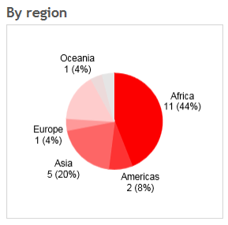
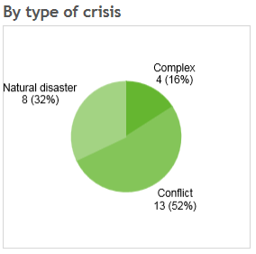
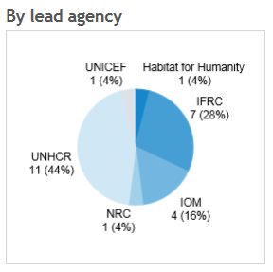

Slide 6
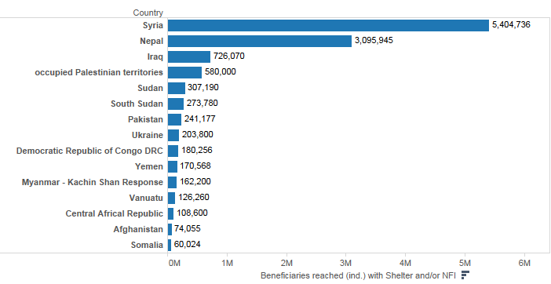
Beneficiaries reached so far in 2015
Total: 11,8 mio persons. Top 15 countries:
Notes:
8,2 mio people in the whole 2014

Slide 7
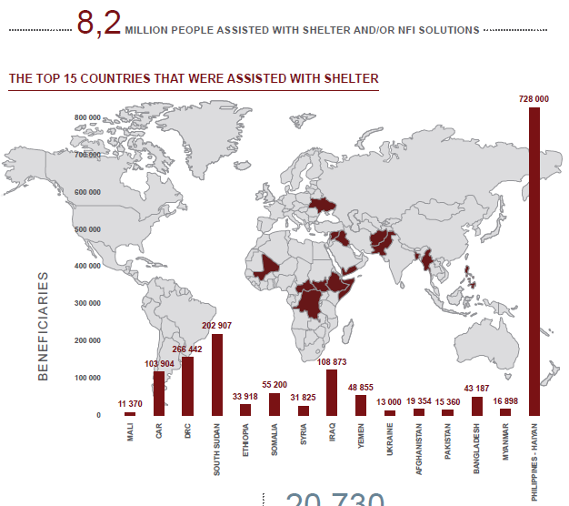
In 2014

Slide 8

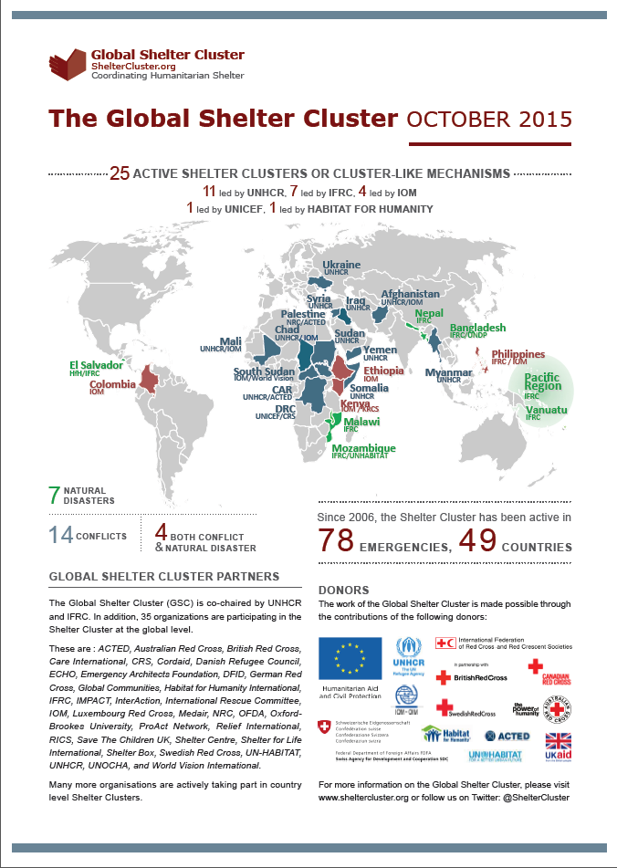
Achievements 2014 & 2015

Slide 9


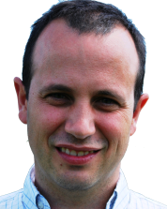



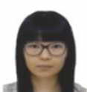
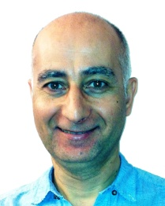






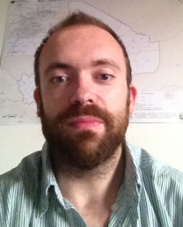
GSC support team
Global Cluster Coordinators
Deputy Coordinators
Graham Saunders
Natural Disasters IFRC
Miguel Urquia
Conflict UNHCR
Pablo Medina
Natural Disasters IFRC
Shaun Scales
Conflict UNHCR
Information Management
Global Focal Points for Coordination
Communication & Advocacy
Bo Hurkmans
IMO UNHCR
Neil Bauman
GFP IFRC/CanRC
Shirin Narymbaeva
Website support IFRC
Davide Nicolini
GFP UNHCR/SDC
Gregg McDonald
GFP UNHCR
Assessment M&E
Grant Management
Roving Focal Points
Joseph Ashmore
GFP IOM (80%)
Tom Bamforth
GFP IFRC
Vincent Annoni
REACH/Impact Initiatives
Antanas Jurksaitis
ECHO grant manager UNHCR
Anna Pont
Americas
UN-HABITAT
Wardell Eastwood
AusRC
Notes:
Include GC Coord

Slide 10
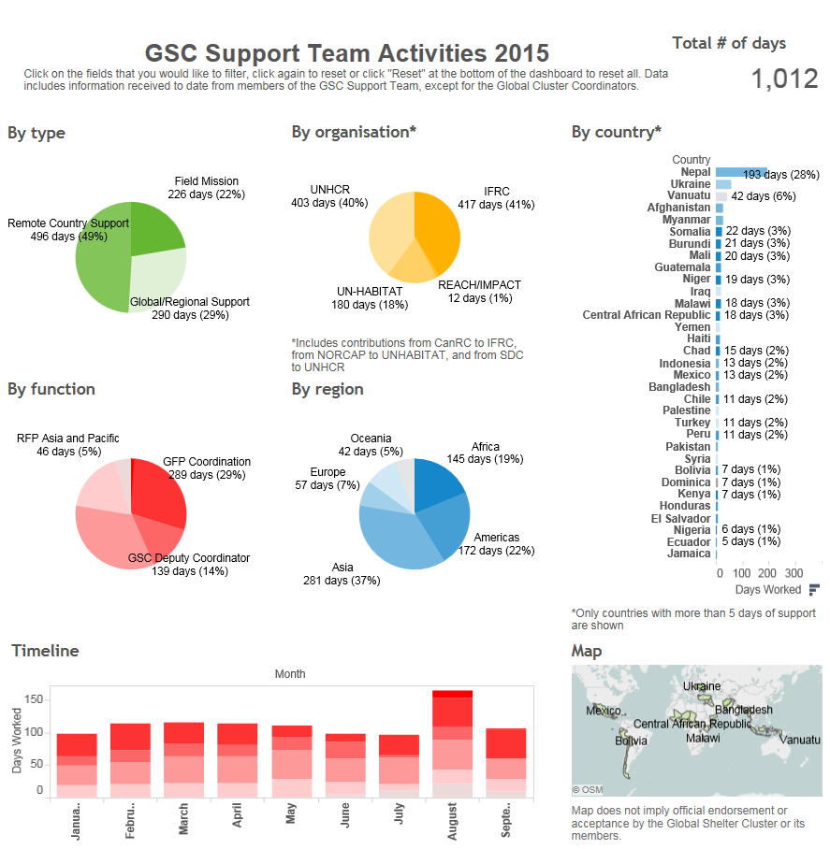
Notes:
http://www.sheltercluster.org/global_support_team_activities

Slide 11
Harmonized Surge Capacity
More than 70% of their time supporting country level clusters
Support missions:
  29 missions to 14 countries in 2013
  51 missions to 19 countries in 2014
  26 missions to 14 countries so far in 2015
Notes:
Each of the GFPs introduces him/herself and where has been

Slide 12
Assessments, monitoring and evaluations
Assessments in Ukraine, Nepal and Vanuatu.
Country-level clusters reviews:
  Vanuatu
  Ukraine

Slide 13
Strategic Aim 2
An effective Global Cluster

Slide 14
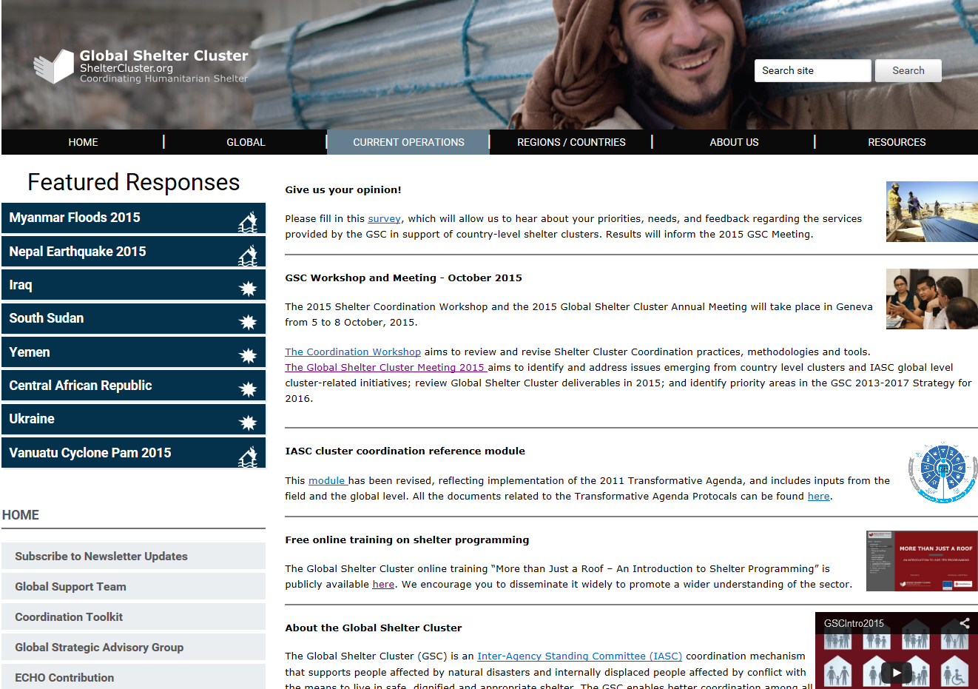
New sheltercluster.org
59,763 visitors in last year

Slide 15
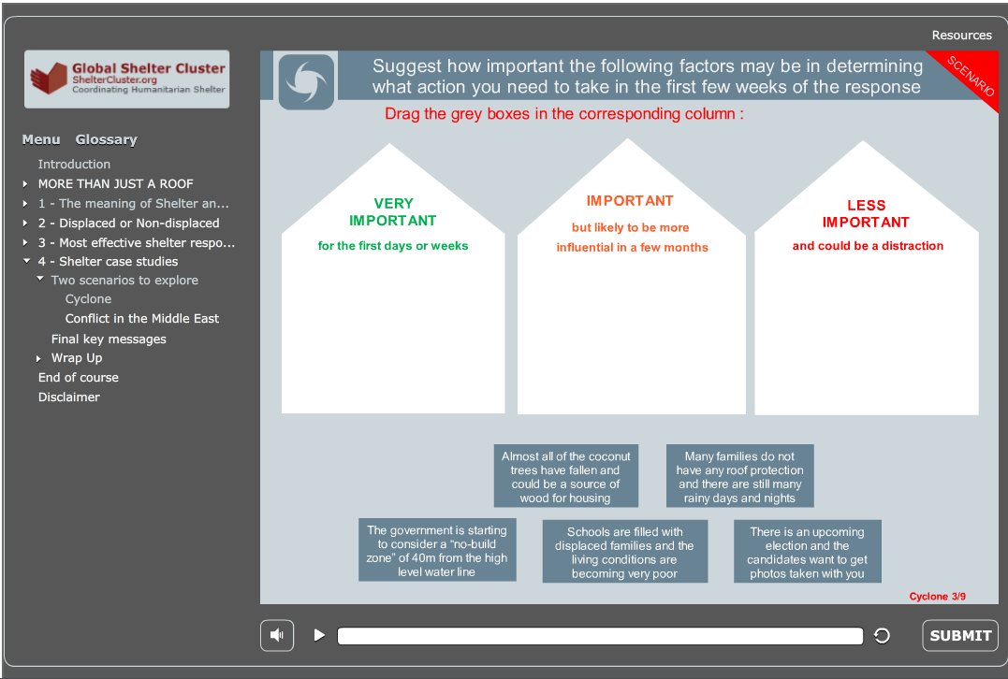
Online training on shelter

Slide 16
Broader donor base
New grant received from ECHO ERC for 2015-2016
Roadshow to donors
Contributory mechanism

Slide 17
Strategic Aim 3
Increased understanding of the sector

Slide 18
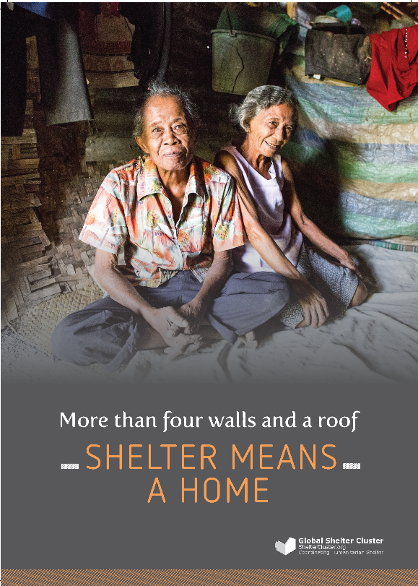
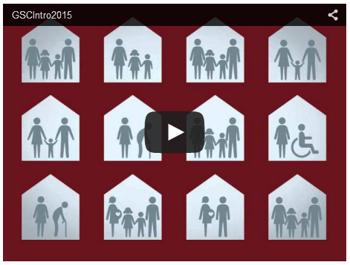
Posters, video
6 posters explaining shelter and:
Protection
Resilience
Rebuild lives
Health
Livelihoods
Home
Video introducing the Global Shelter Cluster
Notes:
6 posters

Slide 19
Website and Twitter
@sheltercluster:
Followers 1,463
453 tweets in last year (around 2 per working day)

Slide 20


Shelter Projects

Slide 21
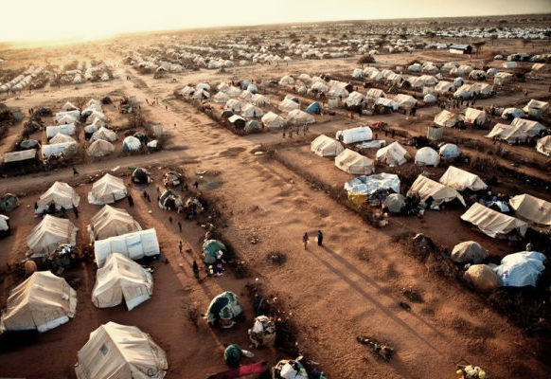
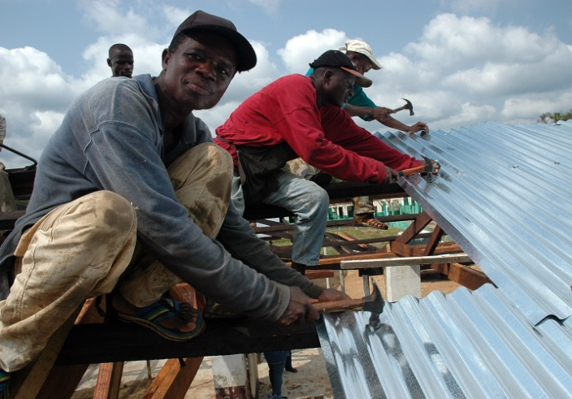
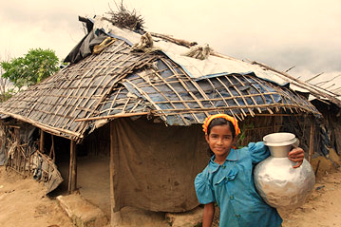
Thank you!
More info:
www.sheltercluster.org
Twitter: @sheltercluster

Slide 22


Supported by:

