Slide 1
GSC Strategy 2013-2017
Progress 2016-2017

Slide 2


Achievements 2016 & 2017
Notes:
Documents available here: http://www.sheltercluster.org/global

Slide 3
Strategic Aim 1
Support country level clusters

Slide 4







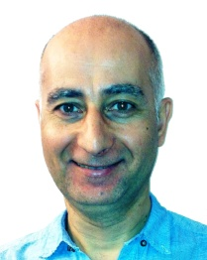









GSC support team
Global Cluster Coordinators
Deputy Coordinators
Information Management
Communication & Advocacy
Ela Serardoglu
Natural Disasters IFRC
Brett Moore
Conflict UNHCR
Miguel Urquia
Conflict UNHCR
Pablo Medina
Natural Disasters IFRC
Bo Hurkmans
IMO UNHCR
Neil Bauman
GFP IFRC/CanRC
Shirin Narymbaeva
Website support IFRC
Global Focal Points for Coordination
Sr Roving Tech Coord
Assessment
M&E
Grant Management
Elisabeth Vikman REACH/Impact Initiatives
Davide Nicolini
GFP UNHCR/SDC
Tom Bamforth
GFP IFRC
Vacant
GFP UNHCR
Carolina Cordero-Scales
NRC / UNHCR
Cecilia Braedt
IFRC/Lux RC
Petya Boevska
ECHO grant manager UNHCR
Regional Focal Points
GFP - HLP
Sr Roving Coordinators
Vacant
Asia Pacific
IFRC
Vacant
IOM / NRC
Graham Eastmond
UNHCR/ IMPACT
Richard Evans
UNHCR/ IMPACT
Nadia Carlevaro
UNHCR/ IMPACT
Jan-Willem Wegdam
UNHCR/ IMPACT
Vacant
Americas
UN-HABITAT
Notes:
More on what this team does can be found here:
http://sheltercluster.org/what_we_do
http://www.sheltercluster.org/global_support_team_activities

Slide 5
Global Surge Capacity
New roles introduced in 2016
Senior Roving Cluster Coordinators: 2
Technical Coordinators: 2
Notes:
Each of the GFPs introduces him/herself and where has been

Slide 6
Cash Champions – HLP Support
Cash Champions:
CRS, Habitat for Humanity, Save the Children, UNHCR
HLP Support:
IOM and NRC

Slide 7
Strategic Aim 2
An effective Global Cluster

Slide 8
Strategic Advisory Group (SAG)
ACTED
CARE International
CRS
Habitat for Humanity
IFRC
InterAction
IOM
NRC
Save the Children
UNHABITAT
UNHCR
World Vision International

Slide 9
Working Groups
Cash and Shelter
NFIs and meeting household needs
Construction Standards
GBV and Shelter
Shelter Projects
State of Humanitarian Shelter and Settlements
Urban Settlements
Americas Regional Shelter Cluster
Promoting Safer Building

Slide 10

Communities of Practice & Helpdesk
Coordination
Information Management
Technical
Environment
Gender and Diversity
Recovery

Slide 11

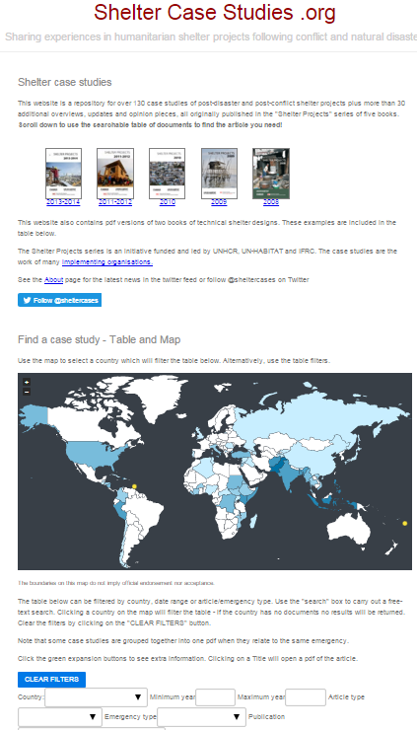





ShelterCaseStudies.org

Slide 12

Construction Standards

Slide 13

Evaluation Strategy 2013 - 2017
GSC Strategy 2018 - 2022

Slide 14
Strategic Aim 3
Increased understanding of the sector

Slide 15
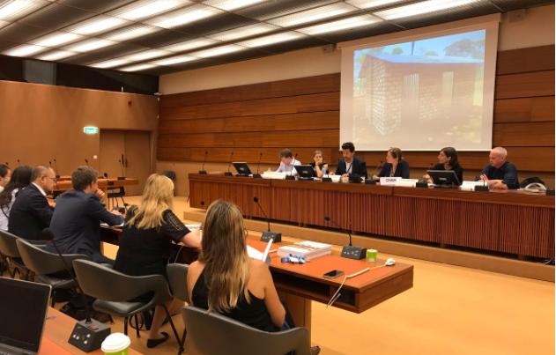

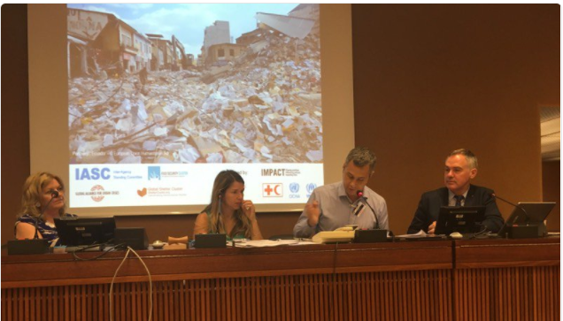
Events
Notes:
6 posters

Slide 16
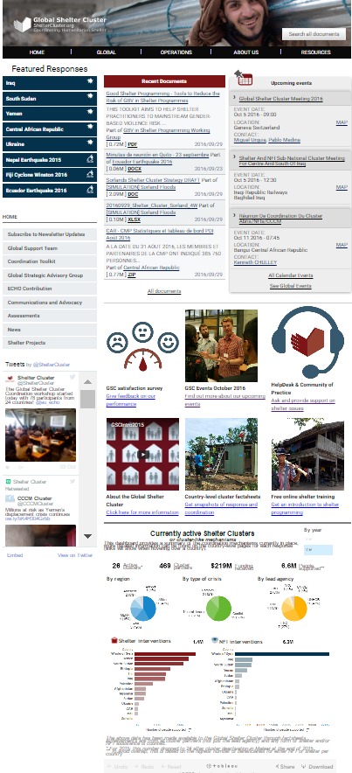

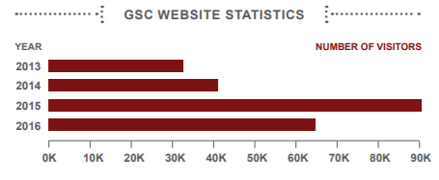
sheltercluster.org

Slide 17

Thank you!
More info:
www.sheltercluster.org
Twitter: @sheltercluster
Supported by:

