Slide 1
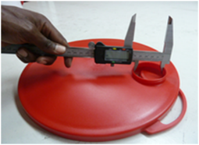
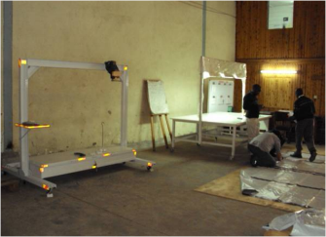
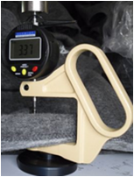
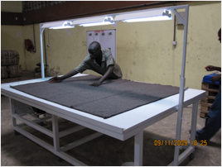
Quality Control training
Stéphane Huot-Marchand; 2017

Slide 2
Summary
Training program
Quality product, Quality Control and Quality Management
Quality Control on Essential Household Items
Determination of acceptability
V) QC key points and continuous improvement

Slide 3
Quality Control training Program
 | Day 1 | Day 2 | Day 3 | Day 4 | Day 5
8h00 10h30 | Introduction to QC (Meeting room) | Practical training on tarpaulins QC (Warehouse + Meeting room) | Practical training on jerry cans QC (Warehouse + Meeting room) | Practical training on sleeping mats QC (Warehouse + Meeting room) | Practical training on Family tents QC (Warehouse + Meeting room)
Break
10h45 12h00 | Installation of stand, table and drop test bracket. (Warehouse) | Practical training on tarpaulins QC (Warehouse + Meeting room) | Practical training on jerry cans QC (Warehouse + Meeting room) | Practical training on sleeping mats QC (Warehouse + Meeting room) | Practical training on Family tents QC (Warehouse + Meeting room)
Lunch
13h00 15h00 | Practical training on blankets QC (Warehouse + Meeting room) | Practical training on Oxfam buckets QC (Warehouse + Meeting room) | Practical training on mosquito nets QC (Warehouse + Meeting room) | Practical training on kitchen sets QC (Warehouse + Meeting room) | Wrap up / Training Evaluation (Meeting room)
Break
15h15 17h00 | Practical training on blankets QC (Warehouse + Meeting room) | Practical training on Oxfam buckets QC (Warehouse + Meeting room) | Practical training on mosquito nets QC (Warehouse + Meeting room) | Practical training on kitchen sets QC (Warehouse + Meeting room) | Wrap up / Training Evaluation (Meeting room)

Slide 4
Summary
Training program
Quality product, Quality Control and Quality Management

Slide 5

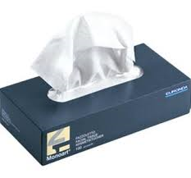

What?
Quality product :
The degree in which customer requirements are met.
Not looking for over-quality but for the right quality requested.
For instance if you need handkerchiefs ....Looking for the right type for the right use.
Right quality when sneezing or coughing
Right quality when going to cocktail

Slide 6




Quality Control :
Consists of activities of detection and measurement of the variability in the characteristics of product.
→ QC insures we are getting what we pay for.
QC insures no over-invoicing from suppliers.
It includes corrective actions.
Without requirements (specifications) no accurate Quality Control.
Purchasing a white car!
QC based on which spec? (colour only!)
How?
City car
4WD

Slide 7

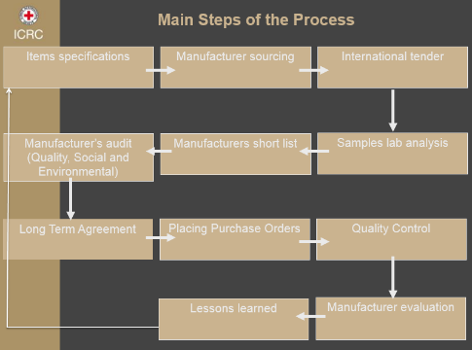
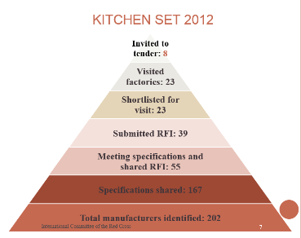
Quality Management :
Consists not only on product quality (and goods testing) but also on the means to achieve it.
It includes establishment of
Quality policy and objectives;
Documentation management;
Quality, Social and Environmental manufacturer’s audit and assessment;
QC and procurement processes improvement.
Why?

Slide 8
Summary
Training program
Quality product, Quality Control and Quality Management
Quality Control on Essential Household Items

Slide 9
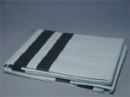

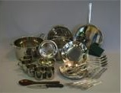
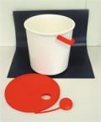
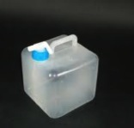

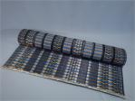
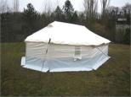
EHI
Tarpaulins
Blankets
Kitchen sets
Buckets
Jerry cans
Mosquito nets
Sleeping mats
Family tents

Slide 10
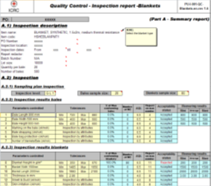
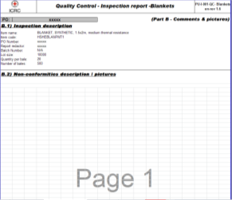
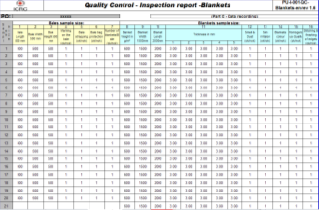
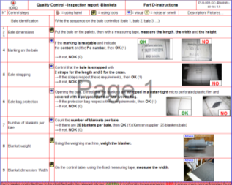
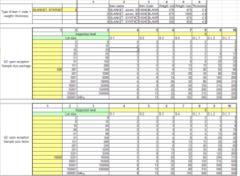
QC methodology:
Quality Control documents (Excel file) based on specification (one specific document for each EHI, made on the same design).
A- Summary report
B- Comments and pictures
C- Data recording
D- Instructions
E- Formulas
Notes:
10

Slide 11
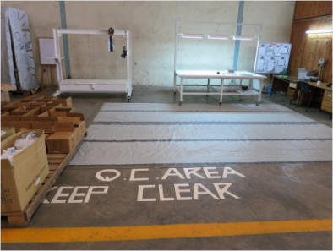
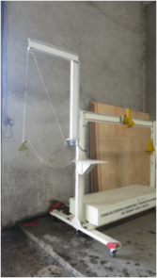
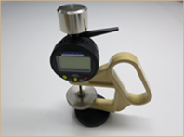
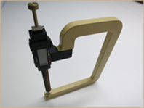
QC methodology:
Quality Control documents (Excel file) based on specification one specific document for each EHI, made on the same design).
QC area in the warehouse , equipment/tools for inspection needs (table, stand, thickness gauge, weighing machine…) + identification and calibration process.
https://prezi.com/e0r-d8qfpps3/procedure-for-assembling-the-icrc-quality-control-table/
https://prezi.com/3fqhl1cmqdig/procedure-for-assembling-the-icrc-quality-control-stand-and-bracket/
Notes:
11

Slide 12
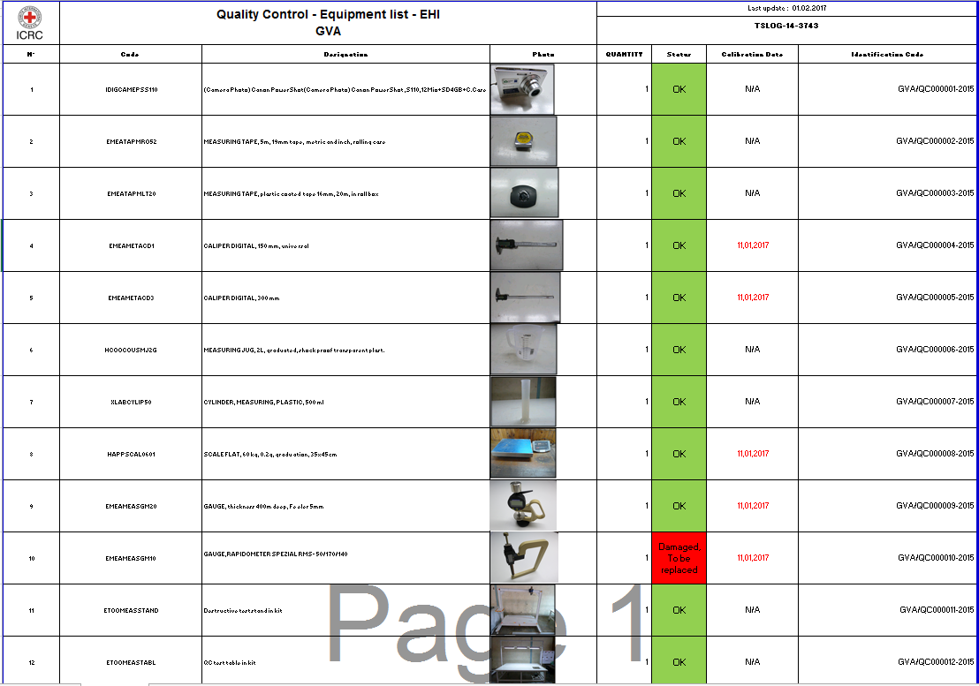

Slide 13
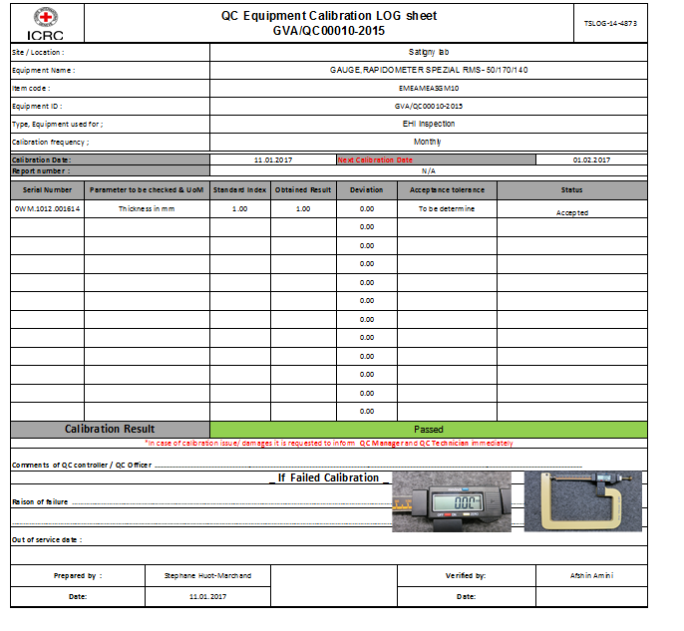

Slide 14
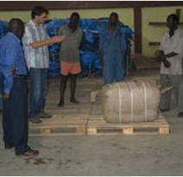
QC methodology:
Quality Control documents (Excel file) based on specification (one specific document for each EHI, made on the same design).
QC area in the warehouse , equipment/tools for inspection needs (table, stand, thickness gauge, weighing machine …)….and calibration process.
Staff training (controllers should be trained on QC protocol)
Notes:
14

Slide 15
QC methodology:
Quality Control documents (Excel file) based on specification (one specific document for each EHI, made on the same design).
QC area in the warehouse , equipment/tools for inspection needs (table, stand, thickness gauge, weighing machine …)….and calibration process.
Staff training (controllers should be trained on QC protocol)
Inspection
Notes:
15

Slide 16
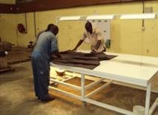
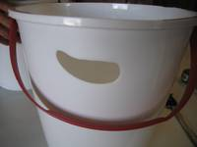
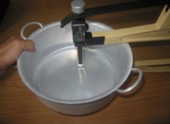
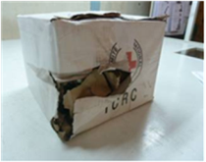
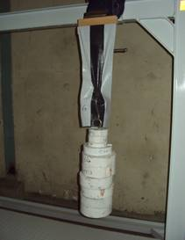
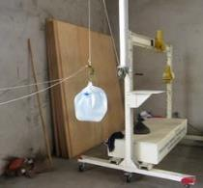
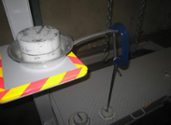
Notes:
16

Slide 17
Summary
Training program
Quality product, Quality Control and Quality Management
Quality Control on Essential Household Items
Determination of acceptability

Slide 18



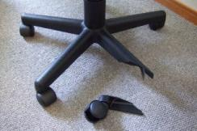
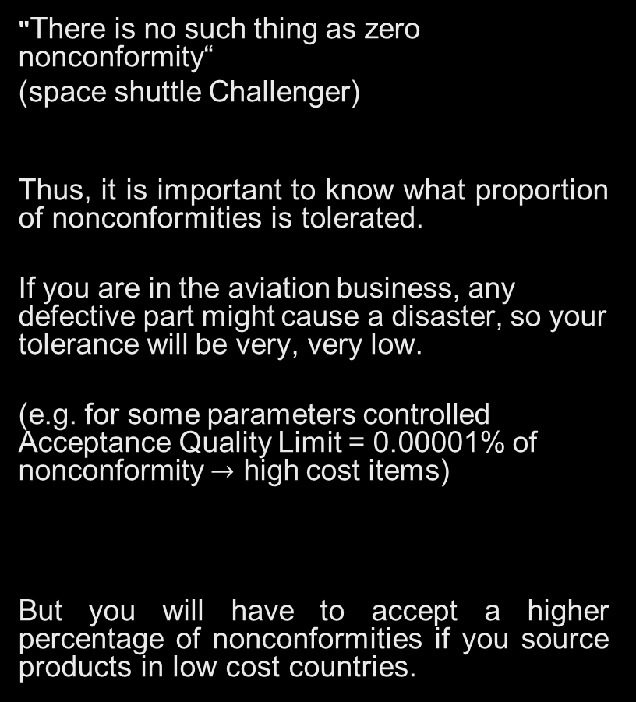
Zero nonconformity ?
"There is no such thing as zero nonconformity“
(space shuttle Challenger)
Thus, it is important to know what proportion of nonconformities is tolerated.
If you are in the aviation business, any defective part might cause a disaster, so your tolerance will be very, very low.
(e.g. for some parameters controlled Acceptance Quality Limit = 0.00001% of nonconformity $→$ high cost items)
But you will have to accept a higher percentage of nonconformities if you source products in low cost countries.
S.Huot-Marchand
AQL

Slide 19


AQL and rejection number
Acceptance Quality Limit.
The AQL is the quality level that is the worst tolerable in average (based on sampling and probability)
AQL 0 means no nonconformity on the parameter inspected is accepted.
AQL 4.0 means max of 4.0% of nonconforming products accepted on the parameter inspected in average.
AQL 6.5 means max of 6.5% of nonconforming products accepted on the parameter inspected in average.
Rejection Number.
The rejection number is the minimum number of nonconforming products in the sample that will cause rejection of the lot.

Slide 20
Nonconformity definitions
Critical nonconformity.
Any discrepancy which might harm a user or makes it impossible to use the product properly is considered to be critical. (AQL=0)
Major nonconformity.
Any discrepancy which makes the usage of the product less efficient than expected is considered to be major. (AQL=4.0)
Minor nonconformity.
Any discrepancy which does not have an influence on the performance of the product is considered to be minor. (AQL=6.5)

Slide 21
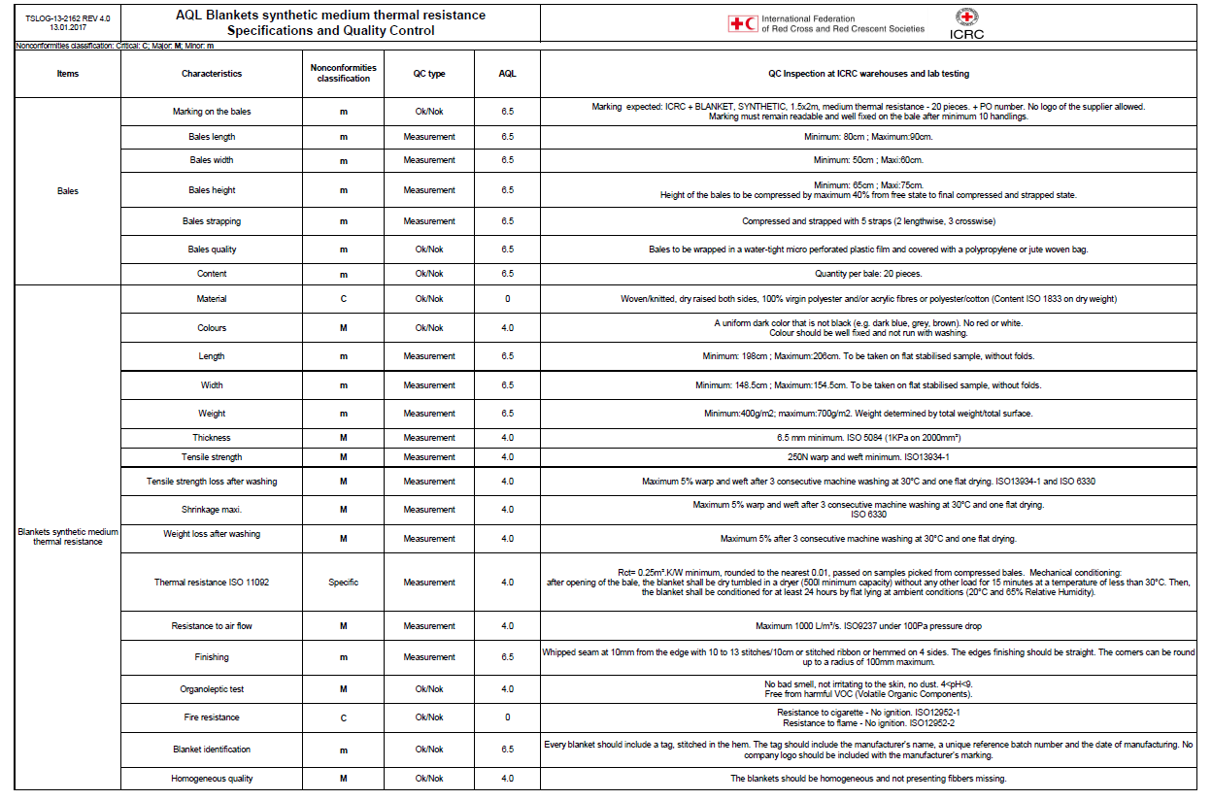

Slide 22
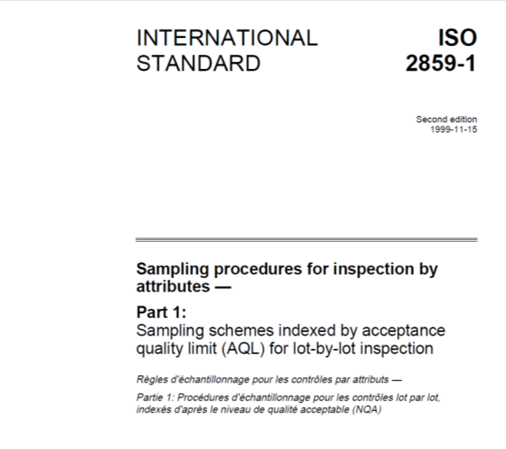
Sampling plan made according to ISO standard 2859

Slide 23
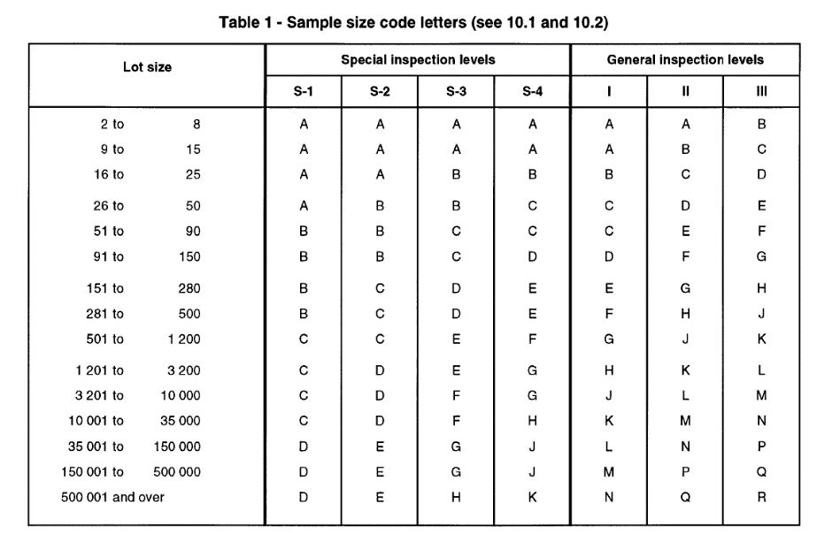
Example

Slide 24
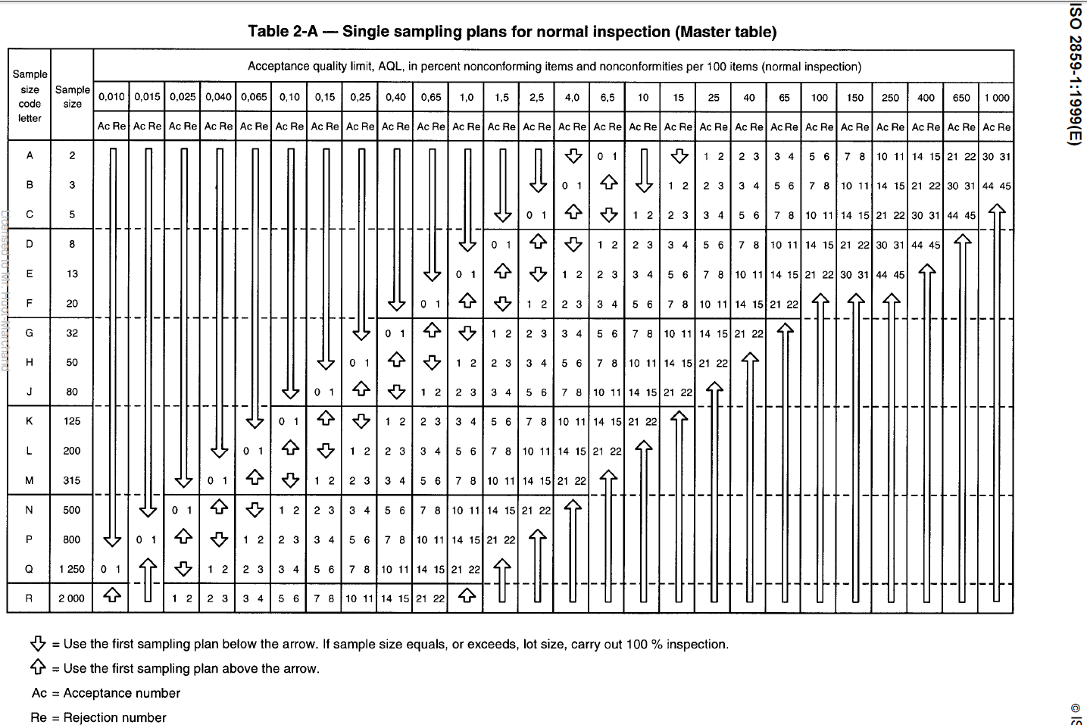

Slide 25
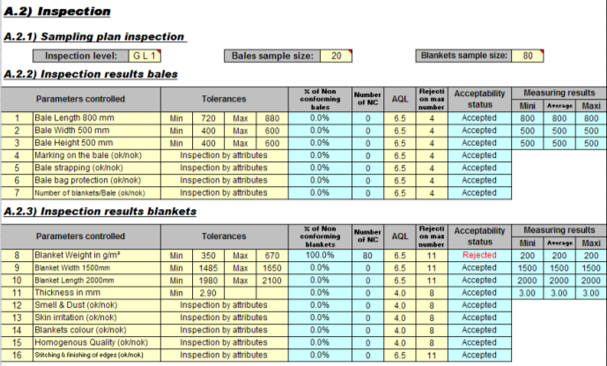
- The Acceptance Quality Limit is defined by the Quality Manager together with buyers and technical team, and then written in call for tenders, purchasing contracts and QC doc.
The number maxi of accepted nonconformity (Rejection number) is automatically determined by the Excel file for each parameter (this is automatically adjusted according to the sample size → Formulas sheet)
- For each parameter, the Excel doc shows if it is conform (accepted) or nonconforming (rejected) using the data written by the controller in data recording sheet.

Slide 26
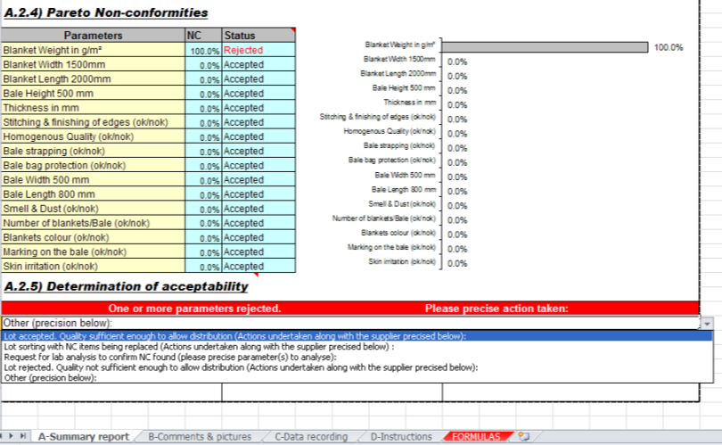
The summary report shows the Pareto of non-conformities
If one parameter is nonconforming, it is indicated in red in the summary report several corrective actions are proposed (drop-down list)
Notes:
26

Slide 27
Summary
Training program
Quality product, Quality Control and Quality Management
Quality Control on Essential Household Items
Determination of acceptability
V) QC key points and continuous improvement

Slide 28
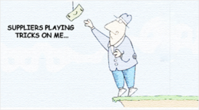
QC insures we are getting what we pay for.
QC implementation (4 steps): documents, equipment, training, inspection.
QC process does not slow down the supply chain (by using appropriate inspection level).
QC is based on a physical control by internal controllers and/or laboratories (UV test…).
QC inspection reports must be of high quality (suppliers use any QC report mistake to gainsay the findings).
Notes:
28

Slide 29


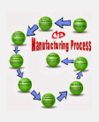
QC is one of the last steps of the procurement process, which is the detection of non-conformities (Ref procurement process)
Efficient procurement process requires good cooperation between Sourcing manager, Buyers and Quality teams.
Vertical integration (working with known manufacturers ….and not traders) decreases the number of quality issues, allows a better management of corrective actions and nonconforming items found by QC.

Slide 30


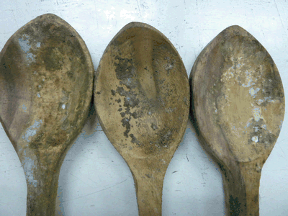
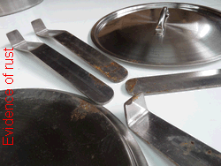
Some nonconformities found by QC on tarpaulins and kitchen sets

Slide 31
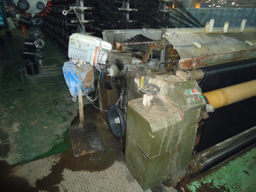
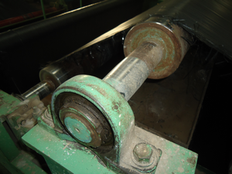
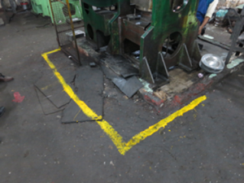
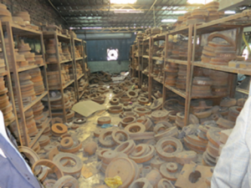
Tarpaulins manufacturer visit further to QC findings
Kitchen sets manufacturer visit further to QC findings
No more nipple on this bearing

Slide 32
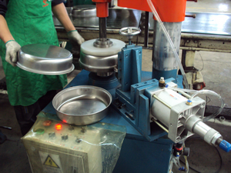
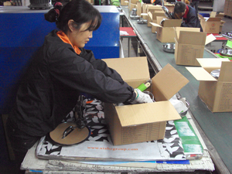
Example of corrective action taken by procurement Unit:
Purchasing from manufacturers showing evidences of process performance control.

Slide 33

⇒ QC outputs are useful for procurement process improvement.
QC findings + suppliers audits help to evaluate suppliers performance.
Comparing apple to apple
Documentation
⇒QC is part of Quality Management (process approach)
Measure processes performance.
Implement actions of improvement.
→ Provide assurance to customers about quality and capability.
Internal customers
Beneficiaries
Donors

Slide 34

Thank you
In case of any question, comment, suggestion do not hesitate to address a message to shuotmarchand@icrc.org

