Slide 1
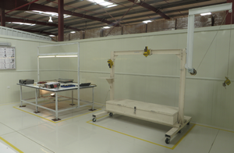
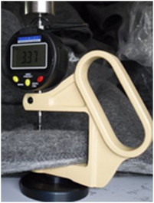
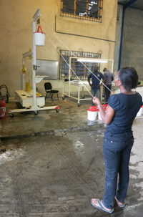
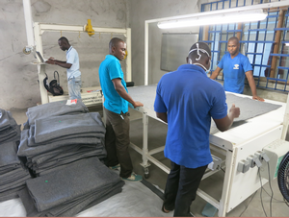
Procurement Quality Management
Stéphane Huot-Marchand
April 2017

Slide 2
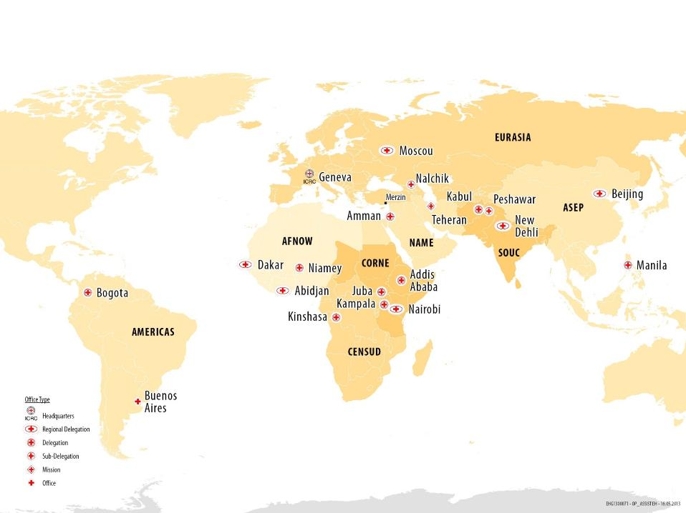
QC Centres deployment
QCC
Damascus
QCC
QCC
QCC
Tartous
QCC
QCC
QCC
QCC
IFRC Kuala Lumpur QCC
Mombasa
QCC
Notes:
2

Slide 3
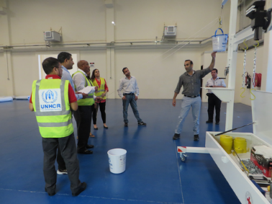
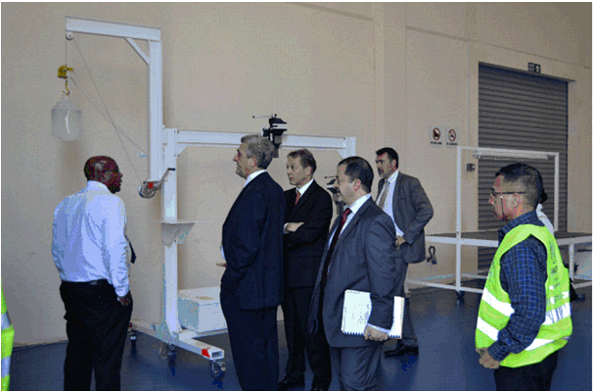
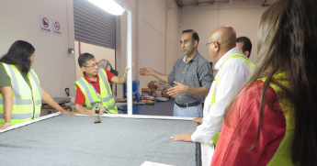
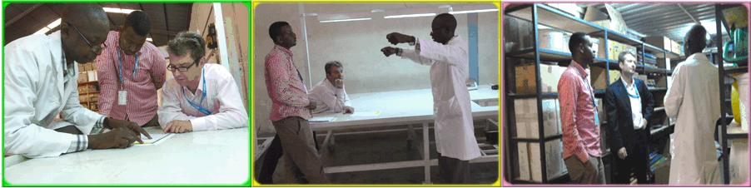
Training session UNHCR Nairobi and Dubai.

Slide 4
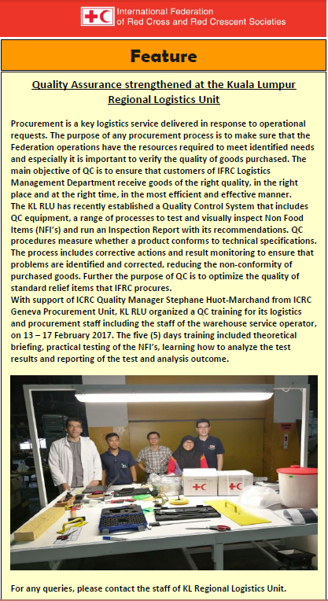
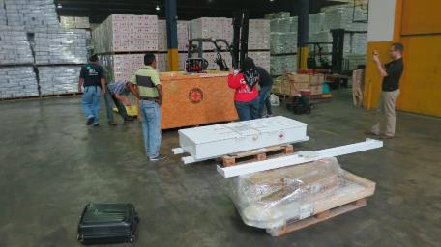
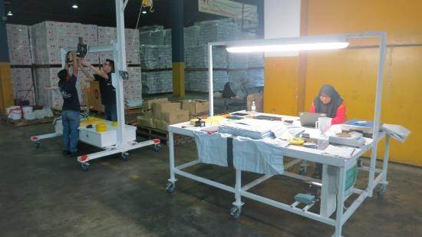
Training session IFRC Kuala Lumpur.

Slide 5

Thank you

