Slide 1

g]kfn ;/sf/
zx/L ljsf; dGqfno
zx/L ljsf; tyf ejg lgdf{0f ljefu
e"sDk k'glg{df0f tyf k'g:yfkgf cfof]hgf sfof{no
e"sDk k|lt/f]wfTds ejg lgdf{0f k|ljlw af/]
kfFr lbg] sflnu9 tflnd sfo{qmd
u'0f:t/ lgoGq0f
efu @ ;q $

Slide 2
u'0f:t/ lgoGq0f
u'0f:t/ lgoGq0fdf k|efj kfg]{ tTjx?
l8hfOg
;fdfgsf] u'0f:t/
sflnu9L
of]hgf cjlw
Notes:
Slide Objective:
To explain the factors that affect the quality of the works.
Activity :
Try to explore from participants how design, quality of materials, workmanship and project period effects the quality of construction.
Slide Detail:
First factor to affect the quality of a building is the quality of its planning and designing. If a building is not properly planned and designed the building can not be of good quality even if it is constructed with greater care and quality control. For a building to be an earthquake resistant, a good quality planning and design means that which follows the basic rules outlined in previous sessions of this manual – appropriate site selection, good configuration and layout, appropriate size and detailing of different structural elements etc.
Another factor affecting the quality of a building is quality of materials used in the construction. Inferior quality materials can not make a higher quality building. Therefore materials used in the construction should be of good quality as mentioned in the specifications.
Next major factor to contribute in the quality of a building is quality of construction process and quality of workmanship. This is the ultimate factor to make a good quality building. Each and every stage of the construction should be in accordance with the provisions and steps mentioned in the standard construction manuals and guidelines.
Resources and time available are also the indirect factors to make a good quality building. Experiences have shown that if the project period is prolonged due to the resource constraints then quality of construction goes on decreasing.

Slide 3
l8hfOg tTjx?
l8hfOgsf] qmddf u'0f:t/af/] ;f]r
  l6sfpkgf, cfsf/, ;+/rgfsf] k|sf/, ck]lIft k|of]u cflb
:k]l;lkms]zg
gSzf tyf lj:t[t :j?k
Notes:
Slide Objective :
To explain design factors which affects quality of construction.
Slide Details:
We need to have design considerations for the quality of work we desire. During design, durability, configuration,
nos. of storey, type of structure, suitability of particular type of structure, intended use and quality of materials are to be
considered.
Proper specification( quality, size and details about materials and workman ship) shall be prepared in order to perform a
particular work and supervise the quality.
Details of Each and every elements shall properly be shown in drawings.
Quality Assurance in the Design & Construction Processes
Quality Assurance is extended to these processes because 90% of all buildings failures have their origin in faults in design and
construction.
Delivery Storage And Handling
Deliver materials in original packages and containers with seals unbroken and bearing manufacturer’s labels containing brand
name and directions for storage and mixing with other components.
Store materials to comply with manufacturer’s directions to prevent deterioration from moisture, heat, cold, direct sunlight or
other detrimental effects.
Project Site Conditions
Environmental Conditions: Comply with manufacturer’s directions for maintenance of ambient and substrate temperature,
moisture, humidity, ventilation and other conditions required to execute and protect work.
Activity:
Discuss about designers’ responsibility on the quality assurance. Why clear specification and drawings required to perform the better quality of works? Describe briefly
Explore from the participants about the design factors on which the quality of works depend.
Ask question to the participants how drawings and detailing should be followed in construction works for achieving better quality of works.

Slide 4
;fdfgsf] u'0f:t/
sfdsf] u'0f:t/ ;'lglZrt ug{ ;fdfg klg u'0f:t/Lo x'g'k5{ -pTkfbg_
lgdf{0fdf k|of]u ul/g] k|To]s ;fdfgsf] u'0f:t/ / u'0faf/] lgZro ug'{k5{
ljleGg :yfgdf ul/g] lgdf{0f sfdsf] nflu ljleGg ;fdfgsf] 5gf}6 ug'{k5{
Notes:
Objectives:
To explain material quality
Activity:
Describe the importance of clear specification required to make quality works.
Difficulty of finding out the material during the construction when specification does not clearly describe the material property.
Convinced the participants that quality of material may vary for different places and different types of construction.ie. All depends on design consideration.
Slide Details / Discussion:
Discuss about all the works should be in sequential order. Material quality should be match with design consideration .
Material quality can vary with place to place so in design should be carefully think about this.

Slide 5
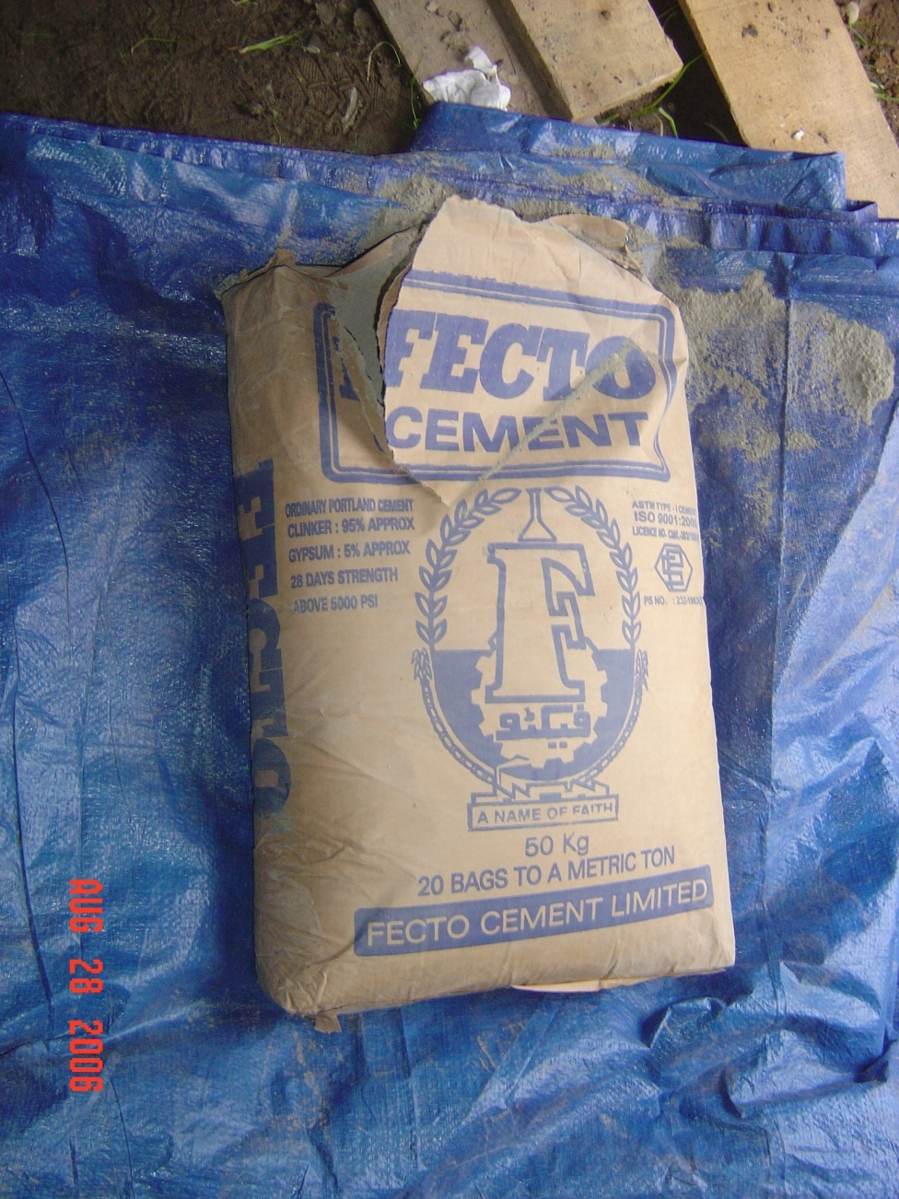
lgdf{0f ;fdu|L
l;d]G6
afn'jf
/f]8f
kfgL
kmnfd] 808L
O+6f
9'Ëf
sf7
Notes:
Objective:
This slide shows materials normally used in construction works.
Also shows the material which we should carefully select with consider the quality for construction works.
Activity:
Try to explore from participants different types of material used in construction works.
Request participants try to make list of material with remembering the different session they have taken in this training.
Slide Details / Discussion:
Common material required for construction works.
Discuss about each and every materials are equally importance for quality works.

Slide 6
l;d]G6
k|of]u M
ljleGg lgdf{0f ;fdu|LnfO{ k/:k/df hf]8\g] dfWodsf] ?kdf k|of]u x'G5
u'0fx? M
d"ntM r"g / l;lnsfn] ag]sf]
w"nf]sf] ?kdf kfOg]
xfjf gl5g]{ af]/fdf pknJw x'g]
kfgLsf] ;+;u{df hd]/ s8f x'g]
Notes:
Objective:
To explain the use and properties of cement
Activity:
Try to explore from participants about the role of cement in any type of construction works.
Ask participants how many types of cement available in their local market and try to explain about the use of different types of cement in different places.
According to the grade explain the appropriate places where cement will be used.
Slide Details / Discussion:
Cement is a binding material which is used to prepare concrete, cement mortar etc. It is in available in powder form. It should be protected from moisture because it sets when it comes in contact with water.

Slide 7
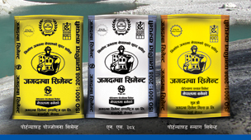
l;d]G6
k|sf/
  ;fwf/0f kf]6{n}08 l;d]G6
  l56f] hDg] jf l56f] s8f x'g] l;d]G6
  Go"g tfk l;d]G6
  ;]tf] l;d]G6 cflb
:t/
  ## u|]8, $# u|]8, %# u|]8 -d]uf kf:sn_
Notes:
Objective:
To explain the types of cement that are most commonly used.
Activity:
Ask participants how many types of cement available in their local market and try to explain about the use of different types of cement in different places.
According to the grade explain the appropriate places where cement will be used.
Slide Details / Discussion:
Generally in most of the construction works ordinary port land cement is used. In the case of repair work, quick setting cement is useful. Low heat cement is used when the huge volumn of concrete is to be concreted.
The different grades of cement are available. Higher the grade more stronger the concrete we can produce but only higher grade cement does not insure the higher strength concrete.

Slide 8
l;d]G6sf] 5gf}6
pTkfbg @ dlxgf eGbf k'/fgf] gePsf]
xfjf gl5g]{ af]/fdf /flvPsf]
cf}+nfsf] aLrdf /u8\bf v;|f] gnfUg]
;'Vvf 7fp+df cf];af6 arfP/ e08f/ ul/Psf]
l8hfOgsf] cfjZostf cg';f/sf]
;+/rgf / 9nfgsf] nflu sDtLdf $# u|]8sf]
Notes:
Objective:
To explain how to select appropriate cement
Activity:
Ask participants how they select appropriate cement for their works.
If their answer match with above points then it will be ok otherwise try to convinced them about the procedure of selecting the good quality cement.
Slide Details / Discussion:
The cement looses its quality with respect to time due to its reaction with moisture. Therefore it should be used within 2 months from the date of its manufacture. The packs should be airtight. The cement bags should be stored in dry place and well protected from moisture.

Slide 9
l;d]G6sf] u'0f:t/
/fd|f] u'0f:t/
pko'Qm cjlwdf hDg yfN5
tf]lsPsf] ;doleq lyrfOdf cfjZos zlQm k|fKt u5{
/fd|/L Kofs u/]sf] af]/fdf k"/} w"nf] cj:yfdf
v/fa u'0f:t/
l56f] hDg] jf lgwf{l/t cjlwleq ghDg]
tf]lsPsf] ;doleq cfjZos zlQm k|fKt gx'g]
klxNo} s8f eO;s]sf s]xL 8Nnfx? e]l6g]
Notes:
Objective :
To explain the quality of cement.
Activity:
If any idea comes from participants to find out good and bad quality cement first give chances to them.
Then formulate their idea with standard parameter which help to major good and bad cement.
Slide Details / Discussion:
This slide explains the good and bad quality cement. For ordinary portland cement the initial setting time is 30 minutes and final setting time is 10 hour after it comes in contact with water.

Slide 10
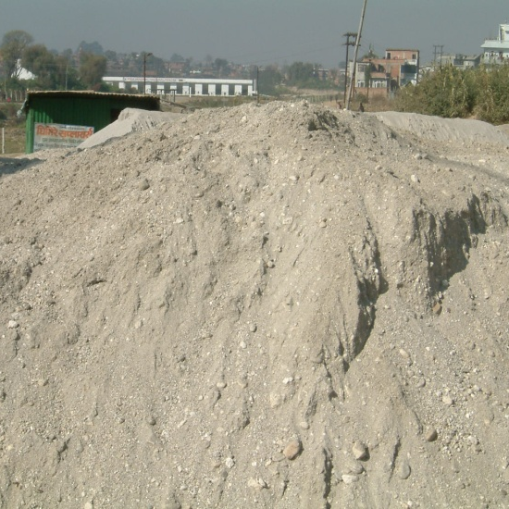
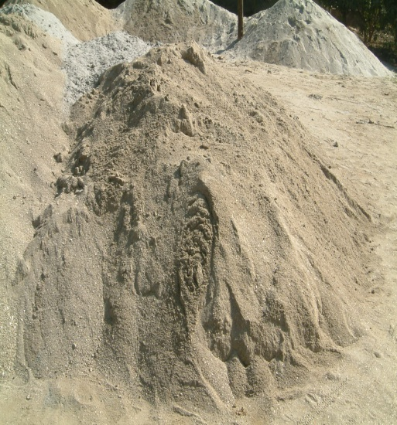
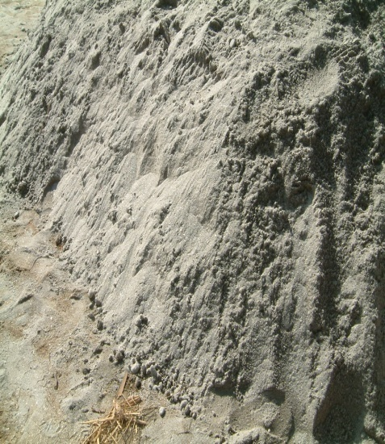
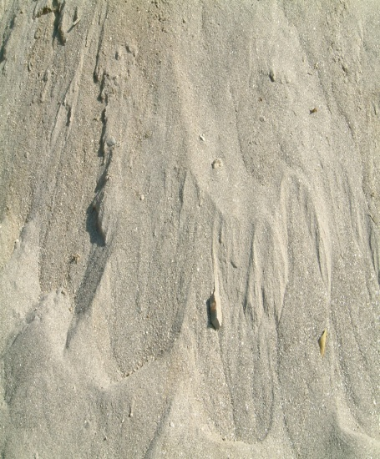
afn'jf
l;d]G6 d;nf jf s+lqm6 cflbdf k|of]u ul/G5
;kmf, /fd|f] cfsf/ / :t/sf] vf]nfsf] afn'jf x'gk5{
df6f], h}ljs j:t' h:tf afXo tTj gldl;Psf] x'g'k5{
Notes:
Objective:
To describe the quality of sand
Activity:
Where is the source of sand?
Discuss the probability of other material mixed with sand.
Ask participants how they choose good quality sand.
Slide Details / Discussion:
Particle size less than 4.75mm are called sand. As far as possible select the river bed sand. If sand is for cement concrete and cement mortar than select coarse sand if sand is using for plaster choose fine sand . Sand should not contain soil and organic materials.

Slide 11
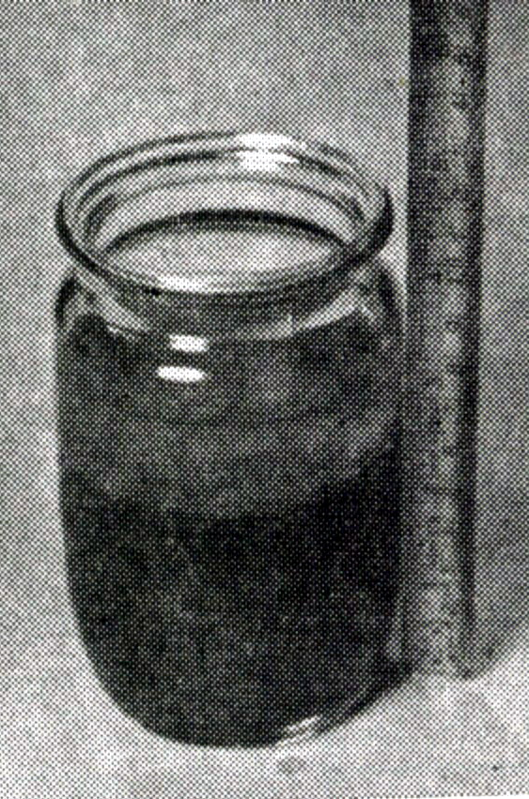
afn'jf–w"nf] k/LIf0f
Pp6f efF8f]df ^) ld=ld= ;Dd ;'Vvf afn'jf eg]{
afn'jfdfly @% ld=ld=;Dd kfgL eg]{
Ps rDrf g"g yKg]
ld>0fnfO{ Psgf;sf] geP;Dd xNnfpg]
ef+8f]nfO{ tLg306f;Dd grnfO{ /fVg]
afn'jfdfly a;]sf] w"nf]sf] kl/df0f gfKg]
w"nf]sf]] kl/df0f % k|ltzt eGbf a9L x'g'x'+b}g
Notes:
Objective:
To explain the process of finding out the good quality sand by simple method
Activity:
Try to explore from the participants easy method to select the good quality sand.
Explain the sand test using jar
Also explain simple technique of sand test. Take some sand on the fist and moist it by adding little water. If palm gets dirty, sand is not good and if it remains clean, sand is ok.
Slide Details / Discussion:
Explain the participants if there is no found of standard jar than drinking glass and stick can be used in this experiment.
Repeat procedure in each step so that participants can follow thoroughly.
Describe the salt role in solution which help silt to dilute with sand.

Slide 12
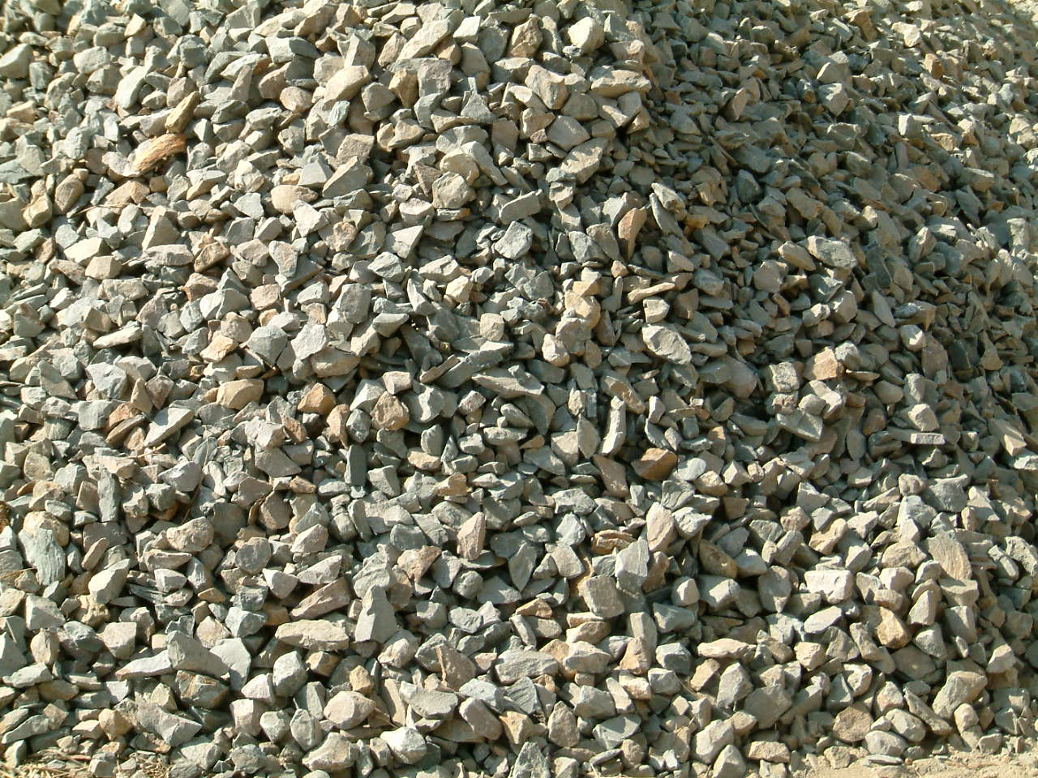
v;|f] /f]8f
;|f]t
  gbL lsgf/
  9'Ëf qmz/ KnfG6
k|of]u
  l;d]G6 s+lqm6
  ;8s
Notes:
Objective:
To explain the source and use of aggregate in construction works.
Activity:
Try to obtain the probable source of aggregate and their use from the participants.
Explain if required
Slide Details / Discussion:
The major sources of aggregates are river bank and stone crusher plant. The stone can be obtained from river bank or quarry. In small scale, aggregates are prepared by breaking the stone manually. Coarse aggregates is one of the major component of cement concrete. It is also extensively used for the construction of flexible and rigid pavement.

Slide 13
v;|f] /f]8fsf] u'0f:t/
alnof], l6sfp / bfgfbf/
sd lvOg], s8f
/fd|f] >]0fLsf]
kq] jf nfdf c+zx? gePsf]
df6f] / w"nf] gePsf]
h}ljs j:t'x? gldl;Psf]
cfsf/sf] lge{/tf
  s+lqm6sf] df]6fO, :k]l;lkms]zg tyf l8hfOgsf] cfjZostf cg';f/
Notes:
Objective:
To explain the quality of coarse aggregates.
Activity:
Discuss on the quality of coarse aggregates.
Explore from the participants best shape of aggregate.
Ask question to the participants what will be the effect if aggregate contain foreign materials.
Slide Details / Discussion:
Strength of concrete depends on the strength of aggregates. Aggregates should be strong, hard, and durable. It should not contain flaky and elongated particles. Rounded aggregates increases workability but it does not produce proper bond. Angular aggregates produce strong bond. Aggregates should contain all sizes of the particles in correct proportion.
Size of aggregates depends on the thickness of concrete members.
For the concrete members having thickness 40 to 100 mm: 12mm down
For members having thickness more than 100mm: 20mm down
For other members and mass concrete: As per design requirements and specification.

Slide 14
kfgLsf] u'0f:t/
;kmf x'g'k5{
s+lqm6 / kmnfdnfO{ laufg]{ s'g} kbfy{ gldl;Psf] x'g'k5{
;fdfGotof lkpg] kfgL eP rN5
Notes:
Objective:
To describe the quality of water for construction
Activities:
Ask participants about their views in the quality of water they used in the construction
Explain in brief
Slide Details / Discussion
This slide describes the quality of water for the construction. It should be clean and free from any deleterious materials to concrete and steel such as oils, acids, salts, sugar, organic matter etc. In general potable water is found satisfactory for mixing and curing, however water used for curing should not produce any objectionable stain to the concrete surface.

Slide 15
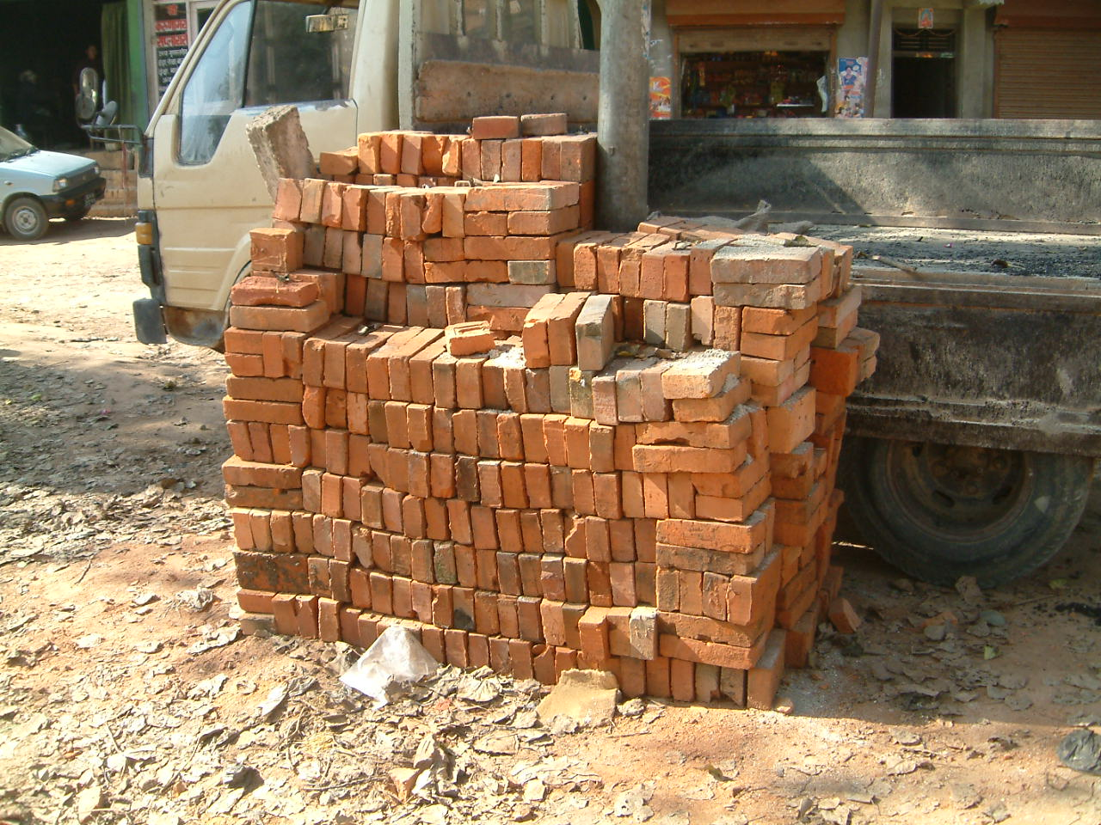
O{6fsf] u'0f:t/
lyrfOdf -sDk|]zg_ Go"gtd zlQm – #=% N/mm²
/fd|f];+u kf]n]sf], Psgf; /ftf] /+usf] / lrNnf] ;tx ePsf]
lgoldt / Psgf;sf] cfsf/ / gfk ePsf]
Notes:
Objective:
To describe the property of good quality brick.
Activity:
Let the participants selection procedure of good quality brick.
Explain the qualities of good brick .
Slide Details / Discussion:
Brick is a clay product. It is mould and burnt in kiln at an appropriate temperature. Bricks may be hand molded or machine made. The minimum compressive strength of brick should not be lower than 3.5 N/mm² and higher strength is preferred. The bricks should be well burnt, regular and uniform shape and size. The frog should always be facing upward so that mortar can be filled in frog and bonding strength of brick masonry will be improved.

Slide 16
O{6fsf] u'0f:t/
k/:k/df 7f]Sbf wft'sf] 7f]lsP h:tf] cfjfh ;'lgg]
cfk\mgf] tf}nsf] @% k|ltzt eGbf a9L kfgL g;f]:g]
# lkm6sf] prfOaf6 v:bf gkm'6\g]
Notes:
Continuation of previous slide
Slide Details / Discussion:
Bricks should produce metallic ringing sound when struck each other. While immersed in cold water for 24 hours should not absorb more than 25% of its dry weight. As a general guide, brick should not break while dropped from a height of 3 feet.

Slide 17
9'Ëfsf] u'0f:t/
k|fs[lts ?kdf k|of]u ug{ x'+b}g
hf]8fO ug'{cl3 km'6fpg' k5{
tn / dfly ;dtn ;tx x'g'k5{{
df]6fO @ OGr jf a9L / rf}8fO ^ OGr jf a9L x'g'kg]{
;lhn} km'6\g] / g/d 9'Ëf k|of]u gug]{
Notes:
Objective:
To explain the qualities of stone
Activity:
Involve participants to have discussion on the good quality stone
Slide Details / Discussion:
Stone should never be used in its natural shape. Before laying stone should be broken down and it should have flat surface on the top and bottom. The smaller size stone should not be used except for filler material.
Stone wall should not made more than 3 feet height in a single day.

Slide 18
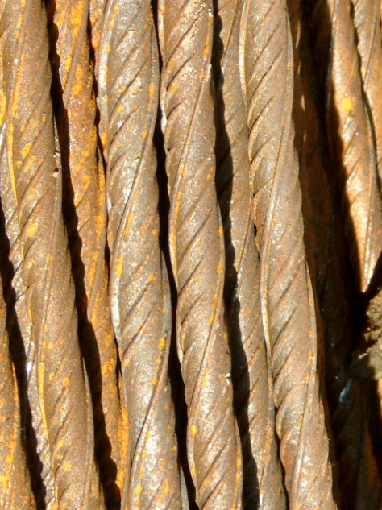
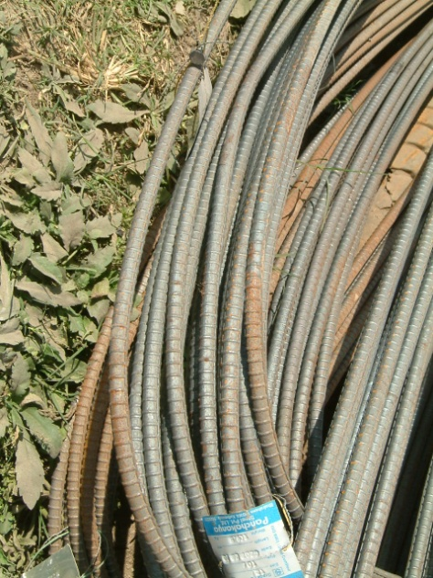
9nfgsf] nflu kmnfd] 808L
;fdfGotof k|of]udf NofOg] 808L
  g/d :6Ln
  pRr zlQmsf] lj?lkt 808L
kq lg:s]sf], lvof nfu]sf], /+u jf t]nsf] k/t nfu]sf], rs]{sf], ;tx lau|]sf], hnk nfu]sf] cflb x'g'x'+b}g
gfk tyf tf}nsf] cfjZostf cg';f/ ldNg] x'g'k5{
a+Uofp+bf gef+lrg] x'g'k5{
Notes:
Objective:
To explain about the quality of steel reinforcement
Activities
Explain about the steel qualities
Slide Details / Discussion
The commonly used types of steel reinforcements are mild steel and high strength deformed bar. All reinforcement shall be free from any defects which prevents the bonds. The bar should not fracture while bending.

Slide 19
sf7
k|of]u
  ;+/rgfsf tTjx?
  e\mofn 9f]sf
  kmdf{ tyf cGo
;+/rgfdf k|of]u ul/g] sf7sf] u'0f:t/
  /fd|/L kl/kSj -l;hg ul/Psf]_
  lr/f / cf+Vnf gePsf]
  ?vsf] aflx/L efu gk/]sf]
  cfsf/df Ps?ktf / gk;f+luPsf]
Notes:
Objective:
To explain the quality of structural timber
Activities:
Explore participants’ views on use and qualities of structural timber
Explain in brief
Slide Details / Discussion:
Timber is used for different structural members like post, beam, joist, rafter etc and also for making doors and windows. Timber also used in formwork for concreting, however their qualities differs from those used in structural members and door and windows. Structural timber should be well seasoned and free from defects.

Slide 20
sflnu9L

Slide 21
;fdfGo lgdf{0f sfo{
uf/f] lgdf{0f
  d;nfsf] tof/L
  uf/f]sf] hf]8fO, So"l/+u
s+lqm6 9nfg
  kmdf{ nufpg]
  808L af+Wg]
  d;nf xfNg], s:g] / So"l/+u ug]{

Slide 22
hf]8fOsf] nflu d;nf tof/ ug]{
afs;sf] k|of]u u/L cfjZos cg'kftdf l;d]G6 / afn'jfsf] afF8 ldnfpg]
afF8nfO{ Psgf;sf] geP;Dd sDtLdf tLg k6s ;'Vvf ld>0f ug]{
kfgL / l;d]G6sf] cg'kft adf]lhd kfgL /fv]/ /fd|f];+u ld;fpg]
kfgL xfn]sf] cfwf 306fleq d;nfsf] k|of]u ul/;Sg' k5{
Notes:
Objective:
To know how to make cement mortar.
Activity:
First ask participants about the local process of making cement mortar then slowly transform them in standard process.
Slide Details / Discussion:
This slide explains about the preparation of cement sand mortar. If lime is added then the workability of mortar will be improved.

Slide 23
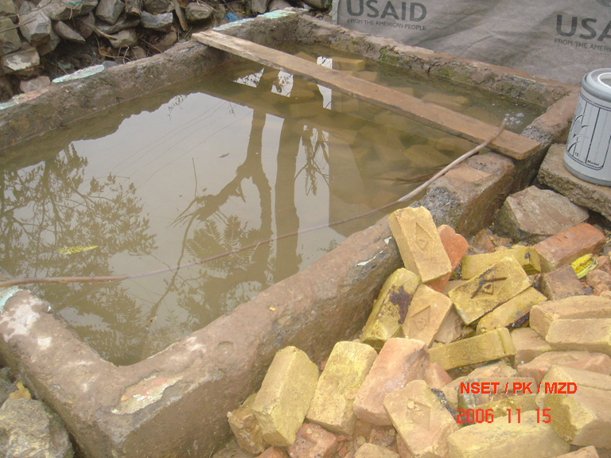
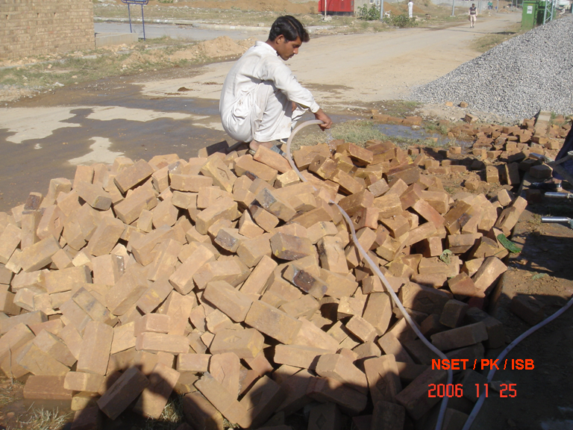
O+{6fsf] tof/L
7Ls
unt
hf]8fO ug'{cl3 sDtLdf & 306f;Dd O+6fnfO{ kfgLdf 8'afpg' k5{
Notes:
Objective:
To understand curing procedure of brick.
Activity:
Discuss about why bricks should be wet
If not can we use the brick only by sprinkling water?
Then slowly try to convince them why proper wetting of brick is required?
Detail discussion:
If dry brick is used in masonry it absorbs water from mortar. This causes mortar dry which prevents it gaining strength. Thus it produces very weak mortar and also the bond between the mortar and brick becomes very weak. Therefore brick should be fully saturated with water. For this bricks should be submerged in water for at least 7 hours before laying.

Slide 24
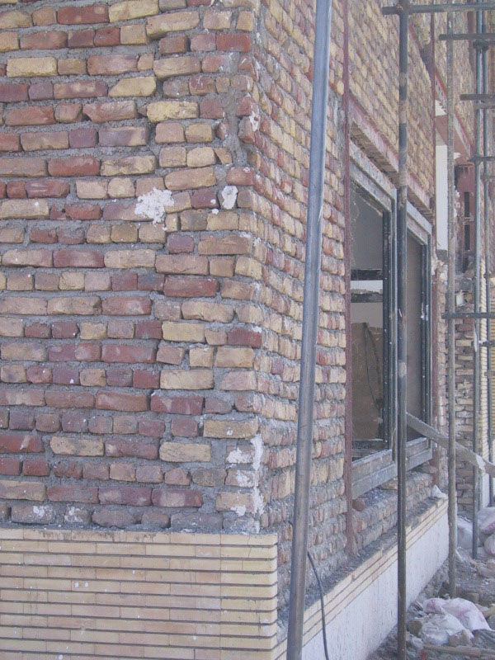
O{+6fsf] hf]8fO
7f8f] hf]gL{x? Ps} 7fp+df gkg]{ u/L 5Ng]
k|To]s @ lkm6 prfOdf k"/} nDafOel/ n]en ldnfpg]
sDtLdf % lbg;Dd So"l/+u ug]{
lgdf{0fsf] !$ lbg;Dd s'g} klg t];f]{ ef/ gkfg]{
Notes:
Objective:
To explain about masonry wall construction.
Activity:
Ask participants what they observed in this photograph.
Discuss overall laying process of bricks masonry.
Also discuss about how much owner is investing on beautiful cladding but not paying due attention for the strength of masonry.
Slide Details / Discussion:
In this building, there is a continuous vertical joint. Bricks are laid haphazardly. This makes masonry wall very weak. Therefore avoid continuous vertical joints in masonry works.
Also at the bottom of wall, a beautiful cladding is started. Thus owner has invested lots on cladding but not attention is given to the strength of masonry.
Proper curing is required to make wall strong because regular curing provides moisture for mortar when it is gaining its strength. Curing should be done at least for 7 days for masonry in cement sand mortar. Wall height should be equal at every layer of masonry works. At every 2 feet height masonry should checked by pipe level.
mason does not press the brick into a sufficient bed of fresh mortar. Disturbing or moving the brick after initial placement will damage the bond. These factors influence the water penetration resistance of the wall. Openings in the mortar joint and lack of contact between the brick and mortar will obviously permit water penetration.

Slide 25
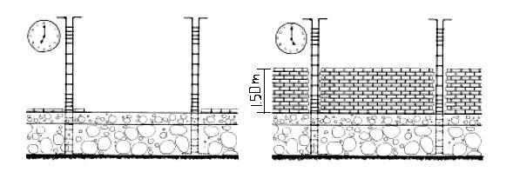
O+{6fsf] hf]8fO
s'g} klg uf/f]df Pslbgdf % lkm6 eGbf a9L cUnf] hf]8fO gug]{
Notes:
Objective:
To explain the maximum height of wall that can be constructed in a single day
Activity:
Take idea from the participants about normal practices of wall construction in community.
Discuss if wall is constructed more than 1.5m in height in a single day what will be the impact.
Slide Details / Discussion:
This slide shows the maximum height of wall that can be constructed in a single day. Cement mortar gets its strength slowly. On the first day, the strength of mortar is not sufficient to sustain load. Therefore wall height should not be more than 5 feet on the single day.

Slide 26
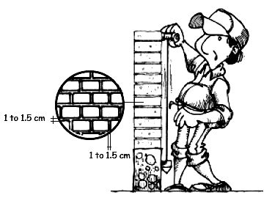
O+{6fsf] hf]8fO
k|To]s txdf 306L 7Ls 5 5}g x]g]{
hf]gL{sf] rf}8fO{ !@ ld=ld= jf sd dfq /fVg]
Notes:
Objectives:
To explain how to make wall true vertical.
To explain the thickness of mortar in wall construction.
Activity:
Ask the participants how they check the verticality of wall
Ask them about their practices of mortar thickness
Explain in detail.
Slide Details / Discussion:
The wall should be truly vertical. The verticality of wall should be checked in each layer. It can be done by using plumb bob.
The strength of wall depends on the thickness of mortar. Thicker mortar will reduce the wall strength, however, if the masonry units are not uniform it demands thicker mortar. Therefore half a inch mortar thickness will be enough.
Disturbing or moving the brick after initial placement will damage the bond. These factors influence the water penetration resistance of the wall. Openings in the mortar joint and lack of contact between the brick and mortar will obviously permit water penetration.
Objective:
To know how to make wall true vertical .
To know thickness of mortar in wall construction.
Activity:
Sharing with participants about verticality of wall.
Used of plum bob in wall to check line and level.
Detail discussion:
If wall will not be truly vertical there is possibility of create of eccentricity.
More the mortar thickness in wall strength will be less.
Can be discuss using procedure of plum bob.

Slide 27
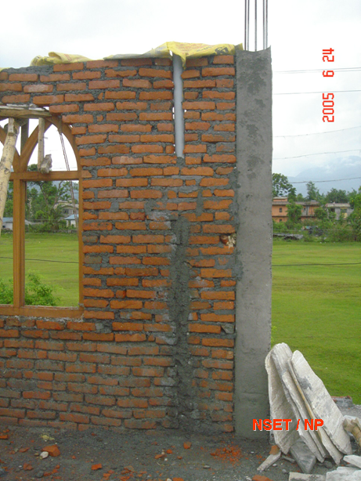
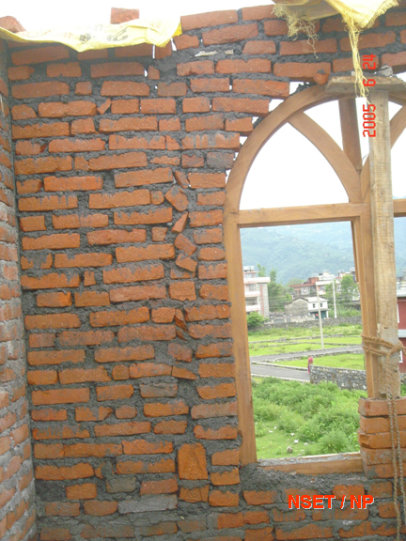
el/Psf] uf/f]
oL el/Psf uf/f]x?df s] s:tf sdhf]/L 5g\ <
Notes:
Objective:
To explain wrong construction practice of infill wall
Activities:
Collect participants’ views in these photographs and discuss on the issues
Slide Details / Discussion:
In this slide, the infill wall is made without giving due attention to its strength. Light is visible through holes in vertical joints. This shows there is no proper mortar in vertical joints. In the second photograph, there is a large pipe inserted in the wall. This makes wall weak.

Slide 28
l;d]G6 s+lqm6
l;d]G6, afn'jf, /f]8f / kfgLsf] ldl>t ;fdu|L
;fdfGotof zlQm -M15, M20) jf cg'kftsf] cfwf/df (1:1.5:3, 1:2:4) o;sf] klxrfg ul/G5
;fbf l;d]G6 s+lqm6
  o;df 808Lsf] k|of]u ul/+b}g
  ;fdfGotof husf] cfwf/df k|of]u ul/G5
k|alnt l;d]G6 s+lqm6
  kmnfd] 808L k|of]u ul/G5
  blng, vDaf, e'O{ cflbsf] 9nfgdf k|of]u ul/G5
Notes:
Objective:
To describe cement concrete
Activity:
Define cement concrete
Share about normal practices in community about ratio of cement concrete.
Describe about plain and reinforced concrete
Detail discussion:
Cement concrete is a composite construction material of cement, sand, aggregates and water. After mixing it is in plastic state. Therefore concrete of any shape can be prepared. It slowly sets in to solid and hardens with respect to time. Concrete is generally specified by its strength like M10, M15, M20 etc. or by proportion of cement, sand and aggregates like 1:1.5:3, 1:2:4, 1:3:6 etc. The numerical values 10, 15, 20 etc define the compressive strength of the concrete cube in N/mm² at 28 days from the date of casting.
Concrete has very low tensile strength, therefore in the structural members, steel reinforcement are used to resist tension. Concrete with out any reinforcement is called Plain Cement Concrete (PCC). Concrete with reinforcement is called Reinforced Cement Concrete (RCC). Generally steel bars are provided as reinforcement. PCC is generally used in foundation base, flooring etc. and RCC is used in beams, columns, slabs and other structural members. For RCC works, concrete of not less than M15 or mix proportion of not leaner than 1:2:4 is to be used.

Slide 29
kmdf{
s+lqm6sf] cfjZos cfsf/ / gfk ldnfpg k|of]u ul/G5
;fdu|L M
  sf7, afF;, kmnfd] kfOk, :6Ln kftf cflb
kmdf{sf] u'0f:t/ M
  s8f, l6sfp, kof{Kt df]6fO / cfjZos gfksf]
  kfgL gl5g]{, Psgf;sf] gfk / cfsf/, ;dtn ;tx
  s+lqm6 / sfdbf/sf] ef/ y]Ug ;Sg]
Notes:
Objective:
To give general idea about formworks.
Activity:
Discuss the importance of form work and desired qualities.
Detail discussion:
Form work is used to achieve required shape and size of concrete product or member. It is a very important component in concrete construction works. The types and quality depends on the type of construction and size of concrete members. In general residential construction works, timber formwork is commonly used since timber is available every where and easy to form. The quality of concrete member also depends on the quality of form work.

Slide 30
kmdf{sf] tof/L
nfOg n]en ldNg], kfgL gl5g]{ u/L 6Dd ldn]sf] hf]gL{
sf7sf] 7f8f] vf+af] / blngx?sf] gfk $ OGr x $ OGr eGbf sd x'g' x'+b}g
vf+af] / blngx? # lkm6 eGbf 6f9f /fVg' x'+b}g
;a} vf+afnfO{ k/:k/df t];f]{ af/n] hf]8\g' k5{
Notes:
Objective:
To explain the formwork preparation for concreting
Activity:
Ask participants what is their experiences in formwork preparation and discuss in detail.
Slide Details / Discussion:
The formwork should be straight and of sufficient strength and properly supported to resist springing or deviation during the process of concreting. They should be securely braced and held firmly to the required level and should not permit any leakage of concrete. Where alignment includes curves, flexible strips of steel may be helpful.

Slide 31
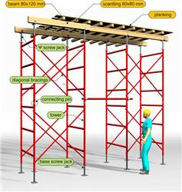
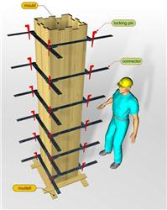
kmdf{sf] tof/L
Notes:
Objective:
To explain the formwork preparation for concreting
Activity:
Ask participants what is their experiences in formwork preparation and discuss in detail.
Slide Details / Discussion:
The formwork should be straight and of sufficient strength and properly supported to resist springing or deviation during the process of concreting. They should be securely braced and held firmly to the required level and should not permit any leakage of concrete. Where alignment includes curves, flexible strips of steel may be helpful.

Slide 32
808L /fVg] tl/sf
lj:t[t gSzf / :k]l;kms]zg adf]lhd dfq sf6\g], a+Uofpg] / hf]8\g] ug'{k5{
d'Vo 808Lx? ;a} jf:tjd} ;Lwf / nfOg ldn]sf] x'g'k5{
tf]lsPsf] 7fp+df dfq vlK6g' k5{
l/+ux?nfO{ ;a} d'Vo 808L;+u af+Wg'sf] ;fy} tf]lsP d'tflas x'g'k5{
dfly / tnsf] 808Lx?nfO{ 5'6\ofpg s';L{ lbg'k5{
808Lsf] cfj/0f -se/_ z'4 x'g'k5{
tf]lsPsf] gfksf] se/ Ansx?sf] k|of]u ug'{k5{
Notes:
Objective:
To explain how to place reinforcement
Activity:
Share the experiences of participants about reinforcement placement
Ask them how they maintain cover and spacing and explain the detail.
Slide Details / Discussion:
All reinforcement shall be cut, bent and erected exactly as per the design specification. The high strength deformed bar should not be re-bent. All reinforcement should be placed and maintain by providing proper cover blocks, spacers, chairs, supporting bars etc.

Slide 33
cfj/0f -se/_ sf] l;kmfl/;
cfj/0f
dflyNnf] 808L
s';L{
:nfa – !% ld=ld= jf % nfOg
blng – @% ld=ld= jf ! OGr
vDaf – $) ld=ld= jf !=% OGr
hu – %) ld=ld= jf @ OGr
Notes:
Minimum clear Cover in Concrete Works
In no case shall be less than diameter of the larger bar.

Slide 34
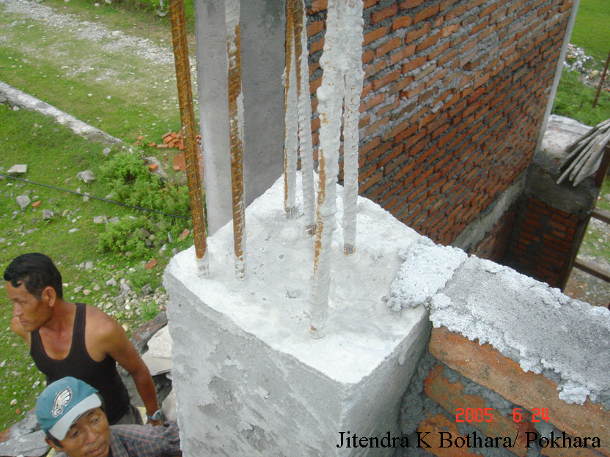
se/ Ans lsg <
Notes:
Objective:
To explain the necessity of cover block
Activity:
Let the participants identify the defects in this photograph and discuss on the probable reason and solution.
Slide Details / Discussion:
This slide shows a RCC column under construction. The bars are not placed properly. Such problem may arise when the cover blocks are not provided. Cover blocks maintain the cover and the quality of construction improves.

Slide 35
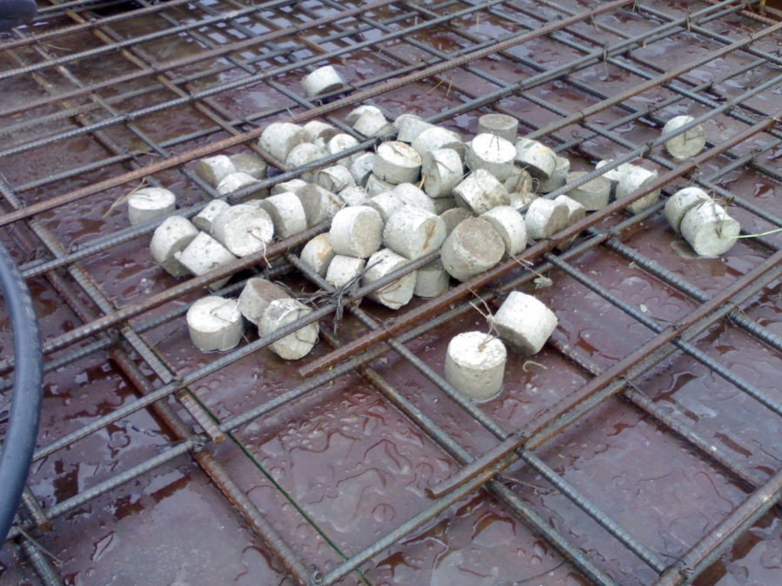
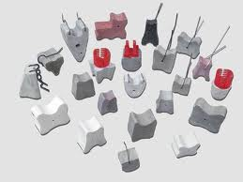
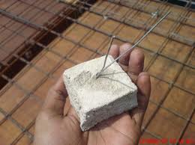
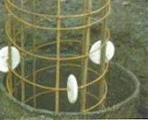
se/ Ans lsg <
Notes:
Objective:
To explain the necessity of cover block
Activity:
Let the participants identify the defects in this photograph and discuss on the probable reason and solution.
Slide Details / Discussion:
This slide shows a RCC column under construction. The bars are not placed properly. Such problem may arise when the cover blocks are not provided. Cover blocks maintain the cover and the quality of construction improves.

Slide 36
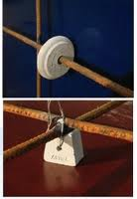
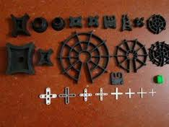
se/ Ans lsg <
Notes:
Objective:
To explain the necessity of cover block
Activity:
Let the participants identify the defects in this photograph and discuss on the probable reason and solution.
Slide Details / Discussion:
This slide shows a RCC column under construction. The bars are not placed properly. Such problem may arise when the cover blocks are not provided. Cover blocks maintain the cover and the quality of construction improves.

Slide 37
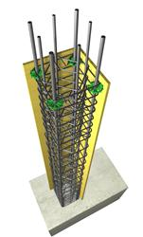
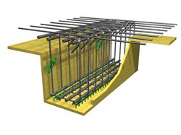
se/ Ans lsg <
Notes:
Objective:
To explain the necessity of cover block
Activity:
Let the participants identify the defects in this photograph and discuss on the probable reason and solution.
Slide Details / Discussion:
This slide shows a RCC column under construction. The bars are not placed properly. Such problem may arise when the cover blocks are not provided. Cover blocks maintain the cover and the quality of construction improves.

Slide 38
808LnfO{ s'rL{ lsg <
Notes:
Objective:
To explain the necessity of cover block
Activity:
Let the participants identify the defects in this photograph and discuss on the probable reason and solution.
Slide Details / Discussion:
This slide shows a RCC column under construction. The bars are not placed properly. Such problem may arise when the cover blocks are not provided. Cover blocks maintain the cover and the quality of construction improves.

Slide 39
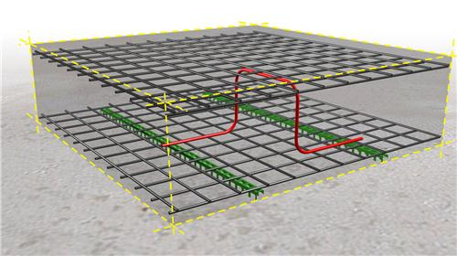
808LnfO{ s'rL{ lsg <
Notes:
Objective:
To explain the necessity of cover block
Activity:
Let the participants identify the defects in this photograph and discuss on the probable reason and solution.
Slide Details / Discussion:
This slide shows a RCC column under construction. The bars are not placed properly. Such problem may arise when the cover blocks are not provided. Cover blocks maintain the cover and the quality of construction improves.

Slide 40
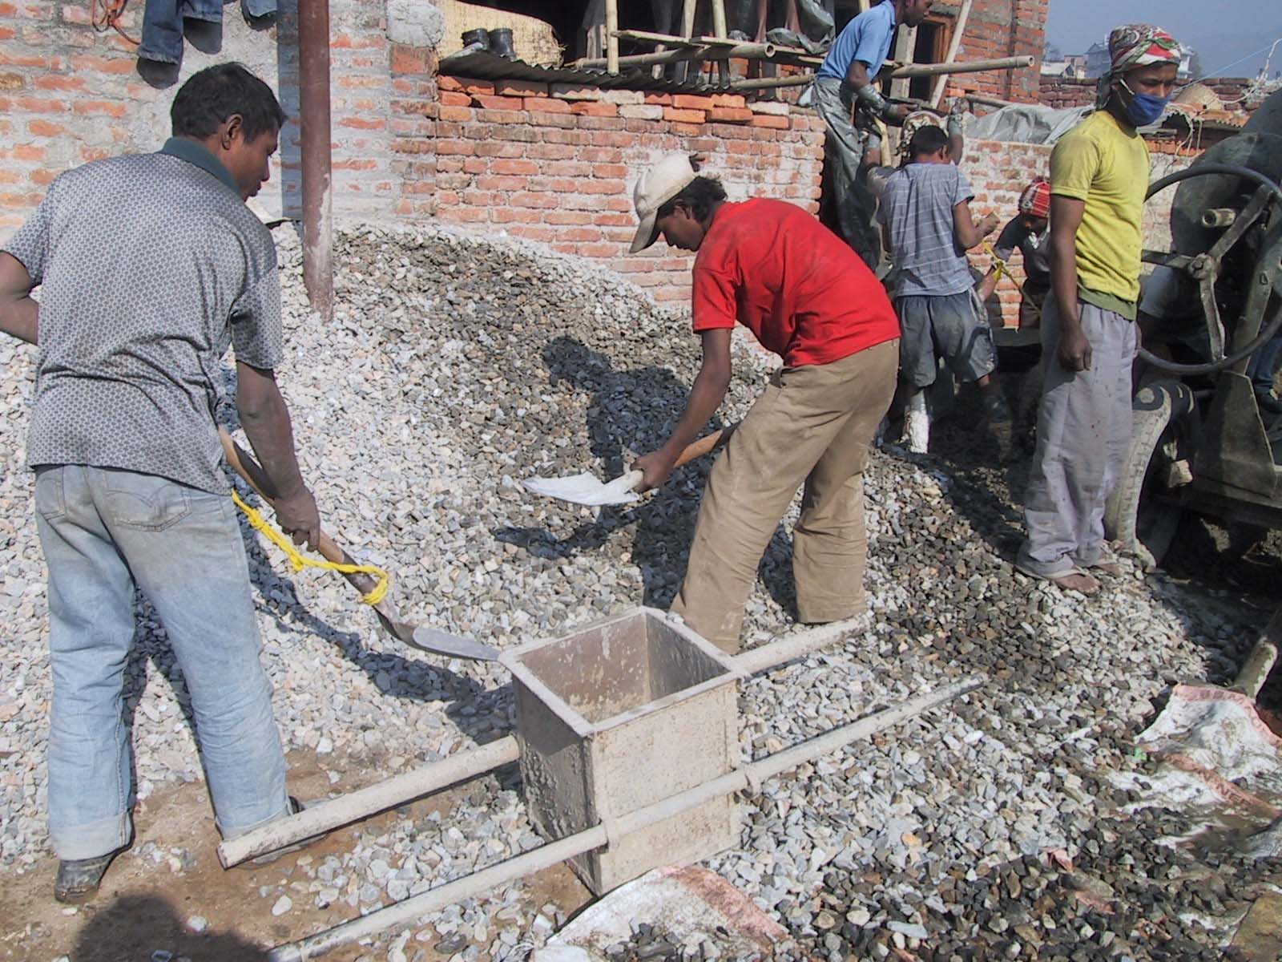
afF8 ldnfpg]
afF8 ldnfp+bf ;fdfgsf] 7Ls kl/df0f /fVg afs;x?sf] k|of]u ug'{k5{
afs;sf] /fd|f] 3g gfk !@ OGr x !@ OGr x !% OGr x'g'k5{
tf}n cg';f/ afF8 ldnfpg' /fd|f] x'G5
d]lzg k|of]u gug]{ eP !) k|ltzt l;d]G6 yk /fVg'k5{
Notes:
Objective:
To explain about concrete batching
Activity:
Explore from the participants different measuring procedures of sand and aggregate in local practices.
Explain the exact measuring process required to maintain the ratio of concrete.
Slide Details:
All required materials of appropriate quality and quantity should be ready at site before proceeding to concreting work. Proportion of cement, sand and aggregates should be maintained to achieve good quality concrete. Batching by weight is preferred than batching by volume.
Standard batching box should be used for measuring the sand and aggregate where batching by weight is not possible. The size of standard batching box is 12” X 12” x 15” which is equal to the volume of one bag of cement. Use of loose bags should be avoided for measuring. In case of manual mixing add 10 % extra cement.

Slide 41
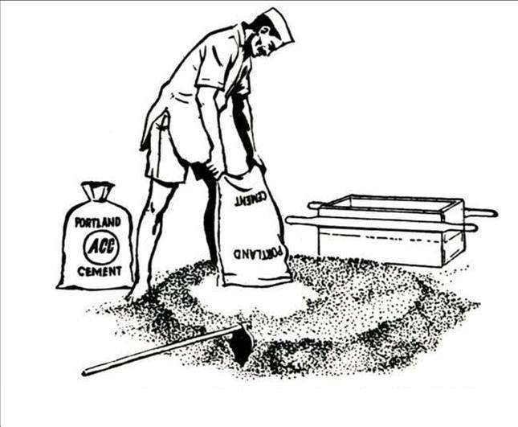
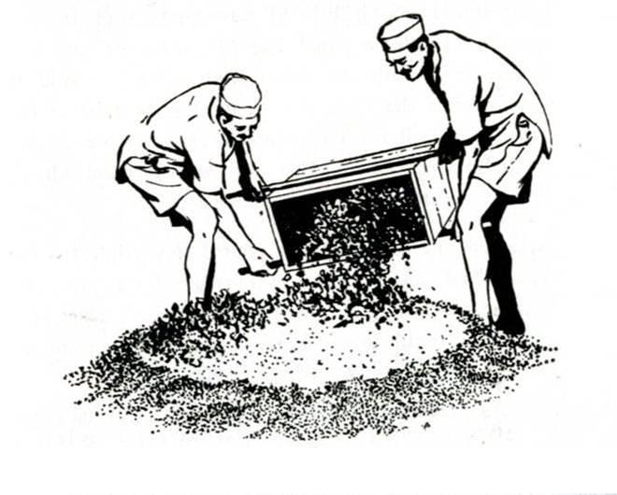
xft}n] s+lqm6 ld;fp+bf
!= l;d]G6 / afn'jf ;'Vvf ld;fpg]
@= To;kl5 /f]8f ld;fpg]
Notes:
Objective:
To explain the preparation process of cement concrete manually.
Activity:
Ask the participants how they prepare concrete.
Then explain the process of concrete mixing manually.
Slide Details / Discussion:
Hand mixing should be done on a clean paved area or a water tight platform. The cement is dumped on the sand and distributed evenly over it. Then mix cement and sand in dry condition. The measured quantity of coarse aggregate is spread out on the sand cement mixture and mix properly.

Slide 42
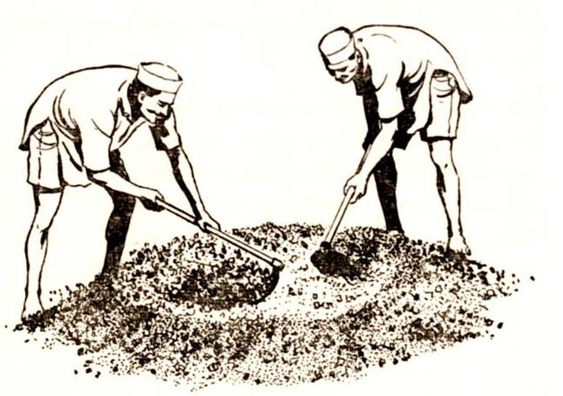
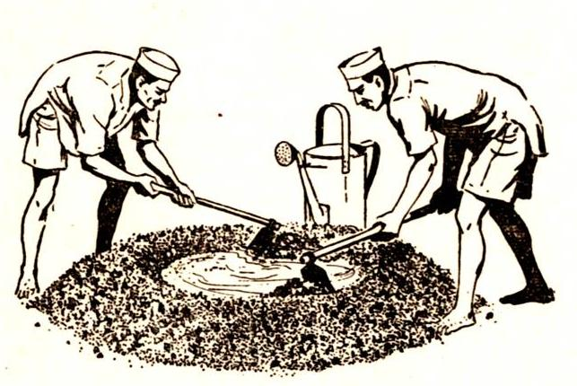
xft}n] s+lqm6 ld;fp+bf
#= aLraf6 5]plt/ ;fa]n rnfpg], To;kl5 km]/L aLrlt/ nUg] / km]l/ 5]plt/ Nofpg]
$= aLrefudf vfN8f] agfpg] / lj:tf/} kfgL xfNb} d;nf jN6fO{ kN6fO{ ub}{ hfg]
Notes:
Objective:
To explain the concrete mixing manually.
Activity:
Show the slide one by one and explaining correspondingly.
Slide Details:
Mixing of dry cement, sand and aggregates is continued by shoveling from the center to the side then back to centre and again to the side at lest 3 times. A hole is made in the middle of mixed pile and water is poured slowly into it as the mixture is turned over and over again at least 5 times and until the mixture becomes uniform.

Slide 43
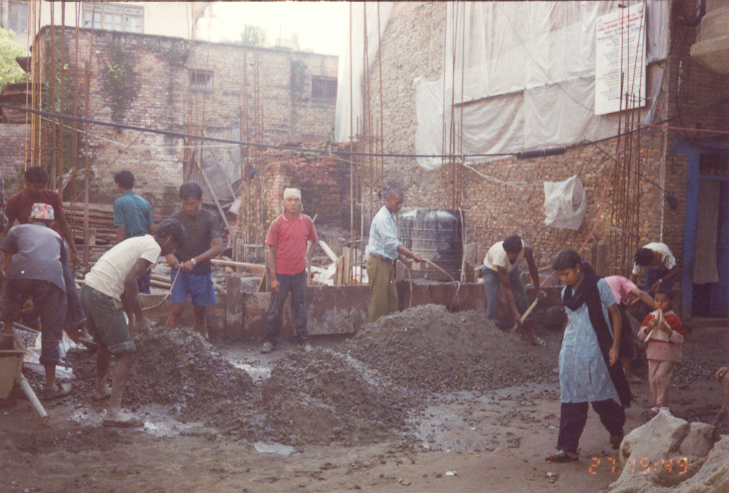
s] uNtL eof] <
Notes:
Objective:
To describe wrong practice of manual mixing
Activity:
Ask the participants to identify the wrong practices in this photographs and discuss on the issue.
Slide Details:
This slide shows concrete mixing activity being done manually. There is no water tight platform. Water is being poured by pipe directly. It does not ensure the proper water cement ratio.

Slide 44
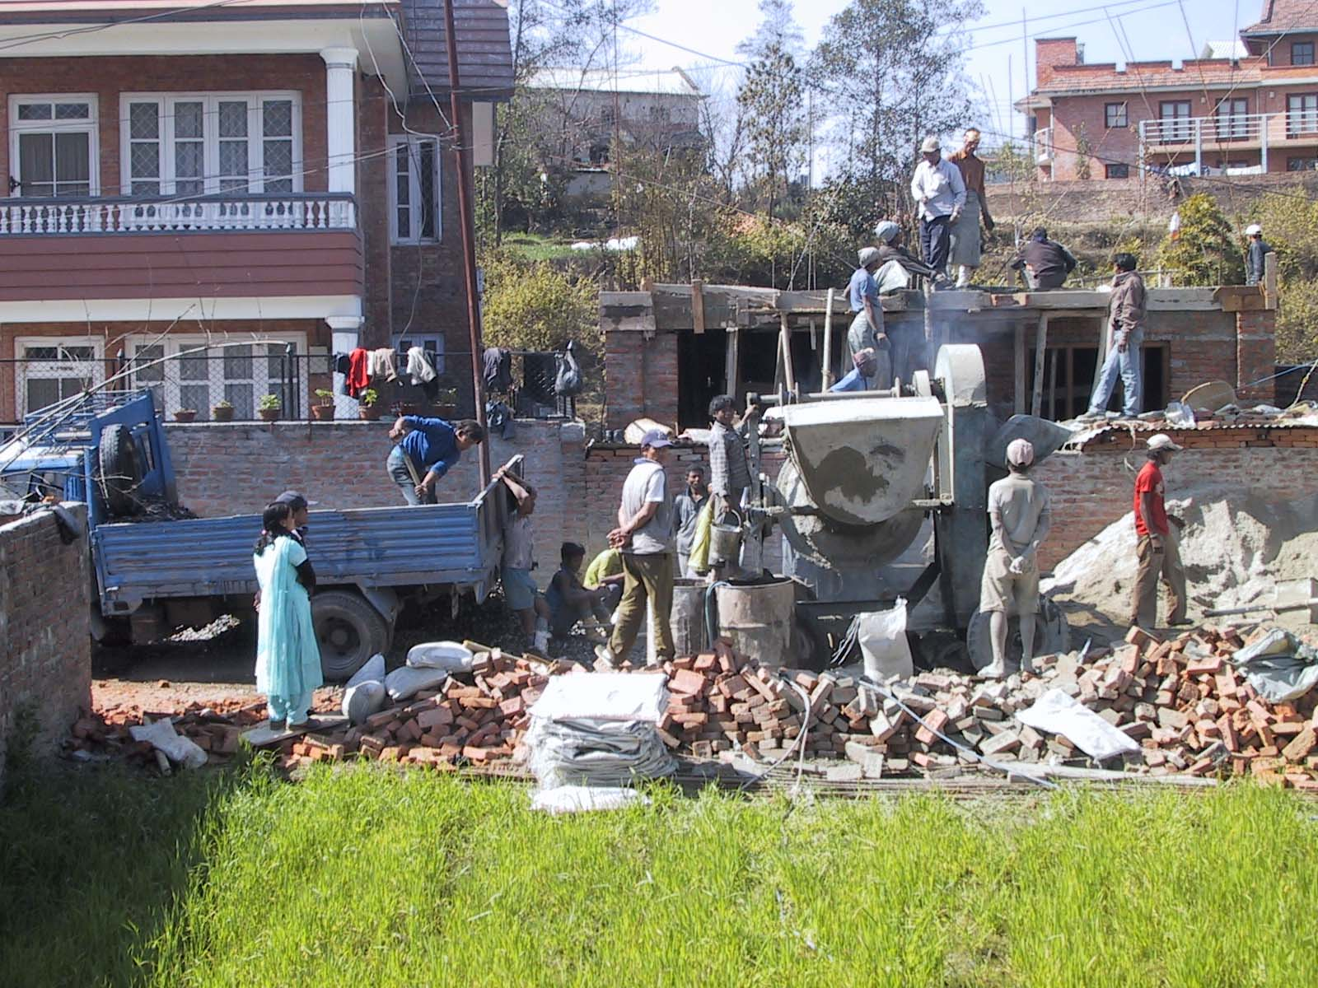
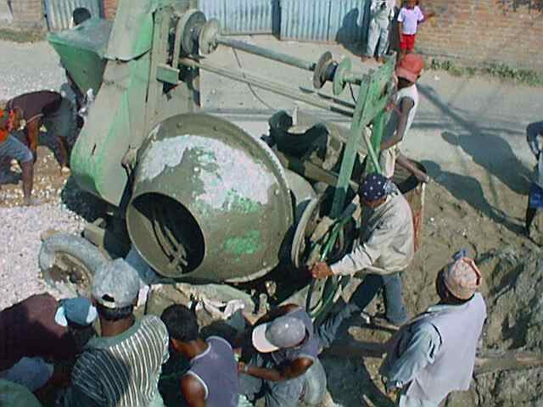
d]lzg k|of]u u/L ld;fpg]
8«ddf clnslt kfgL xfn]/ v;|f] /f]8f xfNg]
o;avt 8«d 3'dfp+b} /xg]
afn'jf / l;d]G6 ld;fpg] / af+sL kfgL yKg]
sDtLdf @ ldg]6 t/ ld>0f Psgf;sf] geP;Dd ld;fpg]
Notes:
Objective:
To explain cement mixing by mixture machine
Activity:
Share participants’ experiences in concrete mixing by using mixer machine and discuss on the process.
Detail discussion:
As far as possible, mixing should be done by using concrete mixer. The coarse aggregates should be laced in the hopper first followed by sand and then cement. A small portion of water placed in the drum before aggregates prevent the accumulation of cement paste around the blade roots. The drum should be kept revolving when materials are charged. Then adding remaining water the concrete should be mixed until it is uniform in colour and consistence but for not less than 2 minutes.

Slide 45
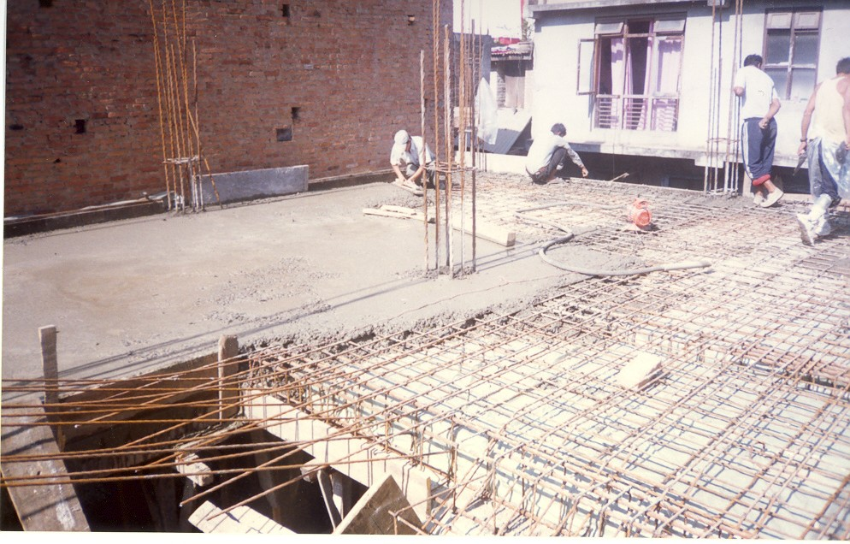
s+lqm6 vGofpg]
kfgL xfn]sf] cfwf 306fleq s+lqm6 vGofO{ sl;;Sg'k5{
s+lqm6 Ps 5]paf6 csf]{ 5]plt/ /fVb} hfg'k5{
;s];Dd glhs} kg]{ u/L s+lqm6 /fVg l;Wofpg'k5{
Notes:
Objective:
To explain how to place concrete properly.
Activity:
Try to explore from the participants local practices of placing of concrete and discuss on the topic.
Detail discussion:
Concrete should be placed and compacted as soon as possible after mixing with water. Concreting work should be done starting from one end and then continuous to the other end. Concrete should be placed as near as possible to its final position. If it is unavoidable concrete should not be dropped from height more than 5 feet because cement slurry and aggregates may be separated.

Slide 46
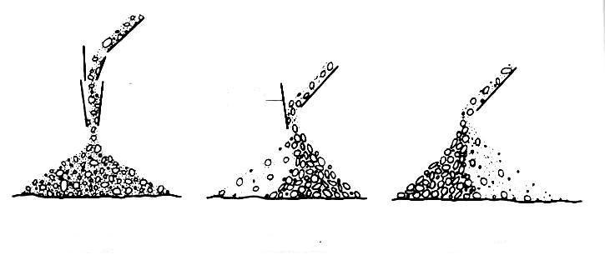
5]sfx?
5]sfx? k|of]u ug]{ tl/sf
5]sf
7Ls
unt
unt
Notes:
Objective:
To explain how to place barrier properly at the end of chute.
Activities:
Ask which of the ways of placing concrete is right?
Explain in brief.
Slide Details:
If it has to drop from more than 5 feet it should be conveyed in suitable receptacles or by using chute to avoid segregation. At the end of chute some barrier should be used properly to protect aggregate from segregation.
This slide also shows right and wrong practices for placing the barriers at the end of chute. It also shows if we are not using barrier for placing the concrete how aggregate will be segregated.

Slide 47
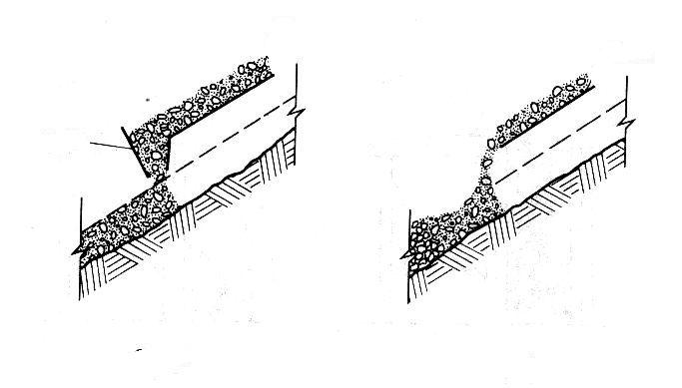
5]sfx?
5]sf
7Ls
unt
Notes:
Objective:
Same as previous slide

Slide 48
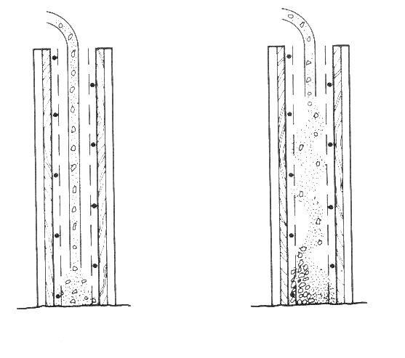
ulx/fOdf 9nfg ug]{
Ps} 7fp+ y'lk|Psf] /f]8f
7Ls
unt
Notes:
Objective:
To explain how to place concrete properly in deep depth.
Activity:
Ask participants what is difference between two pictures in this slide and let them choose right and wrong practice.
Enter and show them the segregated aggregates and discuss on the topic.
Slide Details:
If of concrete is to be placed from height more than 1.5m ( 5 feet), pipe or chute can be used for proper placing, pipe/ chute should run up to concrete placing level. This prevents segregation of concrete. This technique generally applied in cast in situ pile construction.

Slide 49
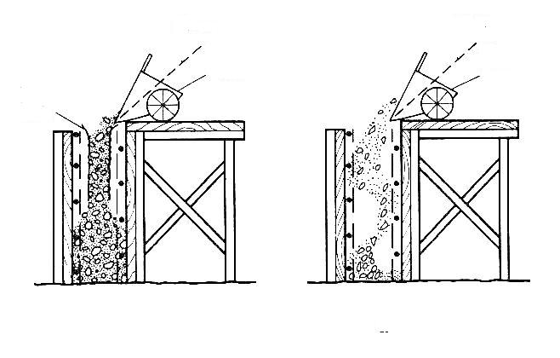
ulx/fOdf 9nfg ug]{
5]sf
Ps} 7fp+ y'lk|Psf]
7Ls
unt
Notes:
Objective:
To explain how to place the concrete directly from the trolley in depth.
To show the right and wrong practices for placing the concrete.
Activity:
Let participants tell which is right and which is wrong. Up to this all participants have to know the correct method.
Ask question with participants how this barrier help to avoid the segregation of aggregate.
Correlate their answer with actual meaning.
Detail discussion:
If the concrete is placing for a low height directly from trolley than some barrier should provided so that segregation of aggregate and sand can be avoided.
This barrier help to guide the concrete up to depth.
This technique is normally used in isolated footing where concrete quantity required more.

Slide 50
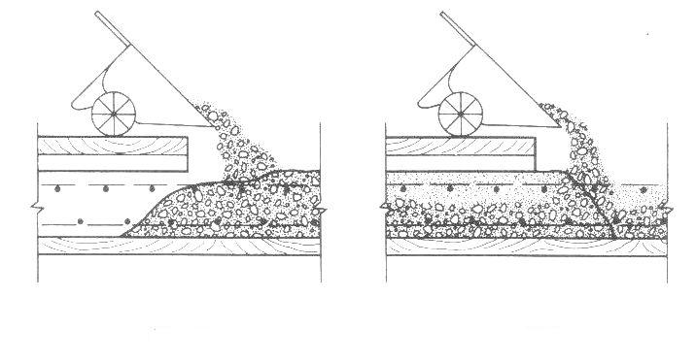
;xL tl/sf
s+lqm6 vGofp+bf ckgfpg' kg]{ tl/sf
7Ls
unt
Notes:
Objective:
To explain proper direction for placing the concrete.
Activity:
Try to explore from the participants what is difference between two picture shown in this slide and discuss
Ask them which is right and which is wrong.
Slide Details:
Concrete should be placed starting from one end and then advancing to the next end continuously. In doing so, advancement should be done in such a way that the already placed and compacted concrete will not get disturbed. If trolley is used for placing of concrete then trolley should not take above the compacted concrete.

Slide 51
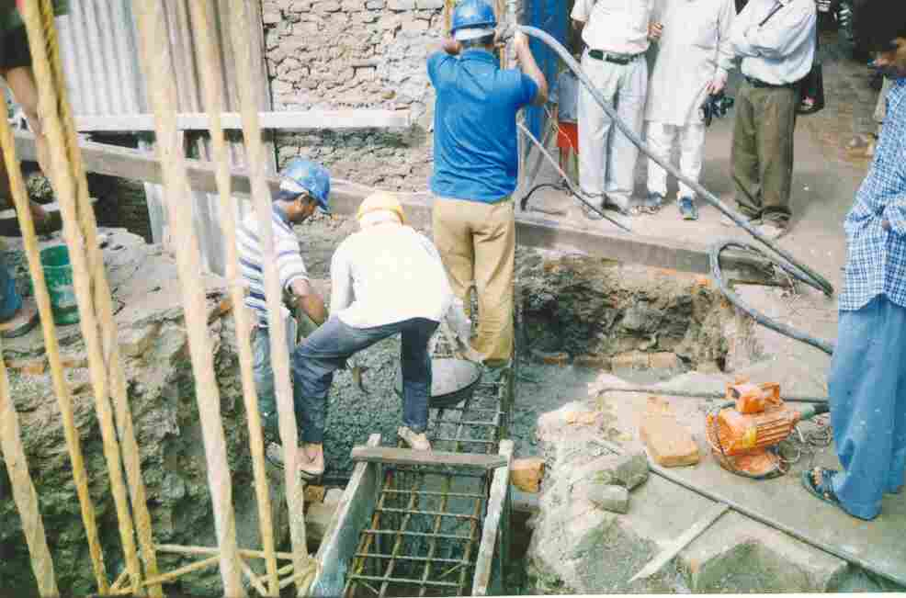
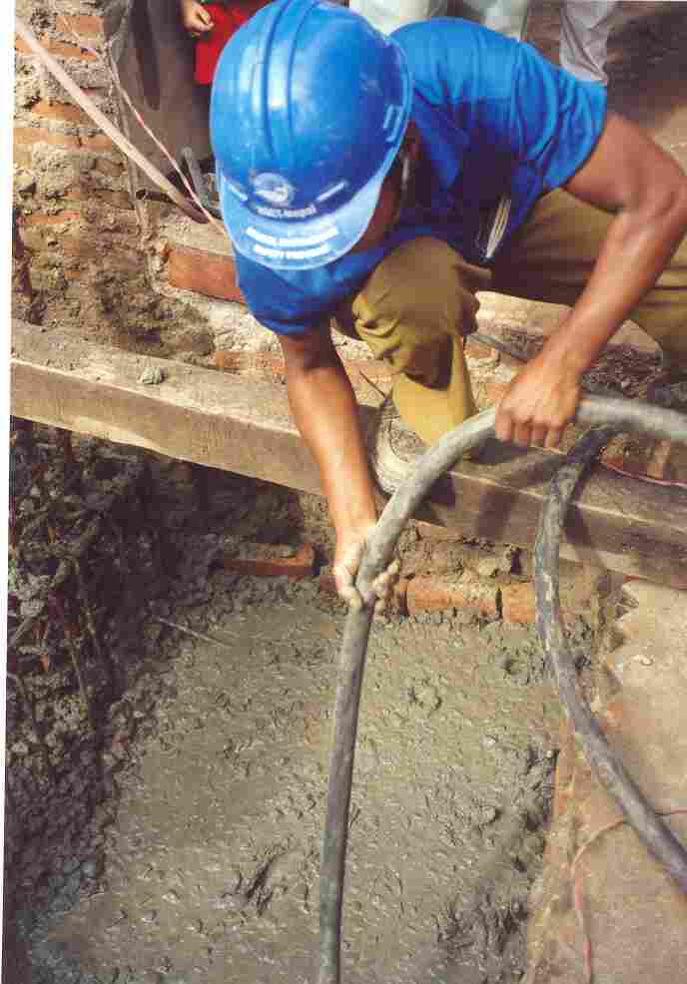

s;fO
s+lqm6 vGofP nuQ} s:g] sfd z'? ug'{k5{
s:gsf] nflu ljleGg tl/sf ckgfpg ;lsG5
;se/ jfOa|]6/ k|of]u ug'{k5{
a9L jf sd jfOa|]zg ug'{ x'+b}g
xftn] s:g'kbf{ 58n] sf]Rg], lyRg] / s'6\g] ug'{k5{
Notes:
Objective:
To explain compaction of concrete
Activities:
Let participants share their experiences in compaction
Explain in detail
Slide Details:
This slide shows compaction being done by using vibrator. It also shows the needle vibrator. Needle vibrator is useful in narrow and thin section.
Compaction can be carried out by hand or by using mechanical vibrations. Concrete should be thoroughly compacted. Also attention should be paid around the reinforcement and near formwork corner. Concrete should be compacted by using vibrator. Over vibration and under vibration are harmful and should be avoided. Over vibration causes segregation. Very wet mixes should not be vibrated. Hand compaction is done either by rodding, tamping or ramming. Rodding consists of inserting a rod or bar vertically into the concrete and moving it up and down until the concrete is thoroughly compacted. Rodding is suitable for thin vertical sections, near corner or around reinforcement. Tamping is suitable for flat sections. It is done with a small wooden mallet. Ramming is used for heavy masses of plan concrete.

Slide 52
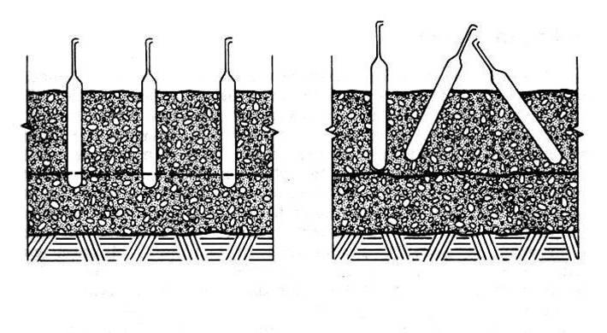
efOa|]6/sf] ;xL k|of]u
7Ls
unt
Notes:
Objective:
To explain the proper use of vibrator in concrete compaction.
Activities:
Involve participants in to the discussion of use of vibrator. Share their experiences.
Ask the participants why vibrator needle should be vertical rather than incline and its implication.
Detail Details:
Vibrator should take vertically so that uniform compaction will be possible. If vibrator is inclined or in some angle rather than vertical there is possibility of segregation of aggregate. Vibrator needle should not insert in concrete fully if so there is possibility of damage of vibrator needle.

Slide 53
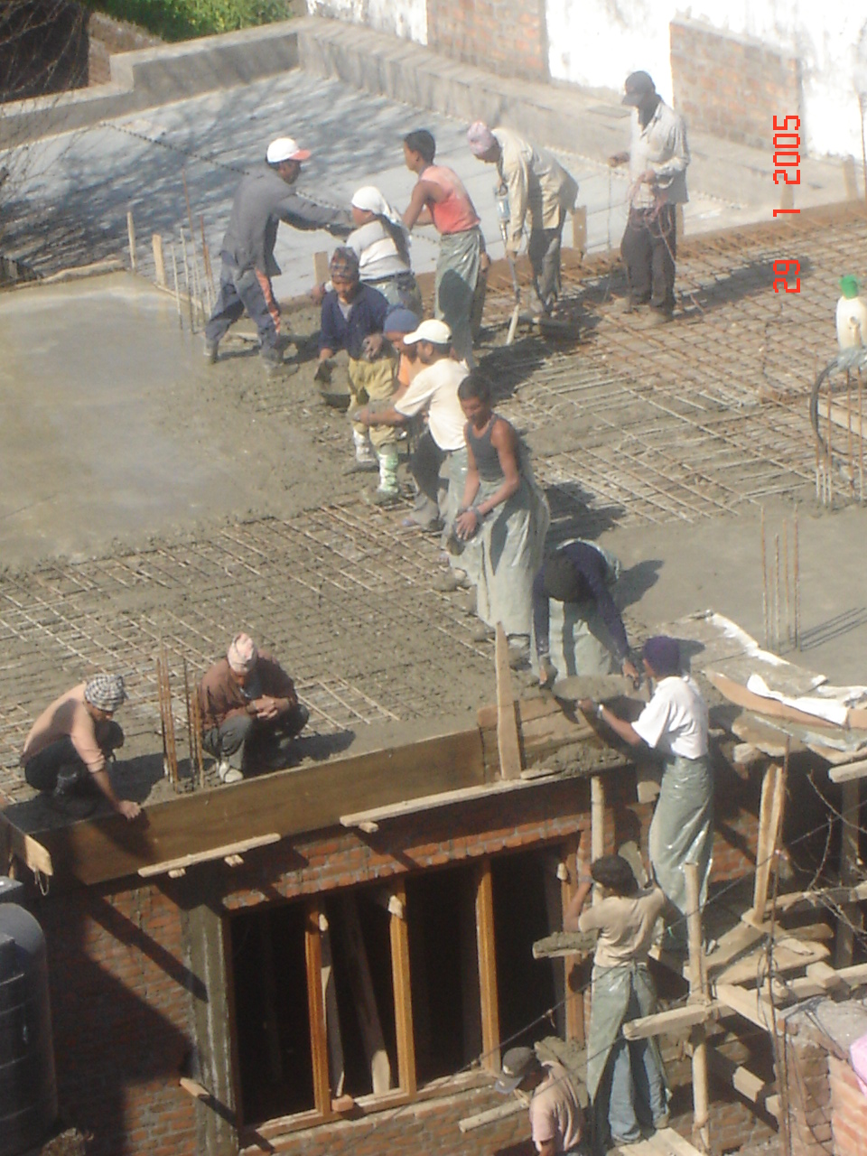
9nfOsf] sfd
sxf+ uNtL eof] ?
Notes:
Objective:
To explain the wrong construction practice
Activity:
Ask the participants to identify the defects in these construction work.
Slide Details:
This photograph shows the wrong practice of concreting work. Concrete is randomly placed.

Slide 54
9nfgsf] So"l/+u
9nfgsf] ;tx sDtLdf & lbg;Dd cf]l;nf] /xg'k5{
of] sfd kfgL hdfP/ jf h"6sf] lr;f] af]/f /fv]/ ug{ ;lsG5
s+lqm6 ld>0f tof/ ubf{ h:t} kfgL k|of]u ug'{k5{
Notes:
Objective:
To explain about curing
Activities:
Ask participants about their practices of curing and discuss on the topic.
Slide Details:
Curing is the process of preventing the loss of moisture from the concrete surface maintaining the certain temperature regime. This slide describes the process of moist curing.

Slide 55
kmdf{ lemSg]
kmdf{ lemSg] cjlw 9nfg ul/Psf] j:t'sf] sjn -:kfg_, gfk, tfkqmd / lgdf{0f:ynsf] cfjZostf cflbdf e/ k5{
vDafx?sf] nflu sDtLdf @$ 306f
!% lkm6;Dd sjn ePsf] :nfasf] nflu & lbg
!% lkm6 eGbf a9L sjn ePdf !$ lbg
!* lkm6 ;Ddsf] sjn ePsf] blngsf] nflu !$ lbg
!* lkm6 eGbf a9L ePdf @! lbg
df};d k|lts"n ePdf OlGhlgo/sf] ;Nnfx adf]lhd ug'{k5{
Notes:
Objective:
To explain the removal time of formwork
Activity:
Ask participants about their experiences of formwork removal and discuss on the topic.
Slide Details / Discussion:
Removing the formworks after concreting is a very serious stage of construction. Formworks should not be removed until the RCC member achieves the sufficient strength. The removal time of formworks depends on various factors like weather condition, spans, type of construction and type cement such as quick set or ordinary etc.
In ordinary weather condition, where ordinary port land cement is used, the form works shall not be removed before as mentioned in this slide.
In cold weather condition, no form works shall be removed before 21 days.
Note:
1. It is strongly suggested to take advise of experienced concrete engineer regarding removal of forms
2. Any RCC member shall not be imposed to any live loads before 28 days of it’s casting.

Slide 56
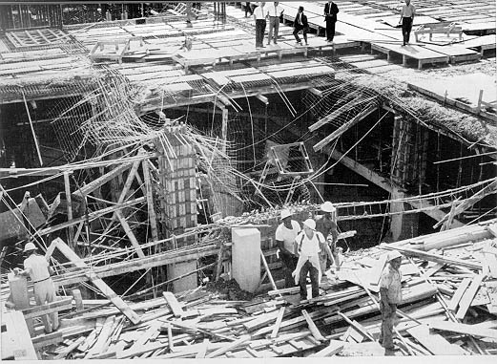
lsg o:tf] eof]] <

Slide 57
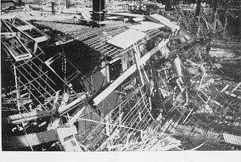
lsg o:tf] eof]] <

Slide 58

uNtLsf] klxrfg ug'{xf];\
Notes:
Object:
To explain the defect of insufficient concrete cover.
Activity:
Ask participants what is the defect in this stair case and why?
Slide Details:
This slide shows a stair in which concrete is spalled. The reinforcement is rusted. The reason may be insufficient cover to the reinforcement as a result the moisture and rainwater penetrated up to the reinforcement and suffered from rusting. Then concrete got cracked and subsequently concrete cover fell down.

Slide 59

lsg o:tf] eof]] <
Notes:
Objective:
To explain the defect on the column construction
Activity:
Ask participants what is the defect in this construction and why?
Slide Details:
This slide shows a column in which bricks are inserted in the column. The reason behind such defect may be such that the formwork for column was short. The floor height was high and bricks were inserted to fulfill the gap between the column constructed with shorter formwork and the beam.

Slide 60

uNtLsf] klxrfg ug'{xf];\
Notes:
Object:
To explain the defect of insufficient concrete cover.
Activity:
Ask participants what is the defect in this stair case and why?
Slide Details:
This slide shows a stair in which concrete is spalled. The reinforcement is rusted. The reason may be insufficient cover to the reinforcement as a result the moisture and rainwater penetrated up to the reinforcement and suffered from rusting. Then concrete got cracked and subsequently concrete cover fell down.

Slide 61

uNtLsf] klxrfg ug'{xf];\
Notes:
Objective:
To explain the defect in the concrete column.
Activity:
Ask participants what is the defect in this construction.
Slide Details:
This slide shows a building where large pipes are inserted into the column. This makes the column week.

Slide 62

uNtLsf] klxrfg ug'{xf];\
Notes:
Objective:
To explain the defect due to electric cables
Activity:
Ask participant what is the defect in this building
Slide Details:
This slide shows haphazardly placed electric cables. It reduces the strength of concrete member.

Slide 63

uNtLsf] klxrfg ug'{xf];\
Notes:
Objective:
To explain the defect due to electric cables
Activity:
Ask participant what is the defect in this building
Slide Details:
This slide shows haphazardly placed electric cables. It reduces the strength of concrete member.

Slide 64

uNtLsf] klxrfg ug'{xf];\
Notes:
Objective:
To explain the defect due to electric cables
Activity:
Ask participant what is the defect in this building
Slide Details:
This slide shows haphazardly placed electric cables. It reduces the strength of concrete member.

Slide 65

ldl>t ;+/rgf
Notes:
Objectives:
To explain the mix structural system
Activities:
Ask participants is this good to have both brick and block construct together?
Explain the detail
Slide details:
This slide shows a building which is constructed by bricks and hollow blocks. Such kind of construction is very vulnerable to the earthquake. It is because they do not form the proper bond and the strength and stiffness are different which results complex behaviour during earthquake and suffers heavy damage.

Slide 66

ldl>t ;+/rgf
Notes:
Objective:
To explain the damage in the building constructed by mix structural system
Activity:
Ask participants why this building suffer heavy damage.
Slide Details:
This building is constructed with mix materials. There was not proper connection between different materials. It suffered heavy damaged due to earthquake.

Slide 67
wGojfb

