Slide 1
Shelter Cluster Damage Database

Slide 2


Damage Database
Planning
Prioritization
Handover
Partner Updates
Capacity Building
Data Cleaning
Referrals from authorities

Slide 3

Process for Reporting Damages and Repairs
Addresses from Partners and Local Authorities
# of Registered Persons/Location of Homeowners
Type of Damage
Modality/Construction Details
Verification with Municipal Authorities

Slide 4
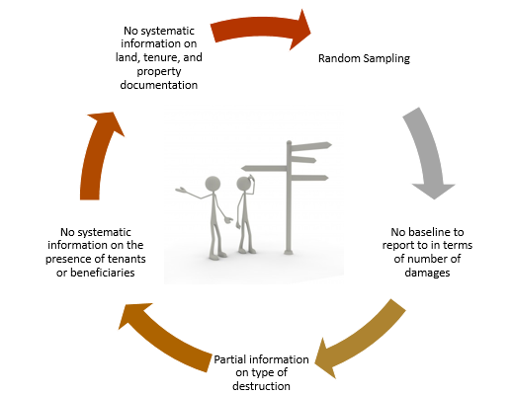
Technical Note on Damage assessment
1
Figure 1 Scheme representing main screening layers.
In red, the total # of buildings damaged indistinctly to other factors.
In yellow, damaged buildings still in need of repair.
In blue dashed line, house occupied by owner or tenant.
Blue plain line, house occupied with beneficiaries who qualify for humanitarian assistance.
Point 1, the intersection of these 4 points represents the potential area for humanitarian intervention.

Slide 5
Technical Note on Damage Assessment
Detailed assessment | Beneficiaries considered as enrolled in a project when
Systematic, per address Addresses reported acting as baseline Category of damaged systematically used Remaining repairs not able to be covered are reported Stable return identified, with ideally go and see visit documented Nature of the tenure of the building identified (OSBB, private, communal) | ☑ Assessment systematic per address for the entire village. ☑ Financial visibility of the NGO/INGO secured for the scope of work ☑ Reported by a total number of damaged buildings within the community. This indicator can be employed when trying to cover several villages located fairly close to one another in a concentrated territory ☑ Remaining repairs systematically detailed and quantified with a Bill of Quantity ☑ Beneficiaries selected based on the permanency of their presence, intentions, vulnerability, and other criteria. Enrollment of local communities recommended as witnessing the process through signing of trilateral agreements between authorities, agency, and beneficiary. ☑ If at village level, uncovered needs are still remaining, referral done through the cluster to another organization. ☑ HLP documentation collected and archived ☑ Beneficiaries informed on their enrollment including a tentative work on their asset starting within the next 3 months

Slide 6
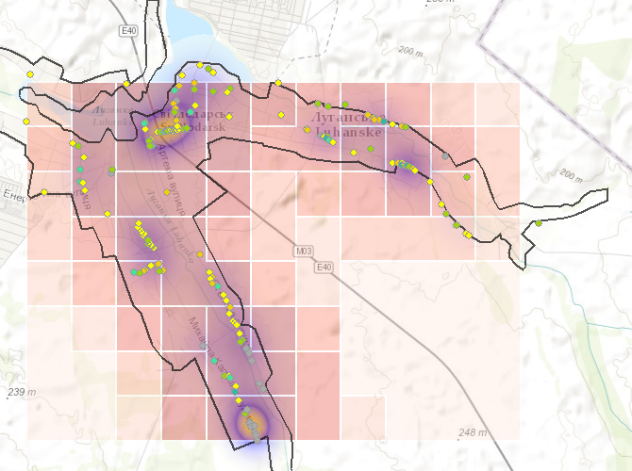
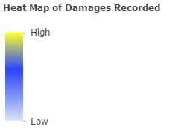
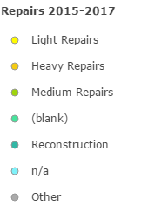
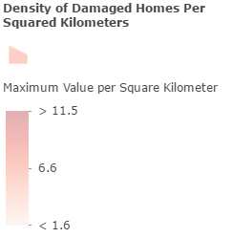
Subnational Updates and Field Monitoring
Luhanske Bakhmut Raion, Donetsk Oblast GCA
Located in in northern Donetsk Oblast in Bakhmut raion, Luhanske is a residential urban area with road transport connections to Svitlodarsk and Mironovskiy.
More than 190 private homes were damaged throughout 2015-2017. The majority of damages occurred in 2015, but more than 15 homes were newly impacted by shelling in March of 2017. Due to its proximity to the frontline, several homes have required more than one repair intervention.
Secondary damages were recorded on Kalinina and Stepova streets where residents are vulnerable to further shelling due to presence of military personnel. The yellow high concentration of damages represent where the greatest number of damages were committed throughout the 3 years of shelling. To understand the greatest pocket of needs in Luhanske and the most vulnerable to damages, a density analysis using greatest maximum value per square kilometre is performed illustrating that the majority of recurring damages can occur in the eastern part of the city facing Debaltseve and Horlivka in NGCA.
Due to ongoing shelling, several residents who have the means rent apartments in Svitlodarsk and return every day to check on their property.
Homes along dirt roads and not connected to city gas were worse off than those connected to the city gas and residing on more central and paved roads in terms of adequate heating and adequate living conditions. These homes are usually found in areas where damages are the densest and require heavier repair interventions.
Between December 2016-February 2017, 819 residents from 299 households received 3 tons of coal per household from NGO Proliska, an implementing partner of UNHCR.

Slide 7
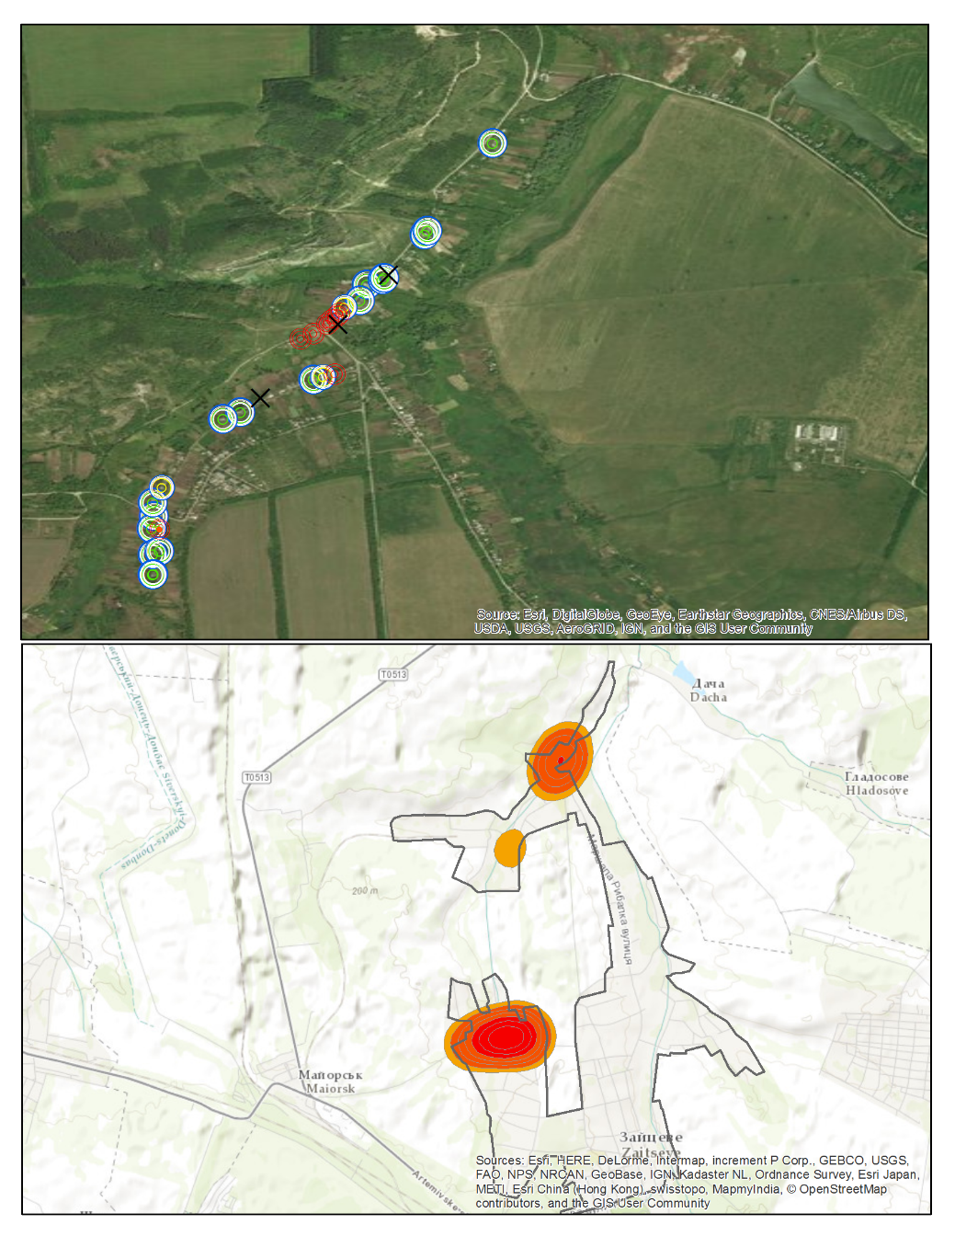
Zaitseve (Assessed Areas)

Slide 8
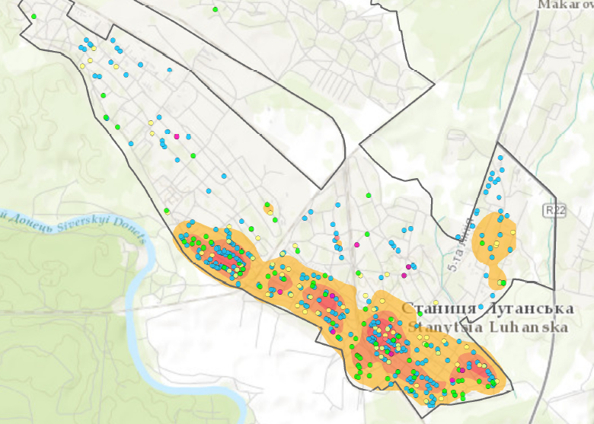
Stanytsia Luhanska

Slide 9
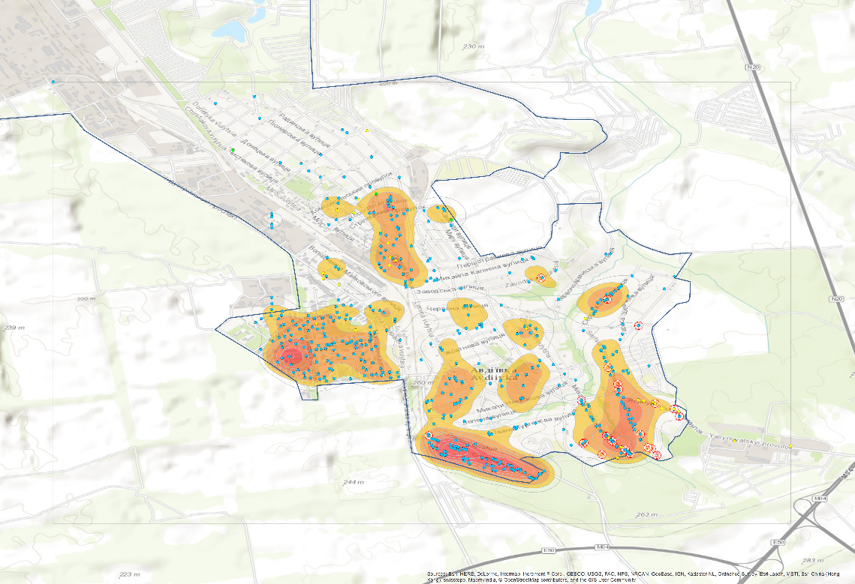
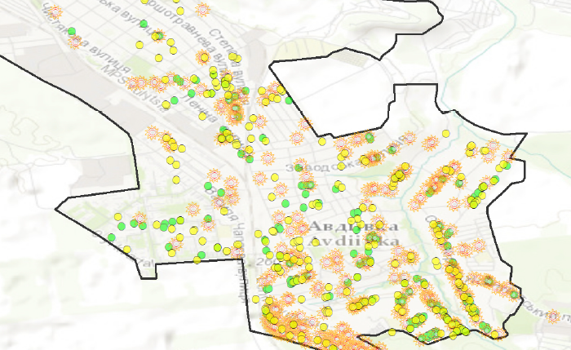
Local Authority Verification

