Slide 1
Area-Based Assessment: Ar-Raqqa City
April 2018

Slide 2
Contents
Ar-Raqqa city context
Timeline of recent events
Current situation and humanitarian response
Area-based assessment
Objectives
Methodology
Key findings
Impact / use
Future support to area-based response
Planned next steps

Slide 3
01
Ar-Raqqa city context

Slide 4
Ar-Raqqa city: timeline of recent events
2013- March
Ar-Raqqa is the first major city in Syria to be taken by Armed Opposition Groups (AOGs)
2014- January
ISIL takeover Ar-Raqqa (city and countryside) and establish the Caliphate
2016- November Operation to expel ISIL from Northeast Syria commences by the SDF, supported by coalition- start taking villages/towns surrounding Raqqa city
2017- June
Offensive on Ar-Raqqa city starts, heavy aerial bombardment and ground conflict
2017- October
Victory declared in Ar-Raqqa city; by this time, city completely evacuated of civilians
Notes:
•

Slide 5
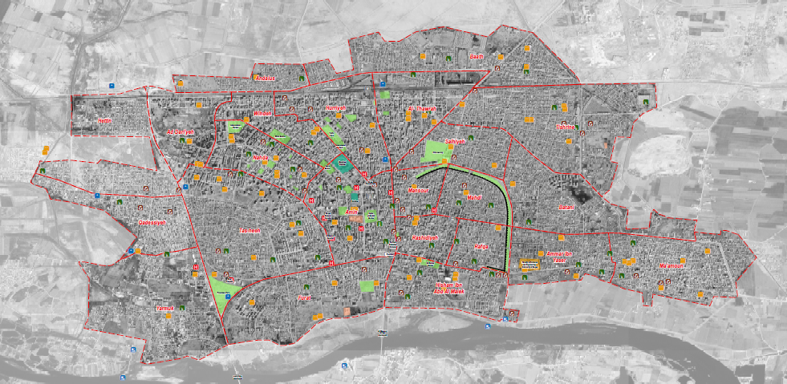
Ar-Raqqa city: current situation and response
2011 pre-conflict population: 279,000
2017 ISIL-control population: 229,000
November 2017: civilians start to return to Raqqa city immediately after the offensive, despite large-scale destruction and high levels of UXO contamination.
March 2018 estimated population: 100-150,000
Initially, humanitarian actors unwilling to provide services to avoid providing a pull factor for returnees.
Scale of returns led to changing dialogue amongst some humanitarian actors.
Current response: mostly local authorities, stabilisation actors and some NGOs (coordinated by INGO Forum); UN planning to start soon (limited presence).

Slide 6
02
Area-based assessment

Slide 7
Rationale
Reasons for the ABA Approach in Raqqa City
Early stage in the response and no humanitarian presence since 2014 → information gaps for all sectors, in all areas.
Actors in general have limited capacity to conduct in-depth assessments, due to security and logistical challenges → extremely important that all data collection efforts should be collaborative as possible, which the ABA aims to be.
Enables a comprehensive overview of the situation across the city, as well as more detailed and granular assessments at the neighbourhood-level → findings usable at multiple levels (coordination, strategic, operational).
Methodology and tools adaptable to context → enables different levels of information to be gathered depending on access.

Slide 8
Overview
Phase 1: Returns, population and access mapping
Phase 2: Service and infrastructure mapping and assessment, with damage component
Phase 3: Neighbourhood level needs assessment and services access mapping
Next steps: Development of IM mechanisms in partnership with humanitarian actors in Northeast Syria
In late October 2017, Ar-Raqqa city was completely evacuated of civilians following months of intense conflict.
REACH conducted a series of assessments to monitor the humanitarian situation as voluntary returns occur and services begin to resume.
The area-based assessment (ABA) was conducted as part of a wider global project aiming to support humanitarian response in urban areas through an area-based approach.

Slide 9
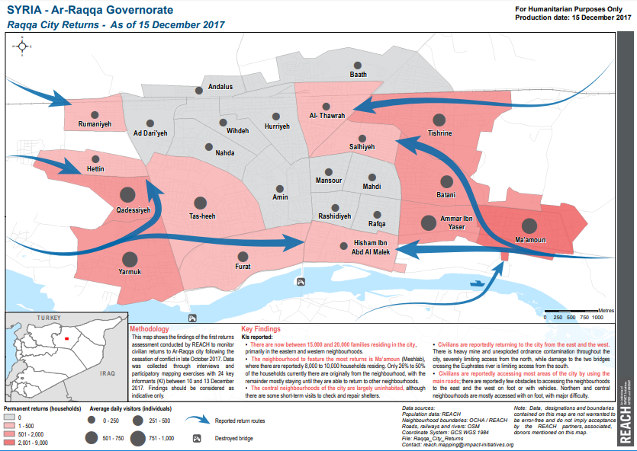
Phase I: Population, Returns and Access
Objective: provide clarity on commonly accepted neighbourhood boundaries, provide regular updates on number of permanent returnees and temporary visitors to the city, as well as access constraints and restrictions.
Methodology: neighbourhood-level remote KI interviews with Key Informants living in the city or visiting regularly.
Outputs: monthly neighbourhood-level maps with population figures, routes, and key findings.
Notes:
Ar-Raqqa city residents have been spontaneously returning to the city since November 2017, initially concentrated in Ammar Ibn Yaser / Ma’amoun (Meshlab), Tishrine (Rmelah) and areas along the Euphrates river. Households have now returned to areas across the city.
• The number of households is greatest where damage is relatively less severe. Neighbourhoods in the centre and north have extensive damage and significant UXO contamination, and consequently remain less populated than areas adjacent to the Euphrates river and on the city’s periphery.
• Population numbers are highest in neighbourhoods with a greater number of functioning services. This likely reflects two trends: households prefer to return to areas where goods and services are more easily accessible, while governmental and private actors (such as bakery owners) prefer to provide such services in more populated areas.
• UXO contamination is a reported barrier to movement in both sparsely-populated neighbourhoods and in areas with more households, such as Furat. Damaged roads are barriers to movement in nearly all neighbourhoods.
• As a result, movement within some neighbourhoods remains challenging. Movement by foot is difficult in central neighbourhoods, which have extensive damage and significant UXO contamination. Access to these neighbourhoods with large vehicles is also extremely difficult, limiting households’
access to critical goods and services, such as trucked water.

Slide 10
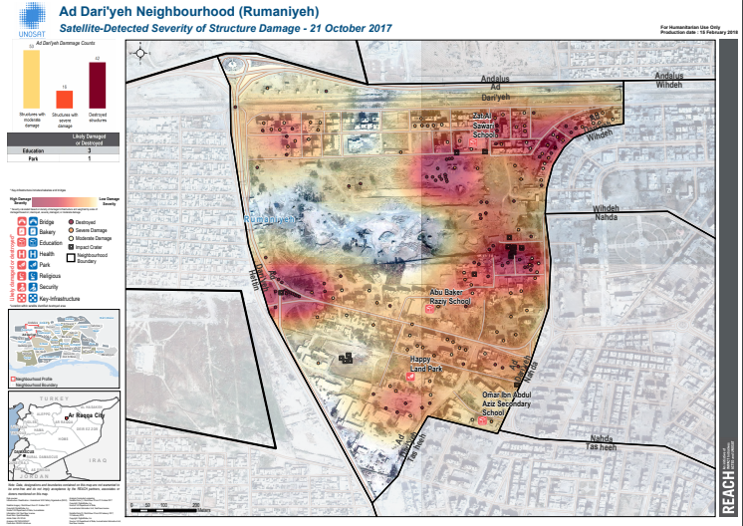
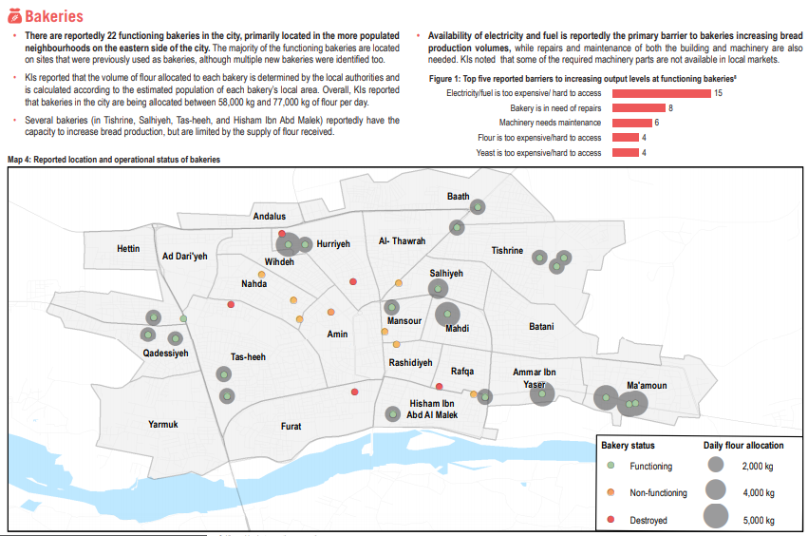
Phase II: Services, Infrastructure and Damage
Objective: mapping and assessment of basic services and infrastructure; detailed damage assessment.
Methodology: neighbourhood-level remote KI interviews and participatory mapping with sectoral experts living in the city or visiting regularly.
Outputs: sectoral service overviews; comprehensive damage atlas.

Slide 11
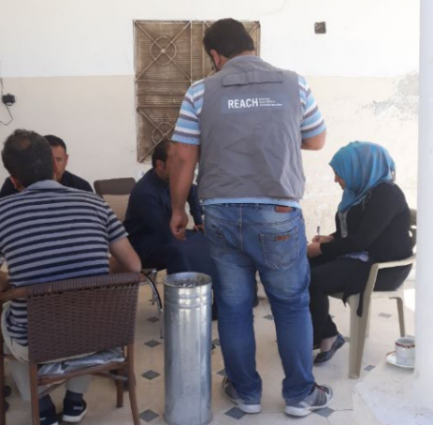
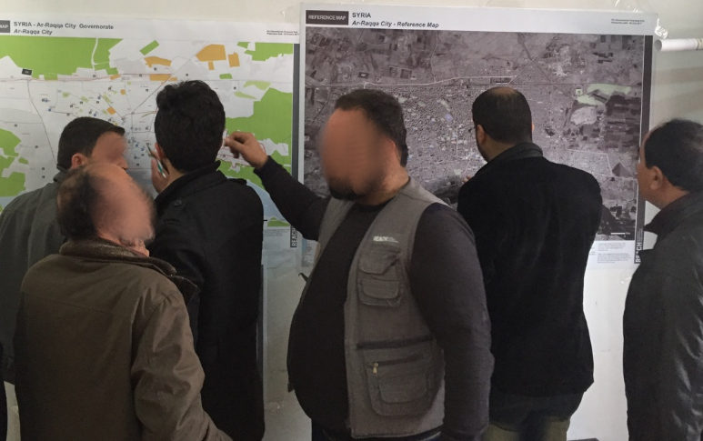
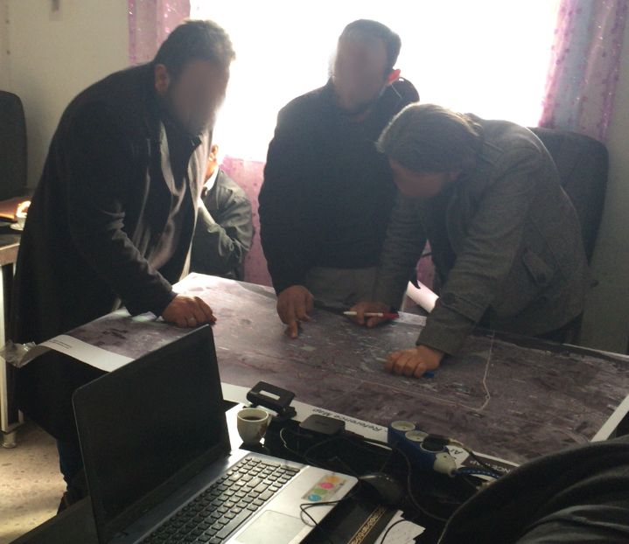
Phase III: Needs Assessment and Access to Services
Objective: full assessment of needs and analysis of access to services at the neighbourhood-level.
Methodology: Key Informant (KI) interviews with a minimum of 3 per neighbourhood, and 2 FGDs per neighbourhood (one female, one male) including participatory mapping exercises with community residents and sectoral experts.
Tools, indicators and methodology designed in collaboration with humanitarian actors: Whole of Syria Clusters, NES INGO Forum, NES ISWG Focal Points, individual NGOs implementing or planning to implement in the city.
High level of participation due to the access challenges to the city and large information gaps.
Outputs: city-wide sectoral needs assessments and analysis of access to services; neighbourhood profiles for priority areas
Report link:
http://bit.ly/2qeVPDQ

Slide 12
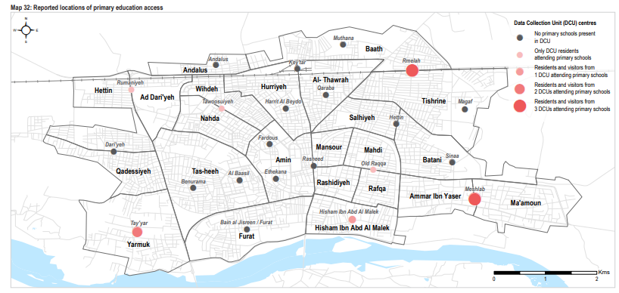
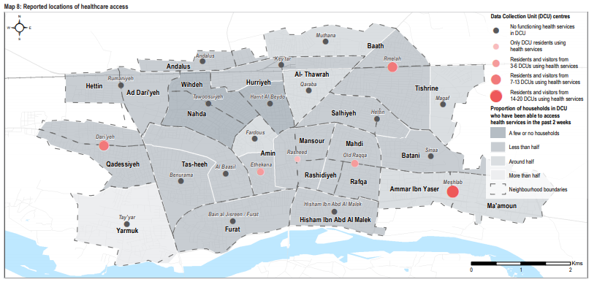
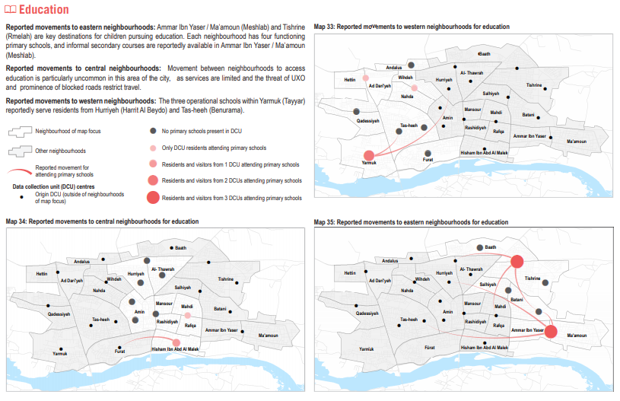
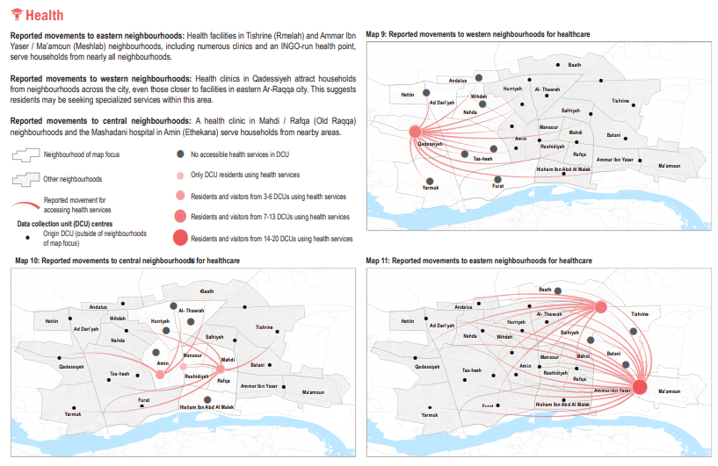
Phase III: Outputs- Service Access Mapping
Notes:
Some services operate on a more local level than others: -Education in particular, as households do not commonly travel elsewhere to access schools, even when insufficient in their own neighbourhood, which is often the case-> means people in neighbourhoods without education services more likely to miss out.
-Compare to health: a few neighbourhoods act as hubs for healthcare, with people travelling across the city to reach services (which as a result are very overcrowded). More difficult for some neighbourhood residents to access these services than others- e.g. north/central neighbourhoods, still contaminated, inhibited by road blockages.
-Markets/cash was an interesting one: general preference to remain within the neighbourhood to obtain goods, and usually possible to obtain most basic goods. Some travel to market areas (same 3 main hubs/areas as health) to buy goods- generally, don’t report issues as these areas spread across the city. Main limitation here is not access, but purchasing power of residents.

Slide 13
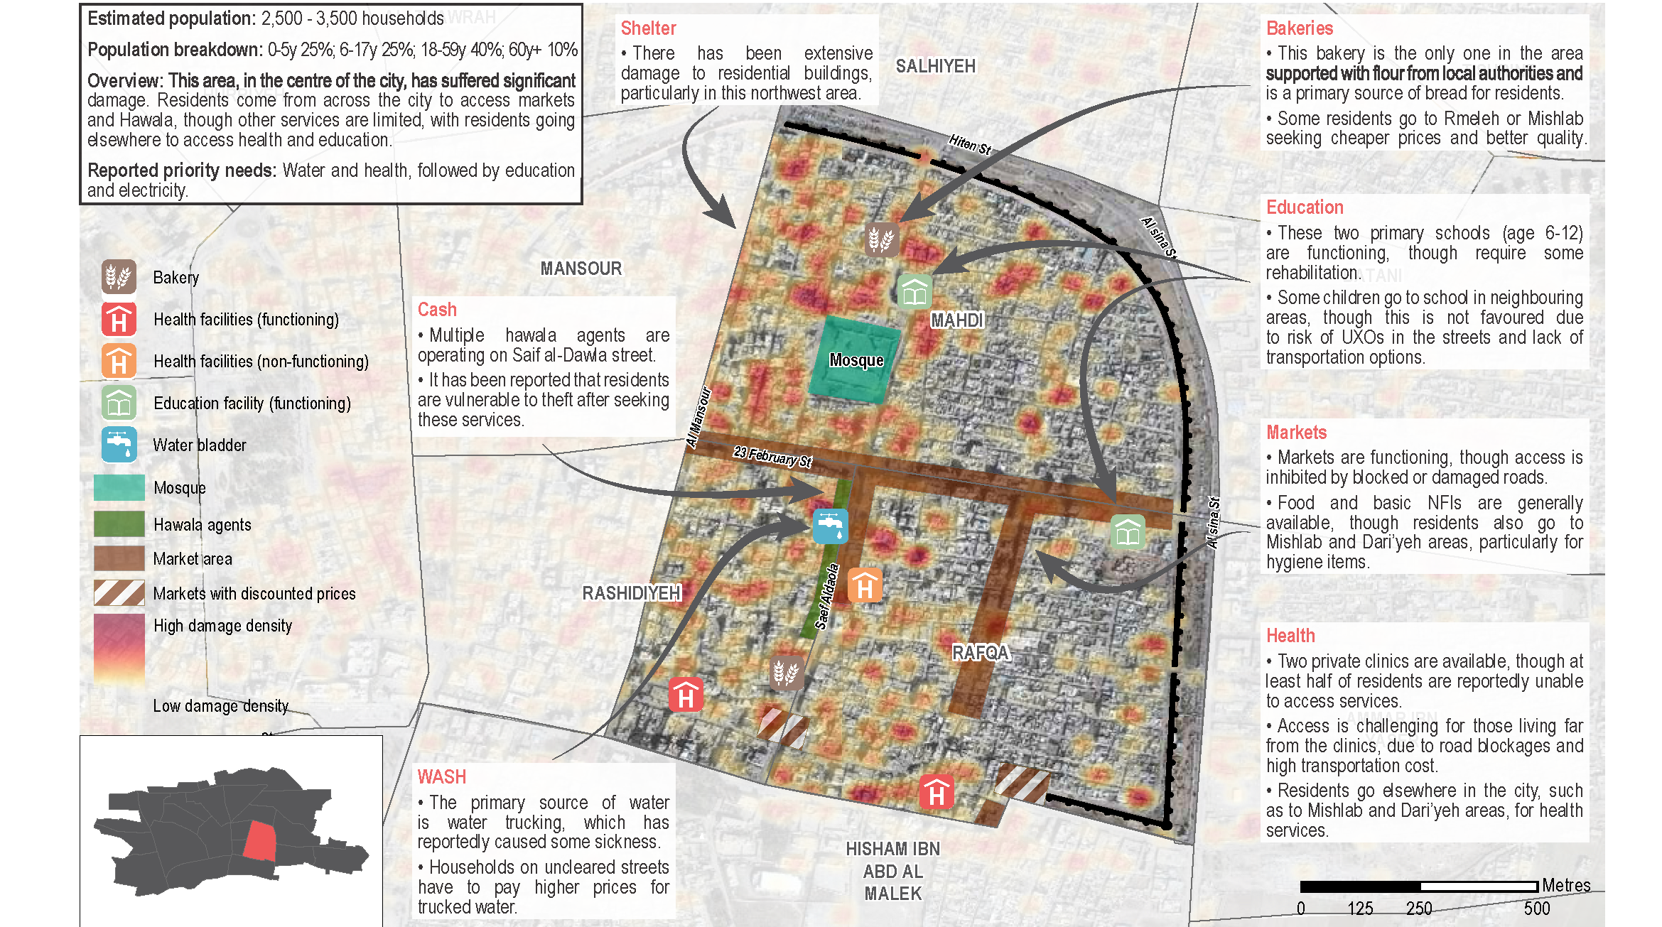
Phase III: Outputs- Neighbourhood Profiles
Notes:
Closer look into the dynamics of each neighbourhood- this is an example of a central neighbourhood, which is also one of the ‘hubs’ described previously.
These were created through participatory mapping, KI interviews and FGDs to give an overall view of the dynamics in the area, as well as specific information on each piece of infrastructure.
Here, can see the main areas of damage in the neighbourhood at quite a granular level. Also picks out key services, with details on their functionality/capacity.

Slide 14
Phase III: Key Findings
Priority needs
In the long-term, across the city the rehabilitation of shelter and infrastructure, as well as continued efforts to remove UXO contamination, are essential for restoring a decent standard of living.
In the immediate term, improvements to health and WASH services are the most urgent priority needs.
Although education services are being resumed and some electricity is available, improving the quality of both of these services is a second immediate need.
Priority needs were also identified at the neighbourhood level.
Access to services
Specific neighbourhoods are key hubs for services: people are willing to travel across the city to access healthcare, due to a lack of services elsewhere. This has led to severe overcrowding of healthcare.
Residents prefer to access food, NFIs and cash in their own neighbourhoods where possible, although use key market areas in the city to access these items when necessary.
In contrast, households also do not commonly travel to other neighbourhoods to access education services even when insufficient in their neighbourhoods: presence and quality of schools should be improved at the local level.
Notes:
Output link: http://bit.ly/2qeVPDQ

Slide 15
03
Conclusion and Next Steps

Slide 16
Impact and Use
Multiple levels of usage
Operational: used by NGOs to assist with their individual planning and programming, as well as field operations- neighbourhoods profiles serve as a guide for working in each area.
Coordination: clear identification of gaps within and between neighbourhoods enables outputs to be used by NES Forum and NES ISWG to assist with NGO response coordination.
Strategic: overview of the city highlights priority needs and key messages for actors outside of Northeast Syria.

Slide 17
Next Steps: Support to Area-Based Planning and Response
Building on the ABA, REACH/IMPACT will work with the Northeast Syria INGO Forum to facilitate area-based response and planning.
This will comprise development of information management tools as well as assistance with gap identification for operational use.
Step 1:
Conduct regular comprehensive area-based assessments
Step 2:
Response tracking of activities conducted by all actors (including humanitarian actors, local authorities, stabilisation actors)
Step 3:
Develop information system (webmap) to enable ongoing situation and response monitoring
Step 4:
Provide analysis support for ongoing operational gap identification

