Slide 1

g]kfn ;/sf/
zx/L ljsf; dGqfno
zx/L ljsf; tyf ejg lgdf{0f ljefu
e"sDk k'glg{df0f tyf k'g:yfkgf cfof]hgf sfof{no
e"sDk k|lt/f]wfTds ejg lgdf{0f k|ljlw af/]
kfFr lbg] sflnu9 tflnd sfo{qmd
;'/lIft lgdf{0f k|j4{gdf k|ljlw x:tfGt/0f / sflnu9sf] e"ldsf
efu $ ;q !

Slide 2
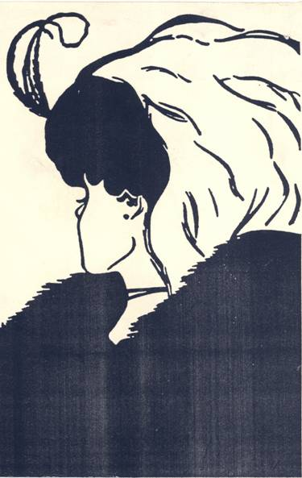
km/s a'emfO
Notes:
Objectives:
To explain different people have different perception based on their academic, economic, social, cultural background; beliefs, age, state of mind.
Activities:
Ask people to have a deep look at the picture and ask what they saw. Give enough time.
Summarize their views and tell the truth.
Discuss, why all people could not see both the ladies though it is there.
Slide Details:
This sketch is a combination of two women: one old and other young lady. The left eye of old lady is the left ear of young lady. The nose of old lady is the face of young lady showing from left side. The portion between upper lip and nose of old lady is the neck of young lady.

Slide 3
ljifo ;"rL
k|ljlw x:tfGt/0fnfO{ k|efjsf/L agfpg lhDd]bf/ ;/f]sf/jfnfx? sf] x'g\ <
k|ljlw x:tfGt/0fsf tTjx? s] x'g\ <
k|efjsf/L ?kdf k|ljlw x:tfGt/0f s;/L ug{ ;lsG5 <
Notes:
Objectives:
To tune the participants
To inform the participants about what they should expect in this presentation.
Activities:
Involve the participants to obtain their views in these questions.
Don’t give any comment on their views.
Just make them realized what are we going to discuss in this session. Do not go in detail. We will do it later.
Slide Details:
This slide presents what we are going to present in this presentation.
Emphasize: It was not problem of availability of technology for earthquake resistant construction. It was available, affordable up to an extent, for our type of building. But the problem was dissemination of the technology to building stakeholders (starting from engineers to masons all together)

Slide 4
lgdf{0f k|ljlw
;fdu|L
hgzlQm
k|ljlw
tl/sf
k};f
Notes:
Objectives:
To discuss what technology does mean.
To explain about what constitute the technology.
Activities:
Ask participants what they understand by “Technology”.
Summarize their views and explain about technology.
Discuss why these are required.
Link this slide with what participants discussed in earlier slide.
Slide Details:
This slide presents components of technology. If there is no manpower, there is no technology. Only man is not sufficient. Also we need materials to construct. On the absence of method, there will be no processing. These overall components are facilitated by money.

Slide 5
lgdf{0f k|lqmof
ejg cfk"lt{ ljlw M cfkm}n] lgdf{0f ug]{ -(% k|ltzt eGbf a9L_
k|lqmof M c;+ul7t, qmdfut
k|d'v ;Nnfxsf/ M :yfgLo sflnu9
d'Vo ;fdu|L / zLk M
  u|fdL0f If]qdf v/, sf7, df6f], 9'Ëf
    k|fljlws jf OlGhlgo/sf] ;xeflutf 5}g
  zx/L If]qdf 9'Ëf, O+6f, l;d]G6, afn'jf / kmnfd
    k|fljlws jf OlGhlgo/sf] Go"g e"ldsf
Notes:
Objectives:
To describe the real scenario of building production mechanism.
To explain the role local craftsman.
Activities:
Explore participants views on how buildings are constructued in their communities and role of engineers/ sub-engineers in majority of buildings.
Try to take their views on the other points as well.
Help them realized the real scenario of building production mechanism in our community.
Slide Details / Discussion:
This slide presents the prevailing scenario of building production mechanism in the area. The engineers hardly have any access to large majority of building stock. In our scenario, involvement of engineers in every building construction would be managerially unviable; economically unaffordable, technically unfeasible, logistically impossible.

Slide 6
;fdflhs ljifox?
Go"g ;r]tgf
  gLlt lgdf{tfx?df
  ejg k]zfsdL{x?df
  ;j{;fwf/0f / ;Defljt 3/wgLdf
  lzlIft ju{df ;d]t
efUojfb
  ;a} eujfgsf] /rgf xf], eujfg g} ;+xf/stf{
Notes:
Objectives:
To explain about the social issues.
To explain fatalism is one of the deterrent for implementation of seismic safety.
Activities:
Explain the points
Make them realized about fatalism.
Be cautious and tactful when talking about God. It could be offending.
Slide details:
This slide presents level of awareness among stakeholders of building construction who could have some say in building development mechanism.
So far a person thinks that god has created and the god is the destroyer then why to build a house safer against earthquake. God has given brain. We should use that brain first to learn and develop techniques. By using the proper techniques construct safer house then leave it for the God.

Slide 7
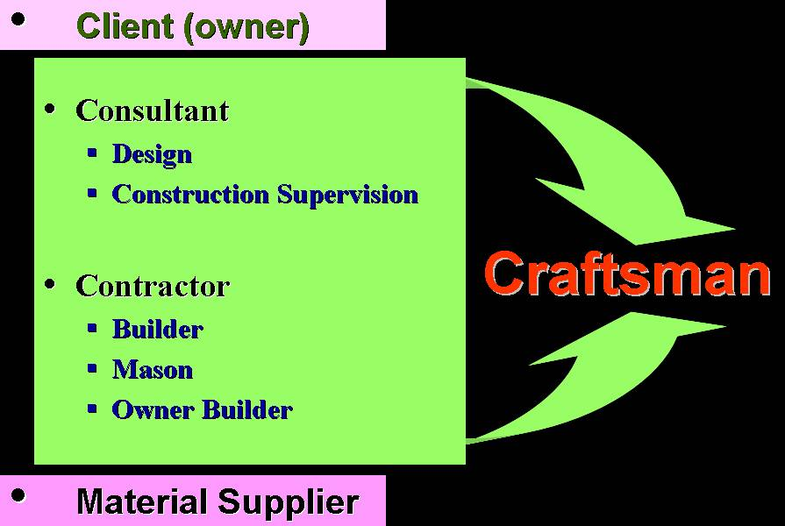
k|d'v ;/f]sf/jfnf
Notes:
Objective:
To explain the craftsmen (mason, bar bender, carpenter) are main players in building construction industry.
Activities:
Ask participants how buildings are usually constructed. Does structural design of a building involving architect/ engineers are fully designed. If not why?
Explain how all the stake holders are ultimately dependent on craftsman.
Slide Details:
This slide presents, craftsman are the core of building construction industry and are the most influential stakeholders. A client may hire a consultant, a contractor. S/he purchases the materials then the house is ultimately built by craftsman.

Slide 8
sflnu9 s:tf] JolQm xf] <
:yfgLo ;d'bfosf] ;b:o
;Defljt 3/wgLsf] ;xh ;Dks{df ePsf]
Jofjxfl/s s'/f a'em]sf]
:yfgLo ;fdflhs, cfly{s / ;f+:s[lts ljifo a'em]sf]
:yfgLo ;d'bfon] ljZjf; u/]sf]
Notes:
Objectives:
To explain about craftsman.
To describe why craftsmen are the most important in building process.
Activities:
Collect participants views about what they think about craftsman.
Discuss about the craftsman briefly.
Slide Details:
This slide presents details about the craftsman. Generally they are from local community. Hence they have better access to the house owner, know better about the house owner, culture and also practical issues. Therefore society relies on them.

Slide 9
sflnu9x?
-8sdL{, l;sdL{, nf]xsdL{ jf gsdL{_ e"sDk k|lt/f]wL lgdf{0fsf] sfo{df
;aeGbf alnof] ;Dks{;"q x'g\
Notes:
Objectives:
To summarize the slides presented earlier.
Activities:
Collect participants views either they agree with this view or not.
Ask them what do they think before.
Make them realized what may happen if this link is weak.
Slide Details:
The slides presented earlier prove that the craftsman are the strongest link between technology and the potential house owner.
Unless, we can convince the craftsman and can not equip them with the knowledge on earthquake resistant construction, we can not bring a change and improve building stock.

Slide 10
lgdf{0fdf ;+nUgtf
k|fljlws – !) k|ltzt;Dd
sflnu9 – () k|ltzt eGbf a9L
ejg lgdf{0fdf ;+nUgtf
Notes:
Objectives:
To show the involvement of technicians and craftsmen in construction.
To make participants realized that craftsman are more involved in construction.
Activities:
Collect participants views either they agree with this view or not.
Ask them what do they think before and explain in brief.
Slide Details:
In general, the involvement of technicians in the construction industry is very low. It is because of the cost a common people can not afford to keep a technician during its whole construction. The technicians’ input is in terms of design, or occasional supervision especially in urban areas.

Slide 11
lzIffdf nufgL
OlGhlgo/ – ;jf b'O{b]lv tLg nfv ?k}of+
;aOlGhlgo/ – Psb]lv 8]9 nfv
sflnu9 – )
nufgL -z'Ns dfq_
Notes:
Objectives:
To show the investment in preparation of technicians and craftsmen.
To make participants realized that there is no investment for craftsmen training.
Activities:
Collect participants views either they agree with this view or not.
Ask participants, how much time and money has been spent for engineers and sub engineers education. But what about craftsman?
Explain in brief.
Slide Details:
Despite being strongest link for production of safer construction, the country or people invest practically nothing for the craftsman though they produce more than 90% of the building. They learn by copying from their seniors. If they see wrong, they learn wrong.
While for the production of an engineer and sub engineer, there is a huge amount of investment.

Slide 12
kl/b[Zo
OlGhlgo/ – !) k|=z= eGbf sd
OlGhlgo/ ?=
225,000 -300,000
;a OlGhlgo/ ?= 100, 000 – 150, 000
sflnu9 – () k|=z= eGbf a9L
sflnu9 ?= z"Go
ejg lgdf{-fdf ;+nUgtf
lzIf0f z'Nssf] ?kdf nufgL
k]zfsdL{sf] nflu sfdsf] aLrdf tflndsf] cefj
k/Dk/fut lgdf{0fdf :t/sf] cefj 5 jf ck]lIft k|of]ustf{ ;dIf k'u]sf] 5}g
Notes:
Objectives:
To show the mismatch between usability and investment.
To make participants realized why technology transfer is being halted.
Activities:
Encourage participants to compare between involvement and investment of technicians and craftsmen.
Summarize the views.
Slide Details:
This is a summary of previous slides. This scenario has practically halted the dissemination of technology being developed or already developed for better and safer living.
Further to it, even for trained engineers there is no provision of mid-level training or upgrading.

Slide 13
sflnu9sf ;Ldfx?
w]/}h;f] sflnu9 clzlIft 5g\
clwsf+zn] gSzf a'em'g ;Sb}gg\
cfk\mgf cu|haf6 l;S5g\
cfw'lgs ;fdu|Lsf] u'0f, k|ljlw / oGqlj1fgaf/] a'e\mg ;Sb}gg\
vf;u/L gjLg k|ljlw;+u ;DalGwt ;d:of / ;dfwfgaLr ;dGjo ug{ ;Sb}gg\
k9]/ eGbf k/]/ jf u/]/ l;S5g\
Notes:
Objectives:
To explain the limitations of craftsmen
Activities:
Try to explore from participants about the craftsmen limitations.
Discuss these with the participants.
Slide Details:
The slide presents limitations of the craftsman. These should be well addressed when dealing with craftsman.
Unfortunately, the craftsman are never taken in trust and engineers commonly use engineering jargons with them such as bending moment and shear force etc.
It should be well understood that the craftsmen learn by doing rather than by reading or listening because of their background.

Slide 14
kl/0ffd !!
OlGhlgo/n] k9]sf s'/f sflnu9nfO{ yfxf x'+b}g
sflnu9n] hfg]sf s'/f OlGhlgo/n] k9]sf] 5}g
Notes:
Objectives:
To explain the result of mismatch between investment and usability.
Activities:
Explain in brief.
Try to know whether they agree or not.
Slide Details / Discussion
It has practically created large technological gap between stakeholders of building construction industry.
The mason knows about masonry, mud, stone but the engineers never learnt about it. On other hand, engineers talk about cement which masons take just as an extension of mud with better strength. They do not understand, the difference in strength gaining mechanism.
Bridging this gap is must for construction of safer and better houses.

Slide 15
ltgnfO{ s] rflxG5 <
cfjZos 1fg / kof{Kt ;Lk clej[l4sf] nflu tflnd
  k/Dk/fut / gjLg ;fdu|Lsf] k|efjsf/L pkof]u ug{
  e"sDk k|lt/f]wL tTjx? ;dfj]z ug{
Notes:
Objective:
To explain how we can bridge the gap.
Activities:
Discuss with the participants what can be done to bridge up the gap.
Make participants realized that certain investment is essential for craftsmen training also.
Slide details / Discussion
The slide discusses what we need to do to bridge up the gap and why we need to do it. It is only through extensive training to craftsmen to upgrade their knowledge and skill.

Slide 16
a'e\mg'kg]{
cfGtl/sLs/0fsf] k|lqmof dGb ultsf] x'G5
e"sDk k|lt/f]wL k|ljlw s'g} 7f]; lgdf{0f Kofs]h xf]Og, of] w]/} xb;Dd j:t'k/s lrGtg / sfof{Gjog ug]{ ljifo xf]
Notes:
Objectives:
To explain that to make materialized is a slow process.
Activities:
Explain about internalization with suitable facts.
Explain why earthquake resistant technology is not a rigid construction package.
Slide Details / Discussion:
To bridge up the gap, we need to understand
Acquiring information is different than implementing it. Turning information into knowledge and then implementation takes a lot of time.
Implementation of a information brings many more issues which needs to be resolved first which further takes time.
When we talk about earthquake safety, there is nothing like absolute safety. We thrive for incremental safety. So what ever we do in positive direction is: a step forward.

Slide 17
;r]t /xf}+
ltgnfO{ /L; p7\g] sfd sbflk gu/f}+
sbfkL cfnf]rgf gu/f}+
kb;f]kfgnfO{ ;Ddfg u/f}+
ltgsf] ;LDffnfO{ a'emf}+
Notes:
Objectives:
To explain the characteristics of adult learning.
Activities:
Collect participants views about adult learning.
Summarize their views and explain in brief.
Slide Details / Discussion:
We are working for adult learning which is different than child learning.
When working for technology transfer, it should be well understood that the recipient has also some experience and expertise. That should be well recognized and respected.
Refrain from criticism. Always appreciate the good work. These people are wealth of practical work. Always appreciate it.
Always follow the hierarchy of construction crew. Give due respect to all but order should follow the hierarchy.

Slide 18
xfdLn] s] ug'{k5{ <
ck]lIft ;Ddfg lbg]
ltgnfO{ ljZjf; ug]{
cfTdljZjf; hufpg]
Notes:
Objectives:
To describe the issues that should be considered.
Activities:
Discuss, what we need to understand for technology transfer mechanism to prevail.
Discuss why it is important.
Slide Details / Discussion:
Confidence building is most for free discussion and communication between stakeholders.
The issues presented in the slide are very important for understanding the level of recipient, their perception and feeling. In long run it would help in effective technology dissemination.

Slide 19
xfdLn] s] ug'{k5{ <
;'Gg] – ;'Gg] – ;'Gg]
z'?d} ;Nnfx lbg gyfnf}+
sfdu/fO x]/f}+
pgLx? s] ub}{5g\ ;f]wf}+
;f] sfd To;/L lsg ul/+b}5 ;f]wf}+
Notes:
Objectives:
To explain the issues that should be considered.
Activities:
Discuss, what we need to understand for technology transfer mechanism to prevail.
Explain in brief.
Slide details / Discussion:
Giving advice in the beginning is not effective. If we do so what we are so that they should listen us? By making them realized what they are doing the situations may be favourable then we can proceed further.

Slide 20
dx;"; ug{ ;xof]u u/f}+
k|ltkmn s] x'g ;Sb5
pgLx? ;xL jf unt s] ub}{5g\
;'wf/sf] cj;/ 5
Notes:
Objectives:
Continuation of previous slide
Activities:
Explain in brief.
Always give some examples.
Slide Details / Discussion:
Rather than talking in abstract form, always give simple examples that are contextual. When talking about concrete, the example could be mixing of concrete, its placing and compaction. Discussion is necessary on what if concrete is not well compacted.
After they knew that they are doing wrong there may be possibility of improvement.

Slide 21
tflndsf] /0fgLlt
l;sfO b'OtkmL{ x'G5
  unt l;sfOnfO{ la;{g]
  c1ftnfO{ 1ft M ;dGjo ug]{
  1ftnfO{ c1ft M ;se/ kG5fpg]
Notes:
Objective:
To explain about training strategy.
Activities:
Explain in brief.
Discuss, why it is important with examples.
Slide Details / Discussion:
It should be well understood, leaning is a two way process i. e. trainer also learns from the trainees.
Before learning anything new, misconception should first be removed.
Whenever delivering training, the new ideas should always be co-related with available knowledge and context of trainees.

Slide 22
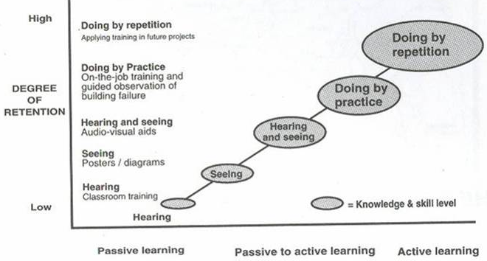
tflndsf] v08x?
Notes:
Objective:
To explain effectiveness of different learning process.
Activities:
Ask participants when they do learn most?
Explain in brief.
Slide Details / Discussion:
The slide presents, hearing is the most inefficient learning process as it occupies only one sense organ. Studies shows that effectiveness of learning by hearing is less than 10%. That means 90% of the resources and efforts are lost.
Lecturing should always be accompanied with some practices, visualizations or if possible repetitions. For example when taking about stirrups, it is better show a stirrup.
Seeing effectiveness of visualization and repetitions, all the technical training for reconstruction activity are accompanied with some practical sessions.

Slide 23
k|ljlw x:tfGt/0fsf pkfo
hfu/0f / k|lzIf0f
tflns sfo{qmdx?
e"sDkLo pkrf/sIf
hf]lvd d"NofÍg e|d0f
Notes:
Objective:
To introduce activities that can be conducted for technology transfer at different levels.
Activities:
Collect participants views: is this training is helpful for technology transfer?
Explain in brief.
Slide Details / Discussion:
This slide presents few of the activities that is useful for effective technology transfer.
In forthcoming slide we are going to discuss about some examples of technology transfer activities such as awareness raising, training programs, earthquake clinics etc. These activities fall under regular program of NSET in Nepal.
It is hoped that this would trigger some new innovation in local building industry stakeholders for technology dissemination.

Slide 24
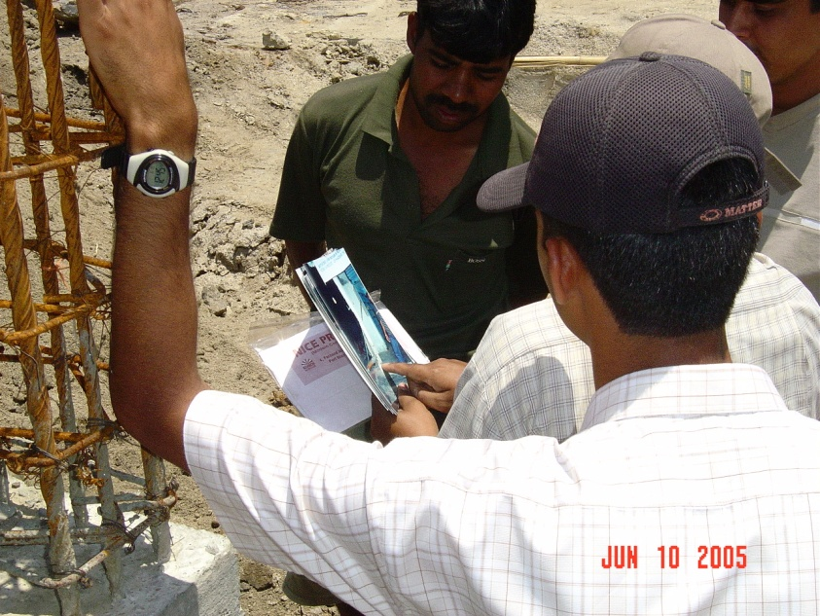
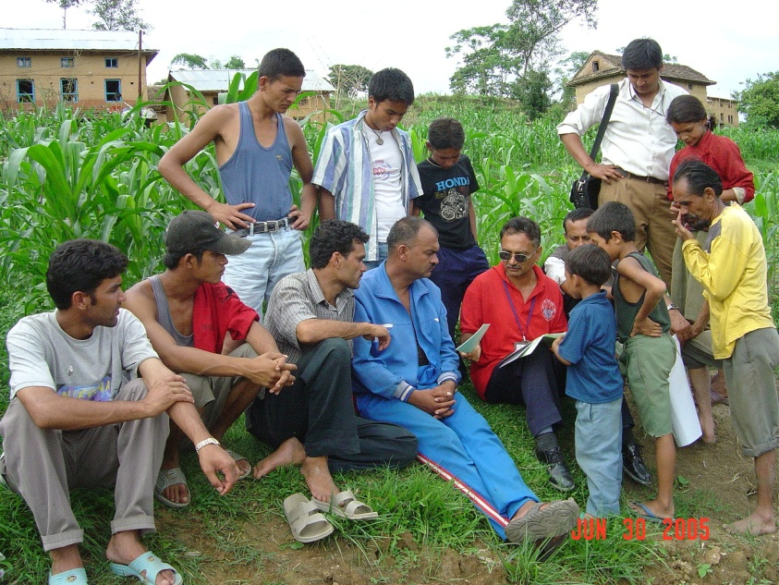
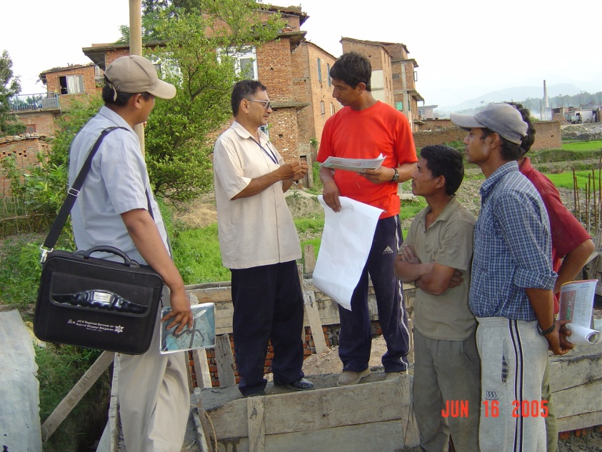
e"sDkLo 3'DtL pkrf/sIf
c;+ul7t If]qaf6 lgdf{0ffwLg ejgdf ;'/lIft lgdf{0faf/] :ynut ?kdf hfgsf/L lbg]
Notes:
Objective:
To show, what is earthquake clinic and how NSET runs it.
Activities:
Involve participants what do they mean by clinic.
Summarize their views and correlate it to earthquake mobile clinic.
Explain in brief.
Slide Details / Discussion:
Earthquake clinic is like medical clinic (both in-house and field) where people can come and get answer to their quarries.
NSET runs two type of clinics:
In-house: where people can come accompanied with the craftsman, bring drawings of their houses and get advice
Mobile Clinic: In this clinic, NSET professional go to the construction site, have a look at the construction, talk with the house owner and the craftsman. Discuss the good points and deficiencies and ways to mitigate these. The photographs resented above are for mobile clinic.

Slide 25
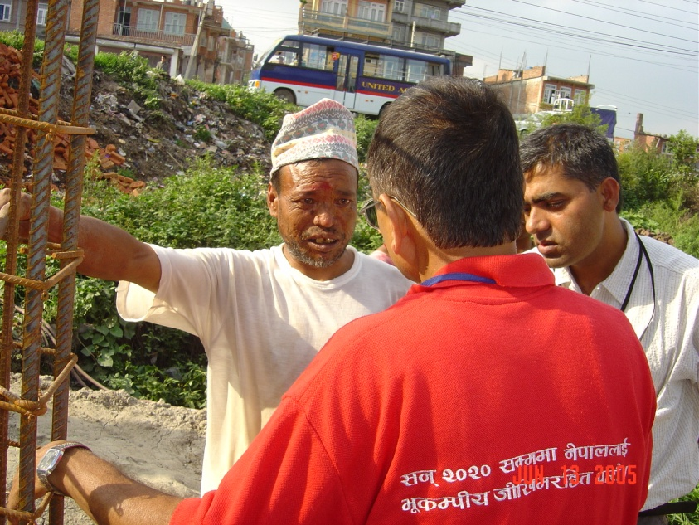
pkrf/sIfdf sfd ug]{ tl/sf
s'g} Ps If]q 5fGg]
lgdf{0ffwLg s'g} 3/ /f]Hg]
kl/ro u/L cleofgaf/] hfgsf/L lbg]
3/wgL clgR5's ePdf wGojfb 1fkg u/L csf]{ lgdf{0ffwLg ejgdf hfg]
cfjZos ;|f]t;fwg M
  k|fljlwsx?
  lh=lk=P;= / l8lh6n Sofd]/f
  kf]i6/, lgb]{lzsf cflb
  Ifltu|:t 3/sf s]xL kmf]6f]x?
Notes:
Objective:
To explain how mobile clinic is run.
Activities:
Explain the steps.
Slide Details / Discussion:
This slide presents the flow path for running mobile clinic. The mobile clinic works like “site campus”. This clinic has helped mitigate deficiencies in houses under construction.
Initially select an area and choose a house under construction. Introduce yourself and your team and explain the mission. If home owner/craftsmen does not show any interest try to persuade them. If they strongly disagree about your mission say thank you and move to next house under construction.

Slide 26
pkrf/sIfdf sfd ug]{ tl/sf
3/wgL ;xdt ePdf M
  e"sDkLo hf]lvdaf/] 5f]6f] hfgsf/L lbg]
  ejgsf] cjnf]sg u/L sdLx?sf] klxrfg ug]{
  sdhf]/Laf/] ;ts{ u/fpg]
  ;'wf/sf pkfo atfpg]
  s'g} c:ki6tf eP ;f]Wg]
  kf]i6/, lgb]{zsfx? ljt/0f ug]{
  cfjZos k/] sfof{nodf ;Dks{ ug{ cfpg ;Nnfx lbg]
wGojfb 1fkg u/L ljbf eP/ csf]{ 3/df hfg]
Notes:
Objective:
To explain how mobile clinic is run.
Activities:
Explain the steps.
Slide Details / Discussion:
This slide is the continuation of previous slide.
If home owner shows interests, give brief description on earthquake risk of the region. Survey the house and identify the deficiencies if any. Aware the house owner/craftsmen about the deficiencies and probable implications. Suggest for possible mitigations. Ask them whether they are fully understood or not and avoid confusions if any. Distribute the posters, guidelines and other materials for distributions. If they had further queries in the future suggest them to visit at your office. Say thank you and goodbye and move to new house under construction.

Slide 27
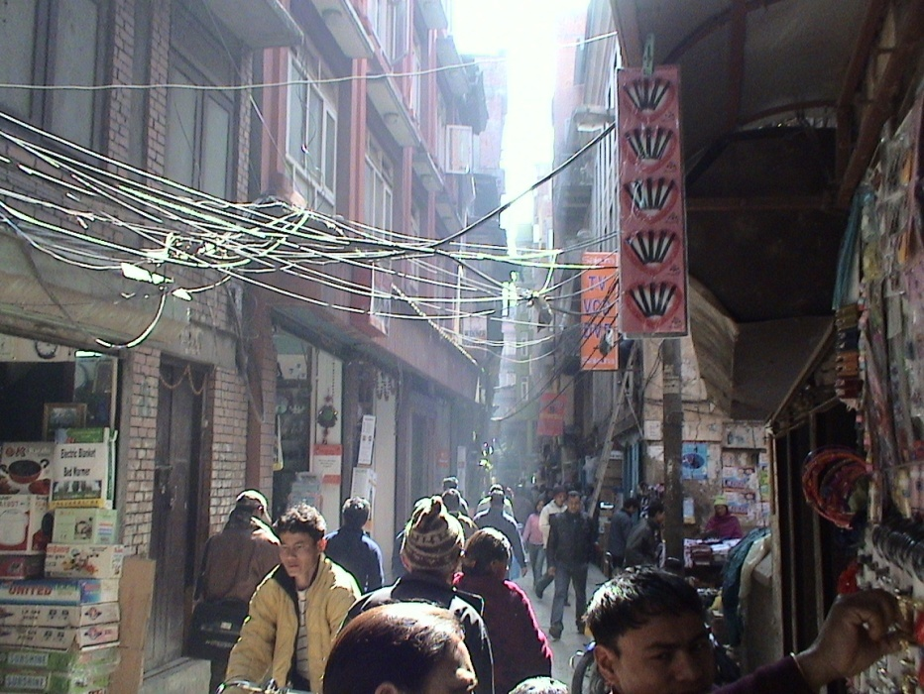
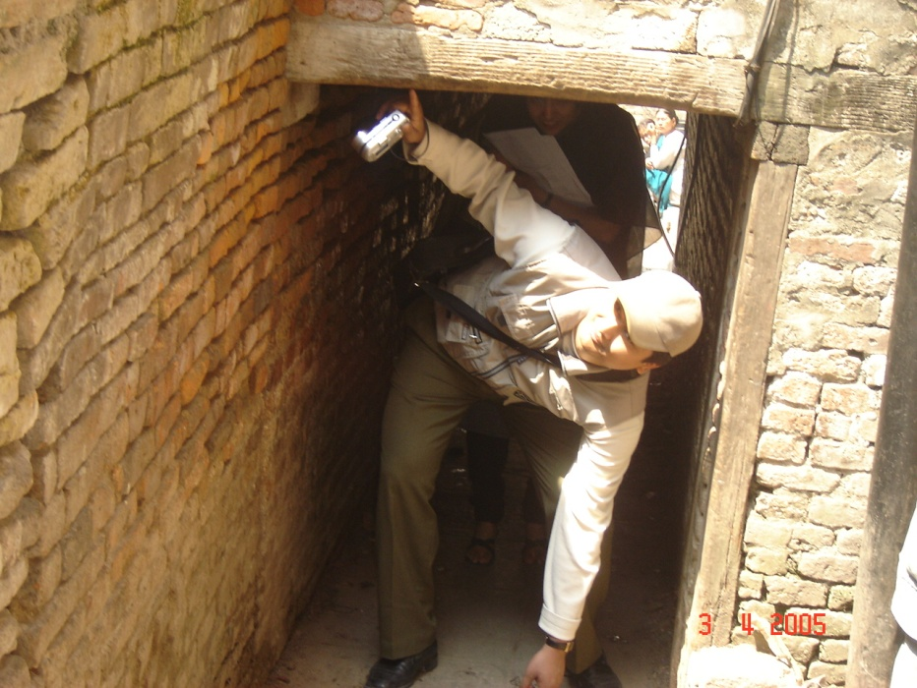
hf]lvd hfu/0f e|d0f
e"sDkLo hf]lvdsf] cj:yfaf/] hfgsf/L lbg
hf]lvd Go"g ug]{ kxnaf/] ;xdlt sfod ug{
:yfgLo ;d'bfo, :yfgLo ;/sf/ / gLlt lgdf{tf tyf lg0f{oflwsf/Lx?;+u e|d0f
Notes:
Objective:
To describe about vulnerability tour.
Activity:
Discuss about why and how vulnerability tour is conducted. Explain the way of making the people aware about the earthquake risk of the community
Slide Details / Discussion:
The slide presents photographs of down town Kathmandu. The first photograph is of a street in down town Kathmandu and second is way to a community.
The earthquake vulnerability tour has the following purposes.
To convince lay persons to the policy/decision makers and the international community on urgency of urban earthquake vulnerability reduction initiatives.
To help develop perception of existing seismic vulnerability of Building structures, life line structures and their combination
To help champion develop their own vulnerability tour in their own wards/cities
In this tour, people from community, local governments, decision makers are taken for a tour. They are made aware on the site what would happen if an earthquake strikes.
The clinic has created a sense of urgency and need in these people and has helped to carve the solutions for it.

Slide 28
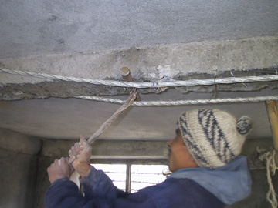
sfo{:yfgdf tflnd
lj1x?n] sflnu9sf] sfdsf] cg'udg u/]/ ToxL+ ;'emfjx? lbg]
gofF k|ljlwaf/] hfgsf/L lbg]
sflnu9n] tL s'/f k6s k6s agfp+b} /fd|f];+u l;Sg]
Notes:
Objective:
To explain about on-the-job training for local crafts person.
Activity:
Explain about possibility of on the job training to local masons during reconstruction.
Slide Detail / Discussion:
NSET has retrofitted or reconstructed various school buildings under School earthquake safety program. This program is designed to penetrate the community for realization of earthquake safe culture through local schools.
All the school retrofitting or reconstruction programs are accompanied with class room and on-the-job trainings. The photograph presents the glimpses of the on-the-job training.
In this training, NSET professionals monitor the craftsman's work and advice them, introduce them with new technology where these craftsman repeat them again and again for effective learning.
Objective:
Activities:
Explain about possibility of on the job training to local masons during reconstruction.
Slide detail/ Discussion
The above figures show some examples of on the job training for local masons.
Masons can learn practical issues with clarity. It is a continuous process. Awareness can be raised in the community through masons and the technology can be disseminated to the local level through this process more effectively.
Helpful in safer construction and convincing house owners.
Note: NSET implements on the job training to the local masons under various community based programs, one of them is School Earthquake Safety Program. Under this program, school buildings are retrofitted involving local masons and training them in earthquake resistant construction technology.

Slide 29
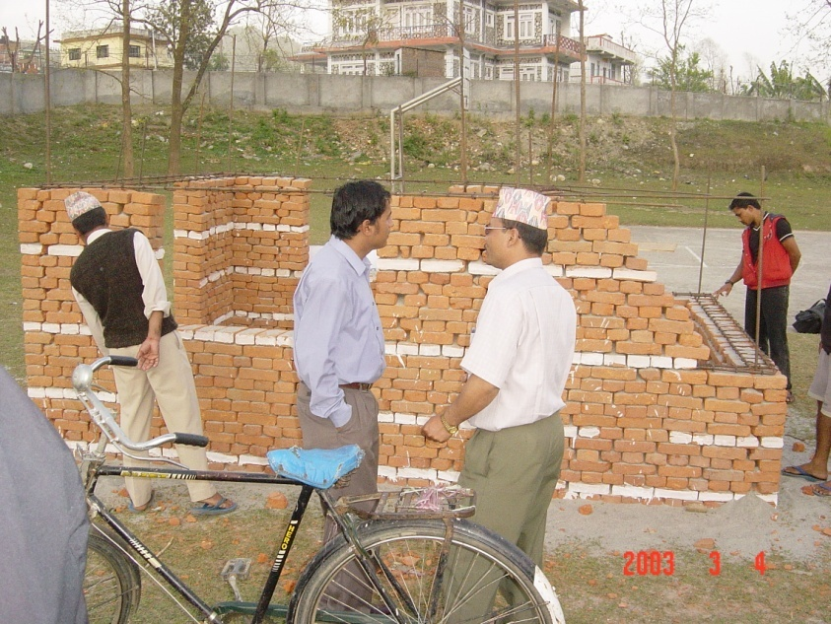
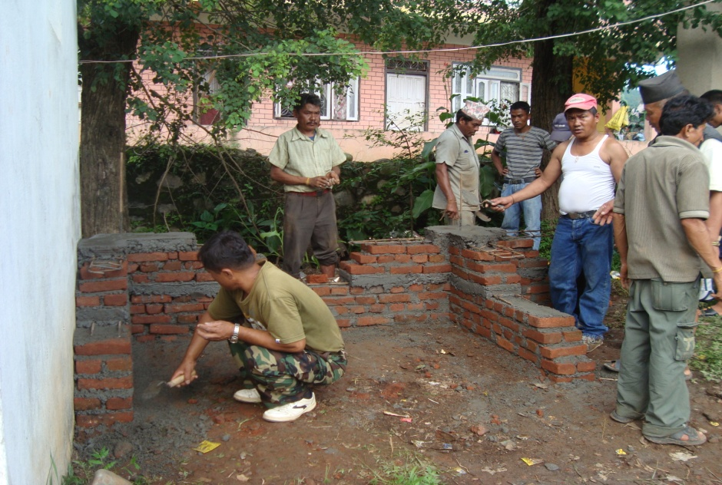
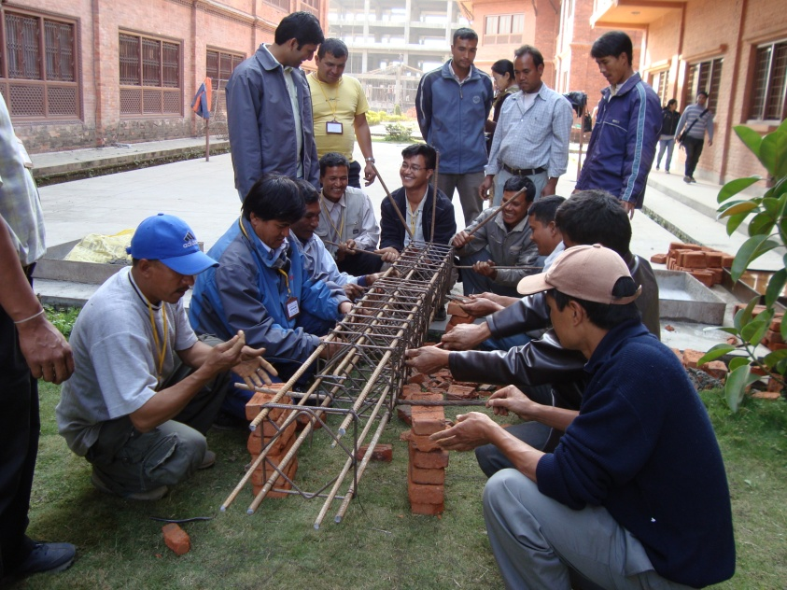
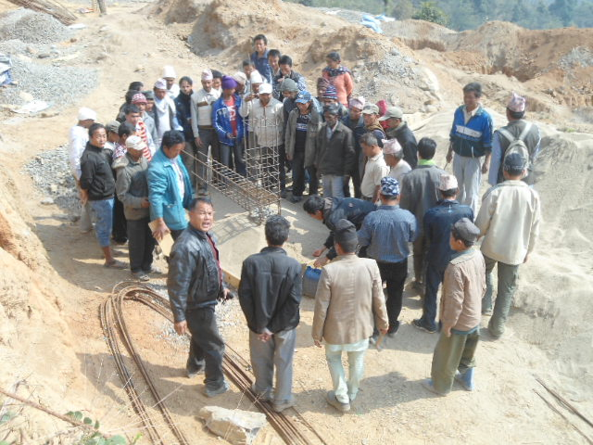
u/L hfGg]
Notes:
Objective
To show some examples of awareness raising programs and craftsman trainings.
Activity:
Discuss the possible means of disseminating the technology through physical models and demonstration
Slide detail/ Discussion
The upper photographs show the demo models of building with earthquake resistant elements. Professionals can contribute their time to explain the features and advise local people on the techniques to be followed.
Lower figures show the training being conducted for the masons. The trainees masons practice making the elements and also they teaches the techniques to their co-workers who are not yet trained.

Slide 30
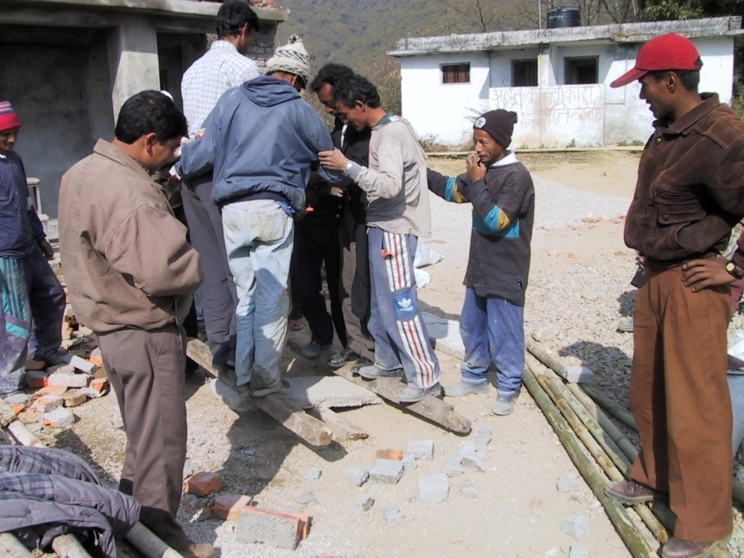
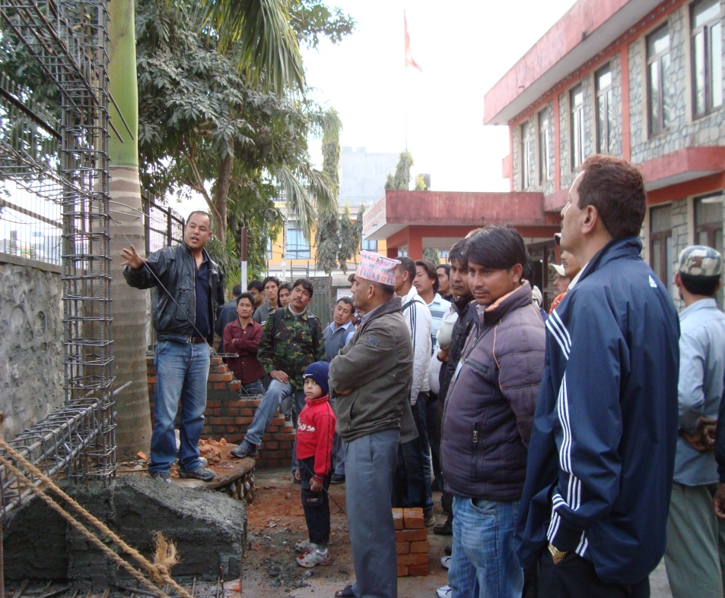
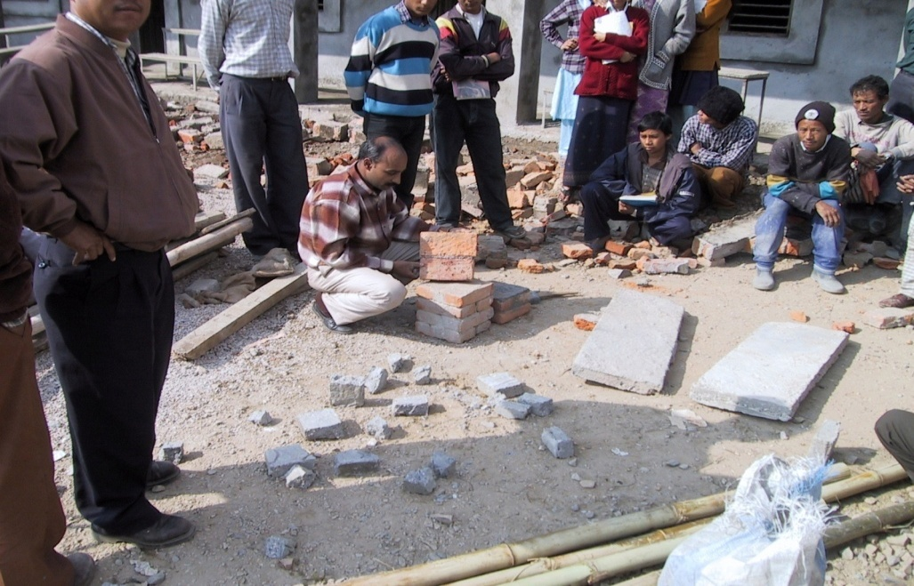
u/L hfGg]
Notes:
Objective:
To describe few tricks for convincing craftsman.
Activities:
Ask participants, how easy it is to convince craftsman or even house owner for some new work in the house construction.
Explain in brief.
Slide Details / Discussion:
This slide presents few photographs of experimental work done to convince the craftsman.
Convincing trainees is the first step towards better construction.
For experiments, blocks, slab pieces etc are constructed depending up on massage to be delivered.
In the first picture, effect of not soaking brick in water and improper curing is being shown.
Similarly, in second photograph, effect of placement of reinforcement in slab (top or bottom) is being presented (seeing inherent limitation of the craftsman). It is all relative. So few good models are constructed and few deficient.

Slide 31
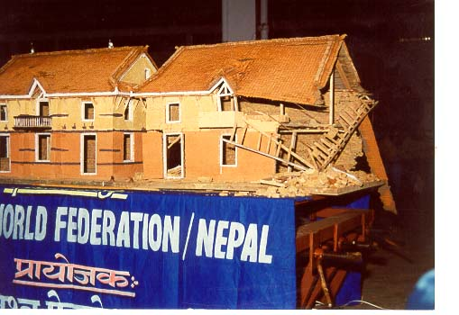
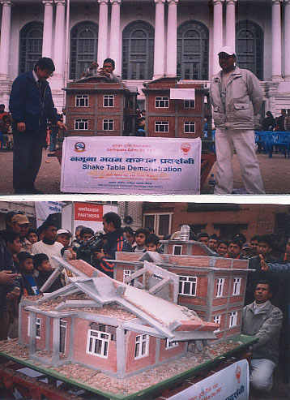
sDkg 6]a'n k|bz{g
.
.
Notes:
Objective:
To describe about shake table demonstration.
Activity:
Explain in brief.
Run the shake table demonstration.
Slide Details / Discussion:
The slide presents photographs of shaking table demonstration.
In this demonstration, two scaled models of same plan, elevations; one with conventional construction and other one with earthquake resistant features are constructed. These models are put on a table (here shaking table) and are shaken. People from all walks of life come to watch the demonstration live. The models are always constructed of local building type so the spectator could feel how his house would collapse and what would be the implication.
This type of demonstration has already conducted in Muzaffarabad and Bagh district of AJK after 8 October, 2005 earthquake.
It is one of the very strong awareness raising tool. NSET has conducted it in Nepal, India, Pakistan, Iran, Afghanistan, Indonesia, Japan, Tajikistan.

Slide 32
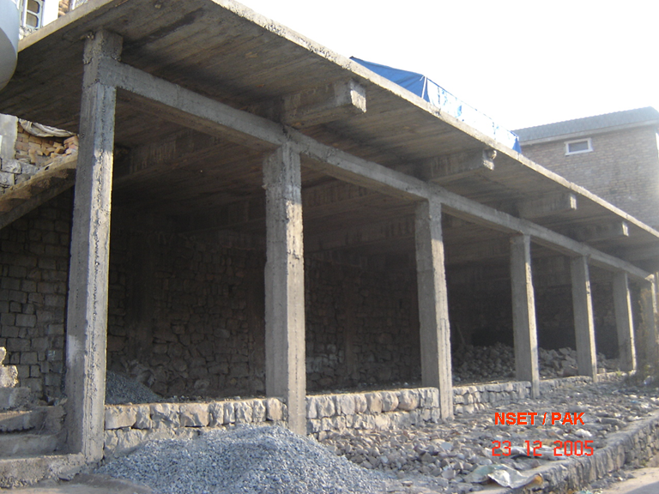
olt~h]n, xfdL sxfF 5f}+ <
Notes:
Objective
To show that technology has not been transferred yet.
Activity
Discuss what are the deficiencies in this construction.
Slide detail/ Discussion
The slide presents a photograph of “RC frame” building.
The building has been constructed as if reinforced concrete is an extension of timber construction. The beams should have been in the same level and slab should have been concreted with the beam.
If so it would have befitted structurally and earthquake performance of the building would have improved significantly.

Slide 33
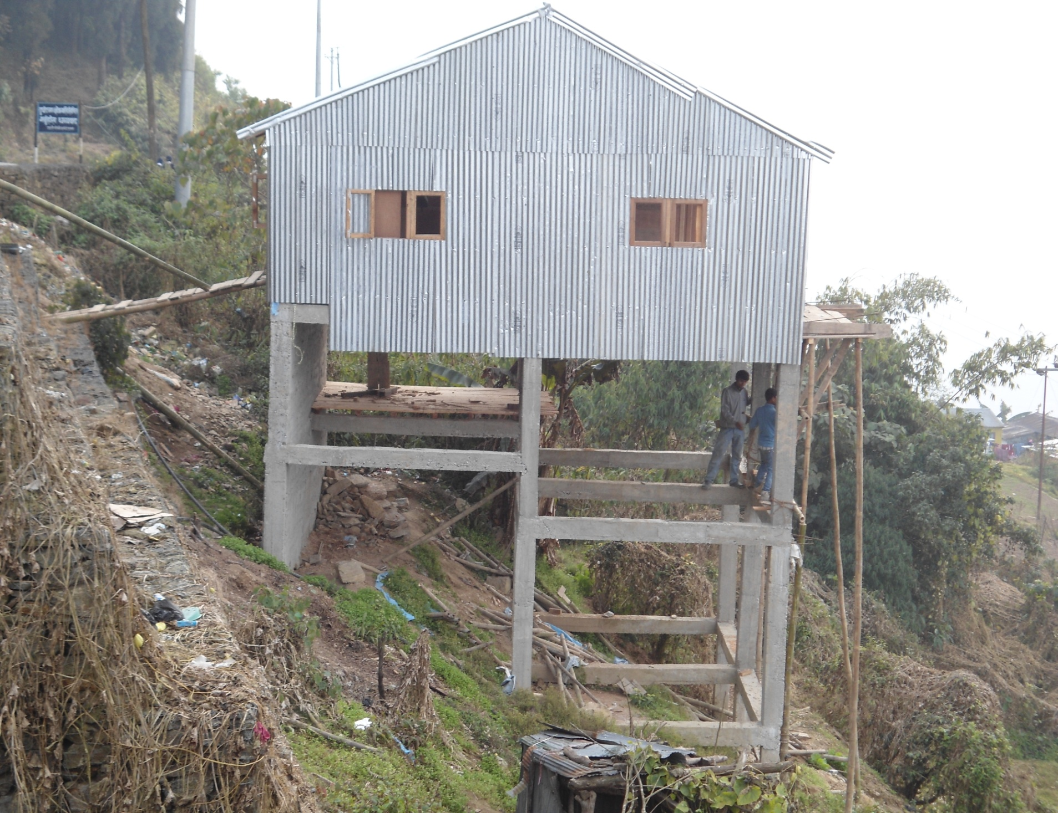

Slide 34
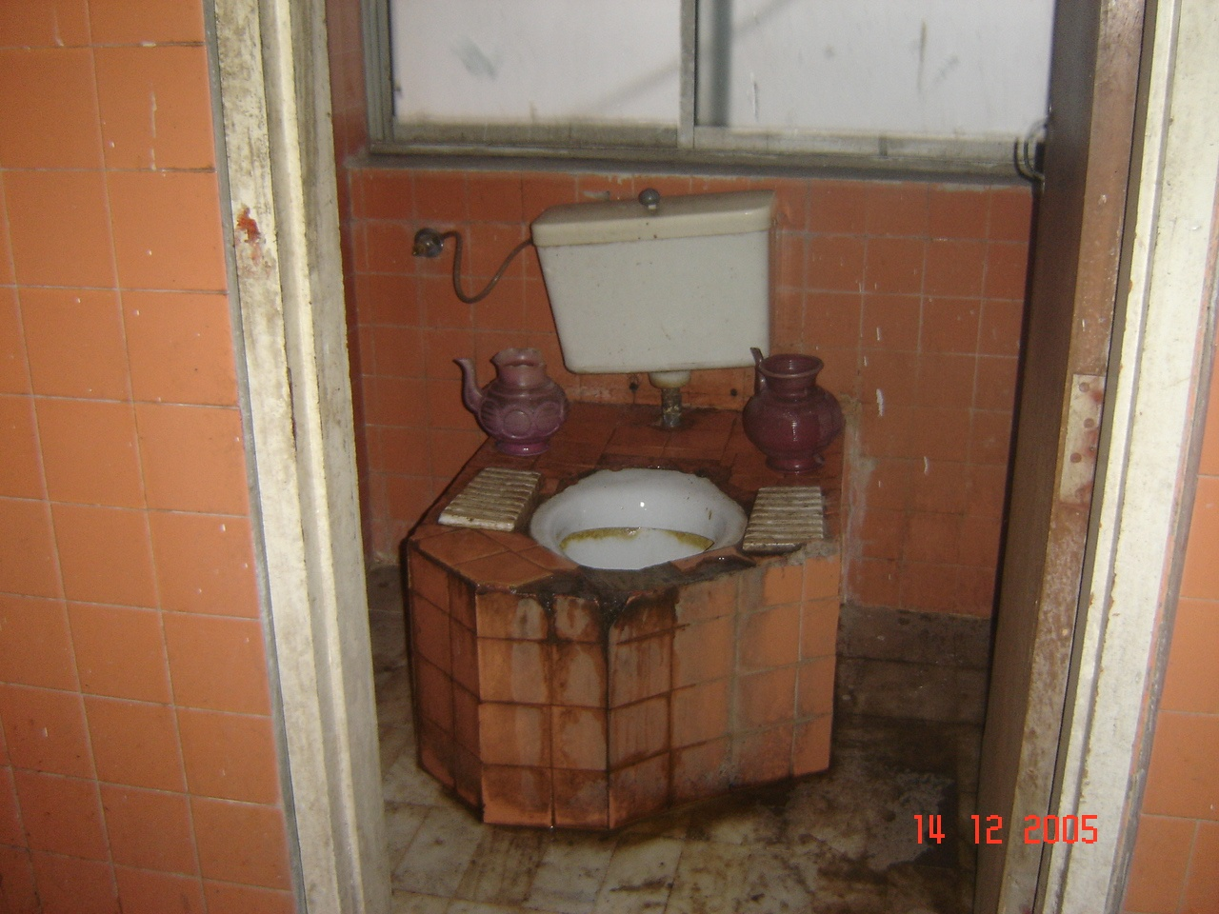
k|ljlw x:tfGt/0f ? ? ?
Notes:
Objective:
To provoke a thought what is good for us.
Activities:
Ask participants, what is odd in this photograph.
Help them identify the photograph and explain in brief.
Slide Details / Discussion:
The photograph presents a French toilet confined with brickwork.
In the beginning it was constructed as a French toilet. But later it did not meet cultural or practical requirement so brickwork has been added. People have climb now for toilet.
The massage is, a squatting type pan would have been much comfortable and cost effective solution than this.
Appropriate technology is a complex issue and needs serious thinking before adoption.

Slide 35

Notes:
Objectives:
To thank the participants.
Get commitment from them that they will do what they learnt.
Activity:
Discuss, we will be able to deliver better and safe houses for the general masses that would be able to protect the generations to come. That would be a gift for them from us.
Slide Details / Discussion:
The slide shows some hope that days to come will be better than today. Message being delivered through a couple of white pegions.

Slide 36
k|f/lDes ;qdf dGyg
;'k/Lj]If0f, cg'udg
  dfgjLo ;|f]tsf] sdL jf cefj
lzIff tyf tflnd
  lzIfsx?df Jofjxfl/s 1fgsf] cefj
;fdflhs cfly{s, gLltut
ejg lgdf{0f :jLs[lt k|lqmof
;fdfGo cfwf/e"t tTjx?sf] cefj
  x:tfGt/0f k|lqmof gx'g'
  1fg / ;Lk j[l4 gx'g'
;fdfGo ljsf; ultljlwx?df k|sf]k Go"gLs/0fsf] ljifo ;dfj]z gx'g'
  cGt/f{li6«o nufgL ePsf ljBfno ejg klg Ifltu|:t x'g'
lgdf{0f:ynsf] cWoog gx'g'
  ef}ule{s hfgsf/L / tLa|tf dfkg gx'g'
Notes:
Objective
Do a brain storming session.
Activity
Before going to details of presentation, conduct a discussion in the periphery of above listed issues.
Help the participants bring the issues forward.
List them out.
Slide detail/ Discussion

