Slide 1
Cyclone Roanu
Shelter Cluster Meeting
6 June 2016

Slide 2
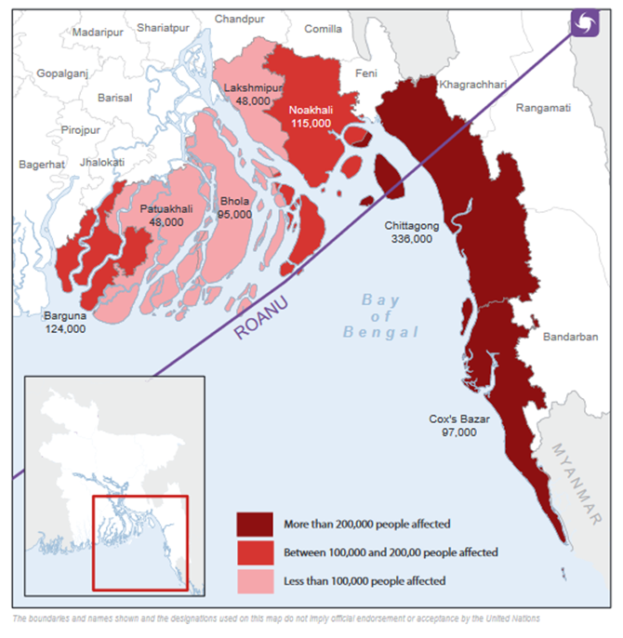
Agenda
• Update from government
• Presentation of key findings :JNA, JRP
• Update on Shelter response and planned actions
• Discussion on displacement
• District level coordination
• AOB

Slide 3
Damage houses (Number) :Cyclone Roanu 2016
Targeted Caseload 35,000 HH
JNA:
7 Districts
Total Damage house 75,533
Source: Situation report on Cyclone Roanu, published on 21 May 2016 by DDM

Slide 4
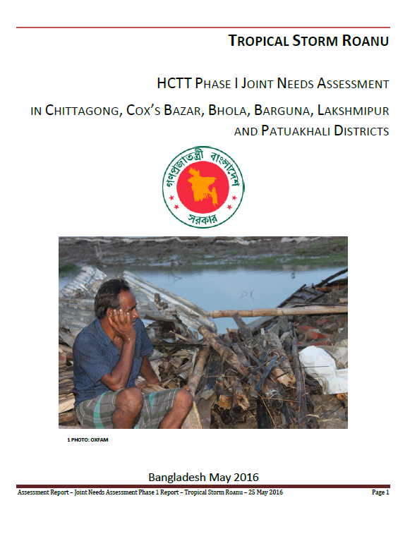
Key findings from JNA
The 3 districts with the highest % of need in need of immediate shelter are Cox’s Bazar, Noakhali and Bhola.
Additional shelter support is requested in all assessed districts and approximately 40% of the Upazilas. Cox’s Bazar, Bhola and Noakhali have reported shelter as their first priority.

Slide 5
Key findings from JNA
Shelter

Slide 6
Key findings from JNA
Shelter

Slide 7
Recommendation from JNA
Shelter
Provide emergency shelter support to vulnerable families with fully and partially damaged houses, with priority to families with fully damaged houses. Recommended to provide cash in combination with training on disaster resilient building techniques as well as NFIs (package or cash) to households in line with shelter cluster guidelines and standards. For the three places where markets are reported as non-functioning in-kind support of materials would be preferred.
Provide labour support, or extra cash for hiring labour support, to female headed households, elderly and disabled in combination with shelter support.
For longer term recovery it is recommended to support households to build back better in line with the Bangladesh National Building Code and shelter cluster guidelines and standards.

Slide 8
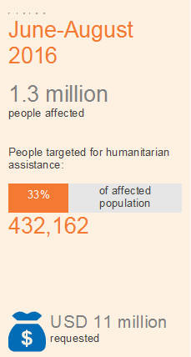
Goal
The overall goal is to ensure that people severly affected by Cyclone Roanu receive timely and appropriate humanitarian assistance.
Strategic objectives
To meet immediate needs of vulnerable population in the severely cyclone-affected areas
To ensure that the common and standard assistance package is respected
To coordinate joint sectoral response to support affected people including those living in hard-to-reach locations

Slide 9
Joint Response Plan
Target Population
District | Upazila | Number of Affected Unions | Number of Affected Population (JNA 1) | No. of Target Population
Barguna | Barguna Sadar | 10 | 78,400 | 7,753
Barguna | Patharghata | 7 | 37,000 | 2,266
Bhola | Burhanuddin | 5 | 40,000 | 6,536
Bhola | Lalmohan | 3 | 20,000 | 3,040
Bhola | Manpura | 4 | 15,000 | 2,907
Bhola | Tazumuddin | 4 | 9,000 | 1,014
Chittagong | Banshkhali | 15 | 250,000 | 28,188
Chittagong | Rangunia | 15 | 33,900 | 1,716
Chittagong | Sandwip | 15 | 45,000 | 3,344
Cox's Bazar | Cox's Bazar Sadar | 5 | 68,862 | 8,431
Cox's Bazar | Kutubdia | 6 | 59,500 | 8,188
Cox's Bazar | Maheshkhali | 9 | 227,810 | 48,657
Cox's Bazar | Pekua | 5 | 100,000 | 14,338
Cox's Bazar | Teknaf | 6 | 67,980 | 13,420
Lakshmipur | Lakshmipur Sadar | 5 | 12,000 | 3,457
Lakshmipur | Ramgati | 6 | 13,000 | 2,075
Lakshmipur | Roypur | 4 | 12,000 | 1,046
Noakhali | Hatiya | 12 | 50,000 | 2,953
Noakhali | Subarnachar | 8 | 30,000 | 2,179
Patuakhali | Galachipa | 12 | 25,000 | 3,597
Patuakhali | Rangabali | 5 | 8,750 | 1,259
 | 21 | 161 | 1,203,202 | 166,362

Slide 10
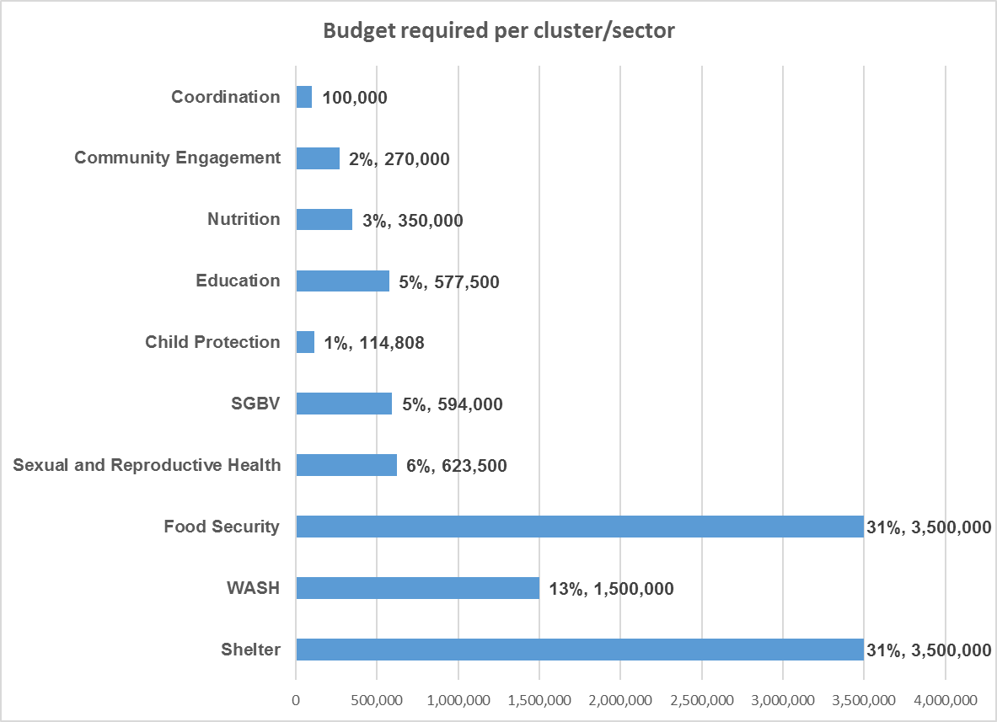
Joint Response Plan
Budget

Slide 11
Joint Response Plan
Shelter
 | Caseload (HH) | Package | Unit cost (BDT) | Unit cost (USD) | Budget (USD)
Emergency Shelter | 35,000 | Tarpaulin, Toolkits, Construction Materials | 5,000 | 63 | 2,187,500
NFIS | 35,000 | Cloths, Kitchen sets, Candle, Blanket | 3,000 | 38 | 1,312,500
Total Package | 35,000 |  | 8,000 | 100 | 3,500,000

Slide 12
Shelter Response in Cyclone Roanu
21 % Coverage
Emergency Phase 6,859 HH
 |  | Government |  | INGO/ UN Agencies/ IFRC
District | JRP Target HH | CGI sheet (Bundle) | Cash (USD) | Emergency Shelter | HH NFIs | Planned/ Responded | GAP (HH)
Barguna | 2,004 | 250 | 9,375 | 400 | 400 | 650 | 1,354
Bhola | 2,699 | 569 | 21,338 | 400 | 400 | 969 | 1,730
Chittagong | 6,650 | 666 | 24,975 | 1400 | 2200 | 2066 | 4,584
Cox's Bazar | 18,607 | 721 | 27,038 |  |  | 721 | 17,886
Lakshmipur | 1,316 | 521 | 19,538 | 500 | 500 | 1021 | 295
Noakhali | 1,026 | 310 | 11,625 | 500 | 500 | 810 | 216
Patuakhali | 971 | 422 | 15,825 | 200 | 200 | 622 | 349
Grand Total | 33,273 | 3,459 | 129,713 | 3400 | 4200 | 6,859 | 26,414

Slide 13
Displaced & Landless population
Location
Bhola :Tozimudin Upazilla, Chandpur Union, Volaikandi (ward no.1) approximately 70HHs and Hazi Kandi (ward no. 6) approx. 100HHs.
Chittagong:
Banskhali Upazilla, Khankhanabad union, Premashia village, Roshangipara Ward no. 3, (83 HHs/2,500HHs in the union lost their houses and some are landless)
Anwara Upazilla, Moddhamgohira villge, Raypur union, ward no. 8 (170HHs destroyed and living with neighbours).
Question
1. What is the immediate shelter support for these displaced population?
Recommendation from SC Meeting on 6th June: Keep same as SC recommended package
2. For landless people what is the appropriate shelter support?
Recommendation from SC Meeting on 6th June: landless affected families should be consider in recovery phase and advocacy with government so that landless can get land in safe location.

Slide 14
Thanks

