Slide 1
Shelter, Cash and Markets Community of Practice (CoP)
Meeting #2: AuguSt 2021

Slide 2

Agenda
Updates [10 mins]
  Survey Results
  MPCA Outcome Indicators for Shelter and NFIs
Shelter-related Market Assessment Experience Sharing [40 mins]
  REACH shelter market assessment in Colombia border areas
  Caritas Switzerland ‘Relying on Markets for the Beirut Blast Response’
  Q&A
  Resources on market assessments and updates on Markets in Crisis (MiC)
AOB [5 mins]
  Next meeting: training and capacity building

Slide 3
1. Updates

Slide 4
CoP Survey Results (Highlights)
20 respondents (mix of country, regional and global level)
Priority topics:
  Market assessments for shelter responses (14/20)
  CVA design (11/20)
  Measuring shelter outcomes from CVA, including MPCA (9/20)
  Advocacy for CVA in shelter responses (7/20)
  HLP and evictions (7/20)
Priorities for CoP:
  Development of resources to facilitate and promote quality MBP, including cash, in shelter responses (16/20)
  Technical support and guidance for countries (11/20)
  Support cash and shelter training initiatives (11/20)
  Forum to discuss challenges and opportunities (9/20)
Engagement:
  Participate in CoP calls (15/20)
  Join thematic sub-group (12/20)
  Reply to discussion threads (8/20)
Frequency of meetings:
  Quarterly (11/20)
  Every 6 months (5/20)

Slide 5
MPCA Outcome Indicators

Slide 6
Old Indicators
SHELTER & SETTLEMENTS /HOUSEHOLD NFI’S
% of households whose shelter solutions meet agreed technical and performance standards
% of target population living in safe and dignified shelters
% of households reporting adequate access to household non-food items*
Remember that most of the data related to these indicators are collected from phone post-distribution monitoring surveys. With other questions asked related to household demographic, process, expenditure etc.
Notes:
May we met: Attending: Angel, Renee, David, Ruth, Jenny, Jim

Slide 7
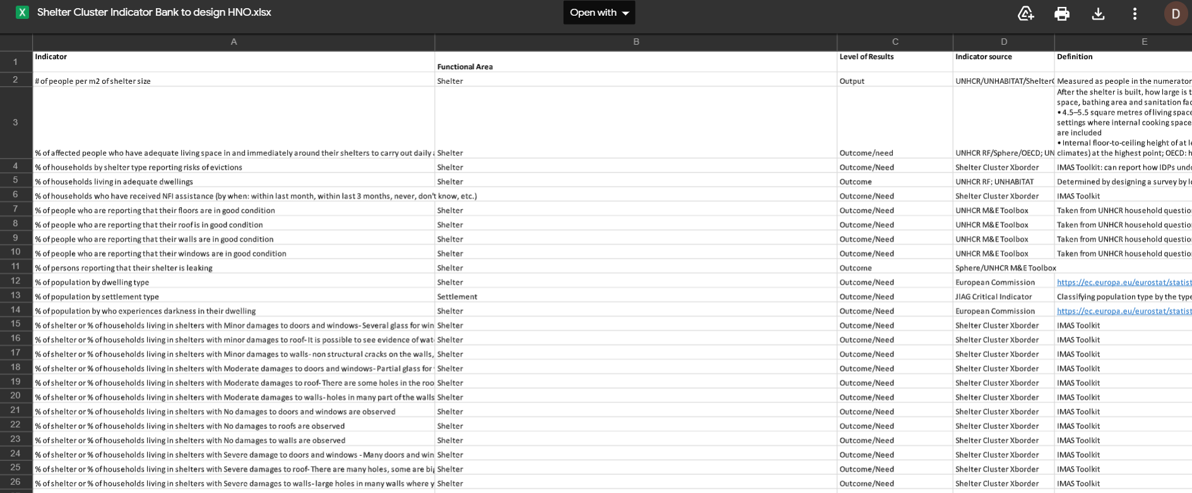
Our Shelter and Settlements indicator bank
From Joint Intersectoral Analysis Group – Shelter and Settlement Indicator bank

Slide 8
New indicators proposed
% of households that report having minimum household items that allow all of the following: comfortable sleeping, water and food storage, food preparation, cooking, eating, lighting, and clothing.
% of households that report living in a shelter that has all of the following: adequate space, feels safe, feels private and protected from the weather.
% of households that report feeling pressure to leave their accommodation because of shelter related expenses or feel at risk of eviction.
% of HH that report that their shelter feels warm enough at night

Slide 9
Guidance to accompany
https://docs.google.com/document/d/1RplcZ3SLd1xProH-gcbGJ8fWzQlfU3Tlz1TuNEnoc9g/edit?usp=sharing
use these indicators in any MPCA program (irrespective of whether the minimum expenditure basket (MEB) or transfer value design includes non-food item (NFI) and shelter components).
The indicators are based on the perception of MPCA recipients
Indicator results should be used to trigger/identify the need for shelter-specific programming or complementary interventions. In order to report positively on the indicator, it is important that all criteria of the indicator are fulfilled.

Slide 10
Feedback so far
Suggested to have different accompanying guidance for Shelter&Settlements vs. NFI
Question about whether we would be happy with a continuum indicator related to “that allow all of the following ….”
Perhaps duplicates the first a little: “% of HH that report that their shelter feels warm enough at night”

Slide 11
2. Market Assessment Experience Sharing

Slide 12
REACH Joint Market Monitoring Initiative (Shelter Market) in Colombia
Shelter, Cash and Markets CoP
3 August 2021

Slide 13
Agenda
    What is REACH?
    REACH Cash and Markets work
    Overview: JMMI in Colombia
    Tool development
    Key findings
    Q&A

Slide 14
What is REACH?
REACH is a joint initiative of IMPACT Initiatives, ACTED, and the United Nations Operational Satellite Applications Programme (UNOSAT).
REACH was created in 2010 to enhance aid effectiveness by promoting and facilitating data collection, analysis and dissemination among aid actors before, during or in the aftermath of a crisis.
REACH is currently operational in 28 countries, where all activities are conducted in support of and within the framework of inter-agency aid coordination mechanisms, such as national Cash Working Groups.

Slide 15
    REACH Cash and Markets work
REACH’s work in cash-based responses has revolved around four main themes, conducted in support of the relevant national Cash Working Groups:
Coordinated, inter-agency joint market monitoring initiatives (JMMIs)
Cash feasibility and market studies
Thematic cash-based projects and assessments
  e.g. consumption and expenditure assessments, financial service provider assessments, etc.
Rapid market monitoring assessments (in response to market shocks)
  Rapid versions of JMMIs and market studies tailored to meet market information needs during shocks to market (i.e. COVID, protests, etc)
Notes:
REACH works globally and nationally to address core information gaps in cash and voucher assistance (CVA).

Slide 16

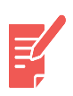
Overview: Colombia’s Joint Market Monitoring Initiative (JMMI)
Context
Based on partner PDMs and multi-needs assessments related to cash assistance, food and rent have been reported as the main household priorities, needs and expenses in Colombia; monitoring rental markets serves to inform multipurpose and cash for rent programming.
Methodology:
Data collection conducted by CWG partners
Structured questionnaire → remote interviews with beneficiary households
20 surveys by municipality (per partner)
One week of data collection per round
Rounds every two months → the tool has evolved across three rounds to include data on rental markets
Primary research objective:
To better understand and monitor the relevant factors of the markets prioritised by the CWG to determine the degree of functionality of the targeted markets (including the rental market)

Slide 17

Overview: Colombia’s Joint Market Monitoring Initiative (JMMI)
Limitations:
Data collection for the rental market monitoring component only captures data from the demand side, due to operational constraints related to supply side data and partner capacity.
The findings are based on self-reported responses and are therefore subject to some degree of bias.
The findings of this assessment are indicative, the amount of data collected is not a representative sample, so the results cannot be extrapolated and are not generalisable to the populations of interest. In particular, because the data is collected/reported by type of accommodation.
Due to data being collected by partners based on their capacity and access to the relevant populations, certain departments and households are likely to be under- or over-represented.

Slide 18
Tool development
Technical guidelines and key concepts used for the tool development:
Tip sheet 1 –Global shelter cluster
  Submarkets – market segmentation
  Rental availability, cost and quality
Sphere Minimum Standards
  Rights-based shelter standards
Step by step guide for rental assistance (IFRC)
  Market segmentation by type of accommodation and how this housing units are defined according to the area, number of facilities, accessibility, type of contract, etc. Price is reported considering this segmentation (i.e unit type x).
Rental Law 820 from 2003:
  Responsibilities tenants and landlords have within a formal contract
Gran Encuesta Integrada de Hogares - DANE
  Types of households in Colombia,
  Estimates of mitigable and non-mitigable overcrowding,
  ‘Strata’: Threshold used in Colombia for residential public services costs and to allocate subsidies/contributions per area
Market and cash programming relevant questions:
-Rent price and other costs (changes?)
- Payment means/frequency
- Access to market
- Location
- Relationship between price-adequacy
- Connecting cash with type of accommodation
Accommodation quality questions:
- Access to services
- Area
- Number of rooms
- Facilities: WC, kitchen, laundry, shared?
- Type of housing
Protection-related questions:
- Minors
- Possession of documentation (by type)
- Perceptions of safety
- Perceived risk of eviction
- Informal/verbal agreements

Slide 19
Results: Median monthly rental cost by type of accommodation and region (COP)
T.A | Strata | National | Central region | Caribbean region | Border region | Southwestern region | Urabá
Room in a tenement | Strata 1 | $ 250.000 | $ 370.000 | $ 250.000 | $ 210.000 | $ 190,000 | N/A
 | Strata 2 | $ 300.000 | $ 370.000 | N/A | $ 300.000 | $ 240,000 | N/A
 | No strata | $ 250.000 | $ 377.000 | $ 280,000 | $ 230.000 | $ 240.000 | N/A
Room in another type of structure | Strata 1 | $ 200.000 | $ 250,000 | $ 200.000 | $ 200.000 | N/A | N/A
 | Strata 2 | $ 300.000 | $ 300,000 | N/A | N/A | $ 300,000 | N/A
 | No strata | $ 250,000 | $ 275,000 | $ 200,000 | $ 250,000 | $ 300,000 | N/A
Pagadiario | N/A | $ 375,000 | $ 600,000 | N/A | $ 300.000 | N/A | N/A
House or flat | Strata 1 | $ 300.000 | $ 350.000 | $ 300.000 | $ 250.000 | $ 300,000 | $ 280.000
 | Strata 2 | $ 350.000 | $ 400.000 | $ 400,000 | $ 300.000 | $ 340.000 | $ 300.000
 | No strata | $ 305.000 | $ 400.000 | $ 300,000 | $ 250.000 | $ 300,000 | $ 300.000
Informal settlelment | N/A | $ 150.000 | N/A | $ 125,000 | $ 170.000 | N/A | N/A
*Precios que aumentaron con respecto a la ronda anterior. *Precios que disminuyeron con respecto a la ronda anterior *Precios que no cambiaron o no se puede reportar cambio por falta de información en la ronda anterior

Slide 20
Results: Market segmentation by type of accommodation
Characteristics | House or flat | Room in tenement | Room in other type of structure | Pagadiario | Informal settlement
Area (m2) | 25m2 | 5m2 | 16m2 | N/A | N/A
Average number of household members | 5 | 4 | 4 | 5 | 5
Average number of rooms | 2 | 1 | 1 | 1 | 1
Overcrowding mitigation estimate | Mitigable | Mitigable | Mitigable | Non- mitigable | Non- mitigable
% of HH reporting access to water service | 95% | 92% | 90% | 100% | 54%
% of HH reporting access to gas service | 81% | 71% | 65% | 83% | 23%
% of HH reporting access to electricity service | 98% | 93% | 97% | 100% | 89%
Monthly rent price (COP) | $ 310,000 | $ 250,000 | $ 250,000 | $ 375,000 | $ 150,000

Slide 21
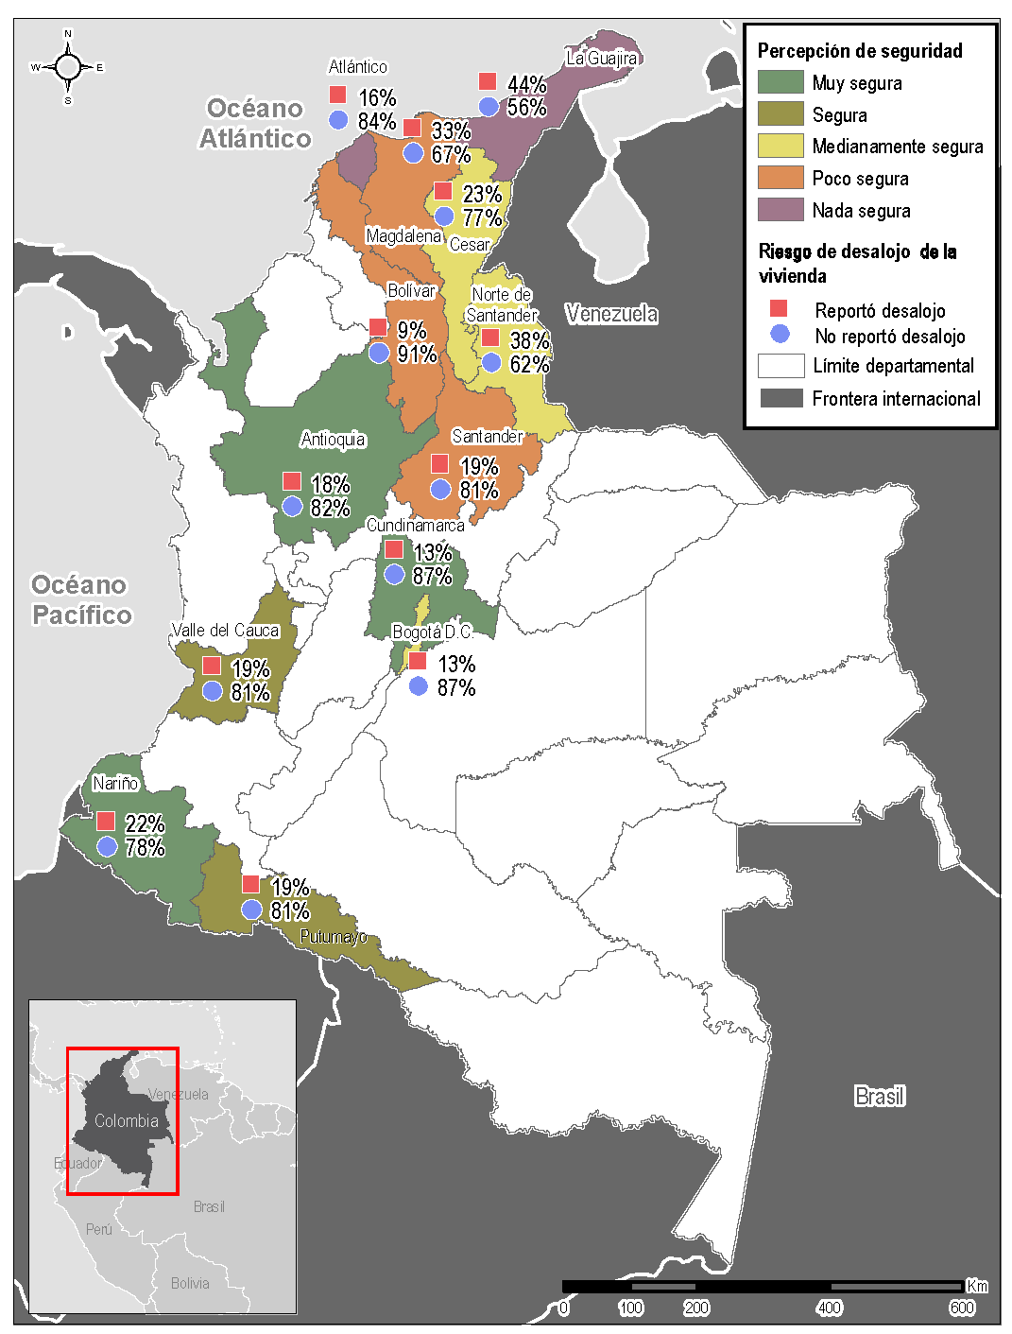
Results: Perceptions of safety and eviction risk
N=580
N=94

Slide 22
Thanks for your attention
Naina Calland-Scoble
Country Coordinator (Colombia and Venezuela)
naina.calland-scoble@impact-initiatives.org
Lina Camperos
Senior Assessment Officer (Cash and Markets)
lina.camperos@reach-initiative.org

Slide 23
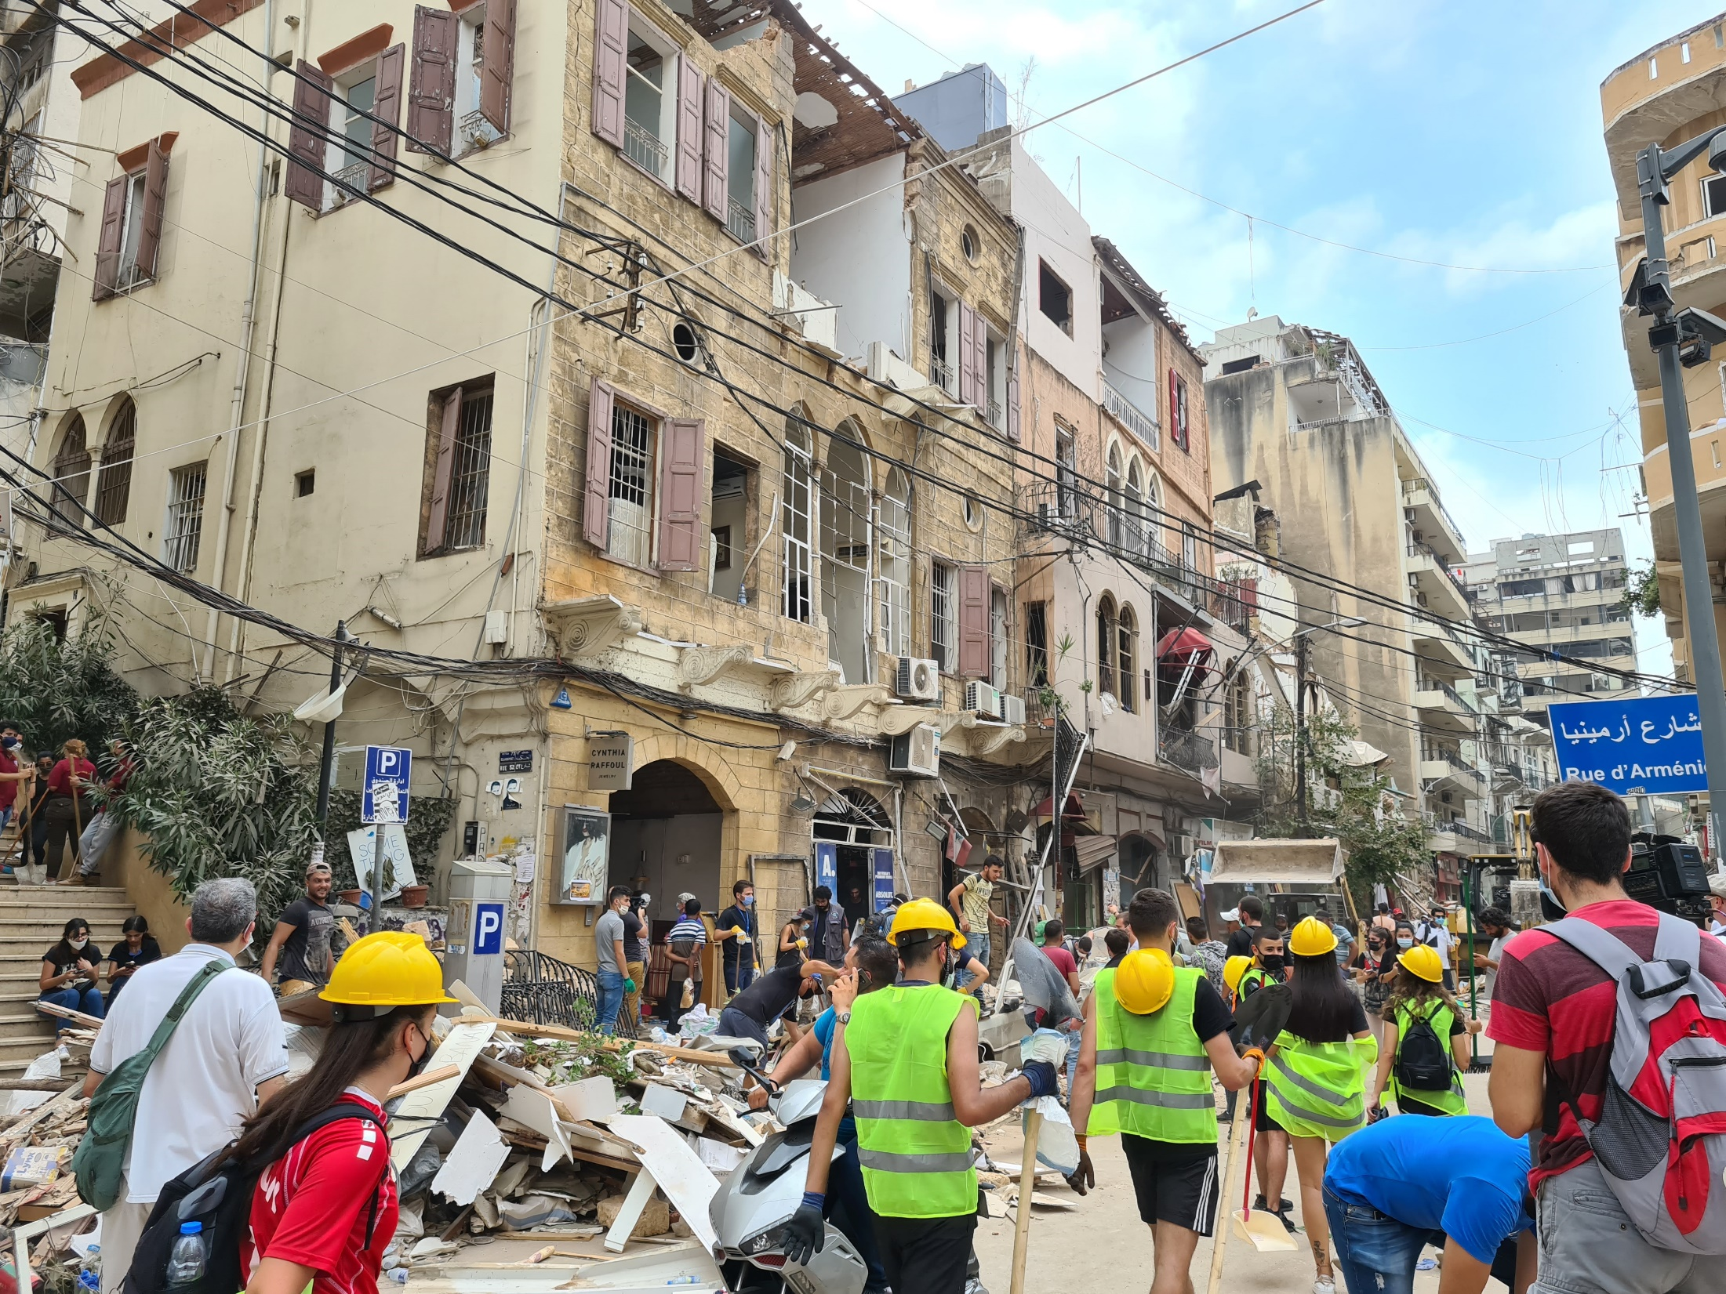
Relying on Markets for the Beirut Blast Shelter Response
Emergency Market Mapping and Analysis (EMMA) of Selected Construction Material Markets in Lebanon
Notes:
The Emergency Market Assessment and Analysis (EMMA) exercise is the result of interagency collaboration that took place in Lebanon in September 2020. Agencies who provided logistical support and field staff for this assessment include: Caritas Switzerland, Caritas Lebanon, ACTED, Concern Worldwide, and the CAMEALEON team for NRC. The assessment was funded by Caritas Switzerland.

Slide 24
Content of the Presentation
Objective
Methodology
Scope
Market System Analysis
  Cement and hollow blocks
  Glass
  Medium Density Fibreboard (MDF)
  Aluminium Frames
Response Recommendations
Q&A

Slide 25
Objectives of the EMMA
Assess market capacity for construction materials
Strengthen the capacity of participating organisations to conduct market assessments
Notes:
This EMMA focused specifically on those commodity markets that are critical for supporting the material reconstruction needs of Beirut Port Blast-affected people.

Slide 26

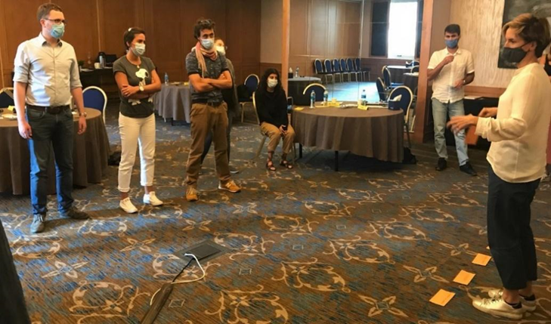
Methodology: Field Research
10 participants from 5 different organizations attended a 2-day EMMA training
Notes:
In preparation for the assessment and to build market assessment capacity among the partner organisations, 10 participants from 5 different organizations attended a 2-day training from 31st of August to 1st of September, 2020: Caritas Switzerland (lead), Caritas Lebanon, ACTED, CONCERN, and CAMEALEON for the NRC. Caritas Germany provided additional support with shelter expertise. There was a mix of skills in the EMMA team, and most participants were programme staff covering a range of fields such as shelter, livelihoods, and monitoring
& evaluation.

Slide 27
Methodology: Field Research
Key Analytical Questions:
Does the market system have the capacity to meet the needs and services people require in sufficient quantities and at reasonable prices?
Which types of market-based responses are the most cost-efficient/effective and feasible?
Joint development of survey questionnaires (KOBO)
Notes:
In preparation for the assessment and to build market assessment capacity among the partner organisations, 10 participants from 5 different organizations attended a 2-day training from 31st of August to 1st of September, 2020: Caritas Switzerland (lead), Caritas Lebanon, ACTED, CONCERN, and CAMEALEON for the NRC. Caritas Germany provided additional support with shelter expertise. There was a mix of skills in the EMMA team, and most participants were programme staff covering a range of fields such as shelter, livelihoods, and monitoring
& evaluation.

Slide 28




Methodology: Field Research
4 field research teams:
Cement and hollow blocks | Glass | Medium Density Fibreboard (MDF) | Aluminium Frames
NRC
8 days of field research (September 2nd – 11th)
  10 KII
  77 market actor interviews (45 face to face, 32 phone interviews).
Notes:
In preparation for the assessment and to build market assessment capacity among the partner organisations, 10 participants from 5 different organizations attended a 2-day training from 31st of August to 1st of September, 2020: Caritas Switzerland (lead), Caritas Lebanon, ACTED, CONCERN, and CAMEALEON for the NRC. Caritas Germany provided additional support with shelter expertise. There was a mix of skills in the EMMA team, and most participants were programme staff covering a range of fields such as shelter, livelihoods, and monitoring
& evaluation.

Slide 29
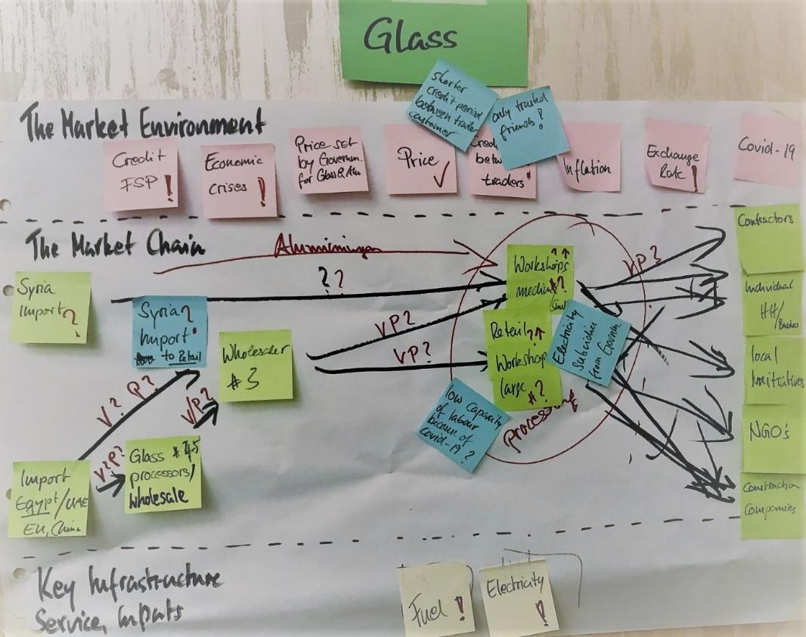
Methodology: Market Assessment
Desk research
Key informant interviews
Survey of market actors (KoboToolbox)
Market analysis (Tableau)
Market System Map (baseline and crisis)
Response analysis
Notes:
The core feature of the approach is the production of market system maps showing how market actors interact and how the market chain is influenced in its functioning by environmental factors (institutions, rules, norms and trends), as well as by key infrastructures, inputs, and market support services.

Slide 30
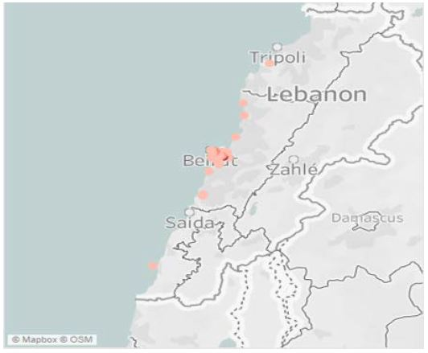
Scope
Critical Markets
  Cement and hollow blocks
  Glass
  Medium Density Fibreboard (MDF)
  Aluminium Frames
Geographic Scope
  Mainly market actors in a 5 km radius of the blast
  Tripoli for MDF and Chekka for Cement and hollow blocks
Notes:
Selection criteria
Anticipated shelter material needs
Recommendations of the shelter working group and shelter experts
Priority markets pre-selected by the assessment partners

Slide 31
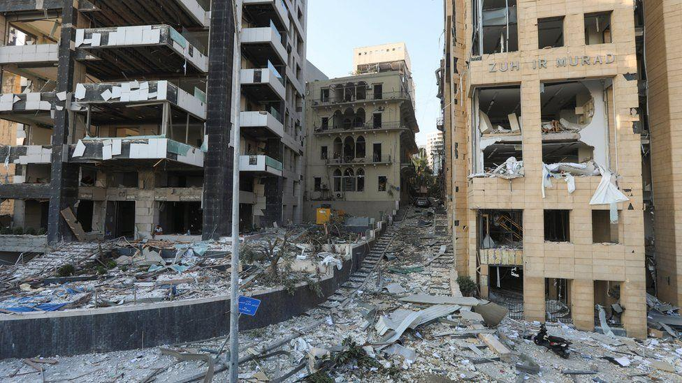
Glass Market

Slide 32
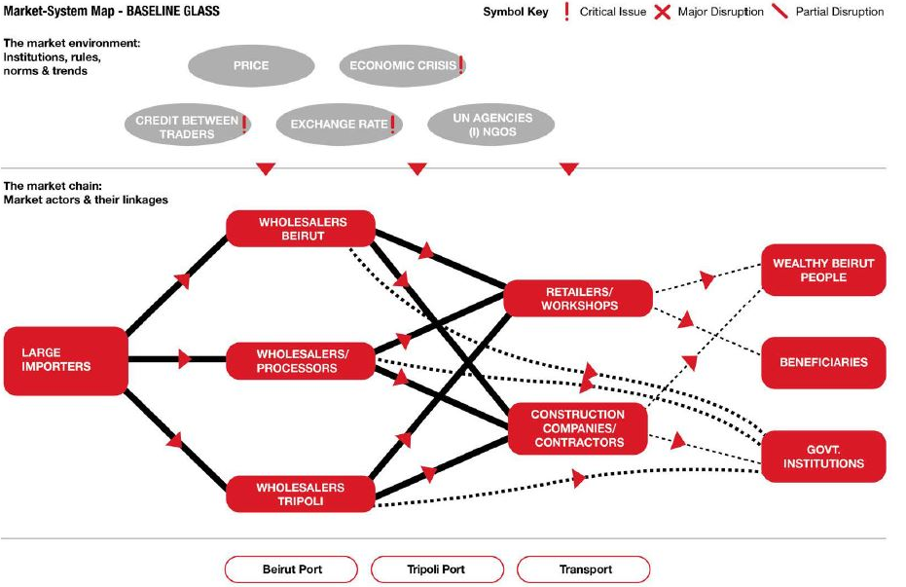
Glass Market: Baseline
Notes:
Lebanon’s glass industry is based on imports from a variety of countries. In the past five years, the importing of flat glass16 dropped significantly from over 33,407 MT in 2015 down to 1,350 MT in of June 2020, mainly due to economic constraints.
Some glass processing factories operating in Lebanon also export processed glass, covering the MENA region and several West African countries.
Glass processing in Lebanon includes architectural glazing, tempering furnace, PVB lamination line, and double glazing.
Governmental institutions, retailers, and workshops where glass is assembled for installation are buying from wholesalers.

Slide 33
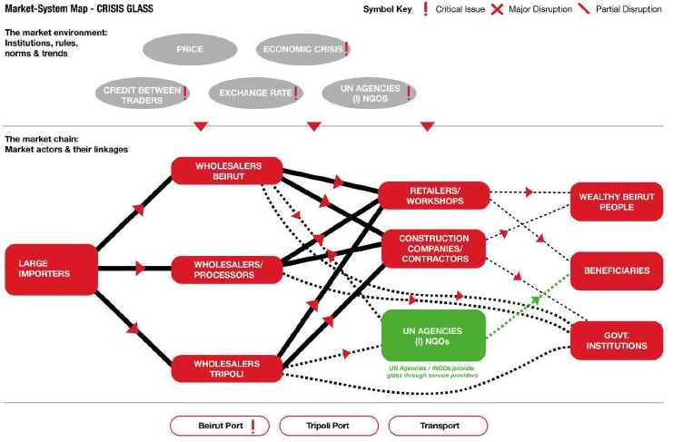
Glass Market: Emergency
Notes:
Apart from an increase in demand and, to some extent, in price, the glass market has not changed substantially.
The importers-to-retailers supply chain is not affected by the Beirut Port Blast. The only difference between the baseline and crisis market system is that UN agencies and (I)NGOs responding
to the blast became active glass market actors since they are now buying glass to reconstruct damaged windows.
To maintain a stable glass price, the Ministry of Trade and Industry introduced a price cap for glass19 of 90,000 LBP for a square meter of 6mm glass including installation.
Some of the glass market actors stated facing challenges purchasing raw material and components for processing as well as selling products due to the economic crisis.
Importers do not foresee any supply issues in the coming months since warehouses are well stocked and importing more glass is not a problem.
So far, interviewed actors mentioned an increase in glass imports of approximately 240% in comparison to the baseline, and this increase in demand/sales is expected to continue steadily into the near future.
Most traders anticipate a slight price increase of 0.5 - 1 USD/SQM to a maximum of approximately 10 USD/SQM. So far, the increase has only materialised at wholesale level, while retailers and workshops are appearing to keep their usual selling price, with some stating that they wouldn’t like to take advantage of the current situation and others explaining that the price is stable due to the lack of competition between actors (“There are jobs for everyone.”).
The main challenges facing traders are the shortage of USD, and the exchange rate, yet most wholesalers and retailers are able to restock/double/triple their stock within 1 to 2 days, while importers need 30 to 45 days.
According to traders, most customers are currently asking for tempered glass since this is safer if it were to ever shatter. This should be taken in account when setting the MEB for shelter items while planning a response.

Slide 34
Glass Market: Summary
Lebanon is importing glass and according to our research, the market chain has not been affected by the blast.
While the demand for flat glass increased significantly, the assessment revealed that sufficient glass is available or can be imported at reasonable costs to meet the needs of the affected population.

Slide 35
Common Findings (all 4 markets)
Construction material demand increased.
Payments across the supply chain in USD or based on the USD/LBP black market rate. Actors prefer payments in USD on delivery.
No access to finance and credit in USD for most traders.
Credit exchange between traders was available before October 2019 and is currently only used between well-trusted partners and with a reduced due payment timeframe.
Beirut Port Blast has not critically affected selected markets as construction material terminal at the port was not critically affected.
Market chains appear functional and able to meet the higher current demand plus expected demand within the next 6 months.
Notes:
Notable is the lower increase for cement and hollow blocks, while glass and aluminium have the highest reported demand. This is expected given the large number of shattered windows when compared to a much lower number of repairs involving cement and hollow blocks.
Credit exchange between traders was available before October 2019, prior to the economic crisis, but this has been put on hold for most traders.

Slide 36
Response Options: Currency
USD | LBP
Stable value / purchasing power Increase USD circulation that may potentially ease pressure on exchange rate Currency is aligned with UN and LRC shelter response (validated by HC) No exchange rate losses at encashment USD preferred by beneficiaries High purchasing power since shelter materials are mainly traded in USD In line with Beirut Port Blast shelter working group recommendations | Used currency for every-day expenses (food, rent, health, water, hygiene items, etc.) Aligned with MoSA and LAF regulations Aligned with sector cash assistance programming under the LCRP Conflict-sensitive (when compared to using USD) Support local currency (avoid use of black market) Adheres to protection-related concerns (risk at the black market and social tensions)

Slide 37
Modality: Cash Assistance
Advantage | Disadvantage
Humanitarian organisations might already have standing service contracts and experience with FSPs (esp. LOUISE platform) Beneficiaries might already have ATM cards from other cash assistance programmes and distributed cards could be included in long-term cash assistance programmes Wide coverage across country After distribution of card, no physical contact required for uploads Reduces costs for beneficiaries and humanitarian organisations Reduces risk of COVID-19 transmission No ID not required for encashment Encashment not linked to working hours and contact with FSP staff Remote loading of assistance reduces risk of COVID-19 transmission | Limits on daily withdrawals Liquidity issues of ATMs People without ID might face access challenges due to KYC regulations (e.g. host community who lost ID, refugees, migrants) ATM disfunction/destruction (protests damaged banks and ATMs) Security risks at the ATM Physical distribution of card creates costs for humanitarian agencies and beneficiaries Risk of COVID-19 transmission during Distribution

Slide 38
Recommendations: Market-Based Programming
Suspension of duty fees on basic construction materials.
Preferential exchange rate for LBP payments.
Provision of credit to construction actors engaged in the reconstruction.
Facilitate direct access to producers (cement).
Ensure that social and environmental standards are adhered to by the construction sector.
Ensure that construction works adheres to occupational health and safety standards.
Ensure that humanitarian actors mainstream gender and protection in programming and external service provision.

Slide 39
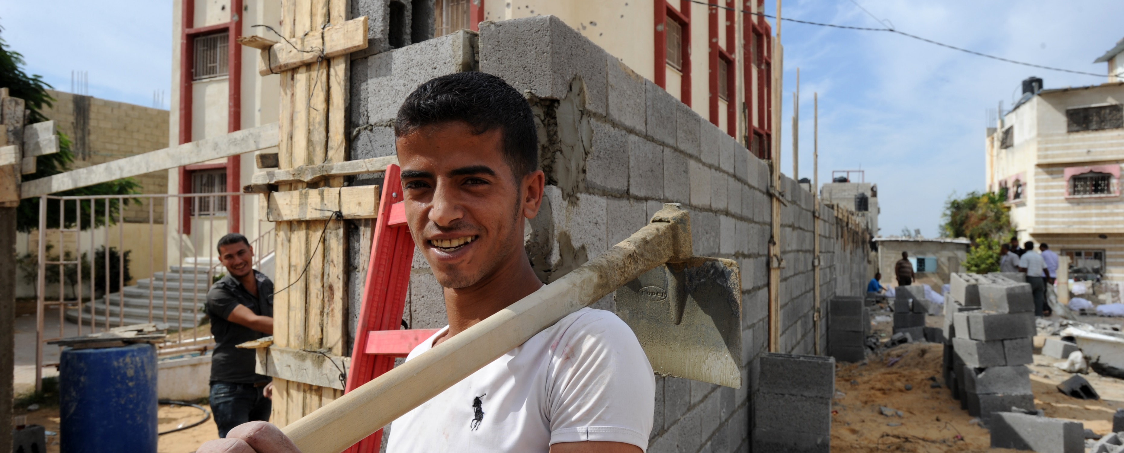
QUESTIONS?

Slide 40
Markets in Crisis (MiC) Updates
  New website under development, including a shelter-focused resource page
  Learning priorities related to shelter/housing and markets

Slide 41
Market Assessment Resources
Do you have relevant market assessment resources and examples for shelter?
  Please add to this document: https://docs.google.com/document/d/1A2xBh6UqcAN-L1KYLko7PpFU5iSlHtyWGdZF--BPSb4/edit#

Slide 42
3. AOB

Slide 43
Next meeting: September/ October 2021
Focus: Training and Capacity Building on Cash, Markets and Shelter
We’ll hear from Jim who developed the Cash and Shelter Training Package: available on the CoP website: https://www.sheltercluster.org/shelter-cash-and-markets-community-practice/discussions/cash-and-shelter-training-materials
Would you be willing to share any training or capacity building resources or experience from your agency or country on our next call? If yes, please get in touch with: Leeanne and Jenny
lemarshall@redcross.org.au / jennifer.weatherall@crs.org

