Slide 1

Shelter Cluster IM update
May 5th, 2015

Slide 2
Key message - Tarpaulin distributions will eventually reach about 8,500 HH for Tanna.
  We are seeing the beginning phases of monitoring, shelter repair training and shelter repair kit distribution activities.
  According to 3W submissions, in Tanna there are still about 3,700 targeted HH for ongoing or planned distributions. Complete distributions have reached almost 4,800 HH in Tanna, with 16,000 plus HH reached for all of Vanuatu.
  Not all agencies are reporting every week – Deadline every Monday (please).

Slide 3
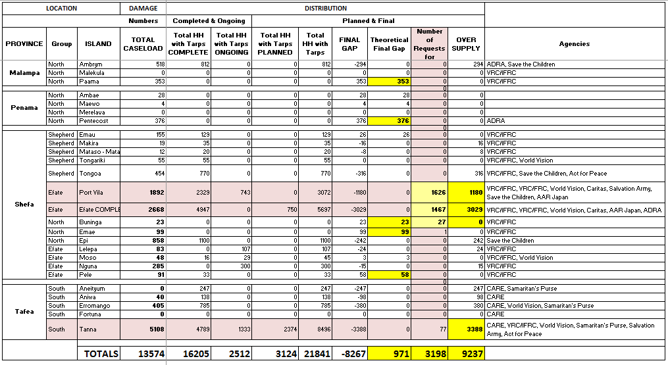
Tarpaulin distribution report

Slide 4
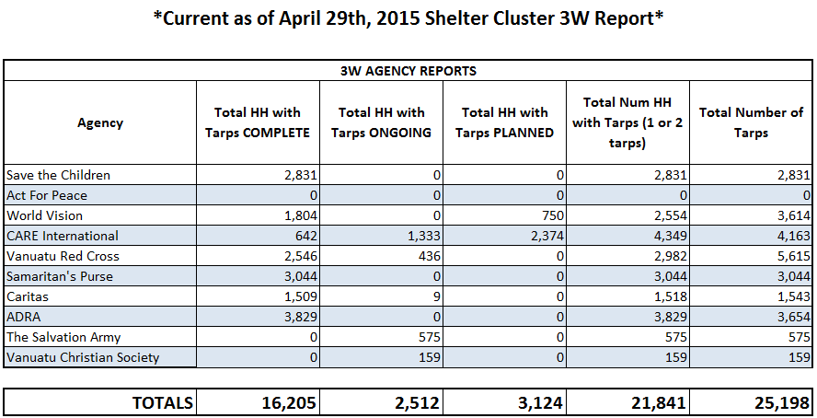
Tarp distribution report

Slide 5
Key message - Requests for shelter assistance are being recorded and analyzed for potential gaps in area coverage.
  Highlighted areas continue to include informal settlements, outer island communities in Efate, and other vulnerable groups such as the disabled.
  Areas with most requests:
  Maps have been created to identify these areas based on shelter assistance requests and will be distributed to all shelter cluster agencies.
  We can also create any maps or infographics for shelter agencies upon request, email me at: im.vanuatu@sheltercluster.org.
Teouma | Erakor
Ohlen | Etas
Blacksands | Manples

Slide 6
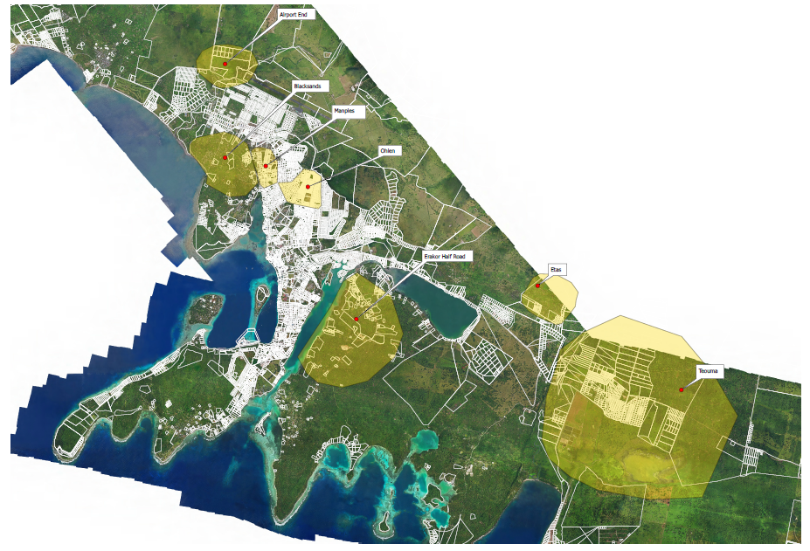
Example of the map of potential gap areas in tarp distributions based on higher numbers of request for shelter assistance. Areas highlighted in yellow below.

Slide 7

Key message - Shelter cluster website has been updated with more shelter resources, information and schedules {click image below for link}.

