Slide 1

Shelter Cluster IM update
May 8th, 2015

Slide 2
Key message - Tarpaulin distributions have reached about 20,000 HH.
  We are seeing the beginning phases of monitoring, shelter repair training and shelter repair kit distribution activities, and working to finalize shelter repair fixing kit standards.
    Keep reporting these new activities in the 3W, with number of targeted HH if possible.
  According to 3W submissions, HH tarpaulin distributions are about 90% complete. There are about 2,331 HH targeted for either ongoing or planned tarpaulin distributions in Port Vila, rural Efate and Tanna.
  We have good agency reporting are reporting every week – Deadline every Monday (please).

Slide 3
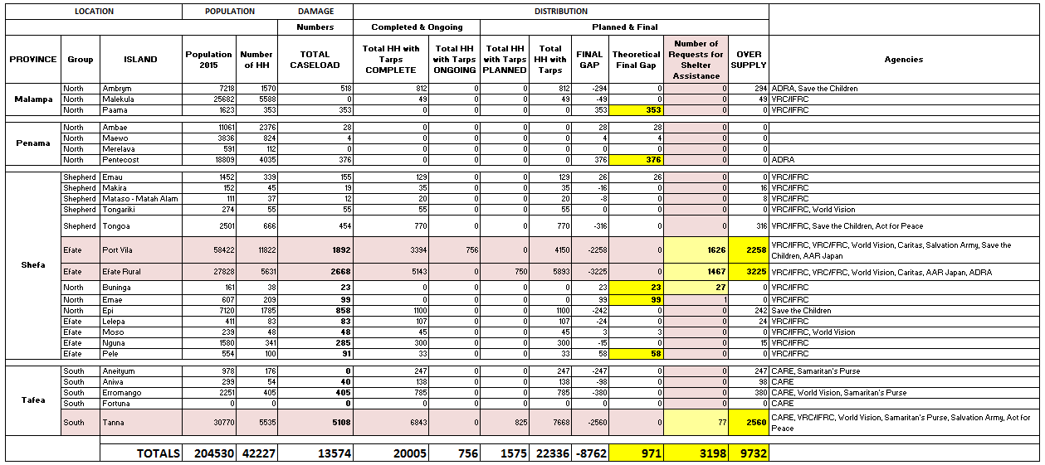
Tarpaulin distribution report

Slide 4
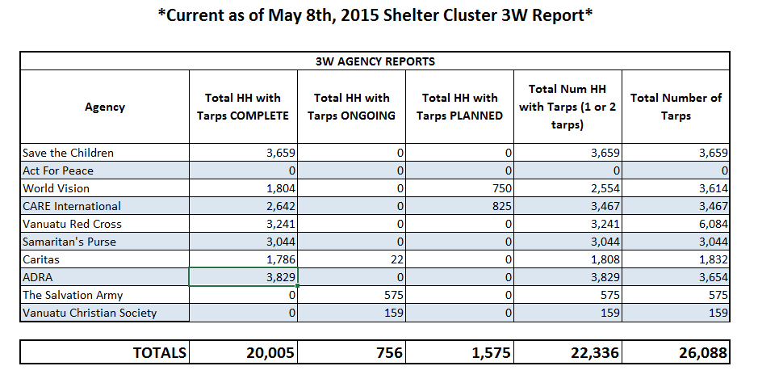
Tarp distribution report

Slide 5
Key message - Requests for shelter assistance are being recorded and analyzed for potential gaps in area coverage.
  Highlighted areas continue to include informal settlements, outer island communities in Efate, and other vulnerable groups such as the disabled.
  Tanna identified gaps included boundary areas and lack of local shelter coordination mechanisms.
  Areas with most requests:
  Maps have been created to identify these areas based on shelter assistance requests and will be updated to the website.
  We can also create any maps or infographics for shelter agencies upon request, email me at: im.vanuatu@sheltercluster.org.
Teouma | Erakor
Ohlen | Etas
Blacksands | Manples

Slide 6

Key message - Shelter cluster website has been updated with more shelter resources, information and schedules {click image below for link}.

