Slide 1
Freedonia
Population Affected
Sources: Village communities, UN agencies, NGOs, FRC, UNHCR, CCCM

Slide 2
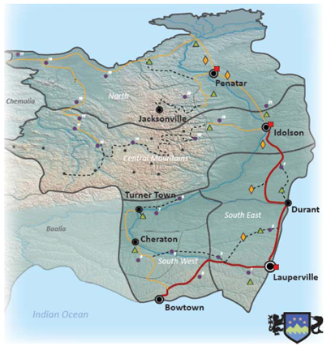
KEY FACTS
9 million
177,086
139,700
5,000
Population
IDP
Refugees
Host Communities

Slide 3
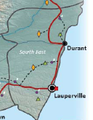
SOUTH EAST REGION
92,000
16,000
3,000
IDP
Refugees
Host Communities

Slide 4
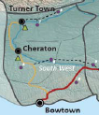
SOUTH WEST REGION
52,200
36,700
IDP
Refugees
Bowtown

Slide 5
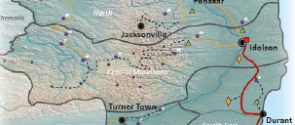
CENTRAL MOUNTAINS REGION
14,186
14,000
IDP
Refugees
Notes:
Mainly mountains,remote area, heavy rainfall results landslides and flooding in the west.
Strongly dominated by the Marlunds. Traditional tribal setting, Tribal leader - Village chief- Council of Elders

Slide 6
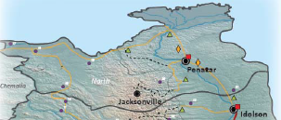
NORTHERN REGION
18,700
73,000
2,000
IDP
Refugees
Host Communities
Notes:
Sariot rebel territory, no strong national government presence. Paramount Chief - District Leader- Village chief- Council of Elders
SPLA Commander-Regional Commanders- Unit commanders

