Slide 1

Non Food Items and Emergemcey Shelter Kits
https://www.sheltercluster.org/response/yemen Twitter: @YEShelterCCCM www.globalcccmcluster.org

Slide 2
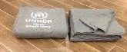

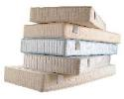

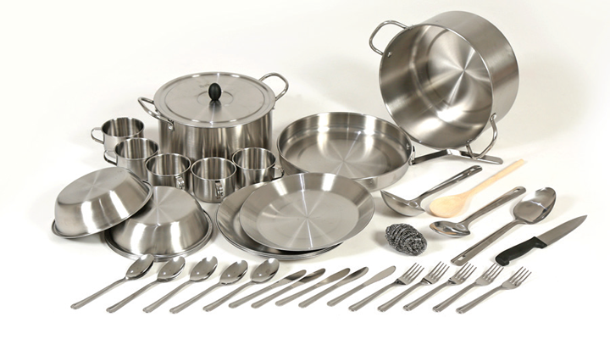

Non Food Items Kit – In-Kind Approach
Item Name | Picture | Quantity
Item Name | Picture | Quantity
Blankets |  | 7
Mattresses |  | 7
Kitchen Set |  | 1
Bucket |  | 2
Sleeping Mats |  | 2
Non Food Items Kit – Cash Approach
Cash |  | $204

Slide 3
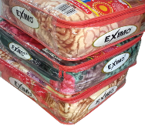
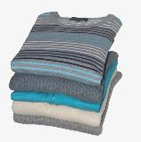
Winter Non Food Items Kit – In-Kind Approach
Item Name | Picture | Quantity
Winter Blankets |  | 7
Clothes |  | 7
Winter Non Food Items Kit– Cash Approach
Cash |  | $265

Slide 4
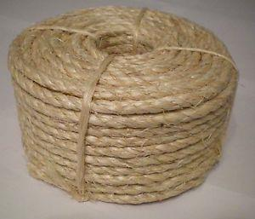


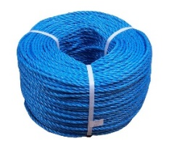


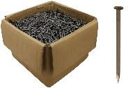
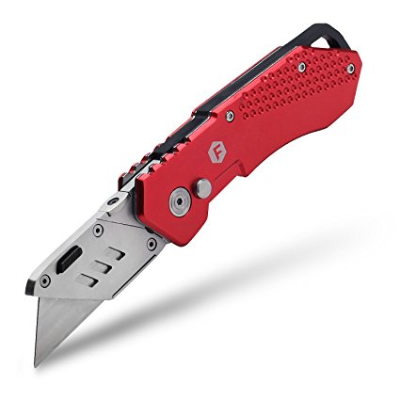
Enhanced Emergency Shelter kit (EESK) – In-Kind Approach
Item Name | Picture | Quantity
Item Name | Picture | Quantity
Saw |  | 1
Hammer |  | 1
Pick Axe |  | 1
Sisal Rope |  | 1
Nylon Rope |  | 1
Plastic Sheets |  | 6
Nails Box |  | 1
Utility Knife |  | 1

Slide 5

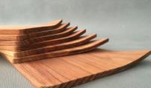
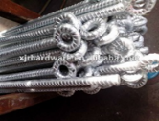
Enhanced Emergency Shelter kit (EESK) – In-Kind Approach
Item Name | Picture | Quantity
Wooden Poles |  | 8
Wooden Plates |  | 7
Metal Pegs |  | 10
Enhanced Emergency Shelter kit (EESK) – Cash Approach
Cash |  | $268

