Slide 1


Tent replacement in camps during COVID-19
(To be disseminated before replacement activities)
Valid for contractors and beneficiary-driven replacement of tents
Version 1.1
9 August 2020

Slide 2
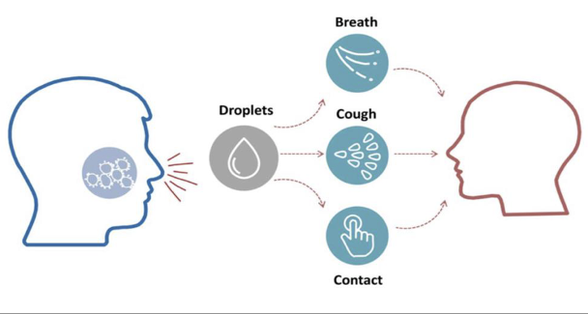
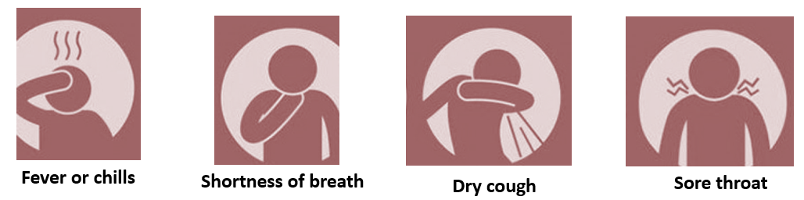
The COVID-19 disease is an infectious disease caused by a virus called SARS CoV-2 (severe acute respiratory syndrome)
Most people recover from the disease
Anyone could catch COVID-19 virus – irrespective of age, gender, sexual orientation, religious, tribal or other affiliations. Hence, it is important to prevent discrimination, stigma, anxiety
Most common symptoms

Slide 3

If you have any symptom, seek immediate advice from the health clinic in camp.
If you notice anyone with these symptoms, suggest him/her to go to the health clinic in camp
Emergency hotline numbers:
122 or 123
or call the Iraqi Information Center at: 800-69999

Slide 4
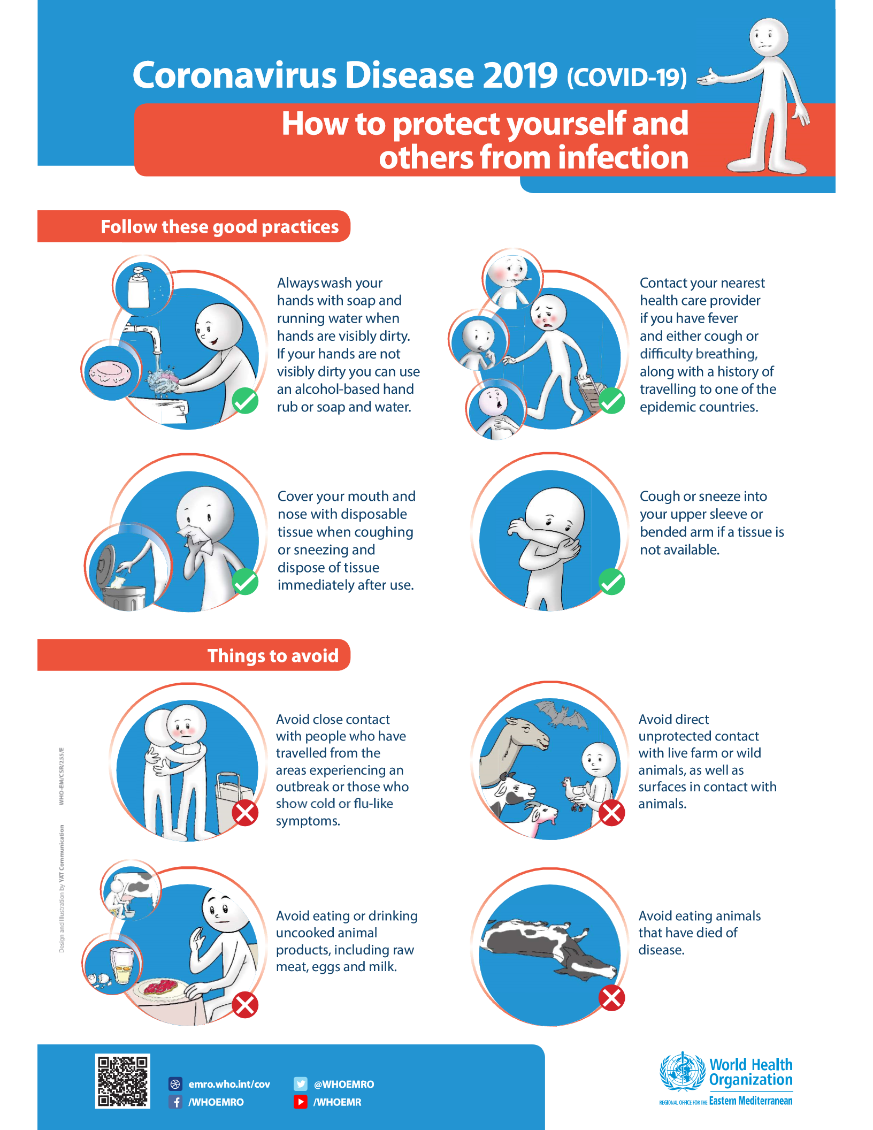

Slide 6

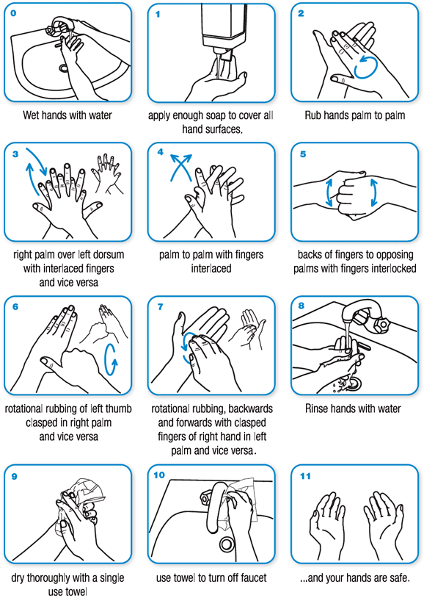

Slide 7
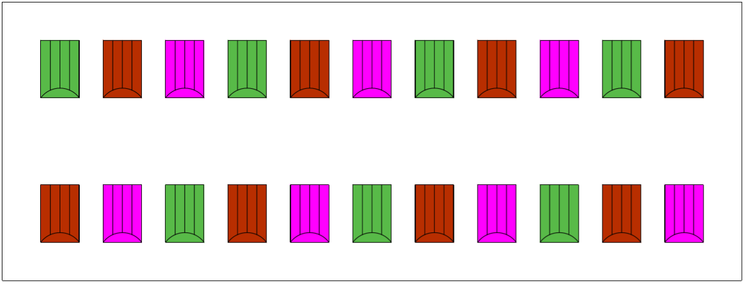
Decide on a replacement plan that:
Reduces the risk of COVID-19 contagion
Prevents crowding of workers and beneficiaries (e.g. every 3rd tent)
Facilitates good working conditions
Can be easily supervised
Sample replacement plan
BEFORE TENT REPLACEMENT
Day 1: replace brown tents Day 2: replace green tents
Day 3: replace pink tents Continue until finished

Slide 8
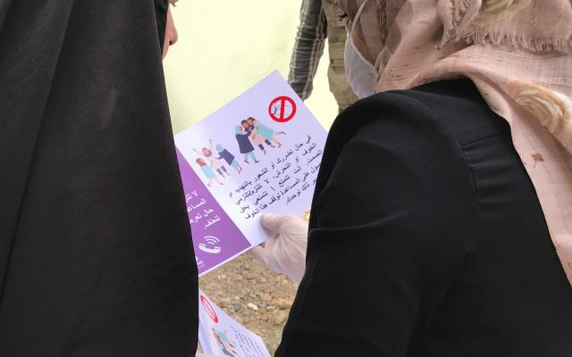
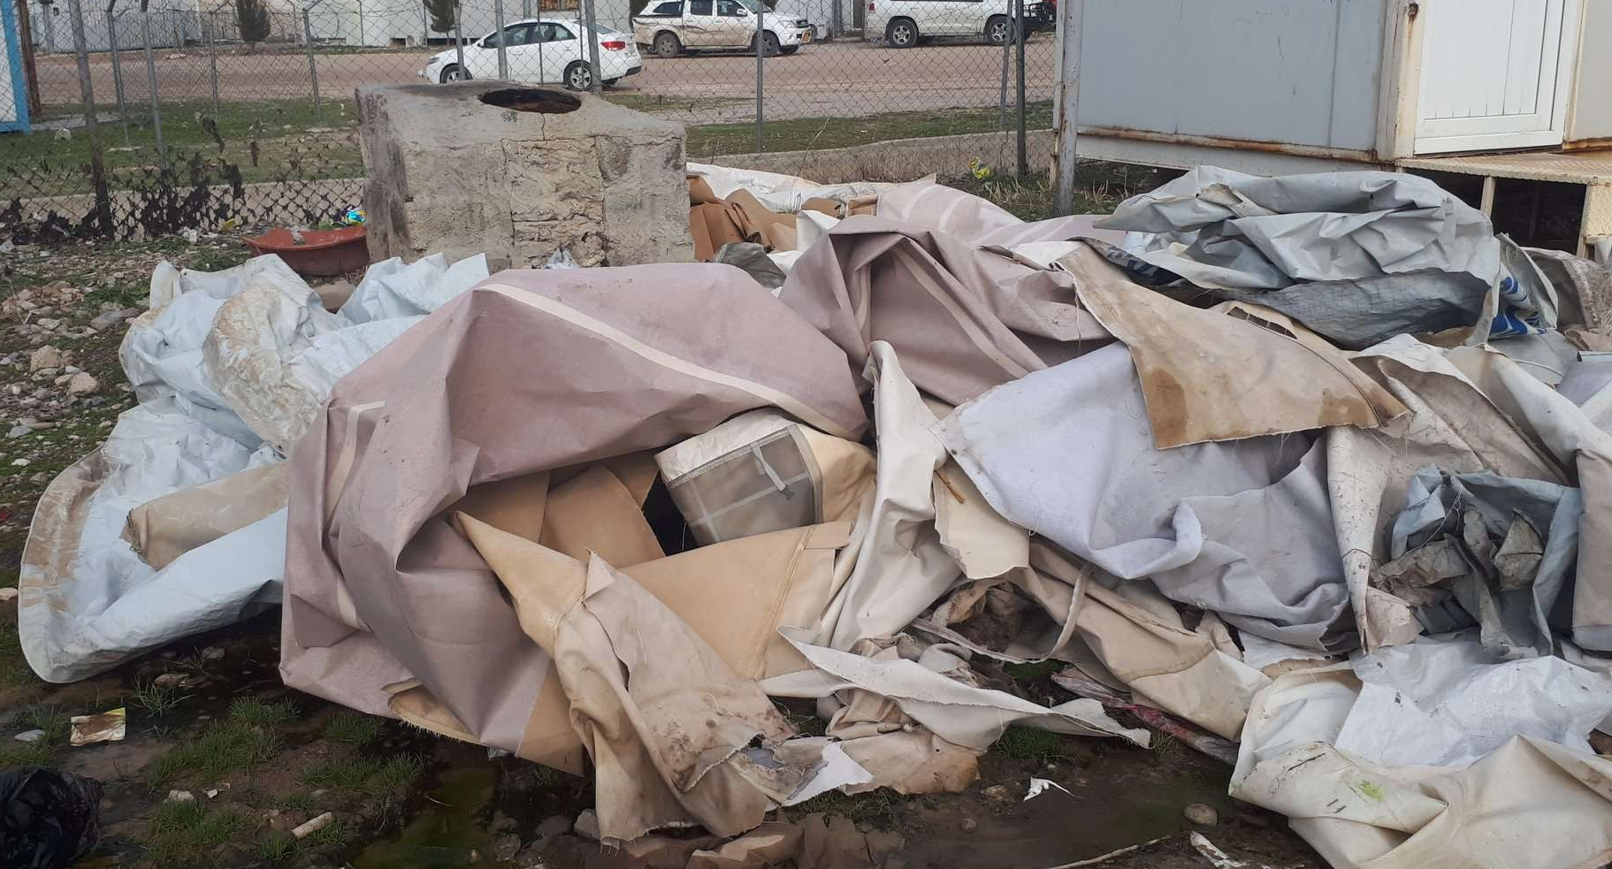
Shelter interventions should:
Provide needed assistance in a timely manner while respecting protective measures
Be designed to prevent panic, anxiety, discrimination or stigma
Reduce the risk of COVID-19 contagion
Follow Do No Harm principles
Be in line with health authorities’ guidance
Be closely coordinated with Camp Management
Respect environmental standards and laws
Old tents should be safely removed and disposed of.
Inform beneficiaries about the intervention:
What will they receive and how? (contractor or beneficiary-driven)
When? (day and time of replacement)
How to prepare? (e.g. remove extensions, empty tents of belongings etc.)
BEFORE TENT REPLACEMENT

Slide 9
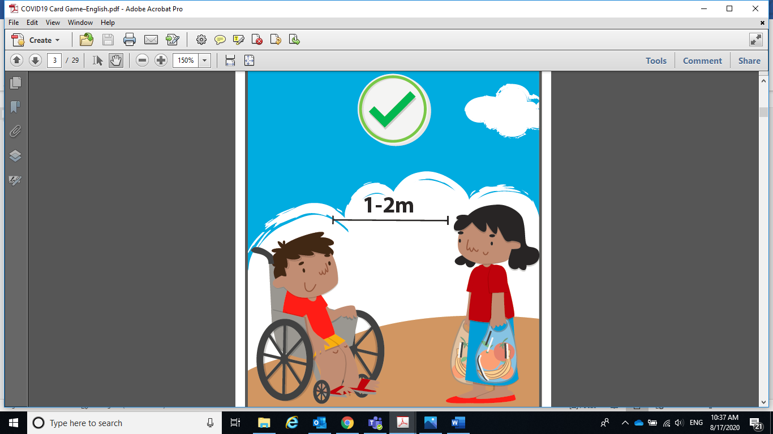
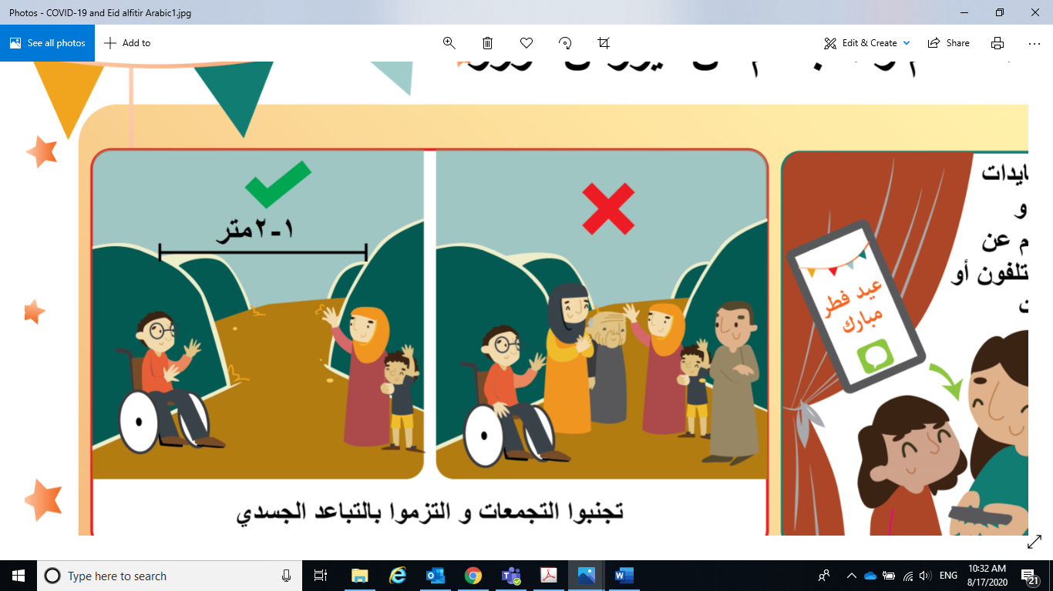
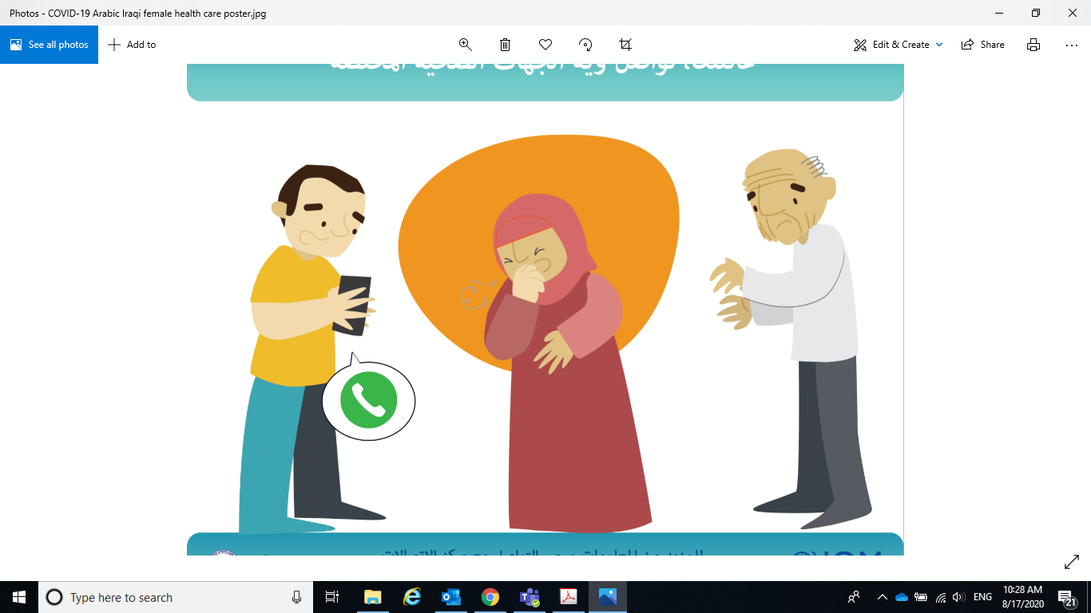
For everyone - under ALL circumstances
Health status confirmation: before commencing any work, self-certify to designated CM staff that everyone is healthy and has no flu-like symptoms OR get checked by the health staff in camp.
Solid waste management: Do not leave any garbage on site (especially used PPE)
Maintain social distancing
Avoid gathering of
large crowds
crowds
Alert health partner of any symptoms
DURING TENT REPLACEMENT

Slide 10
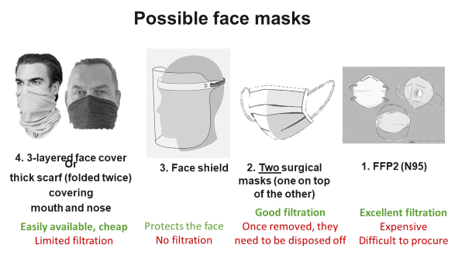
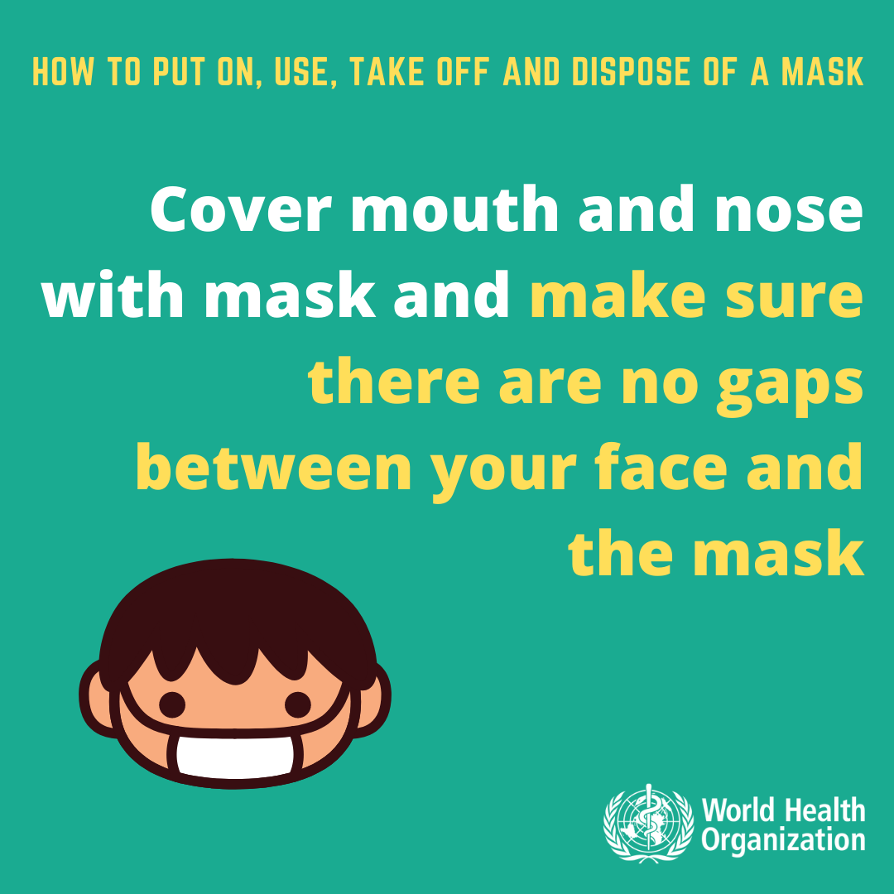
For everyone - under ALL circumstances
DURING TENT REPLACEMENT

Slide 11
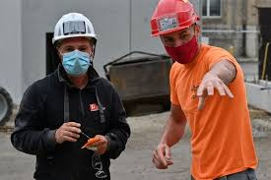

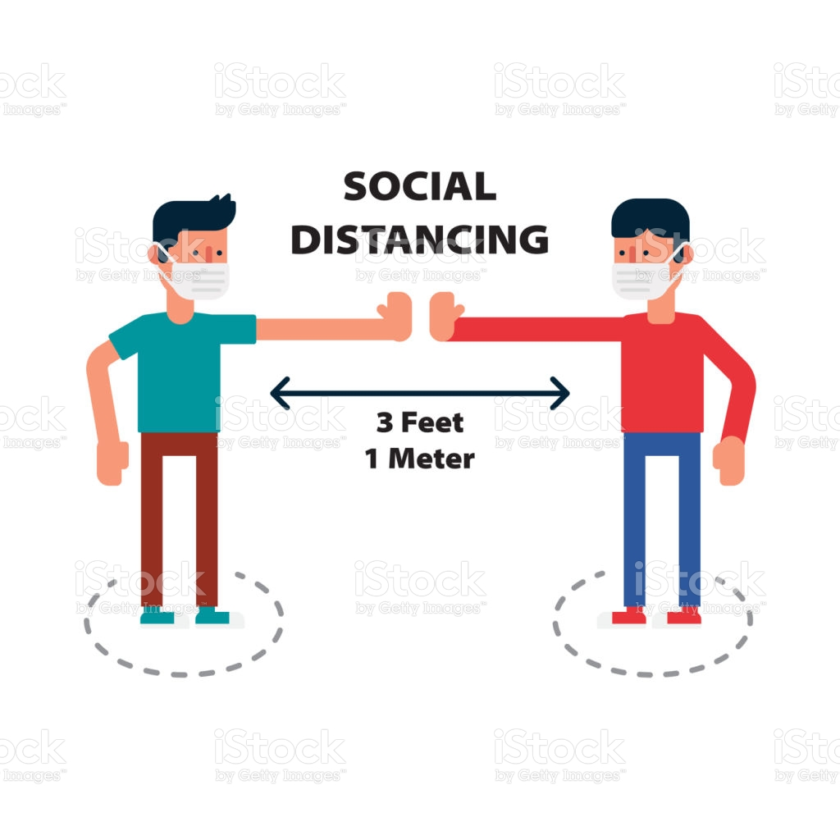
Contractors/workers
Access: Self-certify to designated CM staff that they are healthy and have no flu-like symptoms or get checked by health staff in camp.
Bathroom facilities: In case there is NO toilet available for the exclusive use of workers, each worker must clean all the surfaces, after each use
Solid waste management: Do not leave any garbage on site (especially used PPE)
Wear Personal Protective Equipment (PPE)
Regularly disinfect shared tools
Avoid contact with beneficiaries/staff
DURING TENT REPLACEMENT

Slide 12
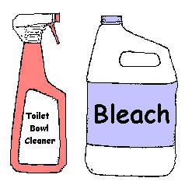
Beneficiary-driven replacement
Beneficiaries should replace their tent at the day and time communicated by CM
High-risk groups: In case there is a family member with chronic illness (e.g. cardiovascular diseases, diabetes, lung disorders, cancers, etc.), let them stay with family and friends in another shelter.
Solid waste management: Do not leave any garbage and belongings outside of the tent
Clean first and then disinfect your belongings
Maintain social distancing
DURING TENT REPLACEMENT

Slide 13
How to prepare 0.1% chlorine solution diluted into water
Chlorine concentrations in commercially available products (domestic bleach) vary between 4% and 6%.
To know the parts of chlorine-based product to mix into water to reach the desired concentration, the calculation is the following:
[% chlorine in liquid sodium hypochlorite ∕ % chlorine desired] − 1 =
Total parts of water for each part sodium hypochlorite.
For 0.1% chlorine-diluted solution, 49 parts of water need to be mixed for each part of sodium hypochlorite (or almost 100 parts of water to each 2 parts of 5% concentrated bleach)
https://apps.who.int/iris/bitstream/handle/10665/332096/WHO-2019-nCoV-Disinfection-2020.1-eng.pdf?sequence=1&isAllowed=y (English)
https://apps.who.int/iris/bitstream/handle/10665/332096/WHO-2019-nCoV-Disinfection-2020.1-ara.pdf?sequence=12&isAllowed=y (Arabic)

Slide 14

Information to beneficiaries
Beneficiaries have the right and access to complaint mechanisms to report any problems linked to the intervention.
Call the Iraqi Information Center, the complaint mechanism provided by the humanitarian partner or inform Camp Management.

