Slide 1
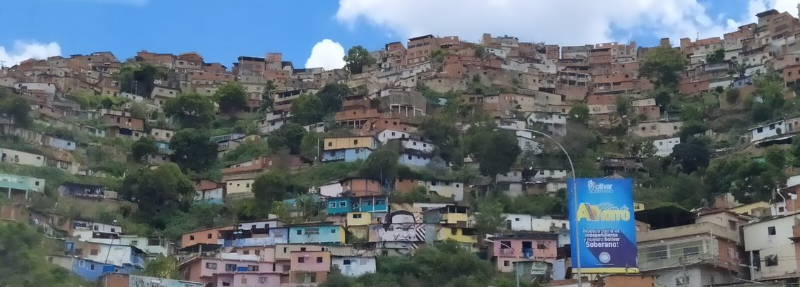
Global Shelter Cluster Meeting 2021: Thematic Session 4 – 15 June 2021
Angel Pascual – UNHCR – July 2019
Multisectoral Impact of Shelter –
How to Make the Most of It

Slide 2
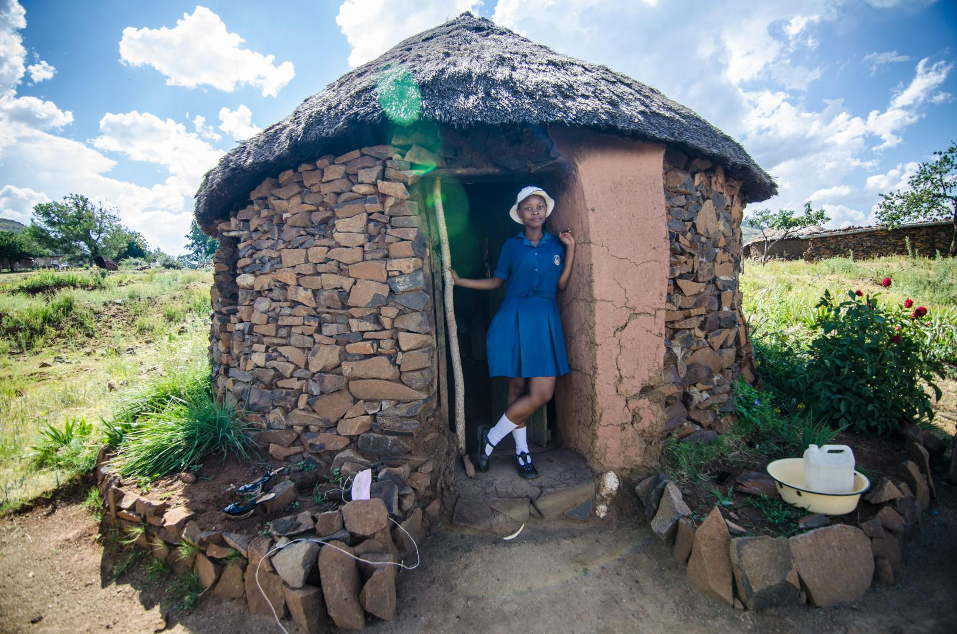
WELCOME AGENDA & INTRODUCTION
Welcome and Introduction
Menti Survey
Brief presentation
Breakout Rooms Discussions
Plenary Discussion
Conclusions and final remarks
Karabo Ntisane, 18, stands in front of her home in Mafateng district, Lesotho. After her father passed away at a very young age and her mother left to find work, Karabo has had to become a parent to her two sisters too young.
Photo: Lesotho Red Cross

Slide 3


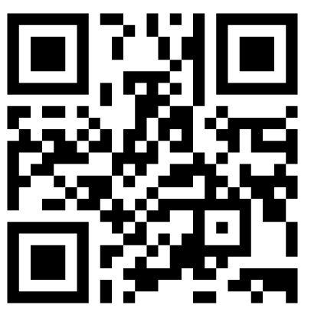
MENTIMETER QUESTIONNAIRE
Scan here to access the menti on your phone
https://www.menti.com/bxg1cjt5hv
Who do you work for?
What is your main field of work?
What kind of setting are you working in?
To whom we should advocate about the wider impacts of S&S?
How do we better integrate our external assistance into local response efforts?
What does shelter mean for you?
Join Menti via internet browser through the link provided in the Teams chat or through mobile phone by scanning the QR Code above or go to www.menti.com and use code 3548 8596

Slide 4

Thematic Session 4
Multisectoral Impact of Shelter
Global Shelter Cluster Meeting 2021

Slide 5












Afford necessities

Slide 6


Slide 7
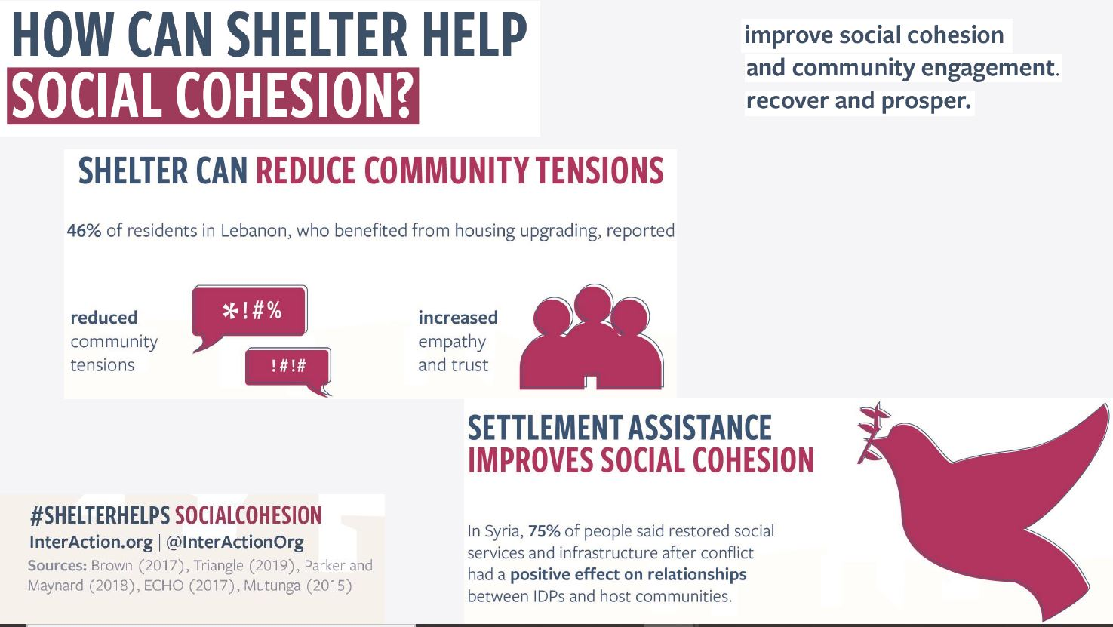

Slide 8
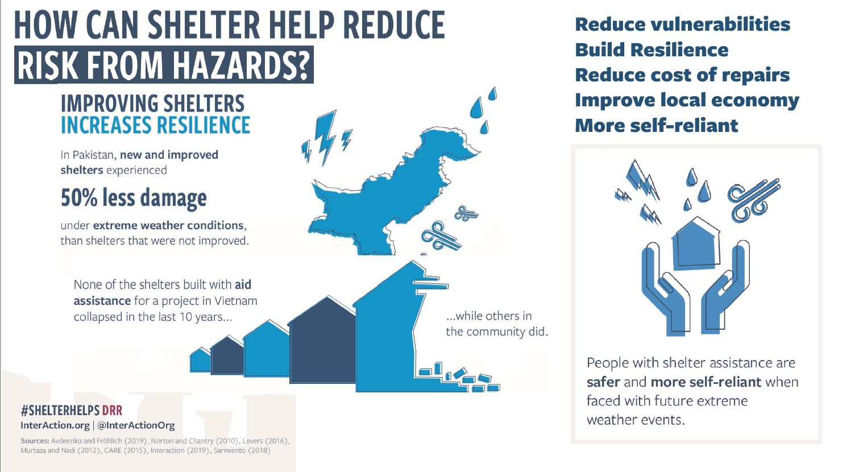

Slide 9


Slide 10
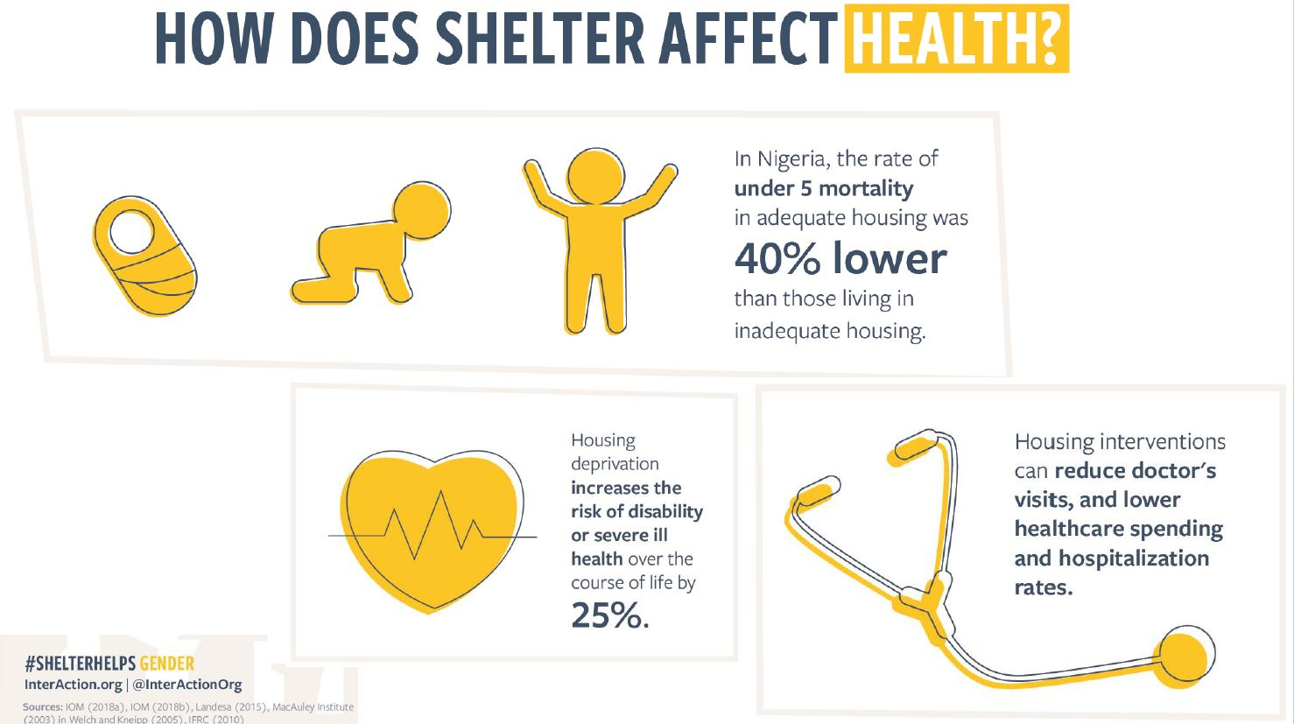

Slide 11
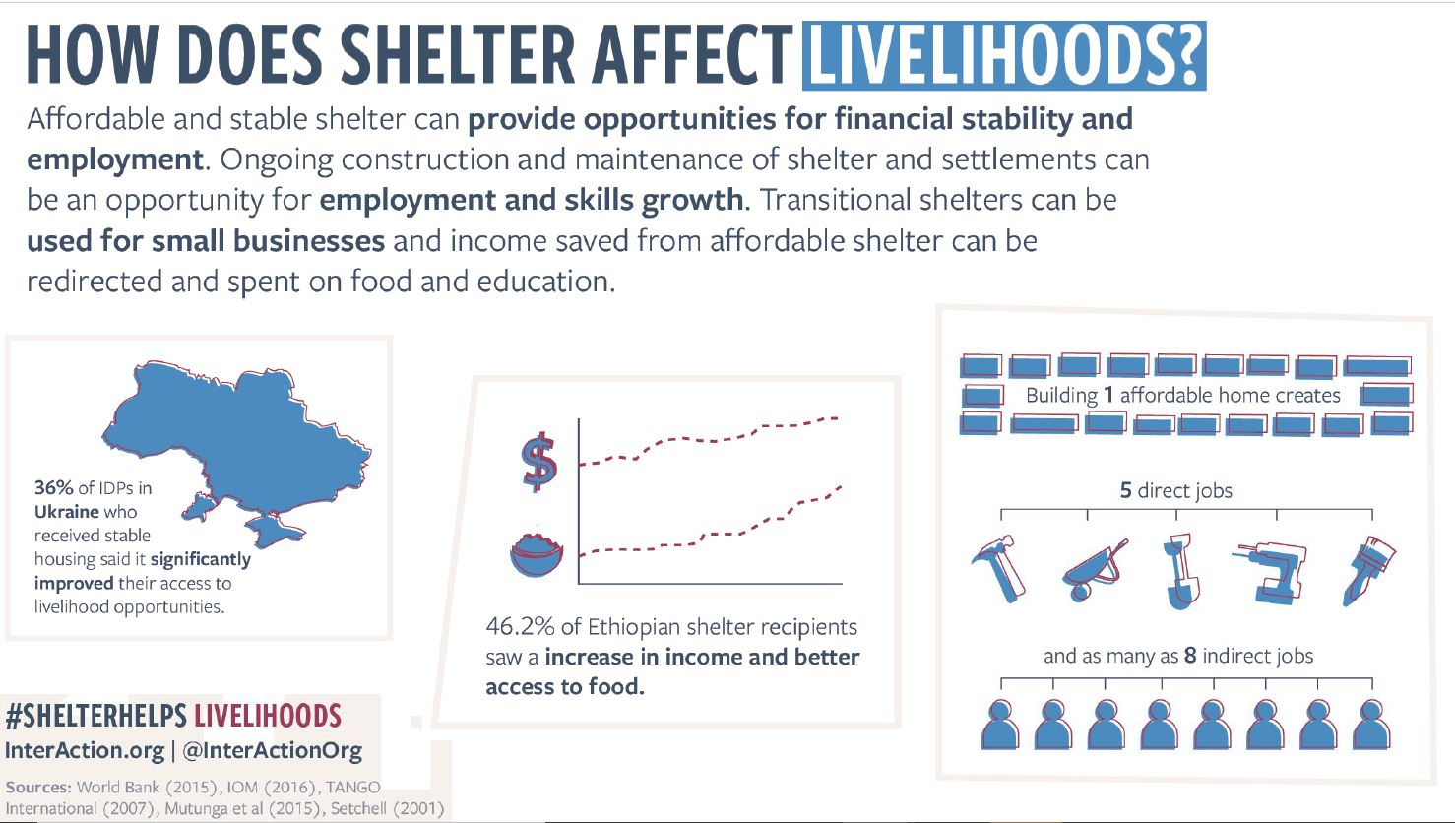

Slide 12


Slide 13
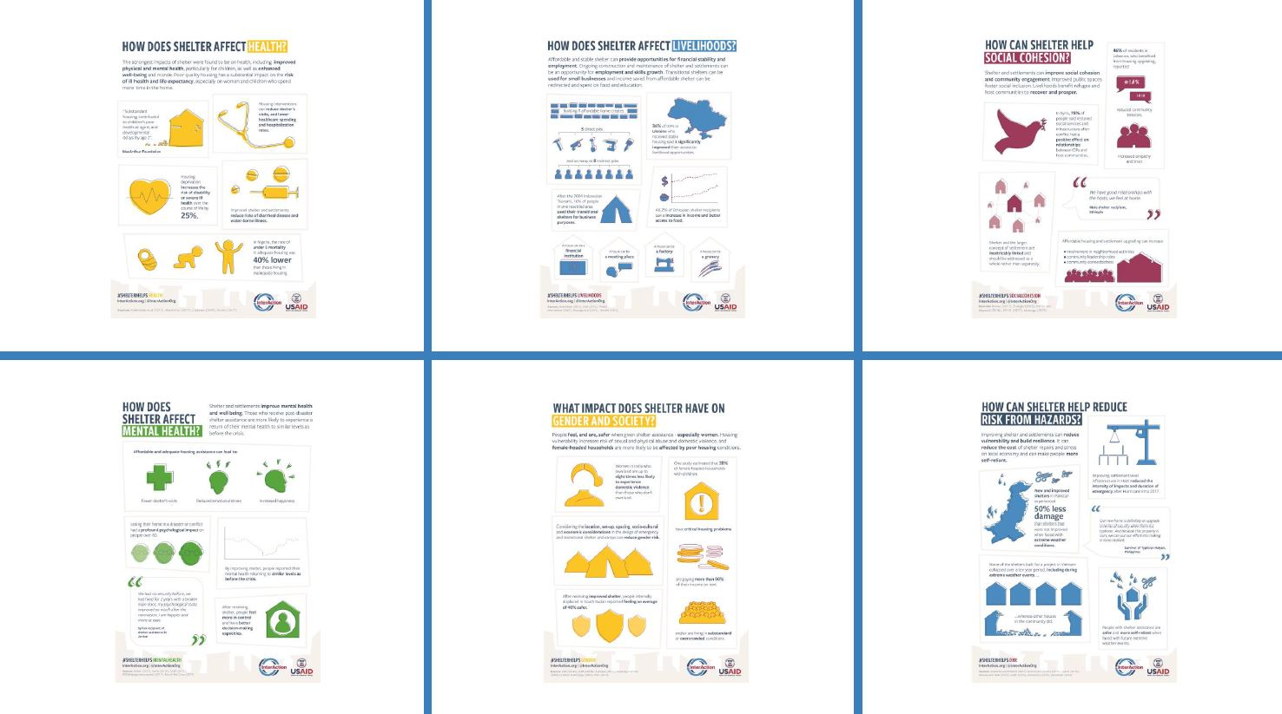

Slide 14
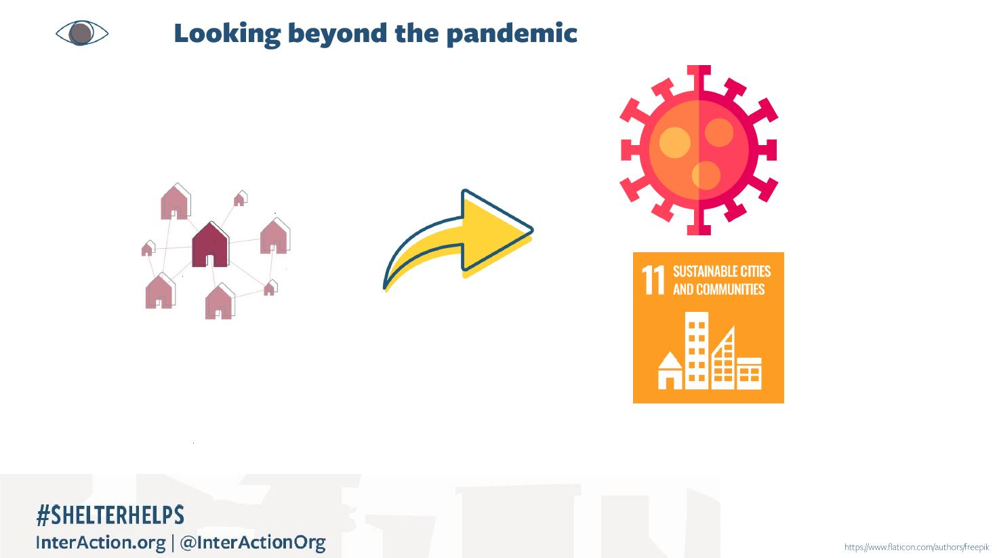

Slide 15


Slide 16
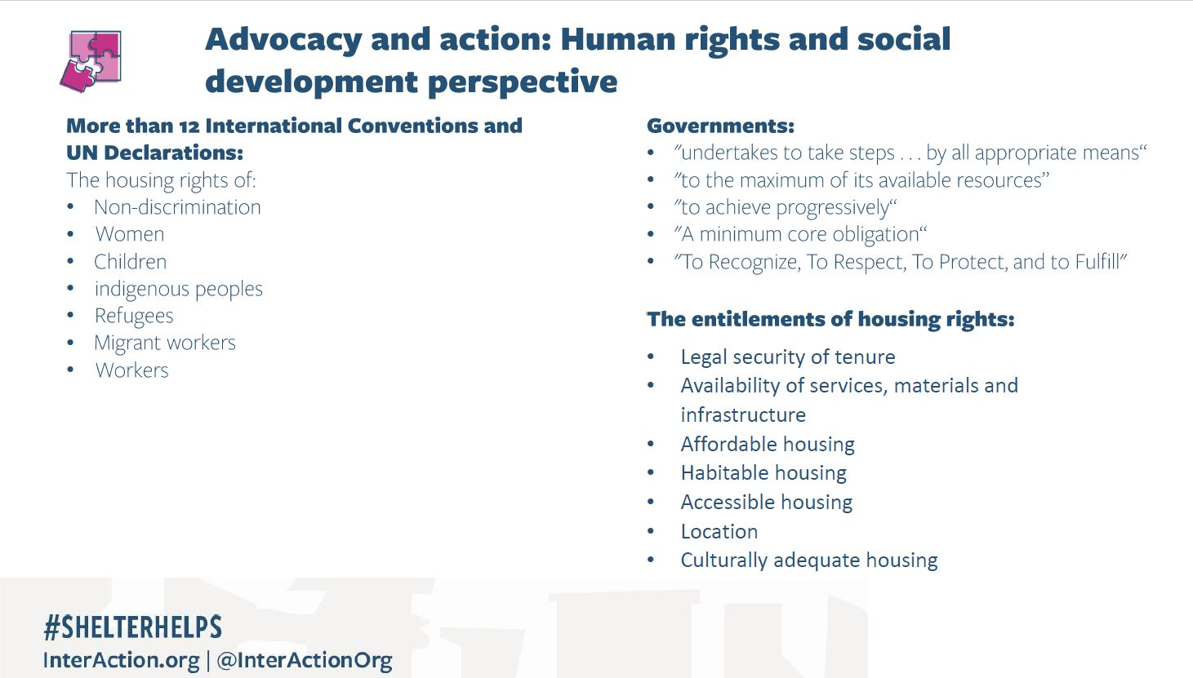

Slide 17
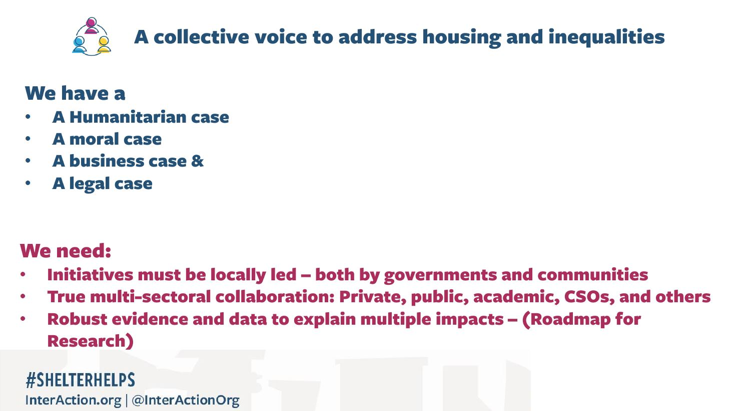

Slide 18

BREAKOUT ROOMS SESSION
Breakout Room 1
Evidence, Research and Advocacy
Facilitated by Lizzie, Laura and Kimja
Breakout Room 2
Protection & Shelter
Facilitated by Yasmine and Fiona
Breakout Room 3
Locally Led Multisectoral Response
Facilitated by Hilmi, Iru and Andrea

Slide 19



FEEDBACK TO PLENARY

Slide 20
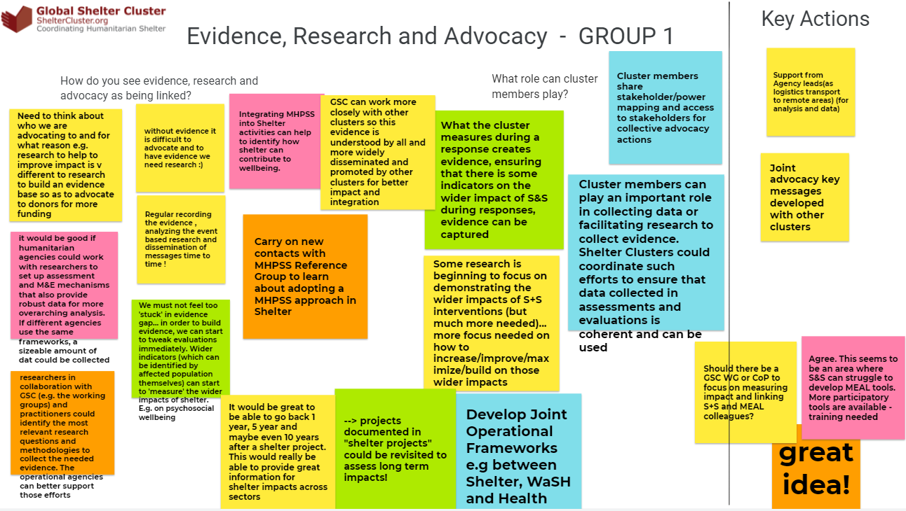
FEEDBACK TO PLENARY BR1

Slide 21
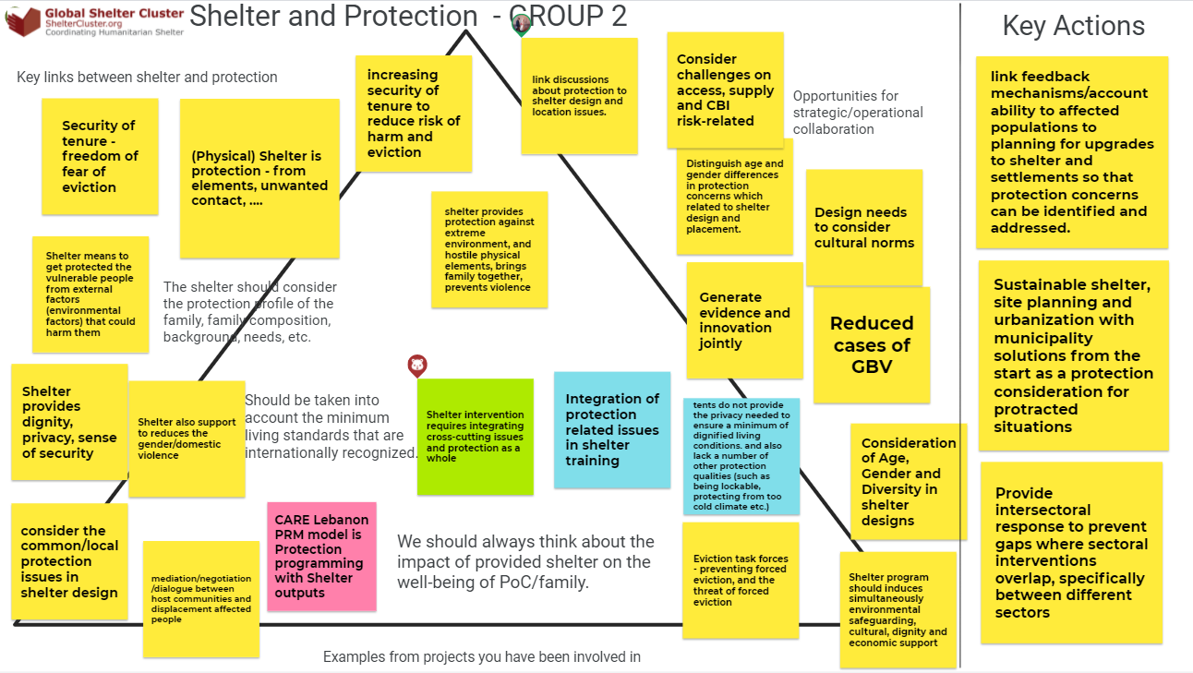
FEEDBACK TO PLENARY

Slide 22
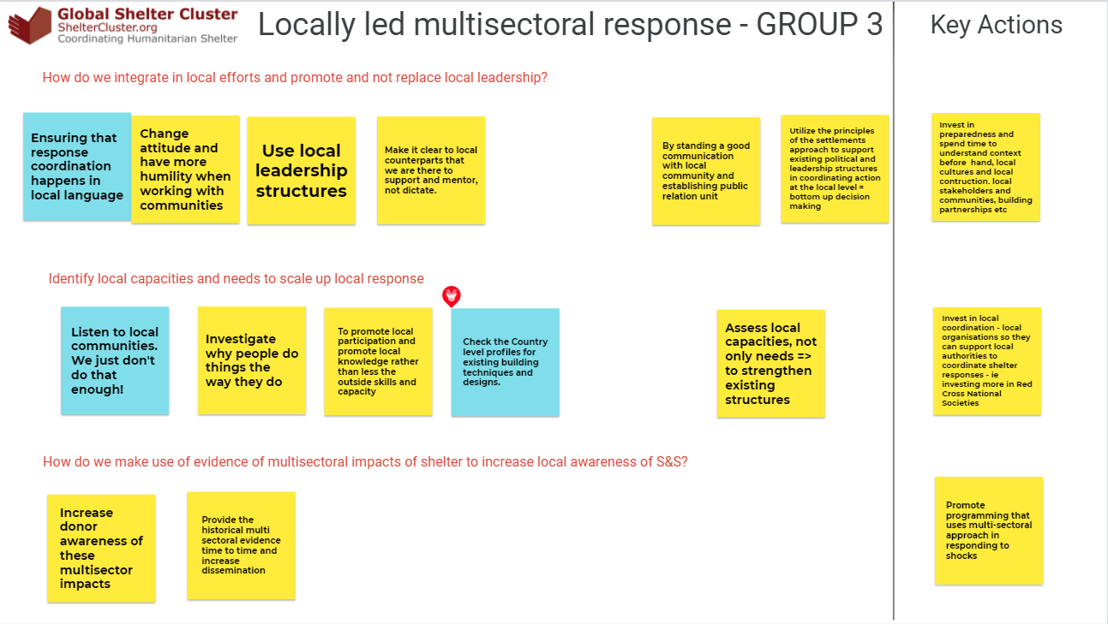

Slide 23

PLENARY EXCHANGE / Q&A

Slide 24



Closing Remarks
Final Remarks

Slide 25
THANK YOU FOR YOUR PARTICIPATION!
NEXT THEMATIC SESSION 5:
Coordination at Country Level -
Ready for the Future?
TOMORROW WEDNESDAY 16 JUNE 2021
@ 14:00 CEST

