Slide 1
Overview of Shelter and Health Learning Day
Key takeaways
Mental health
Moving forward
Disability Inclusion Working Group
2nd September 2020

Slide 2
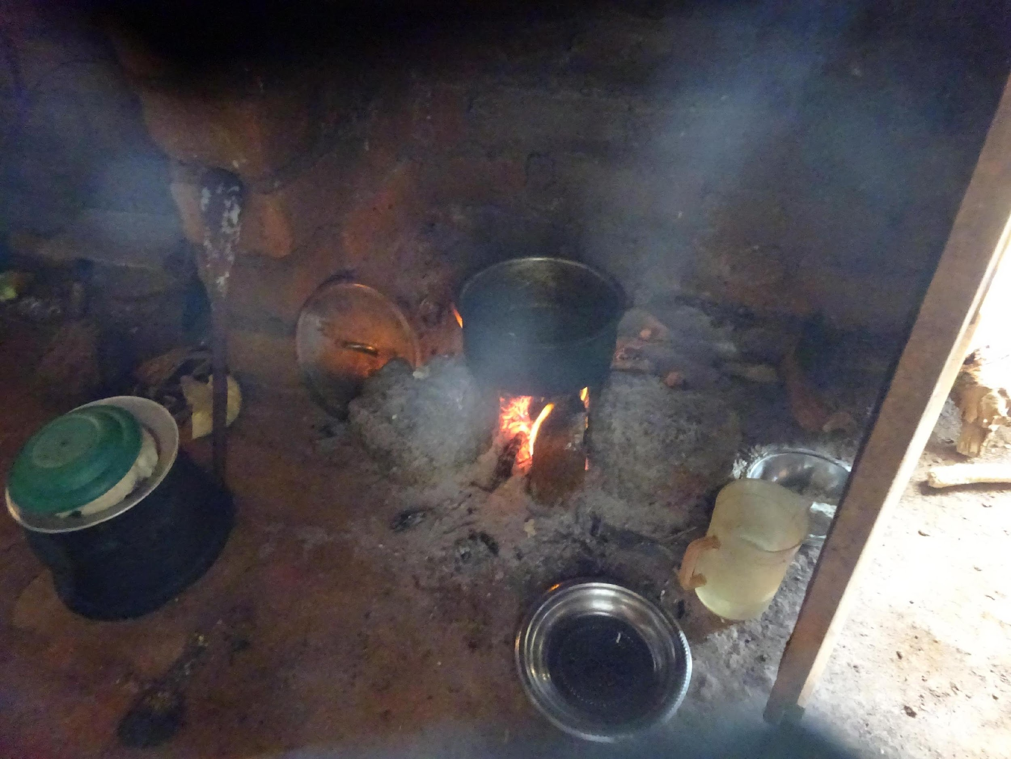
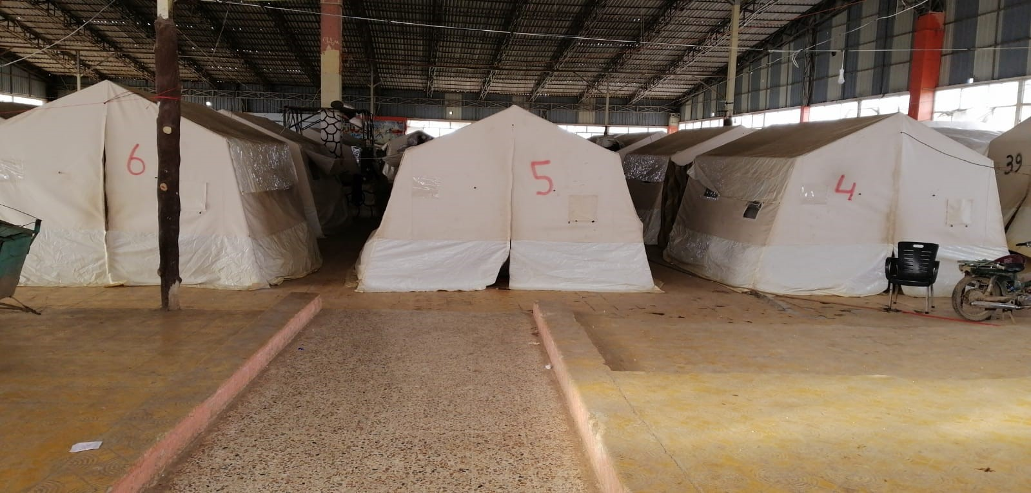
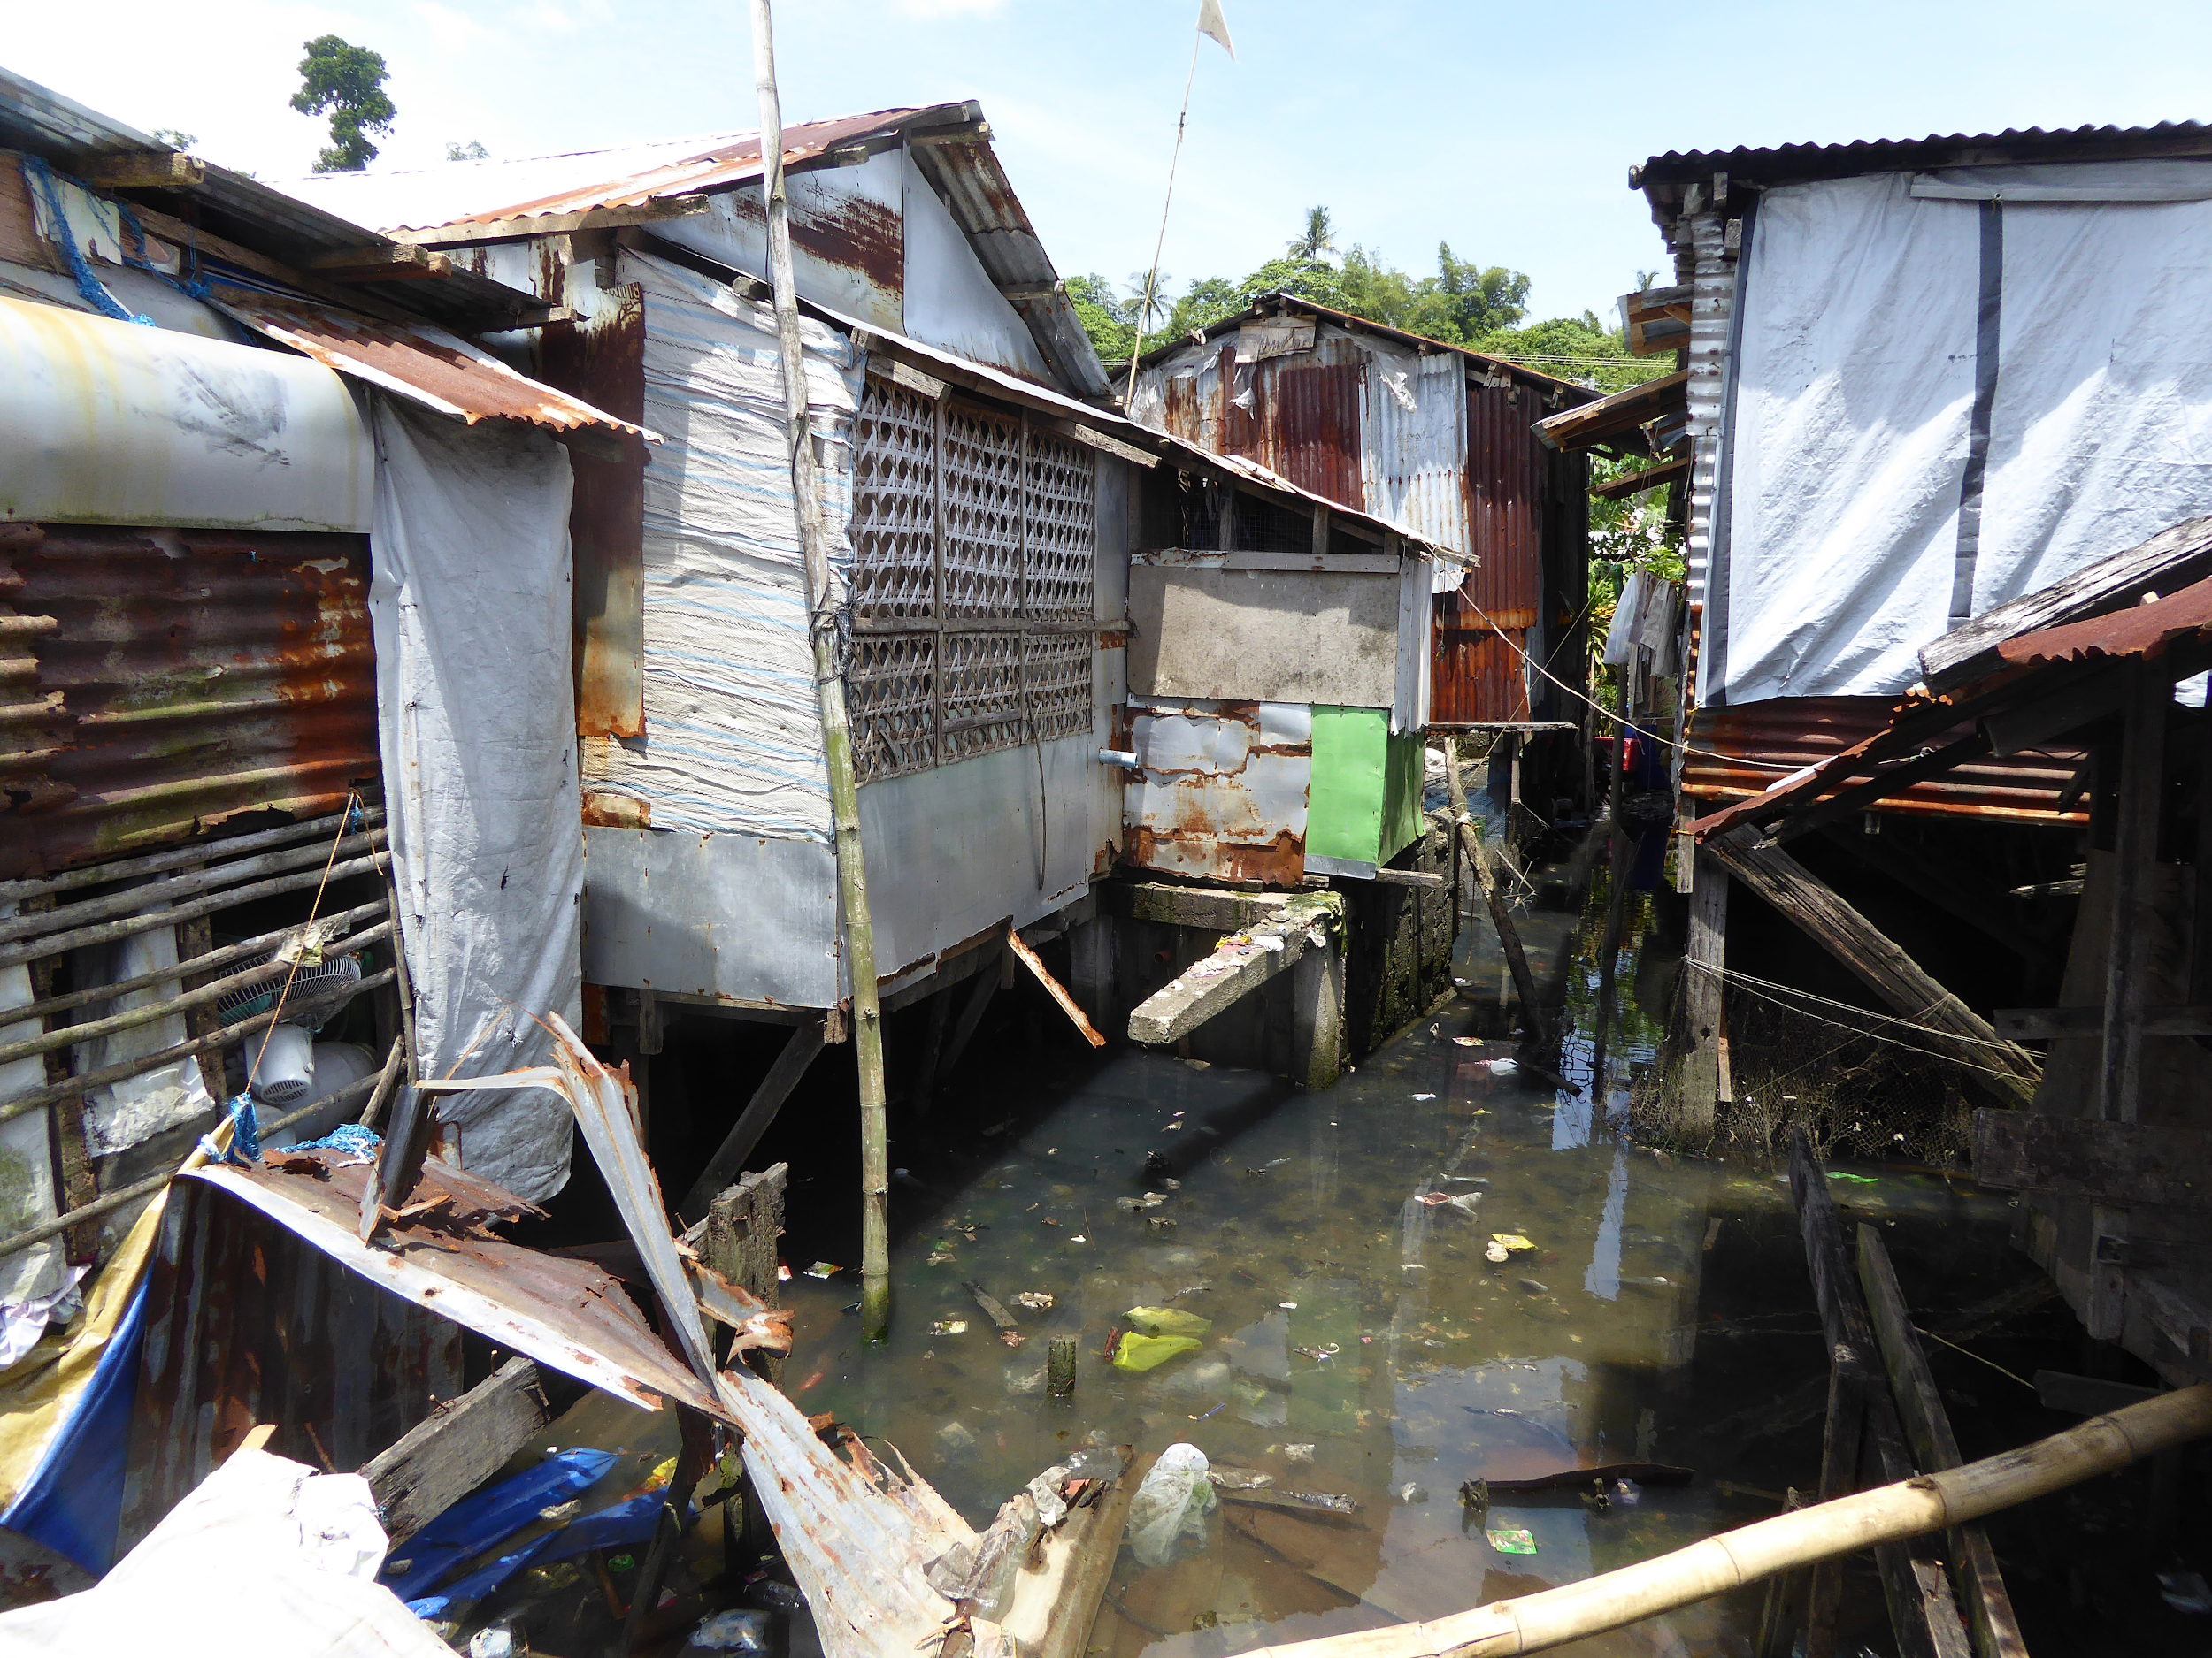
Notes:
There are so many ways that housing and indeed humanitarian shelter affect people’s health. Here are just some examples:
• indoor air pollution, linked to cooking and heating fuel, chimneys and ventilation, increases rates of respiratory infections like pneumonia
• Dirty water, inadequate sanitation cause diarrhoeal and other infections
• Overcrowding, noise and extreme temperatures are linked to mental health conditions and cardiovascular disease.
• Other issues such as damp, poor mud floors, lack of protection from vectors of disease such as rats and mosquitoes are more examples.

Slide 3
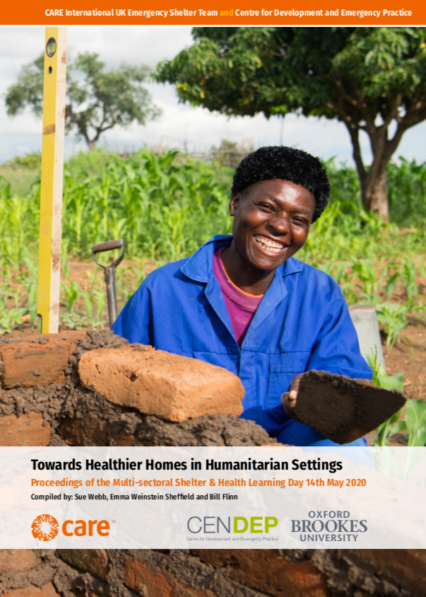
Shelter and Health Multi-sectoral Learning Day 14th May 2020
Learning Day in brief
20 presentations and 8 breakout groups
Representatives from Health, WaSH, Shelter
Report’s main findings in three categories
Shelter realities and practice
Research and evidence-building
Advocacy and policy
Recommendations and research gaps
Inter-cluster / inter-agency Environmental Health WG
Work on integrating health into assessments...evaluations
Generating evidence on impacts
Collaboration with development and health actors
Notes:
We organised the Shelter and Health multi-sectoral Learning Day in May. I know many of you attended, so I won’t dwell on it. The key idea was that the day involved both development and humanitarian actors. Both academics and practitioners. People with Shelter, Health and WaSH expertise. Groups that don’t normally meet!
There were 20 presentations with opportunities for further discussion in breakout groups. Not enough time for discussion, but happily there have been many follow-up conversations and there are many more to come. One important point to make though is that we are aware that one group was missing from the conversation, as so often, the affected populations – the ‘home-makers’ themselves.
Following the presentations and the surrounding discussion plus feedback forms, we divided the main findings from the day into three themes - Shelter realities and practice, Research and evidence-building, Advocacy and policy. You can read the detail in the report. We also really want to draw your attention to the recommendations. Link to the report here
https://insights.careinternational.org.uk/publications/towards-healthier-homes-in-humanitarian-settings

Slide 4
People living with some disabilities are possibly more home-based = higher risk of shelter related health conditions
Different types of disabilities
Mental health - key area of interest but lack of understanding
Need for better evidence
Key ‘takeaways’ relevant to DIWG
Notes:
People living with some disabilities (especially physical disabilities?) are possibly more home-based, so more exposed to poor air quality, damp, cold/excess heat…
Housing improvements that address these issues could be beneficial to disadvantaged groups in multiple ways
Of course there are so many different types of disabilities – the focus is often on physical and visible disabilities e.g. mobility issues of the elderly. Mental health issues are less visible and have often been ignored/excluded – often due to simple ignorance of the issues.
As so often seems to the case, a barrier to improved programming is a lack of good quality evidence of the impacts of interventions (or the lack of them). InterAction’s ‘Wider Impacts’ publication, authored by Fiona Kelling earlier this year, which emphasised the current lack of good quality evidence of the impacts of S&S assistance on health.
https://www.interaction.org/wp-content/uploads/2020/03/1.-Wider-Impacts-of-Shelter-Key-Findings_Final1.pdf
Fiona spoke also at the Learning Day a summary of her presentation is also in the Report. She spoke about data and the need for humanitarian Shelter practitioners to be very clear about what data they need, why they need it and how they are going to get and use it.

Slide 5
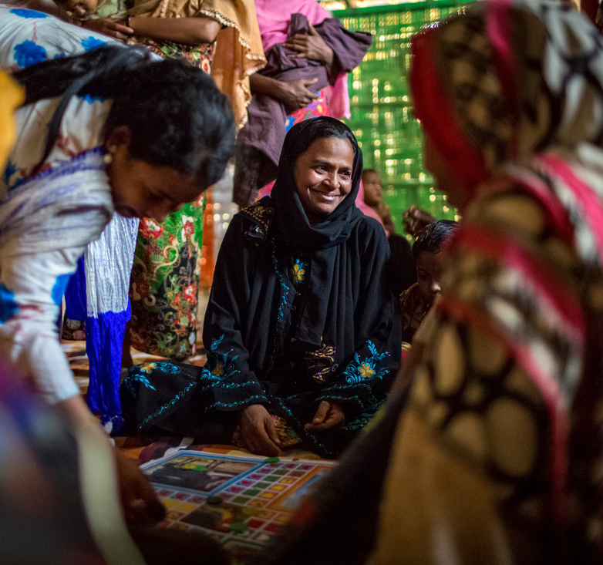
Mental Health and Psychosocial Support
Representatives from CRS, IOM, Miyamoto and academia (McGill/Imperial)
Notes:
Moving to focus briefly on Mental Health and Psychosocial Support – this topic was addressed during one of the panels on the Learning Day, convened by Beth Simons and Jamie Richardson. Practitioners from IOM, CRS spoke, as well as researchers from Miyamoto and Jill from McGill University who spoke of her research into tenure security and mental health. Again, you can read the summaries of their presentations in the Report.

Slide 6
Impact of trauma/displacement on existing MH conditions
Does the impact of trauma/displacement cause new MH conditions?
Can humanitarian responses cause/exacerbate MH conditions?
Interaction of programming and mental health
Tenure insecurity
Lack of livelihood
Displacement
Examples
Notes:
There are perhaps 3 main areas of interest for programming to be aware of:
What impact trauma/displacement have on existing MH conditions
The question of how trauma/displacement cause new MH conditions -and for how long might these persist?
· Also the question of whether humanitarian responses can cause or exacerbate MH conditions?
Specific examples of issues that can create mental ill-health include tenure insecurity, loss of livelihoods and the whole process of displacement itself.
“...people with mental health conditions are more likely to be in vulnerable situations that worsen the social, emotional, physical and economic impacts of the pandemic, and all too often are “left behind” in emergency response as well as ongoing development efforts.”

Slide 7
Can rebuilding (with appropriate support) be therapeutic... evidence for this?
Need for common language around mental health.
Questions and Knowledge gaps
Notes:
Again, there are many questions and knowledge gaps
Although there is some anecdotal evidence that rebuilding can be therapeutic, these is a lack of solid evidence for this.
One of the recommendations from Learning Day was the need for common language around mental health...the new Mental Health Topic Guide might be useful. DFID’s Theory of Change and Position Paper on mental health and psychosocial disabilities, as well as a new K4D-DFID Topic Guide on mental health for development professionals. https://www.mhinnovation.net/mental-health-and-international-development-launch-dfid%E2%80%99s-position-paper-and-voices-field
https://opendocs.ids.ac.uk/opendocs/bitstream/handle/20.500.12413/14908/K4D_MentalHealthTopicGuide_Online.pdf?sequence=2&isAllowed=y
P30 “ Protection issues in humanitarian emergencies – for example, unsafe shelter – may disproportionately affect people with psychosocial disabilities.”

Slide 8
Current work
Ongoing research with health and shelter experts
  Data and evidence gathering
R4R chapter
Self-recovery research e.g. Malawi
Translating research into practice
Ways forward
Questions for WG members
Case studies: examples of good practice and challenges
Notes:
Finally, so you know what we are continuing to work on – we are continuing to make connections with health experts to tackle the need for evidence-building in humanitarian contexts. We are collaborating with other institutions for a chapter in the upcoming Interaction Roadmap for Research publication on Shelter and Health. The self-recovery project is also including health in its research in, among other places, Malawi. All with a view to TRANSLATE this research into good practice in shelter assistance.
Ways WG can be involved ...we’re here to learn. Any examples/ideas?
What issues are partners facing on a daily basis? Need to understand gaps in ways people are working now…
There’s a push to capture age/sex/disability disaggregated data. What do shelter people do with this data at the moment? What’s possible in terms of genuine beneficial inclusion? Examples of good practice?
Can WG members share their experience - positive and less positive case studies of capturing and using data. How much coordination and sharing of data is there between Shelter/ Health/ WaSh at country level?

Slide 9
Sue Webb,
s.webb@brookes.ac.uk
Emma Weinstein Sheffield,
weinstein-sheffield@careinternational.org
www.self-recovery.org
https://insights.careinternational.org.uk/publications/towards-healthier-homes-in-humanitarian-settings
Thank you
Notes:
Thank you for inviting us to your WG meeting. Is you have any further questions or ideas for us, please get in touch. And download and read the report and get back to us with feedback!

Slide 10
Camp settings and WaSH - not ‘one size fits all’
Cost-benefit
Examples
Barriers
Lack of collaboration between Shelter/ Health/WaSH; needs/capacities can be missed
Weaknesses in data/evidence building
Realities of humanitarian contexts
Notes:
Examples
Some speakers at the Learning Day suggested how the shelter/health connections can be addressed in practice. For example, WaSH practitioners Jenny Lambe and Andy Bastable talked about camp settings and the fact that one size does not fit all...can we ‘tweak’ interventions in consultation with the ‘beneficiaries’. We need also to be able to make cost-benefit analyses of how ‘tweaks’ to shelters can have beneficial impacts.
Barriers
There are barriers to changing the way things are done. There was almost universal agreement at the Learning Day that there’s not enough collaboration and data sharing between Shelter, WaSH and Health. Notwithstanding the challenging realities of humanitarian contexts, perhaps ways can be found to work more effectively together.
Questions and knowledge gaps certainly remain

