Slide 1
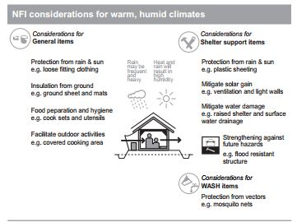
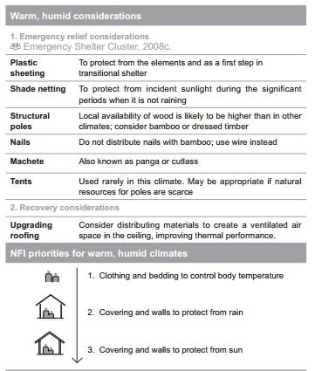
Warm, Humid climate

Slide 2

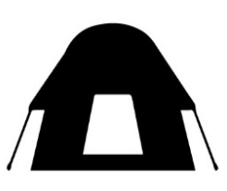
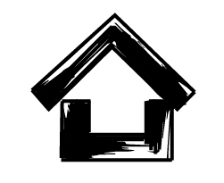


 | Acute Emergency Shelter | Standard Emergency Shelter | Robust Emergency Shelter | Transitional Shelter | Permanent Shelter
Main characteristics | Lightweight Air lift able Basic kit Below sphere standards Lifespan: 3 to 6 months | Truck transportation Standards kits in pipeline According Sphere standards Lifespan: 3 to 6 months | Truck transportation Top up kits on Standard E shelter According Sphere standards Reinforced structure Lifespan: 6 to 12 months | Truck transportation Design acceptable by local culture Structure fully reinforced and stable Wall using flexible materials acceptable as last resorts. 70 % of the materials shall be reusable and transportable. Lifespan: 12 to 24 months | Truck transportation Design acceptable by local culture Structure fully reinforced and stable Wall using infilling or durable materials Roof potentially upgraded with thatch or CGI sheets. Lifespan: over 12 months (to 10 years) Proper door, wall base and slab provided.
Applicable when … | For ‘harsh to reach’ area | Road transport Common kit applying as baseline for all situations. | Road transport Mid stay foreseen (over 2 seasons)) Unsecured returns Land Tenure un-cleared (population stranded or in transit) P.O.C. | Road transport Mid stay foreseen (over 6 months) Secured returns P.O.C. with high security constraint (closed PoC) Land Tenure cleared. | Road transport Secured returns Land Tenure fully cleared and documented.
^{[1]} Excluding plastic sheet. Reusable target mainly the structural elements.
^{[2]} Corrugated Gauge Iron or tin also called tin sheet. Gauge under 28 or 26 .

Slide 3
Proposed kits | 2 Plastic Sheeting 30 meter linear of 6mm or 7 mm nylon rope 6 Pegs Tools: Hoe according distribution scheme | 3 Plastic Sheeting 2 Rubber binding ties 30 meter linear of 6mm or 7 mm nylon rope 2 Bundle or bamboo (10 pieces each) 4 wooden poles 36 sand bags Tools: Hoe according distribution scheme | Top up kit: 8 extra wooden poles (total shall be 12 poles) 3 bundles of bamboo 10 extra sand bags 200 g nails for structure (30 nails) on 6 inches Tools: according Optional 400 g of roofing nails 2,5” (around 120 nails) not from the pipeline If design use non split bamboo add 50 ml of 1.2 mm metal wire to tie (around 500 g) | To be defined by T Shelter agencies Shall preferably use timber structure (for repairs, conversion etc.) Shall preferably being locally produced. Shall avoid or reduce plastic sheeting, polyethylene materials 80 % of materials shall be locally (south sudan) materials | 18 to 20 poles 10 bamboo bundles (doubling wattle for wall) 2 plastic sheeting for temporary roof (if needed) 2 plastic sheeting for temporary wall (if needed) 100 ml of 1.2 mm metal wire (around 1 kg) 70 hollow cements block for floor 2 cement bags for block mortar and slabs Ironmongery and nails, 1 pair of hinge, 2 lock 1 small 1 big, padlock, ½ 5 hinge nails 2 timber 2x4 + half iron sheet (door leaf)
Costs | Cost : 61.7 USD (without transport) | Cost : 153.3 USD (without transport) | Cost total: 225 USD Cost for the top up kit: 60 to 70 USD Cost on 10 000 units = 700 000 USD |  | Total cost 450 to 475 USD

Slide 4
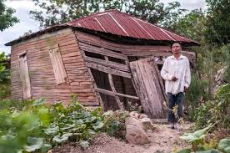
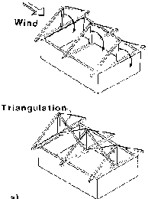
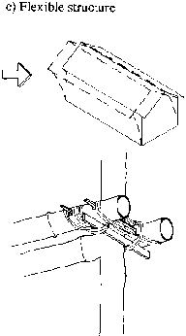
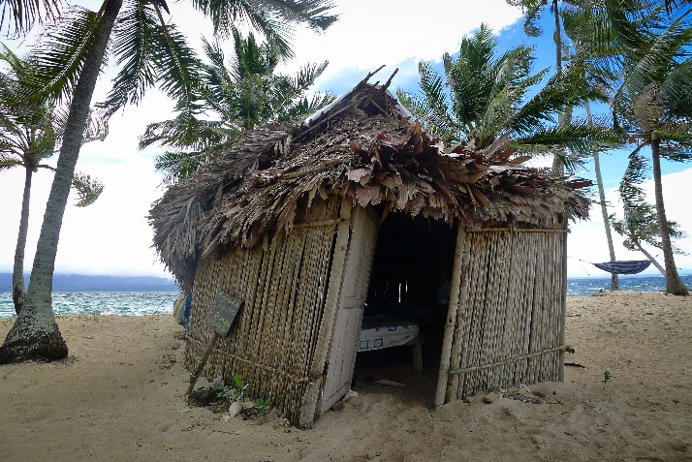
Structural components, bracing
With winds or any other loads, non braced structures may drift, twist or lean.
Bracing should be done on the structure, in filling material are just helping.

Slide 5
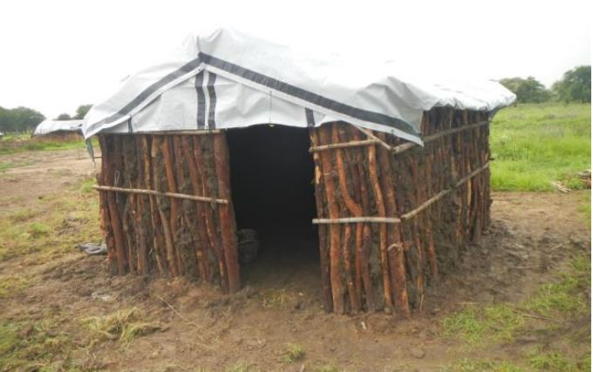
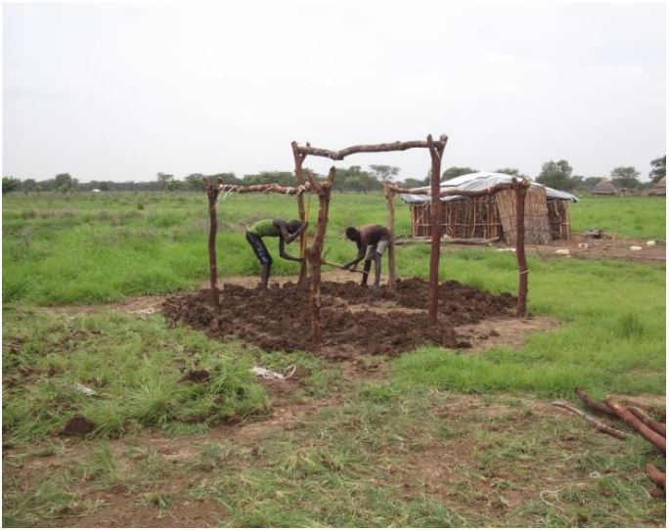
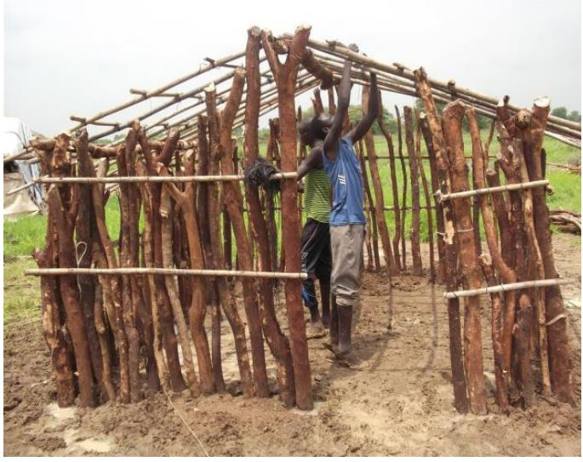
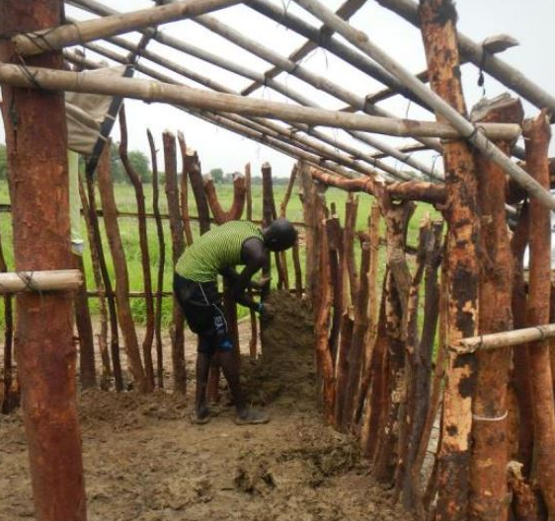
Even Multiple vertical poles could lean

Slide 6
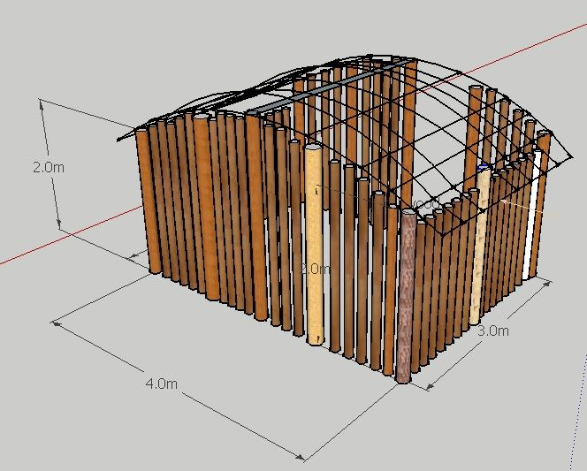
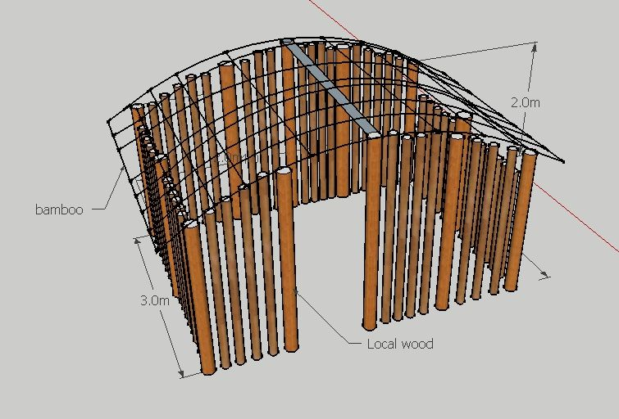
Global communities in Abey, developed a design taking account evolution to more permanent shelter using wattle and daub technics. 12 m2

Slide 7
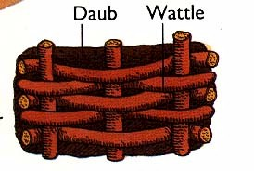
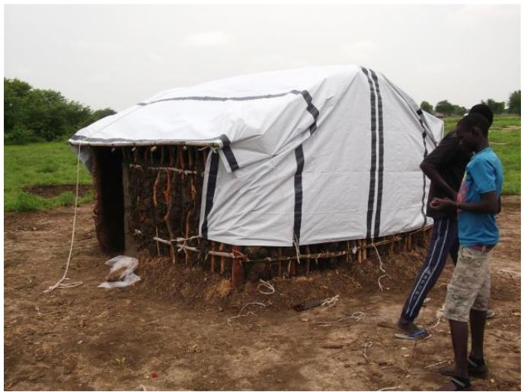
Wattle & Daub general
Global Communities, Abey 2014

Slide 8
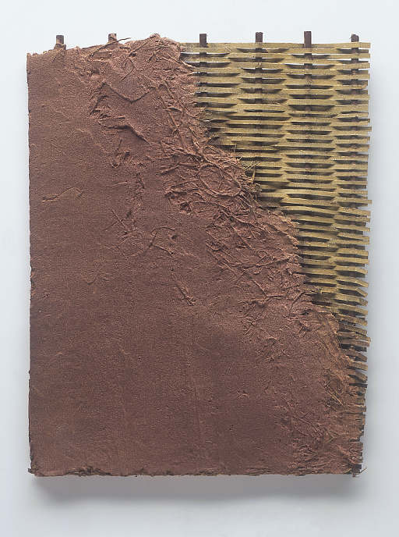
Wattle & Daub Specifications
Clay soil as black cotton soil are useable with wattle and daub
Possibility to amend with fibers or sand in order to reduce shrinks. For fiber better to use animal (hair) if termite are very common on site.
Reinforcing the wall in filling do NOT dispense or proper bracing.
In order to save materials, the main structure could be done with wooden pole and a secondary structures with Bamboo

Slide 9
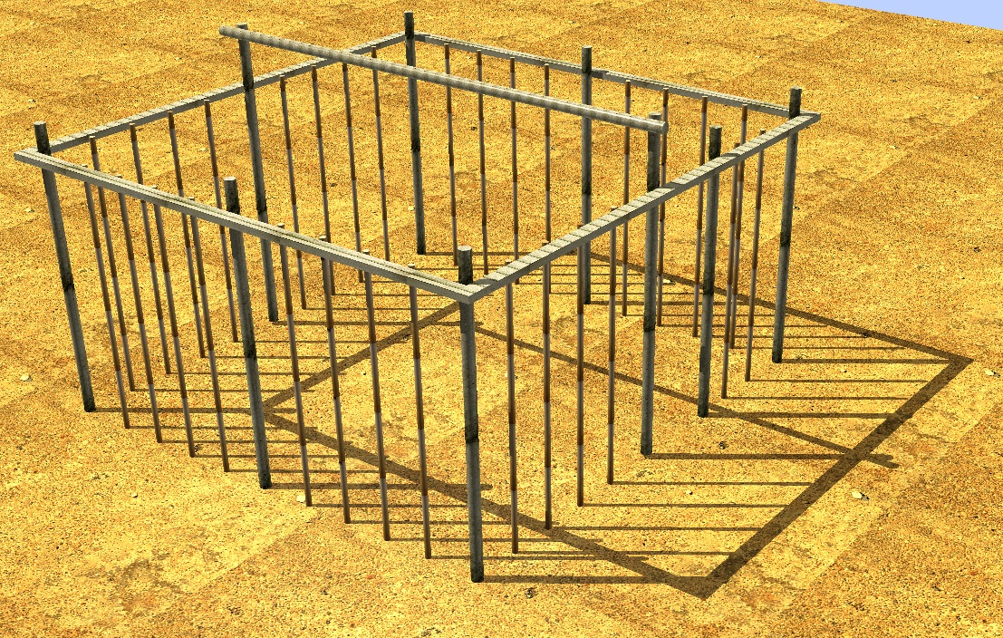
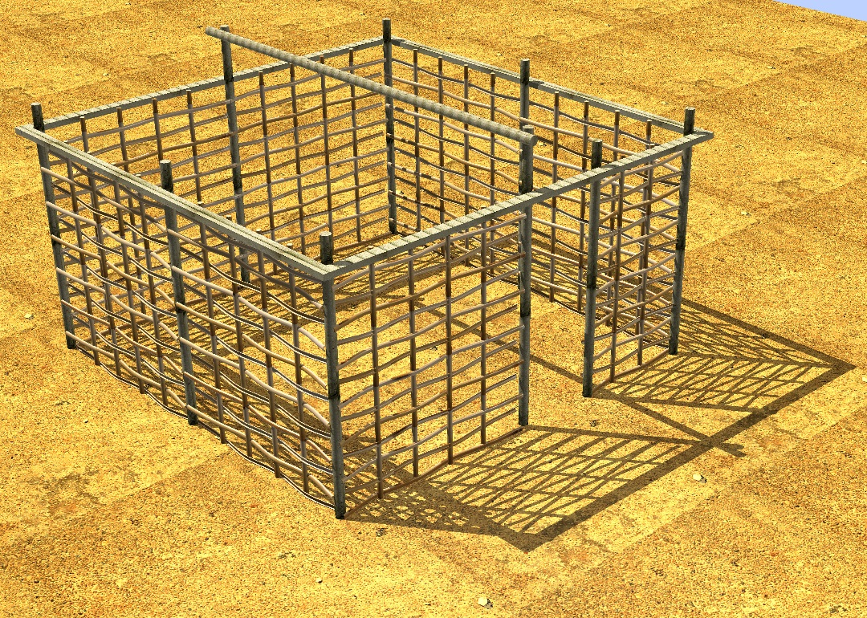
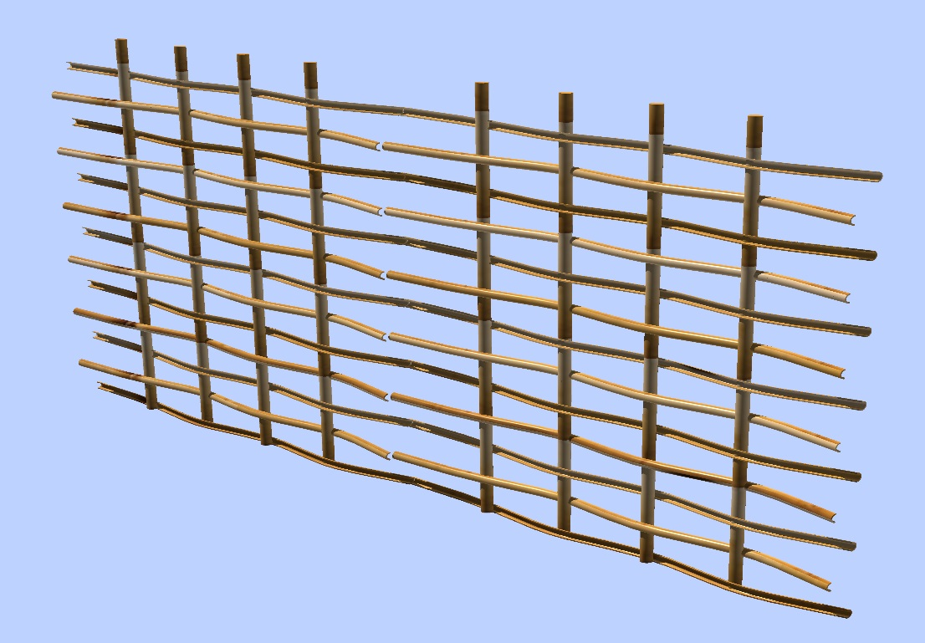
Structure using wooden poles, bamboo culms & bamboo lattices
Primary structure 9 vertical elements
Rigidity ensured on upper frame with wooden pole or similar elements.
Door reinforced
Secondary frame made with bamboo culms
Lattices (optional) to act as wattle.

Slide 10
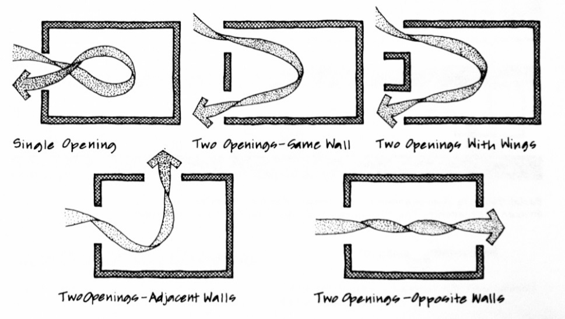
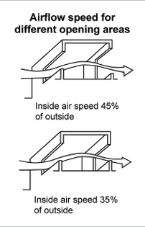
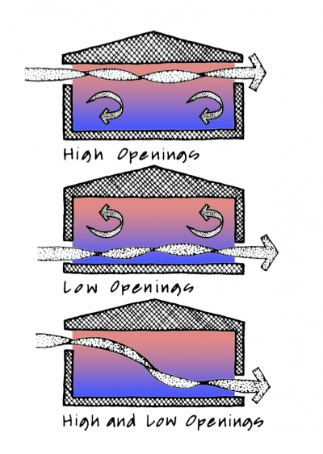
Ventilation principles
Cross ventilation (opposite)
Difference of opening size
High-low ventilation

Slide 11
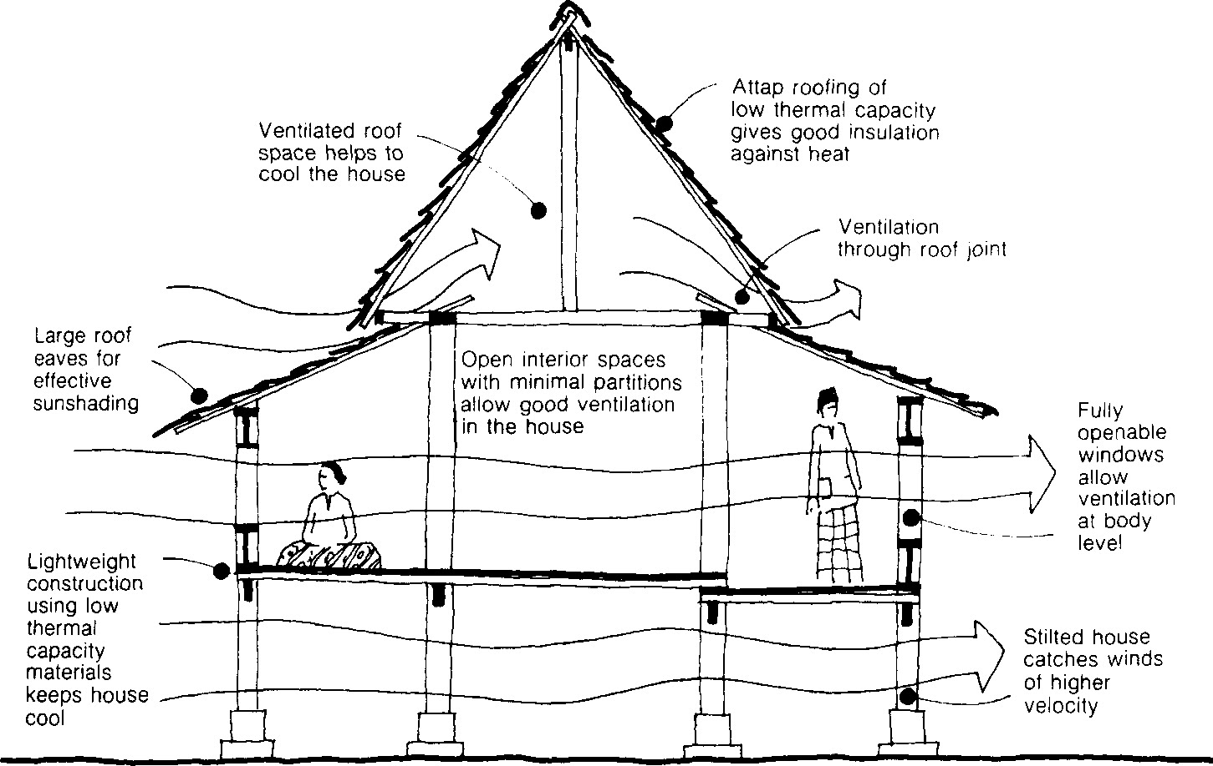
Ventilation (example)

Slide 12
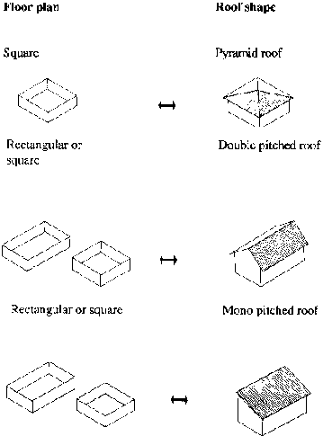
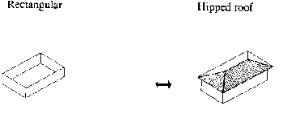
Roof types

Slide 13
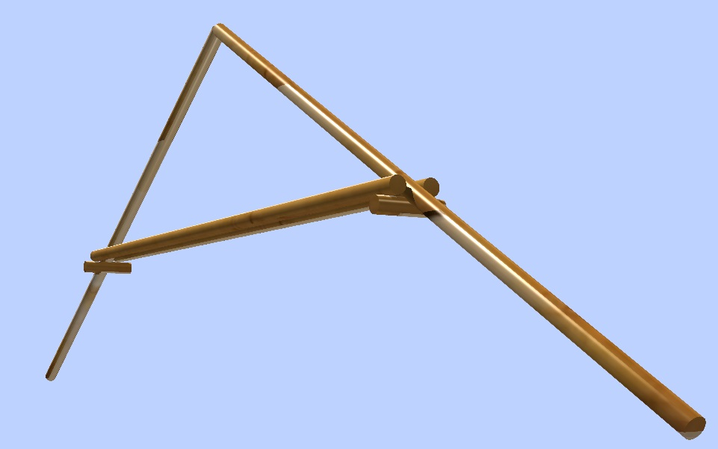
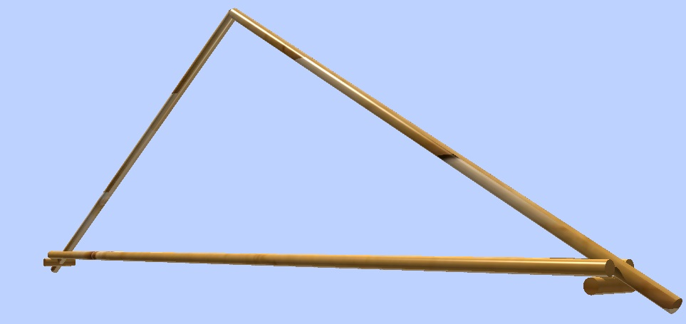
Roof structure, importance of tie or collars for the trusses.
The full bamboo culm shall not be nailed (avoiding cracks and splits) better to use rubber tie or metal wires
Bamboo lattices could be nailed if nail diameters are corrected (less than 2 inches)

Slide 14
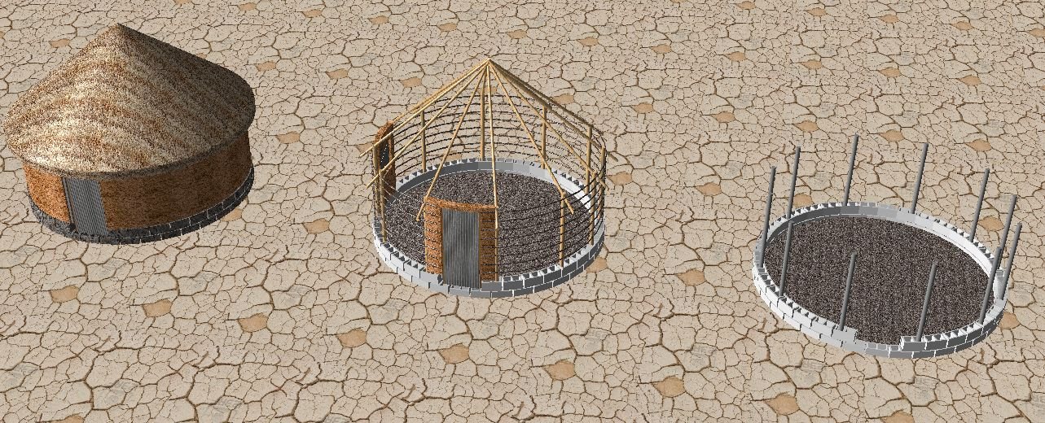
Permanent Shelter (Example)

Slide 15
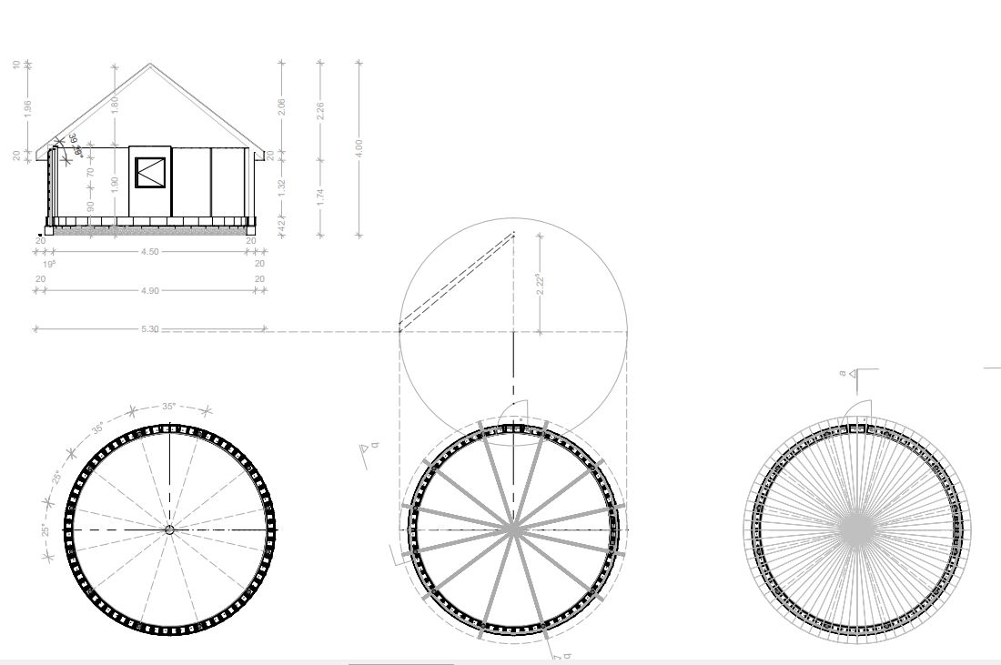
General composition
Main elements:
Cultural acceptance (tukul)
Local material (thatch roof)
Investment on expensive items (cement blocks, slabs, door, hinges)
Reinforcing structure
Improving wall base and floor

Slide 16
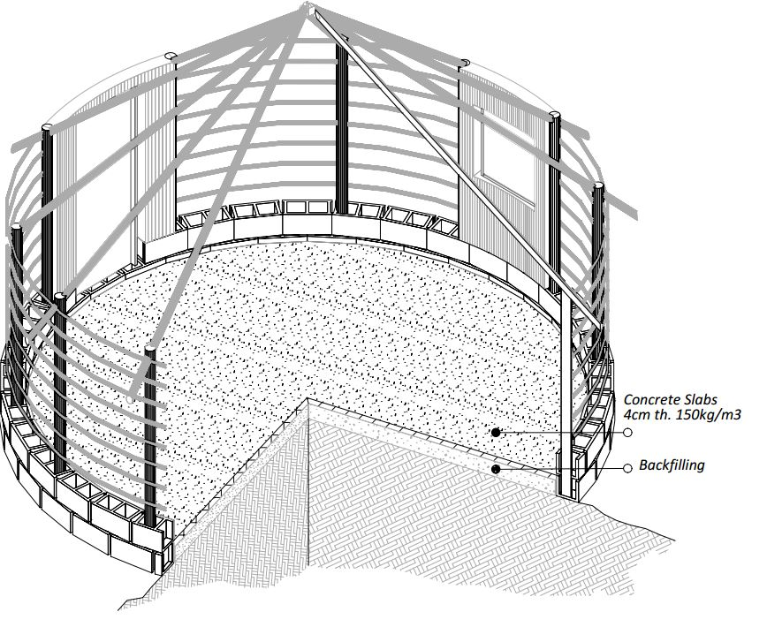
Axonometric View

Slide 17
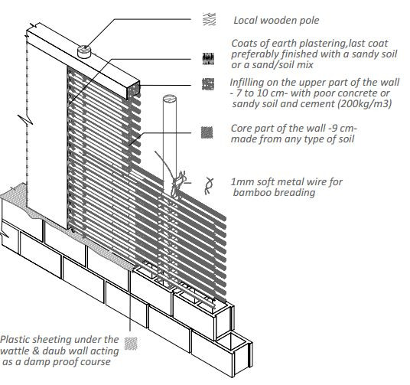
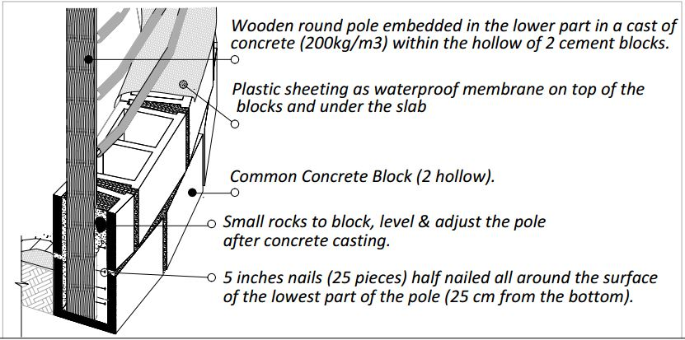
2 designs of wattle and daub technics

Slide 18
Useful Addresses, sites & links
800 miscellaneous publications to download including classic of construction
http://www.fastonline.org/CD3WD_40/CD3WD/INDEX.HTM
General shelter library http://sheltercentre.org/
Earth construction specialized NGO Craterre-EAG
Shelter cluster http://sheltercluster.org/
Compressed Stabilised Earth Block Manufacture in Sudan, Doctor E.A. ADAM, UNESCO publication
Transitional Shelter Guideline, shelter center
Transitional Shelter, 8 designs, IFRC
MCR, Roofing system. Skat

