Slide 1

National Statistics on housing in vanuatu
Shelter Cluster Meeting – Informational Presentation
2 July, 2015

Slide 2
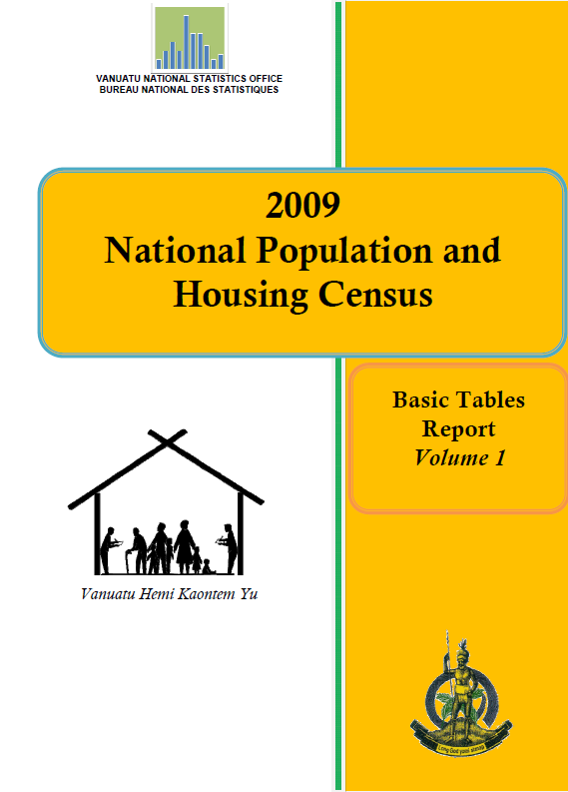
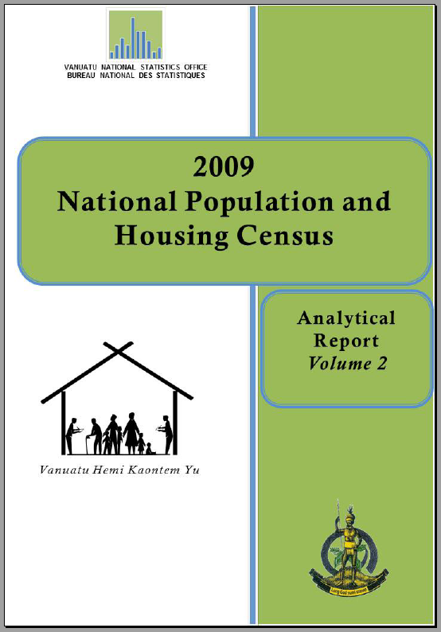
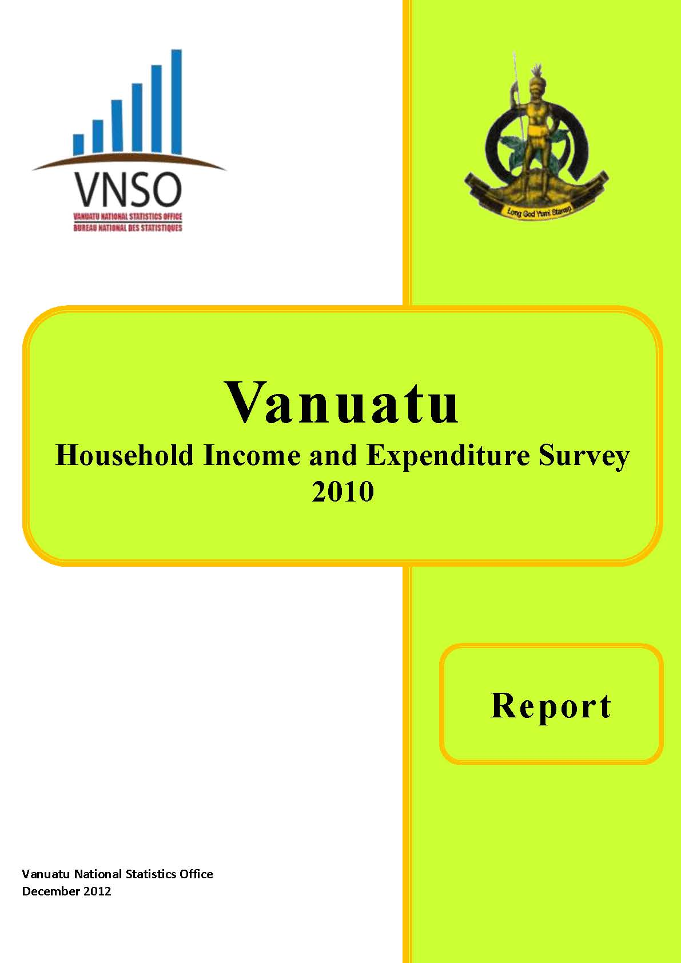
What is collected by VNSO
National Population and Housing Census (Vol 1 & 2)
Comprehensive, 10 year frame
Last collected 2009
Next expected 2019
Household Income and Expenditure Survey
Sample survey, 3-5 year frame
Last collected 2010, with unreported 2013 data from Pacific Living Standards Survey
Next expected 2016
All publications available online, www.vnso.gov.vu

Slide 3
Before collection
VNSO is the Official enity tasked with meeting the information needs of the Government of Vanuatu at a high standard.
Prior to commencing with fieldwork, extensive review of questionnaire must be done with all relevant stakeholders
Ensure that the information collected is still relevant, will be useful/used
Ensure that the changes made reflect national interests and adhere to international standards

Slide 4
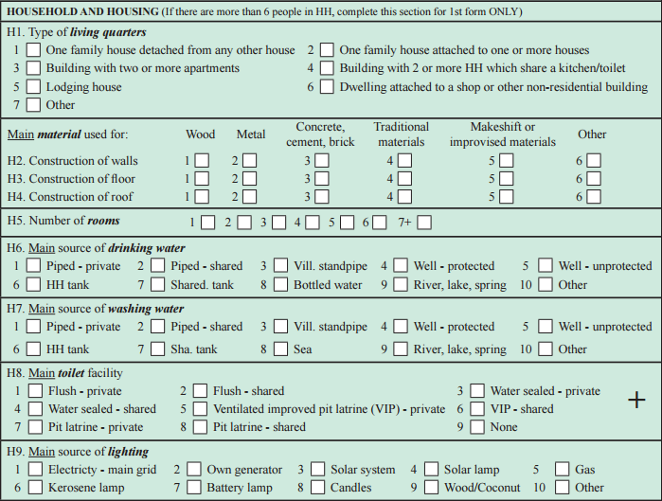
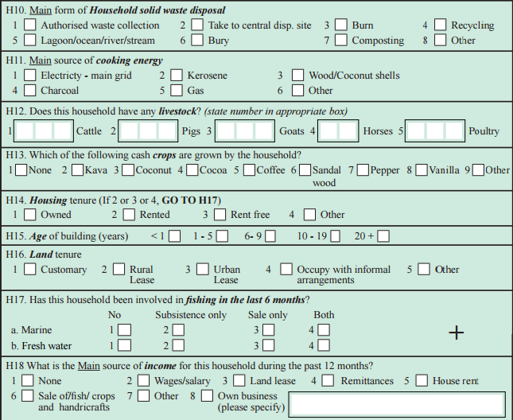
Household Characteristics – Questions from 2009 Population Housing Census

Slide 5
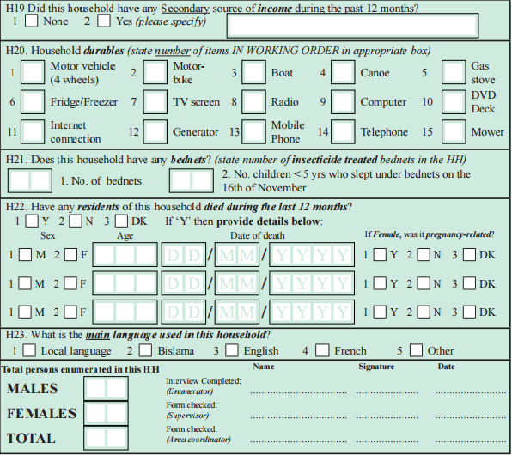
Household Characteristics – Questions from 2009 Population Housing Census

Slide 6
Household Characteristics Reported from Census
Chapter 5 of Vol2 (pp 124-159 with brief narrative analysis, charts, diagrams)
Average HH size (using # “private households”) by area, Province
HH change and distribution by area, Province
HH composition, language, income
HH housing and land tenure
HH living quarters type, age, # rooms, materials used
No classification for full shelter as with HIES (reporting only proportion of HH with different materials for walls, floors, and roofing)
HH source of drinking and washing water, lighting, fuel
HH type of toilet facility

Slide 7
Household definition
“Those persons who usually eat together and share the work of preparing the food and/or the cost of work of providing it”.
Normally household members also live and sleep in the same building but experience has shown this is not always so, which is why the definition is based on eating together rather than on living or sleeping in the same building.
A household may be found in a variety of forms.
It may spread over more than one building but share one place to cook and eat.
Can consist of an individual person.
Consist of persons who normally live in that household and visitors
Two or more households can be found in one building.
Households may be found in buildings intended primarily for other purposes.

Slide 8
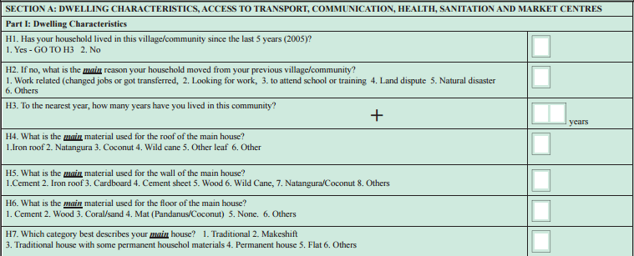
Household Characteristics – Questions from 2010 HIES

Slide 9
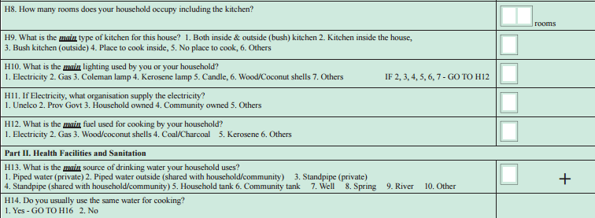
Household Characteristics – Questions from 2010 HIES

Slide 10
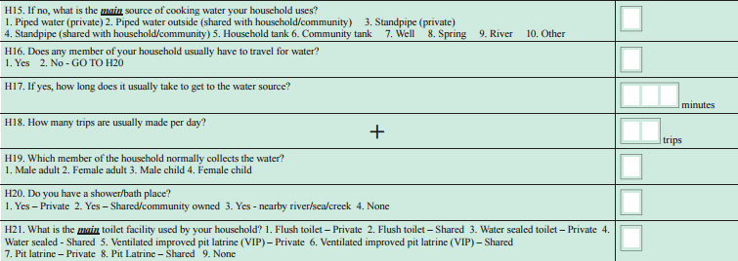
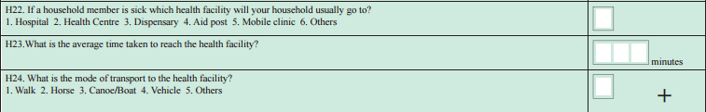
Household Characteristics – Questions from 2010 HIES

Slide 11
Household Characteristics Reported from HIES
Chapter 3 (pp 48-63 with narrative analysis, charts, diagrams)
Classification for housing used in analysis of HIES:
“Permanent houses are those constructed out of cement blocks or wood (including masonite sheeting), with a galvanised iron or similar roof and cement floor. Some permanent houses are constructed entirely out of galvanised iron sheeting. Houses which are mixed typically have some permanent and some traditional materials, such as an iron roof and concrete floor with woven thatch walls. Makeshift houses are generally made out of whatever materials were available to the household at the time of construction so can be a mix of both permanent and traditional materials, as well as plastic or other tarpaulin covers, cardboard and so on.” (HIES, 48)

Slide 12
Household Characteristics Reported from HIES
HH migration
HH type (using classifications)
HH sources of fuel, lighting, drinking water
HH proportion with “improved” toilet facility
HH expenditure analysis
10 pages of tables providing information at disaggregated levels (area, Province)

Slide 13
Opportunities for updates
2016 Post Pam Mini Census
2016 HIES

Slide 14
Thank you!
Happy to answer questions on methodology used by VNSO with collection of housing data and production of housing characteristics

