Slide 1
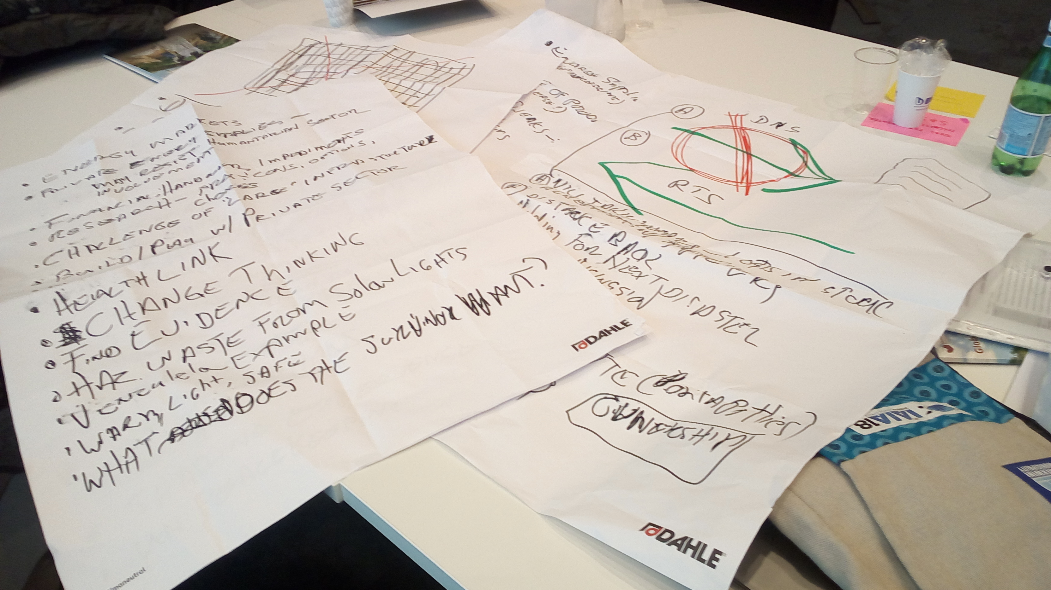
Environment CoP Discussion on
Environmental Checklist and Profiling – Vanuatu
Single Use Plastic
Plastic and Humanitarian Operations
Energy and Environment

Slide 2
Results
Checklist and Profiling – See Mandy or Robbie – best thing you could do
Single Use Plastic –
Don’t send and Return to Sender – but think first
Change specs – “Non-Commerical Requirements
Plastics and Humanitarian Assistance
All is ok
We need to change
Low hanging fruit
Incremental change
Look before you leap
System wide change
And the system is complicated
The process has stated
Energy and Environment
Just do it! (There is a lot to do ….)

