Slide 1
Winterization Campaign 2019-2020
Lessons learned

Slide 2
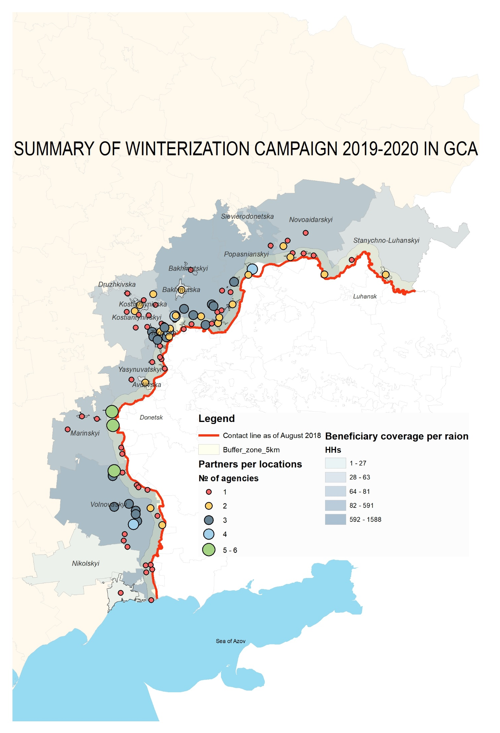
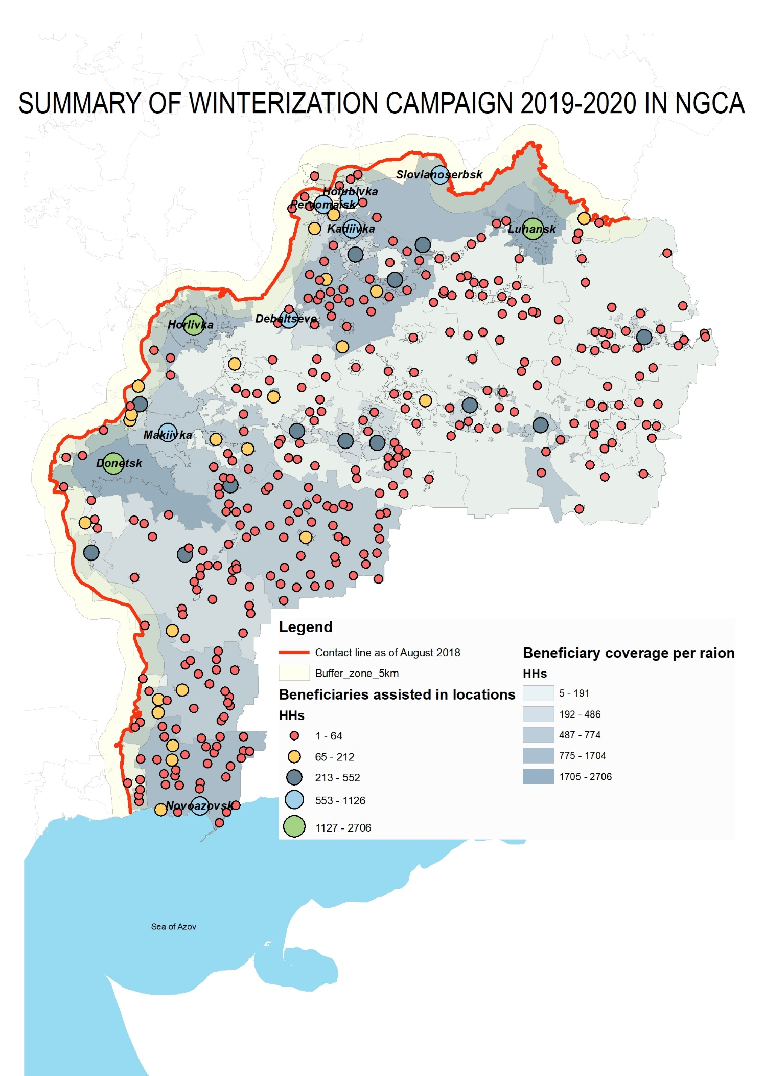

Slide 3
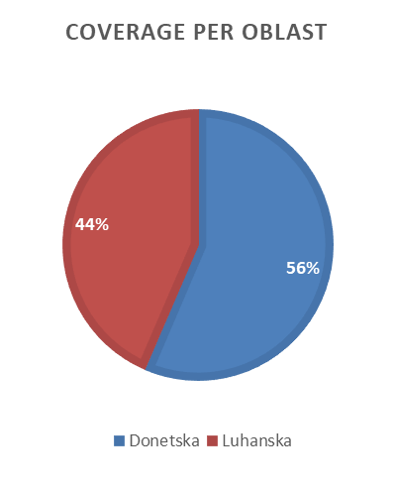

Slide 4
Winterization campaigns (2014-2020) at a glance
1.2 M individuals benefitted from assistance;
76.35 M USD in total as of Q2 2020 spent on winterization activities;
Average of 12.72 M USD spent per year;
Peaks of assistance: 2015 and 2016 campaigns (50% of all beneficiaries covered in this period);
63 USD - money spent per beneficiary.
GCA – 69,2%; NGCA – 30,8% of beneficiaries.

Slide 5
Typical winterization support
NFI distribution: individual clothing sets for winter season, bedding sets (blankets, bedlinens), furniture (beds or mattresses);
Solid fuel distribution & stoves installation: coal, wood, briquettes;
Winterization cash grant: amounts depend on the rationale behind;
Full-house insulation;
Collective centers’ winterization activities.

Slide 6
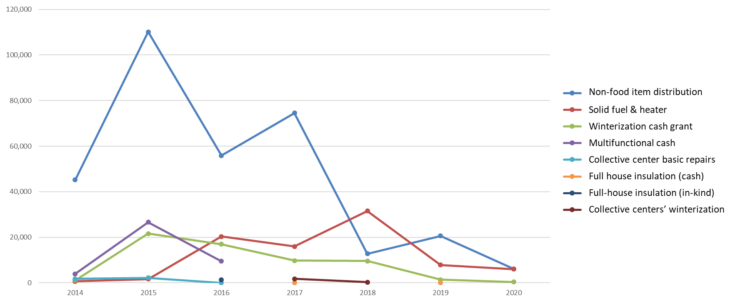
Trends in winterization activities
HHs
Years

Slide 7
Future opportunities for development programs
State energy efficiency programs;
State subsidies & compensation programs;
Infrastructure programs (electricity/gas connections);
Installation of energy efficiency stoves (e.g. Kuznetsov’s stove, from 200 USD and up to 2,000 USD price per unit) supplemented by full-house insulation activities;
Synergy with livelihood programs.

