Slide 1
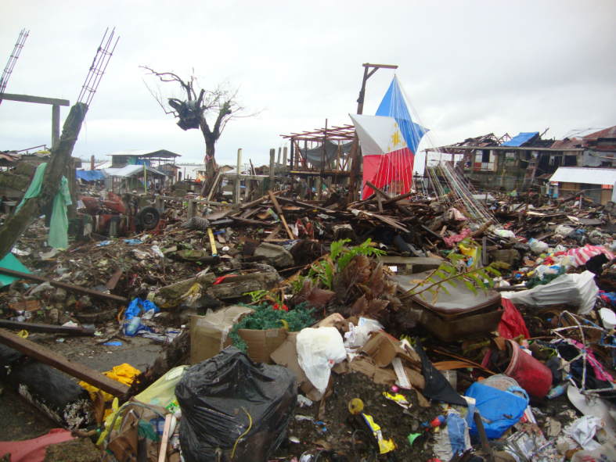



Greening Reconstruction: experience of WWF’s EDM Program
Missaka Hettiarachchi

Slide 2
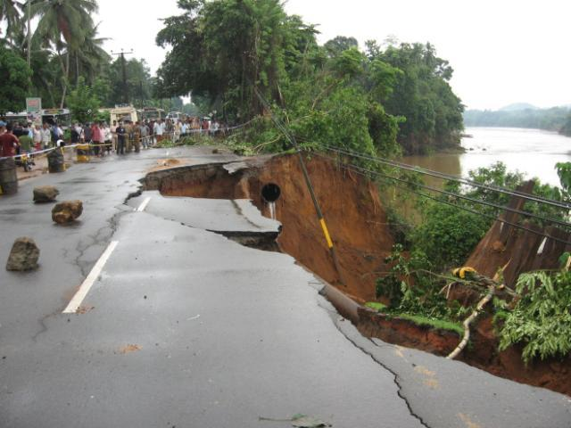
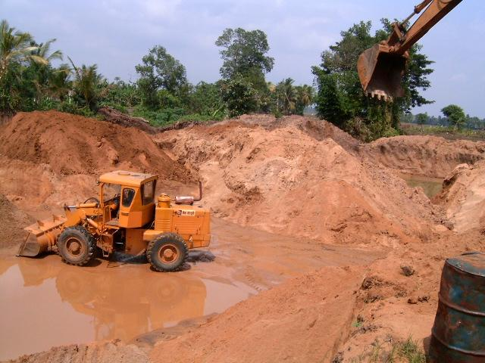
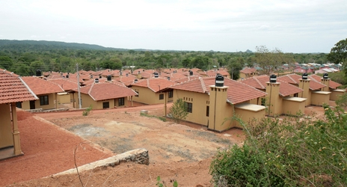
Environmental issues:
A foremost cause and consequence of disasters

Slide 3


Humanitarian-Environmental Partnership
The Green Recovery Partnership of World Wildlife Fund, American Red Cross launched in:
Sri Lanka-Maldives, Thailand and Indonesia

Slide 4
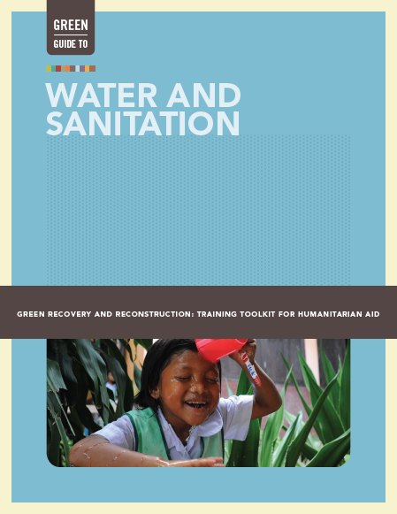
Green Recovery and Reconstruction: Training Toolkit for Humanitarian Assistance
Green Guide to:
Opportunities for Green Recovery and Reconstruction: An Introduction
Project Design, Monitoring and Evaluation
Environmental Impact Assessment Tools and Techniques
Strategic Site Selection and Development
Materials and the Supply Chain
Construction
Water and Sanitation
Livelihoods
Disaster Risk Reduction
Organizational Operations
http://green-recovery.org/download/english
Available in English, Spanish and Basha Indonesia
Notes:
Currently we have 10 comprehensive modules, we are in the process of incorporating more climate smarting aspects into all modules and also developing nationally or regionally context specific versions of the modules.

Slide 5
Project Cycle and Environmental
Entry – Points
Disaster
Identify major environmental Issues & risks
Environmental report cards, community reviews, workshops, publications
1. Initial Assessment
Identify vulnerabilities & capacities
6. Evaluation / Lessons Learned
2. Problem/Stakeholder
Analysis
5. Monitoring
3. Project Design
Environmental & climate monitoring
Raise environmental concerns, Plan for green practices, Environmental compliance
4. Implementation
Green design, materials, construction and responsible livelihoods
Notes:
Give examples for each.

Slide 6
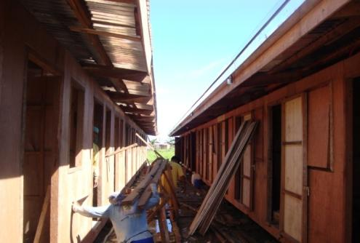
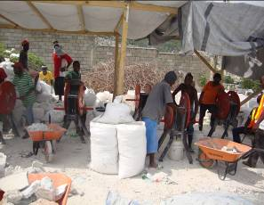
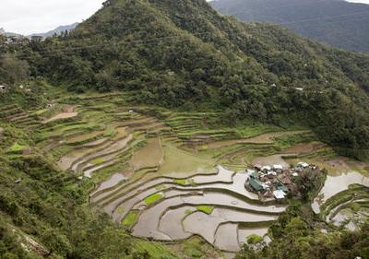
Connecting Recovery, Environment and Livelihoods
Disaster
Risk Reduction
Climate Change Adaptation
Notes:
Our vision is to strive for disaster risk reduction practices that connect recovery with livelihoods, environment, DRR and adapation.

Slide 7
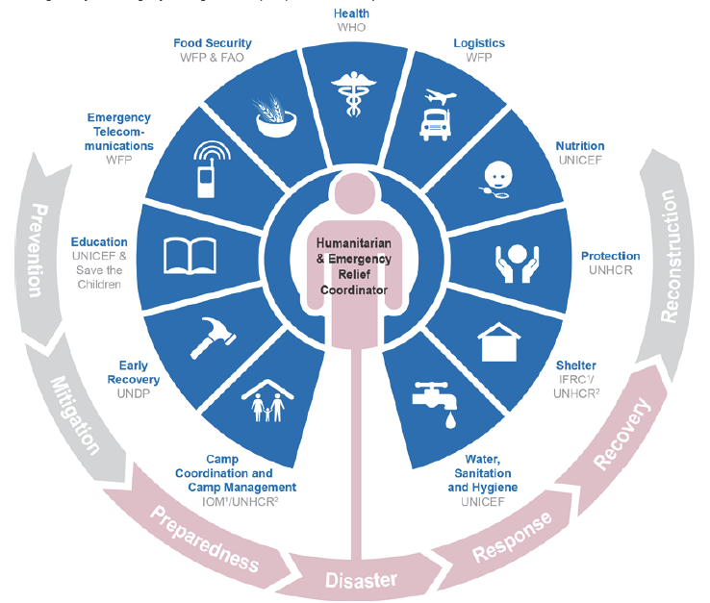
GRR applied through the
UN Cluster System
WWF deployed Environmental Advisors for reconstruction work in: Haiti earthquake – 2010, Chile earthquake – 2010, Pakistan (Sindh) floods – 2011, Typhoon Haiyan (the Philippines) - 2013

Slide 8
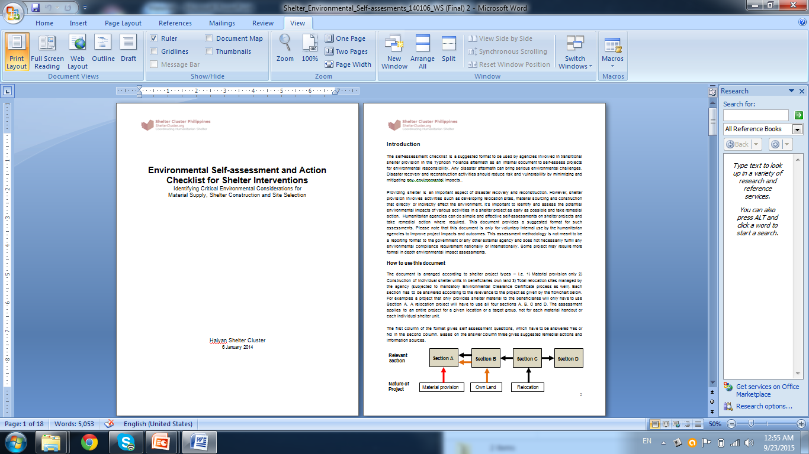
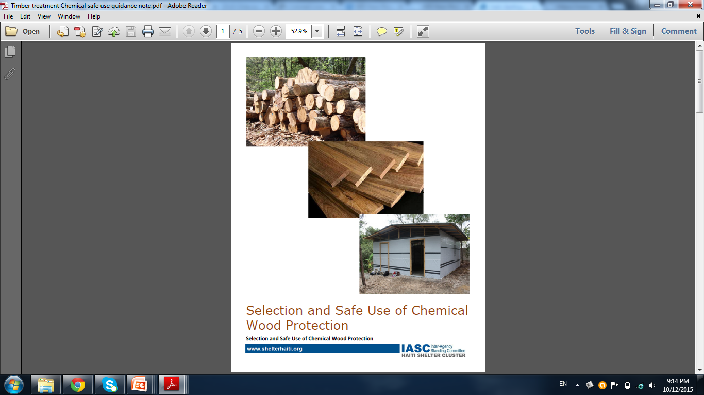
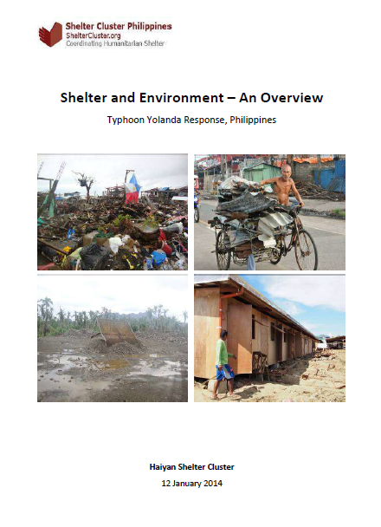
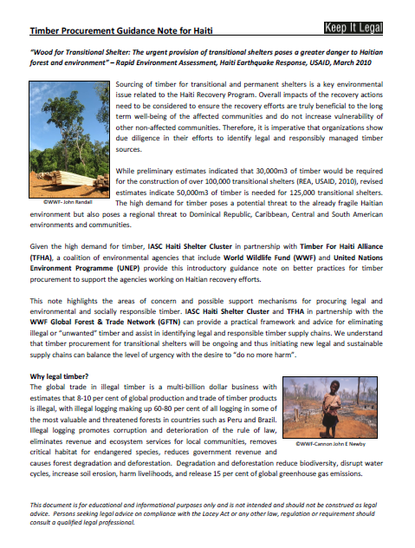
Work with Shelter Cluster: some outcomes

Slide 9
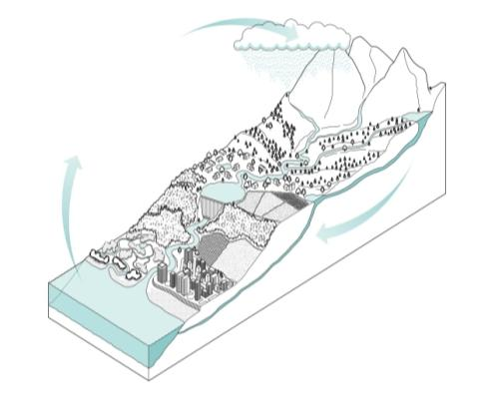
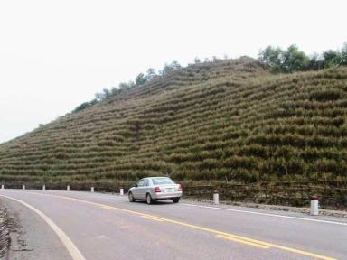
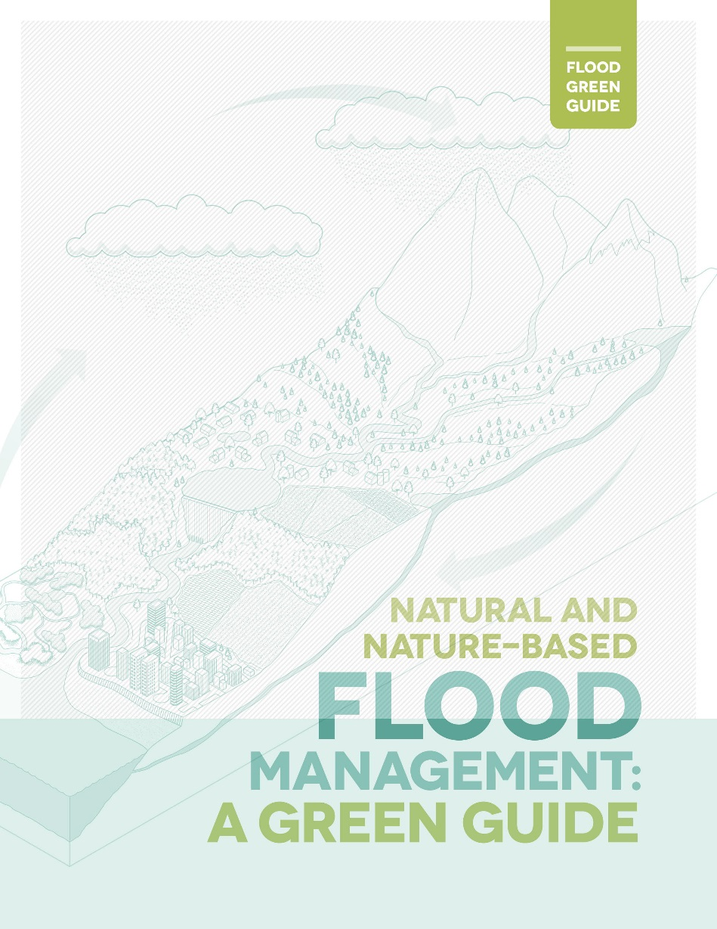
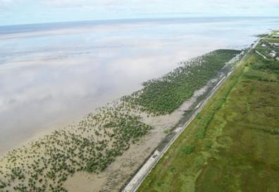
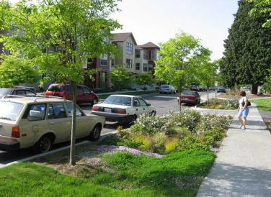
Natural and Nature-based Flood Risk Management
http://www.vetiver.org
http://www.mangrovesgy.org
http://www.fondriest.com

Slide 10
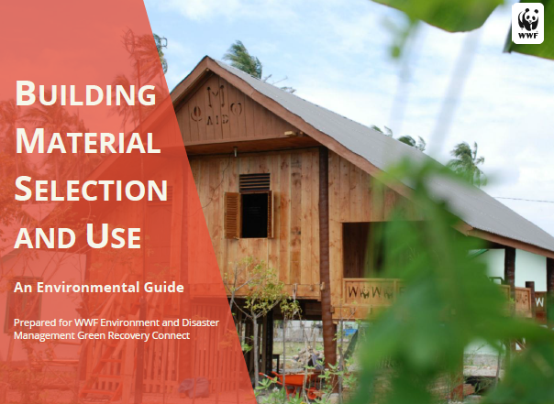
Building Materials Environmental Guide
Key principles
Think through the whole supply chain
Design to use fewer materials and reduce waste
Only support sound and legal sourcing of materials
Use local sources
Use disaster debris as a reconstruction material
Use materials with recycled content and recycle
Notes:
Multiple version, collaboration with NU, online version, Nepal applications, Enthusiastic uptake in Sri Lanka

Slide 11
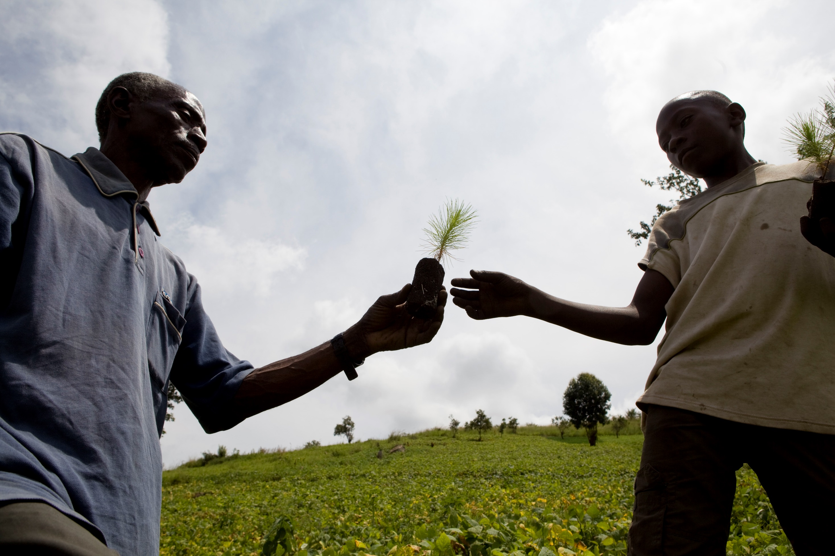
Green Recovery Connect
Access to environmental experts 24/7
Available by phone, email, and live chat
Resource library & fact sheets
Learning agenda
Examples of requests received:
  Environmentally responsible materials for use in internally displaced persons camps in DRC
  Timber in the Ecuador earthquake recovery
  Winterization of schools
  Plastic tent disposal after emergency phase
Link: http://envirodm.org/helpdesk

Slide 12
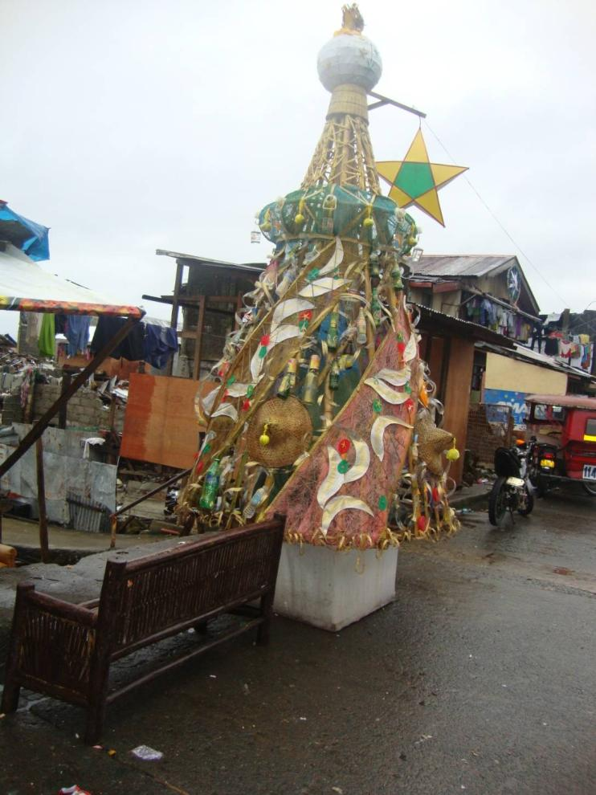

Thank you!
To find out more information:
www.envirodm.org
Email: envirodm@wwfus.org
Twitter: @envirodm
Facebook: www.envirodm.com/envirodm
ENVIRONMENT &
DISASTER MANAGEMENT

