Slide 1
Comms Audit
Key Messages & Initiatives
Please complete each section
Current Comms Channels
Please list here
Company Strategic Priorities for This Year
Historical Data (Reach, engagement, sentiment)
Notes:
Slides they use in order to summarize what we heard on the discovery call. Should probably have bullets or cards/icons

Slide 2
Comms Audit
Voice of our Employees (Surveys, Focus groups)
Please complete each section
Main Stakeholders and Contributors
Success Measures and Desired Future State
Notes:
Slides they use in order to summarize what we heard on the discovery call. Should probably have bullets or cards/icons

Slide 3
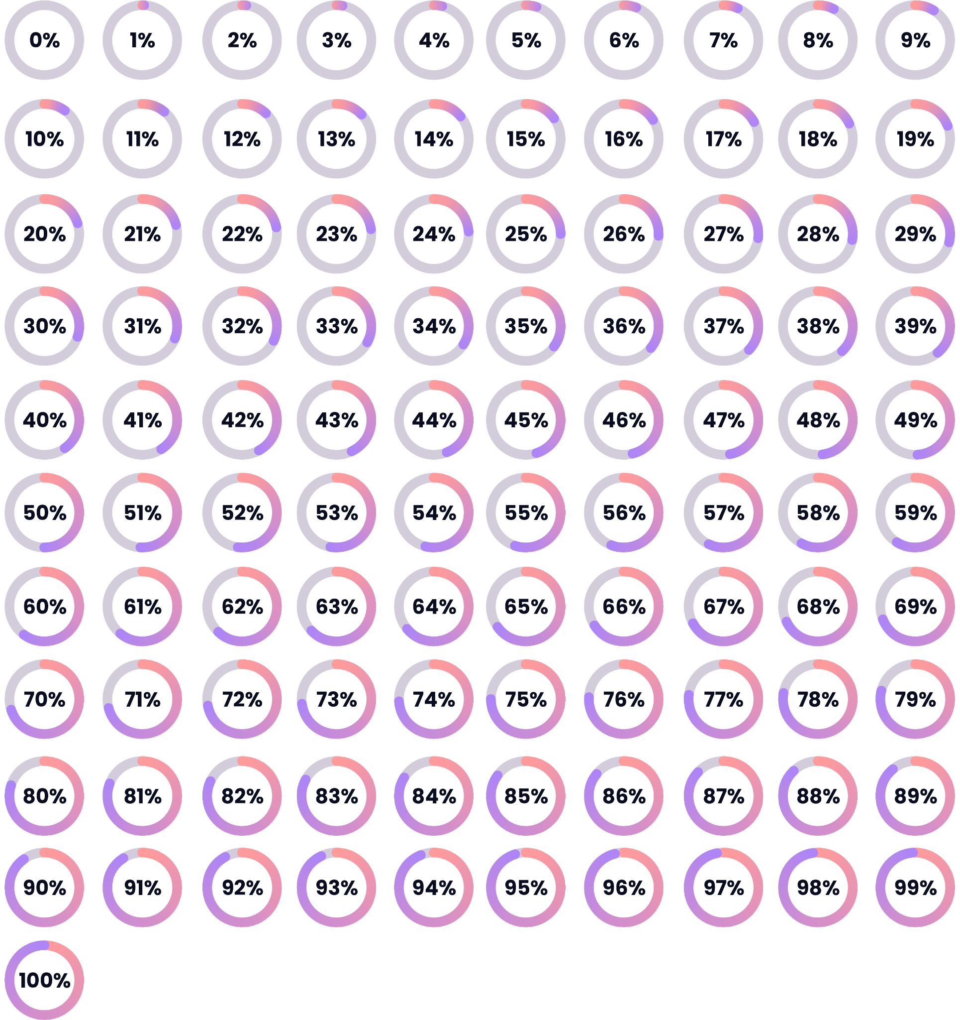
Comms Audit
Key Messages & Initiatives
Please complete each section
Strategy, vision, purpose
Diversity, Equity & Inclusion
Values and culture
Wellbeing and mental health
Benefits, rewards, compensation
Employee recognition and awards
Customer experience
Ways of working
Career paths
Sustainability initiatives
Current Comms Channels
Please list here
Email
Intranet
Newsletter
Town Halls
Team Meetings
Enterprise Chat Tools
Company Strategic Priorities for This Year
Historical Data (Reach, engagement, sentiment)
Metric
Score
#1
Grow market share by 3%
2022 Employee Satisfaction Rate
Average email open rate
Intranet adoption
Town Hall participation
Employee Retention
Comms Satisfaction Survey
#2
Retain 96% of our customer base
#3
Expand into new territories: UAE & APAC
Notes:
Slides they use in order to summarize what we heard on the discovery call. Should probably have bullets or cards/icons

Slide 4
Comms Audit
Voice of our Employees (Surveys, Focus groups)
Please complete each section
Current State
More:
Less:
It can be noisy on a given day, with key information getting lost
A focus should be given to who is posting, bringing more visibility and engagement from the exec and leadership team
Sometimes recognition can miss some people that contributed
More highlights on what’s going on across different areas of the business and department overviews
Some new faces across panels and updates, to bring variety and power behind messaging
Gamification works well at engaging employees and supporting information sharing
Condensing some daily content into more cyclical updates, such as once a week
Content that takes a lot of time to review – a challenge for teams that struggle to get time away from phones or their day to day
Repeated contributors – some more variety would support in reaching different areas of the business
Main Stakeholders and Contributors
Internal Comms Team
Laura Martin (EMEA)
David Clifford (NA)
Peter Laffey (APJ)
Human Resources
Yvonne Leo (EMEA)
Mary Berry (NA)
Aiko Tanaka (APJ)
Executive Champions
Yolanda Paul (EMEA)
Jeff Abrams (NA)
Hama Nakamura (APJ)
Success Measures and Desired Future State
Metric
Goal
Regional Comms Champions
2023 Employee Satisfaction Rate
Average email open rate
Intranet adoption
Town Hall participation
Employee Retention
Comms Satisfaction Survey
+4%
+11%
+2%
+10%
+5%
+8%
Mike Murphy (EMEA)
Patricia Barnhart (NA)
Justin Fields (APJ)
Notes:
Slides they use in order to summarize what we heard on the discovery call. Should probably have bullets or cards/icons

